Slide 1
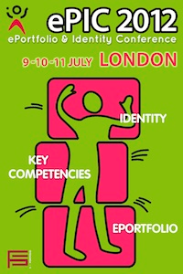

Digital Identity
Are students’ views regarding digital representation of ‘self’ gendered?
Lyn Lewis
Notes:
In the School of Education, we I have been researching eportfolios since 2009. What began to emerge in focus group discussions amongst students who had used eportfolio for 18 months was an awareness of issues around ‘digital identity’. Last year, at the ePIC conference in London, I presented a paper entitled…. “it’s your spell-checked version of yourself” …..

Slide 2
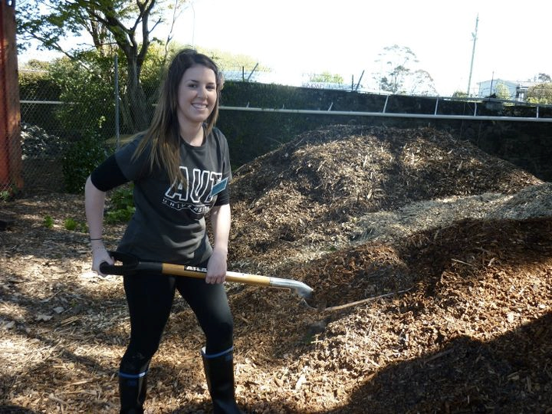
ePIC Conference presentation (July 2012)
“It’s your spell-checked version of yourself”: Student perceptions around (re) presenting self through ePortfolio.
Preparing the tiger enclosure at Auckland Zoo
Notes:
This was a comment referred to an assignment which required an eposter view of student participation in a group community project and referred to the constructed (airbrushed) view of the student ‘self’ rather than a ‘warts and all’ version!

Slide 3

Research Project (2011)
‘Student perspectives of their learning through ePortfolio’
Focus group: 6 participants from the BEd (primary) programme = 18 months experience with ePortfolio
Notes:
The presentation came out of a 2011 qualitative research project seeking to understand student perspectives of their learning through Mahara eportfolio. Discussions were held with two focus groups involving 6 Year 3 participants from the Bachelor of Education (primary) programme who had used eportfolio for 18 months. 3 issues emerged in the discussion around digital identity …. The first was representing and revealing the personal ‘self’

Slide 4

3 emerging issues around digital identity…..
Representing and revealing the personal ‘self’
conscious selection of material to reveal ‘self’
relationship with lecturer
alignment with future role of ‘teacher’
Notes:
The participants were open to expressing their individual personality through the careful selection of images or artefacts which revealed something of themselves and thus, they felt, developed a closer relationship with the lecturer. They felt that the eportfolio was an ideal medium for teacher education as authentic, practice-related tasks engaged their personal ‘self’ which they felt was aligned with being a teacher in that the personal and the professional self become integrated ie you teach who you are (Palmer, 1998). They saw the eportfolio as a bridge between the academic work at the university and their professional work in the classroom.
This begins to hint at the tension between the representation of the personal and professional self and the dilemma of balancing or integrating the selves in a constructed digital view.

Slide 5

2. Identity construction for different audiences
Accept that views ‘massaged’ for audiences
Significance of context
ePortfolio as backup, value face-to-face
Notes:
The nature of an eportfolio to present and increasingly to represent the achievements of its owner to different external audiences raises the profile of the ‘authentic self’ as expressed in multiple identities. These participants acknowledged that views could be constructed for different audiences and felt strongly that the eportfolio could not speak for them as it lacked the X factor which they themselves would bring to a face-to-face interview situation, which they felt was more ethical and honest.

Slide 6
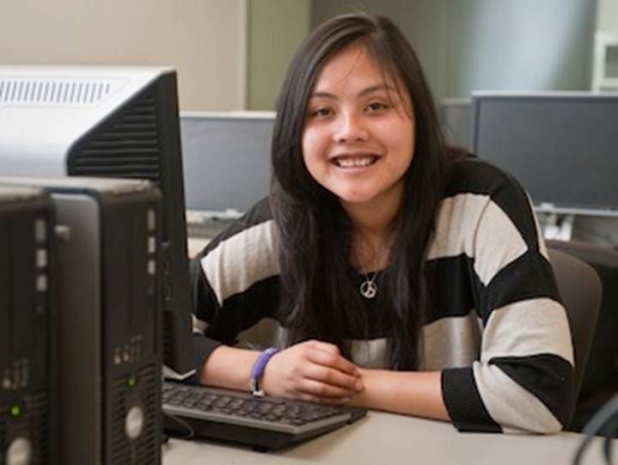
3. Ethics around personal and professional honesty
Concern with issues of honesty and authentic representation of ‘self’
Concerns about perceptions of others
“I think its important that everything I put on there is truthful. I mean it’s really what I believe and it really is coming from me” (Jane)
Notes:
The question for these participants was around ‘who am I as my digital self and how closely does that resemble the essence of who I am as a human being in a professional context?’ Jane summed up the general feeling that: I think it’s important that everything …..
Participants grappled with the notion that the presentation of their authentic personal ‘self’ may be different from their digital ‘self’ thus ethical issues of honesty and personal representation became more significant.

Slide 7
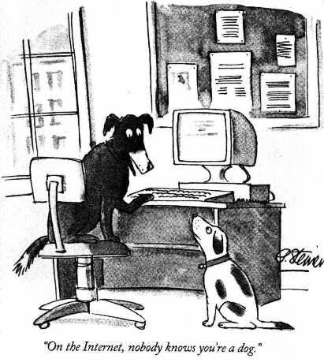
An ePIC conference attendee responds ……
“your participants must have been female… Males would have no ethical problem in projecting a digital ‘self’ very different from their authentic ‘self’, in fact they would consciously construct such an identity in order to create a positive impression on their audience”
Notes:
The assumption that males would hold different beliefs and behaviours around digital identity and its construction spurred me on to another research project ….

Slide 8

Research Project (2013)
‘Digital identity: Are students’ views regarding digital representation of ‘self’ gendered?’
Focus group: 6 participants (male) from the BEd (primary) programme = 18 months ePortfolio experience
Notes:
I have recently completed another qualitative project which asks the question: are students’ views regarding digital representation of self, gendered? A focus group of 6 Year 3 males from the Bachelor of Education primary programme, again with 18 months eportfolio experience, discussed a number of specific questions around digital identity:
How do you make decisions about what to put into a view and what to leave out? How do you represent yourself through your views?
Would your choice about constructing the view differ depending on your audience?
What are your views about representing yourself in person versus a ‘virtual’ presence in digital space?
Do you believe that males and females represent themselves differently in digital space?

Slide 9
1. Representing and revealing the personal
‘self’ through ePortfolio
All 6 in agreement:
Reveal only as much as is required to meet the
assessment criteria and get the task done
“Generally I would only post things that would be a requirement and nothing much else”. (Sam)
Notes:
All 6 participants were in strong agreement that they would only reveal as much about themselves as was required by the task – they do not seek to share anything additional in terms of personalizing a view (only one participant saw some value in the creative aspect of eportfolio construction). Generally a very pragmatic view of meeting the assignment requirements, and very little awareness that through doing this in a digital form, the self might be revealed they don’t see this happening any more than it would do in a written essay or a face-to-face presentation. Acknowledging the generalization, they felt that females were more open to sharing their emotions and presenting their personalities online.

Slide 10
“I do not like to put anything of myself on line. That has always been at the back of my mind when I have been using it (ePortfolio). I have always been super cautious of what I put on there… who can see it in 10 years – where it goes when you delete it? Once I realised I had to do it to get through University you just do it in a way that gets you by.” (John)
Notes:
An interesting comment from John who is suspicious of putting stuff into cyberspace – this raises a flag for the lecturer who simply has an expectation for eportfolios to be used without any consideration of the ethical concerns held by students such as John. He went on to talk about the ease with which some people share more online than they do in person, particularly in social media. This made him wonder whether lecturers are aware of these patterns and so had introduced eportfolios to capitalize on students revealing more through their digital expressions? Something for the lecturers to think about!

Slide 11
2. Awareness that digital identity can be constructed and manipulated for different audiences
All purported to know about digital identity construction, its purposes and contextual influences
“I would say you are not going to show the un-PC parts of yourself, you are only going to show the really you-PC parts of yourself. So, for most people that is not really who you are, you are only going to show the assignment-appropriate university side of yourself on an ePortfolio. That is not bad as it is a professional thing”. (Ian)
Notes:
All were in agreement regarding the need to be professional particularly with university work where ‘you are doing it as a representative of AUT’ and never to forget that even when you are reflecting you are doing it for an academic purpose so while you might be trying to be authentically yourself, you still need to balance this against the task.

Slide 12
Clearly understand that different views will be constructed for different audiences and have no issue with that, as long as the selection of material is honest (not necessarily the message).
Accept that views will be massaged to suit the purpose and audience’s expectations
“you just need to put the parts that they want to see and that are true. You can’t really put in things that don’t represent yourself at all.” (Ian)
Notes:
An interesting point made in the group was that the material in the view must be honest which was equated with ethical, rather than the message conveyed through the constructed view! As with the initial group, the men agreed that a face-to-face presentation was more honest than what they perceived to be the case in digital space…

Slide 13
Preference for the physical context where the
true ‘self’ is expressed and concern about the risks
associated with constructed identities
Physical space is real
Digital space is half real
No taking back what you say in physical space
Delete any mistakes made in digital space
Less human context in digital world
Disconnected identities
False personas are unhealthy
Notes:
Some interesting dichotomies expressed here between the dangers of digital space and the perception that physical space is real and honest

Slide 14
3. Concern with ethics around digital representation of ‘self’
While discussing the construction of a view for an employer:
John: So if you’re doing it for a principal, it might not even be a true reflection of what you are trying to display in its entirety but you are just putting out what you perceive they want to see
Ian: You can’t just completely make it up
John: It’s more like tweaking, directing….
Ian: White lies? (laughter)
John: No , not white lies, just like directing, adding or leaving out what you may see fit, directing it at who is going to see it.
Notes:
This dialogue around the ethics of constructing a view for a principal reveals the acceptance of constructing a digital identity although not as extreme as suggested by my critic at the London conference

Slide 15
Concern for authentic verification of ‘self’ in face-to-face interactions
“As long as you are going to lectures and the lecturer can see who you are there – there will be no ethical issue. But if it was all done online, I would have a bother with that “ (Ian)
Notes:
Another take on the construction of a digital identity centred on the verification of the ‘self’ by a known person such as a lecturer, so that with a constructed eportfolio view, they would know you and that would in a sense ‘protect’ you and keep you honest and ethical. Ian obviously would question the representation of distance learners in a digital form. The face-to-face engagement is powerfull for verification.

Slide 16
In summary:
Based on a very small sample of male student teachers, the research findings suggest that:
Males are more reserved and reluctant to reveal the ‘self’
through ePortfolio than females, with a clear division between
personal and professional ‘self’
Males acknowledge that digital identities are constructed to
present ‘self’ in a favourable light, however, value as strongly
as females, face-to-face interactions for presentation of
‘authentic’ identity
Males are more pragmatic than females, about the
importance of honest representation of the ‘self’ in a digital form
Notes:
In summary:
Males are less open to revealing the ‘self’ and keep their professional ‘self’ separate from the personal
Both males and females feel very strongly about the value of face-to-face interactions for honest representation of the self
Males are far more pragmatic about all aspects around digital identity

Slide 17
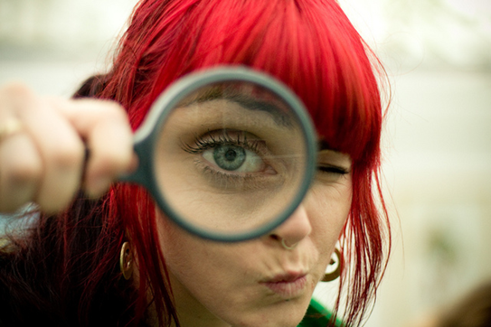
Are students’ views regarding representation of
‘self’ gendered?
Notes:
In conclusion, the strong assertion made that males have no ethical qualms around constructing digital identities was not supported by the discussion in my small project. Particularly as these participants are our future teachers, it is reassuring to know that they are aware of the ethical issues!

Slide 18
What does the literature say about representation of digital ‘self’?
Abrami & Barrett (2005) – showcase/presentation portfolios demonstrate achievements, attributes or competencies for a particular audience
Ring & Foti (2006) – combination of control and customization raises ethical issues involving showcasing the ‘self’
Stefani, Mason & Pegler (2007) – warn that selection of material can “be used to evidence learning in a persuasive way” (p. 13)
Ravet (2008) – digital identify or e-self = extension of a physical self to include the total extent of a digital presence, including data ….. Need for ‘digital education’
Notes:
The showcasing character of an eportfolio is widely recognised and includes a range of digital artefacts and text presented in a multimodal format. ePortfolio offers the owner the unique function of control and creation of multiple views for varied audiences and pruposes, raising the issue of representing the self in what can be perceived as a constructed identity or multiple identities, particularly in the choices and selection of material that best represents them. Stefani, Mason and Pegler sound a warning note when they observe that such selection can be used to evidence learning in a persuasive way. Ravet names the presence of those operating in a digital world as a ‘digital identity’ or ‘e-self’. The digital identity being the total extent of a digital presence including all data. Barrett talks of a ‘digital self’ – these are increasingly accepted concepts.

Slide 19
What does the literature say about representation of digital ‘self’?
Cambridge (2007) – ePortfolio = the genre at the intersection of two spheres of life : more personal than a CV and more professional than Facebook – need to negotiate the tension
Grant & Grant (2003) – need for ethical ePortfolios which reflect personal identity and values
Lewis & Gerbic (2012) – teacher educators confronted by challenges of digital representation, ethics of honesty and professional presentations
Silence on gendered perspective of representing ‘self’
in the digital medium of ePortfolios
Notes:
To present the digital self requires an understanding of both the nature of that media and the expectation of the audience. Thus in the social media of Facebook or Twitter there is an expectation of a strong personal ‘self’ – for an academic the presentation of a professional self in an ejournal demands meeting particular conventions. ePortfolio however, presents a challenge to both the personal and professional selves, when for example, its blogging tool encourages a loosening of the professional and an incorporation of the personal. The question of how this is balanced within the eportfolio view of self for external audiences becomes a dilemma for those grappling with the authentic and ethical representation of self when caught up in a preconceived belief of what constitutes a professional self. Cambridge introduces the concept of an integrated portfolio which has integrity in that it represents both the personal and professiona – it represents the well-integrated and complete representation of the creator’s sense of themselves as they wish to make that sense visible to their audience – it is the genre at the intersection of two spheres of life, more personal than a CV and more professional than Facebook – this is the challenge for eportfolio users to find the balance! And a challenge for teacher educators to engage in digital education (Ravet) and the creation of ethical eportfolios (Grant & Grant) which reflect personal identity and values.
The area of authenticity and integrity in the digital environment is under-researched, particularly in the area of eportfolios (Grant and Grant) and there is silence on the question of gendered views on digital identity.

Slide 20
Implications for Teacher Education Practice
Move away from a focus on ePortfolio as tool and beyond ePortfolio as pedagogy – to include digital identity education
Discuss with students, issue of ethics and levels of personal
accountability, particularly around employment applications
Understand the gender differences in representing ‘self’ and
digital identity – adjust expectations?
Notes:
Engaging the self and representing the self are important steps towards an authentic representation of self in knowing one’s identity as an academic and as a professional, one’s values and beliefs and how those inform the identity and integrity of the inner and outer landscape of the person (Palmer 1988).
Students need to become aware of what Grant & Grant call ‘ethical portfolios’ which are based on an identity grounded in personal beliefs and values – Grant contends that the creation of a self presentation aspect of identity through eportfolio requires focussed attention and even professional development around values, ethics and identity.
Cambridge suggests that an eportfolio has integrity when the user has negotiated the tension between the personal and professional to the extent that the one informs and enhances the other, giving a view of self which has life and personality, yet maintaining the professional edge.

Slide 21
References
Abrami, P. & Barrett, H. (2005). Directions for research and development on electronic portfolios. Canadian Journal of Learning and Technology, 31(3) Fall. Retrieved from http://www.cjlt.ca/index.php/cjlt/article/view/92/86
Cambridge, D. (2007). Audience, integrity and the living document: eFolio Minnesota and lifelong and lifewide learning with ePortfolios. Computers in Education, 51, 1227-1246.
Grant, S. & Grant, A. (2003). Ethical portfolios: Supporting identities and values. ePortfolio 2006 Conference Oxford 11-13 October. Downloaded from http://www.simongrant.org/pubs/ep2006/
Lewis, L. & Gerbic, P. (2012). “It’s your spell-checked version of yourself”: Student perceptions around (re)presenting ‘self’ through ePortfolio, Conference Proceedings, ePIC, London, United Kingdom.
Ravet, S. (2008). The ePortfolio is dead? Long life to digital identity. EIfEL Team Blog April 06. Downloaded from http://www.learningfutures.eu/2008/04/eportfolio-is-dead-long-life-to-digital.html
Ring, G. & Foti, S. (2006). Using eportfolios to facilitate professional development among pre-service teachers (pp. 340-355) in A. Jafari & C. Kaufman (2006) Handbook of research on eportfolios. Hershey, PA: Idea Group Reference.
Stephani, L., Mason,R., & Pegler, C. (2007). The educational potential of e-portfolios. London, United Kingdom: Routledge.

