Slide 1

The State of Play in New Zealand
SYMPOSIUM ON INTERNATIONAL DIVERSITY ON BOARDS
Wednesday 6 March, UTS, Sydney
Associate Professor Coral Ingley, Faculty of Business and Law, AUT University

Slide 2
Overview
NZ Census of Women’s Participation 2012 (and other international comparisons)
Recently highlighted in the media
  Corporate
  Sports
  Public Sector
Agenda for Change

Slide 3
NZ Census of Women’s Participation 2012
Do we want to keep seeing women in leadership positions? If we do we’re going to have to do something about it because it won’t happen of its own accord.....former Prime Minister and UNDP Administrator, Rt Hon Helen Clark.
Ko te Pua–waitanga o nga– moemoea–, me whakamahi. Dreams become a reality, when we take action.... Princess Te Puea.

Slide 4
NZ Census – The Good News
Women are now 30% in sports governance, compared with 24% in 2010
Recent appointments will lift the proportion of women as public service chief executives over 24%
The NZX has agreed to a gender diversity rule
The Prime Minister John Key, and successive Ministers of Women’s Affairs, Hekia Parata and Jo Goodhew, have helped mainstream the debate about women on boards
Notes:
New Zealand is making slow, incremental but unspectacular progress for women in many areas. For example, while women on boards of the top 100 companies listed on the New Zealand Stock Exchange have climbed over 10% for the first time, they have yet to reach 15% (14.75%). The increase over 2012 has been influenced by companies with dual listing on the Australian Stock Exchange and the recent introduction across the Tasman of gender diversity reporting rules. At the rate of progress for women in corporate governance over the past decade, it will be another 35 years before boardroom equality is achieved.
The figures reported here show that across many areas of professional and public life there has been a two or three percentage point increase for women in two years. Women’s low representation at the top, despite increasing participation at entry level, remains systemic and frustrating. It appears largely immune to economic cycles, despite the global financial crisis being regularly used as an excuse for women’s slow progress.

Slide 5
NZ Census – The Bad News
Two companies in the top ten, Sky Network Television and TrustPower, have no women on their boards and have no excuses
The percentage of women on government-appointed state sector statutory bodies has declined (2008 42%, 2012 41.1%)
  the gender parity goal of 50% set in the 1980s has recently been revised downwards to 45% by 2015 by the Ministry of Women’s Affairs in its current Statement of Intent, 2012-2015
Notes:
The 2012 Census Report shows that New Zealand now follows, rather than leads, other countries in active measures to improve women’s representation and that the benchmarks being set are often lesser than those introduced overseas.
Women are being short-changed by those setting targets on their behalf. There’s a bleak picture of pale ambition for women’s progress in New Zealand as a result.
“Low bar” targets for women’s progress are currently being set by the Government, business and the public and private sectors. Some of them are as low as aiming for 10% women’s representation in corporate governance by 2015, which appears to accept 90% male domination of governance as a norm. And if New Zealand publicly aspired in 1998 to equal gender representation on government appointed statutory boards following the Beijing Platform for Action, why is only 45% acceptable in 2012?
The weak nature of target setting for women’s progress has not gone unnoticed. The United Nations Committee on the Elimination of Discrimination Against Women told New Zealand in 2012 that “while there is co-operation between the Government and the private sector to identify targets for the advancement of women in decision-making positions, the targets, goals and time frames set are not sufficient and may be a symptom of regression rather than progress in women’s representation.”2
The Committee recommended to the New Zealand Government that it review the targets, goals and time frames set for the advancement of women in decision-making positions to ensure that they sufficiently enhance progress in women’s representation.
Unambitious targets for women’s progress have a number of negative effects. They demand no stretch whatsoever. For example, the 10% Ministry of Women’s Affairs indicator for corporate governance, was so low when it was set that it has already been exceeded. It required less than one percentage point change and the time for it to be achieved was pushed out to 2015. While political accountability may be satisfied at one level by such target-setting, women’s progress has been downgraded and devalued in the process.

Slide 6
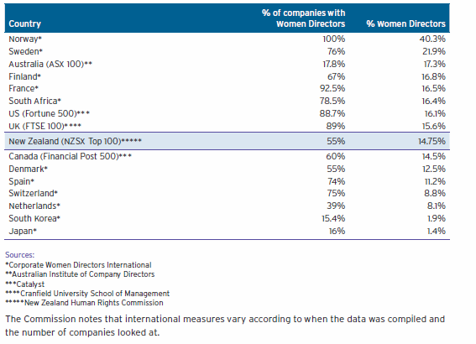
International Comparison of Women as Company Directors
Notes:
Sources:
*Corporate Women Directors International
**Australian Institute of Company Directors
***Catalyst
****Cranfield University School of Management
*****New Zealand Human Rights Commission
The Commission notes that international measures vary according to when the data was compiled and the number of companies looked at.

Slide 7
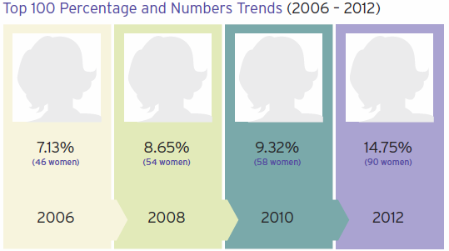
New Zealand Stock Exchange
Notes:
Women are making slow gains in corporate governance and only time will tell whether the NZX’s commitment to diversity reporting will be a catalyst for more dramatic change.
The New Zealand Exchange comprises three securities markets -the NZX Main Board (NZSX), the NZX Debt Market (NZDX) and the NZX Alternative Market (NZAX). The data reported here relates to the top 100 of the NZSX, and the total of the other two exchanges.
NZX Main Board (NZSX)
The top 100 companies listed on the New Zealand Stock Market (NZSX) have made a 5.43 percentage point gain in female representation as directors in the past two years.
Women hold 14.75% of board directorships of the top 100 companies by market capitalisation. This is up from 9.32% in 2010. This comprises 90 directorships held by 69 women in 55 companies.
The 55 companies in the top 100 with female‑held directorships is an increase of 12 companies from 2010. Of the 45 companies without female representation, 27 are in the bottom half of the top 100 companies by market capitalisation, which indicates a size effect in favour of gender diversity. Governance experts have long regarded 30% as the level in which a women’s perspective on a board can make a real difference.

Slide 8
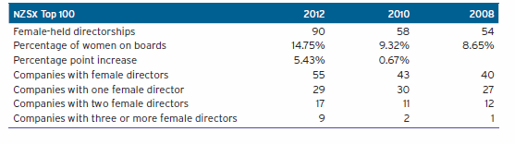
Women Directors on Top 100 Companies
Notes:
Five of the top 10 companies, Telecom Corporation of New Zealand Ltd, Fletcher Building Ltd, Contact Energy Limited, Vector Limited and a new entrant on the market, Trade Me Group Ltd, have two women on their boards. Both Sky City Entertainment Group and Ryman Healthcare Ltd have a single female director each. Twenty-six companies out of 100 have two or more board members who are women. This is double the number of companies since the 2010 Census report.
A total of 69 women are listed as directors of top 100 companies. Fourteen women have multiple directorships, up from 8 women in 2010. Seven women, including three female directors of fund companies hold three directorships each. Seven other women have two directorships each. The figures do not support the emergence of an “old girls” network of female directors in New Zealand, particularly as there are at least 12 overseas directors among the women on the top 100 of the NZSX.
NZX Alternative Market (NZAX)
Women hold 6.31% of directorships in the 25 companies listed on the NZAX, a decrease of 0.51 percentage point from the 2010 Census report. The total number of female directors has decreased by two from 2010.
NZX Debt Market (NZDX)
Women hold 15.19% of directorships in the 40 companies listed on the NZDX. The NZDX has increased female directorships by 5.62 percentage points since the last Census report in 2010. Genesis Power is the only company that has gender parity on their board. However, in 2010, Genesis Power as a Crown company reported a higher number of 5 out of 8 female directors.

Slide 9
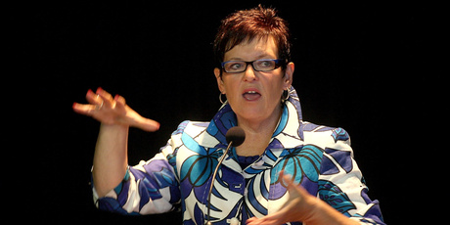
Recently Highlighted - Corporates in Trouble
Another company linked to Dame Jenny Shipley is under pressure and may be forced to stop operating by September if it cannot meet new Reserve Bank requirements.
Sentinel Assurance is owned by Seniors Money International, of which Shipley is the chairwoman.
Shipley has come under fire recently since the collapse of construction company Mainzeal. She resigned as chairwoman of Mainzeal on December 31 - just six weeks before the company went into receivership on Waitangi Day (February 6th).
Notes:
New pressure on Shipley By Tamsyn Parker 5:30 AM Thursday Feb 21, 2013
Sentinel Assurance, linked to former PM, is working to meet Reserve Bank demands.
Former Prime Minister Dame Jenny Shipley says Sentinel is working through the new licensing requirements with the Reserve Bank.
Another company linked to Dame Jenny Shipley is under pressure and may be forced to stop operating by September if it cannot meet new Reserve Bank requirements.
Sentinel Assurance is owned by Seniors Money International, of which Shipley is the chairwoman.
Shipley has come under fire recently since the collapse of construction company Mainzeal. She resigned as chairwoman of Mainzeal on December 31 - just six weeks before the company went into receivership on Waitangi Day.
Sentinel, which is New Zealand's largest provider of home equity release mortgages, noted in its annual report in June last year that it did not meet the minimum solvency requirements for the new Reserve Bank licence and was investigating potential solutions.
"If solvency cannot be achieved the company may need to cease its insurance activities," the report stated.
The firm's auditor, KPMG, also noted that while the company was working with the regulator to resolve the licensing issues, the existence of the "material uncertainty" cast doubt on the company's ability to "continue as a going concern".
Under new licensing requirements brought in after the collapse of insurer AMI, Sentinel is required to have $5 million in solvency capital on its balance sheet.
Sentinel's accounts show it does not have any capital that meets the solvency requirements because the capital is held by a related party.
Shipley said Sentinel was working through the new licensing requirements with the Reserve Bank and was on target to meet full licensing requirements.
"[Sentinel] expects the Reserve Bank will issue a solvency standard for captive life insurers, under which the company will have a significant solvency surplus."
She said Sentinel's parent company Seniors Money international was on track to make a $10 million operating profit and was well positioned for the future.
Sentinel chief executive Vaughan Underwood said the company did not need to raise capital and insisted it was about getting its classification and internal structuring right.
"It's a little bit about them [the Reserve Bank] understanding us better. It's clear we are in a slightly different category."
Asked why the discussion was taking so long to resolve, Underwood said "it doesn't feel like that long".
"To engage with a large organisation everything takes time. It doesn't feel like there are any hold-ups."
A spokesperson for the Reserve Bank said that in most cases the minimum capital and solvency requirements for insurers came into effect on December 31 last year as specified in their provisional licences.
However, the bank said it envisaged most full licences would be issued by the end of June.
Questions have been raised about Shipley's suitability as chairwoman of Genesis Energy ahead of its planned partial float on the stock exchange.
Asked if she would stand down if investors were put off buying into Genesis because of her involvement with Mainzeal, Shipley said she would do what was best for the company.
"In all my governance roles I focus on the best interest of the companies and I will continue to do so."

Slide 10
Recently Highlighted – Sports Governance
Rugby is one of 7 sports without any women at national governance level
A number of trailblazers are supporting the campaign including an All Black great, the first woman on the Australian Rugby Union, the most successful Black Fern captain, members of the Canterbury Women’s Rugby Board, a Member of Parliament and a community leader
The HR Commission encourages other New Zealanders to get in behind the campaign for women’s voices at the top as preparations are made for the inclusion of Women’s Sevens at the 2016 Olympic Games
The HR Commission wrote to the Chief Executives of all provincial rugby unions to confirm the number of women on their boards. Of the 194 provincial rugby board members, only 4 (2%) are women
Notes:
A campaign to ensure there is women’s participation at the top of the New Zealand Rugby Union (NZRU) is also launched in this report. Rugby is the major New Zealand sport with NO women on the NZRU board. A group of trailblazers is urging change.
Women represent only two percent of provincial rugby union board directors. There is only one women director on the New Zealand Super XV franchise boards.
Despite the low numbers of women in governance the NZRU has a women’s rugby development strategy that includes support of provincial unions and their member clubs, as well as secondary schools to ensure growth of the women’s game in New Zealand.
The Commission wrote to Mike Eagle, Chairman of the NZRU and asked:
1. What initiatives are there to get more women on provincial rugby union boards across the country and what has happened in the past?
2. What proportion of NZRU funding goes towards women’s rugby?
3. Why have no women been appointed to the New Zealand rugby union to date?

Slide 11
Media Commentary - Sports Governance
NZOC secretary-general Kereyn Smith:
“There is still a long way to go…it will come as no surprise to most – there won’t be many women featuring in the … sporting power list… Despite notable achievements of our female athletes in 2012, when it comes to sport’s governance and management, it seems that women are being sidelined”
  Of 55 national sporting organisations 89% have less than 50% female representation on their boards
  Just over half achieve the target of 20% representation set by IOC

Slide 12
Media Commentary – Sports Governance
CEO, Sport NZ, Peter Miskimmin:
“Sport still has that old boys’ club mentality. Part of it is to educate chairs and boards that they have to be far wider in their perspective”
EEO Human Rights Commissioner, Judy McGregor:
“Sports governance is a critical area for female representation – given its significance to our national identity rugby should be a leader, not the last bastion of male chauvinism”

Slide 13
Resistance to Change
Where there has been resistance to change in sports governance it is generally around the idea that setting base targets for gender representation will lead to females being appointed ahead of more skilled and qualified male applicants
Miskimmin:
“The recent response to the women in sport mentoring seminars run by the NZOC and Sport NZ, which unearthed a wealth of highly skilled female business leaders wanting to contribute to sports governance, proved there are no problems on the supply side. The challenges exist on the demand side”

Slide 14
Other Recent Media Commentary
Justice Minister and Minister of Ethnic Affairs, Judith Collins rejected the advice of an independent panel (headed by David Rutherford, Chief Human Rights Commissioner) which recommended a woman lawyer for a top state service job and selected her own nominee despite a plea from Human Rights Commissioner, Judy McGregor. Ms Collins announced Auckland barrister Robert Kee as the new Director of Human Rights Proceedings, an independent role within the Human Rights Commission, after nominating him (as one of 13 candidates) for the post
Ms Collins also eliminated another woman candidate during the early elimination process
Mr Rutherford :
“If ministers treat each of these opportunities as a one-off appointment process rather than a strategic opportunity to improve gender balance, I fear we may never get to where we all want to get to”
Notes:
A controversial former rugby union boss is the new Chief Human Rights Commissioner.
Justice Minister Simon Power announced commercial and sports lawyer David Rutherford was appointed after Rosslyn Noonan stepped down yesterday.

Slide 15
Steps to Address
These include:
Global Women,
The New Zealand group of the United Nations Women’s Empowerment Principles,
The 25% Group,
Women on Boards NZ,
The New Zealand chapter of the International Women Corporate Directors network,
among others
Notes:
A prevalent private board strategy to address women’s access to the boardroom has been to insist in corporate governance codes and in annual financial reporting that diversity at governance level is a necessary element in good business practice. This strategy, which has an element of public relations and is largely about transparency through “knowing and showing” how many women are on the board, has taken on an added emphasis during the global financial crisis. Investors, governments and the public are increasingly questioning the “group think” of current mainly white, male-dominated boards to withstand the ebb and flow of volatile business cycles and deep troughs.
In the 2010 Census report, the Human Rights Commission urged that the “New Zealand Exchange (NZX) monitors the Australian Stock Exchange’s new gender diversity reporting regime with the aim of following suit in 2012.” In 2012, after receiving about 30 plus submissions that were mainly positive, the NZX adopted a gender diversity rule, subject to FMA approval, which is a voluntary code for gender disclosure. NZX Chief Executive Tim Bennett said feedback from listed companies revealed gender diversity was seen as important to the market. “There is credible research-based evidence which suggests that diversity-and gender diversity in particular — at both board and senior management level — contributes to improved performance.”11
Finland was the first country to adopt board diversity language in corporate governance codes in 2003 and there are 15 other countries with corporate governance, stock exchange, or securities exchange commission initiatives. Australia adopted its measure in 2011 and both the United States and the United Kingdom introduced similar reporting in 2010.12 New Zealand becomes the 16th country with corporate governance reporting of diversity in listed companies.
CWDI in its international comparison states that these requirements are basically ‘comply and explain’ initiatives with no punitive measures and asks whether they have helped move some companies to add more women to their boards. The research concludes, “Fortune Global 200 companies based in countries with board diversity language have a higher percentage of women directors than those companies in countries without these provisions in their corporate governance codes.”
The NZX has been praised for finally adopting diversity reporting in relation to listed issuers who will have to provide a breakdown of gender composition at executive team and board level in their annual reports and compare it to the previous year. The rule applies to companies with a balance date of December 31, 2012.
However, women’s groups and the Human Rights Commission believe the rule does not go far enough. The Commission submitted that to be useful as a driver of positive change and to improve transparency a company should be required to establish gender and diversity policies if it did not have them, and disclose the policy including measurable objectives in its annual report. The absence of a requirement to have a gender and diversity policy in the first place and to set measurable objectives, which were critically positive components of the ASX Governance Council’s policy across the Tasman, could potentially reduce the effectiveness of the rule.13
Global Women’s chair Dame Jenny Shipley welcomed the rule but said it was a missed opportunity to match Australia’s progress, and New Zealand Council of Women president Elizabeth Bang called the NZX rule a “half step”. The New Zealand Shareholders Association criticised the NZX for covering only gender in the diversity listing rule.14
It remains to be seen how effective the NZX rule will be and how well it is monitored. For the listed entities in New Zealand who are dually listed on the Australian exchange, it will be business as usual because they are already experienced in diversity reporting. The Australian experience revealed that prior to the rule taking effect, early adopter companies appointed their first or second woman to boards in order to “show” gender diversity, thus improving Australia’s overall percentage from a low base of 8.3 percent in 2008 to 13.9 percent in March 2012.15

Slide 16
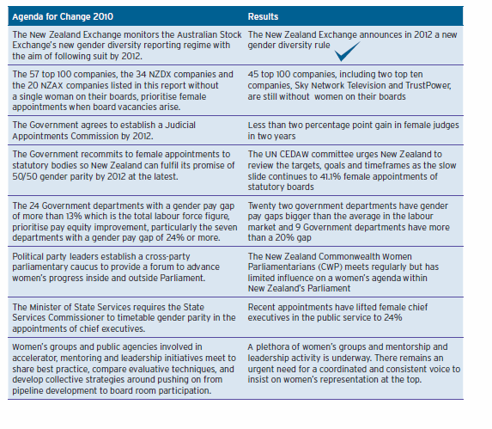
Agenda for Change Scorecard
Notes:
A recent World Bank You Tube campaign, Think Equality for Women and Girls, ends up by asking, “what can you do?” It then runs through a list that includes, “discuss, debate, yell, speak, fight, vote, demand, change.” All of that and more will be required. Women’s civil society groups, men and women within organisations and male and female leaders who have assumed that women’s equality will be progressively realised, now face the imperative of more effective interventions.
The challenge will be how to identify those that will prompt the step change required for equality to be realised. The interventions may be at the customer and client interface, or through shareholder activism in the corporate world, by litigation or other forms of direct action to achieve pay parity in the public service. Quotas and affirmative action3 will need to be more seriously debated to speed up women’s representation on corporate boards if the NZX gender diversity rule has little effect in the next few years.
Feminist Germaine Greer during her New Zealand visit in 2012 told audiences that women had lost ground partly because they had become far too polite. There has been a buzz of activity around women on corporate boards in particular in recent years and there are now a number of women’s groups, business organisations, networks and campaigns working on the issue.4 For this welcome momentum to translate into traction there is an urgent need to coordinate these activities. The public voice about women’s representation must become co-ordinated, compelling, consistent and insistent.
Two initiatives in New Zealand since the last Census report in 2010 indicate the new wave of male support for boardroom change. These are the growing number of chief executive officers of major New Zealand companies who have signed up to the United Nations Women’s Empowerment Principles and the formation of the 25 Percent Group.
The Women’s Empowerment Principles
The Women’s Empowerment Principles (WEPS) is a global campaign asking CEOs of major companies, many with a footprint in New Zealand, to commit to a public statement of support that they will advance equality between men and women by bringing the broadest pool of talent to their businesses and modelling behaviour within their companies that society would approve of for employees and families among others.
One of the principles relates directly to the issue of board room diversity and recommends that signatories “assure sufficient participation of women-30% or greater-in decision-making and governance at all levels and across all business areas.” Another suggests the transparency, measuring and reporting are vital. The principles ask CEOs to:
• Make public the company policies and implementation plan for promoting gender equality
• Establish benchmarks that quantify inclusion of women at all levels
• Measure and report on progress, both internally and externally, using data disaggregated by sex
• Incorporate gender markers into ongoing reporting obligations.
Thirteen of the 18 New Zealand CEOs who have signed to date are men and the signatories include New Zealand companies such as The Warehouse, Z Energy and Isaac Construction as well as New Zealand arms of multinational companies. The principles have been promoted in New Zealand by a group involving civil society; UN Women in New Zealand, Business and Professional Women, the New Zealand Human Rights Commission and the EEO Trust.
The 25 Percent group
Eight of twelve founding members of the 25 Percent group who have committed to a quarter of boardroom directorships being female by 2015 are male chairs or CEOs from a selection of private, publicly-listed or international companies in New Zealand. The 25 Percent group is very similar to the 30 Percent group set up in the United Kingdom in 2010, advocating for non-mandatory measures, except that the target is five per cent softer. One of the founders, Dave Chambers, the managing director of Progressive Enterprises states that “there is a real waste of talent and resource in New Zealand with women not adequately represented in senior management positions (and boards) despite comprising a high percentage of both the workforce and tertiary qualifications.”
Unverified analysis shows that in terms of women in governance the 25 percent group is on target but it will need to ensure greater progress for women in senior management.

