Slide 1
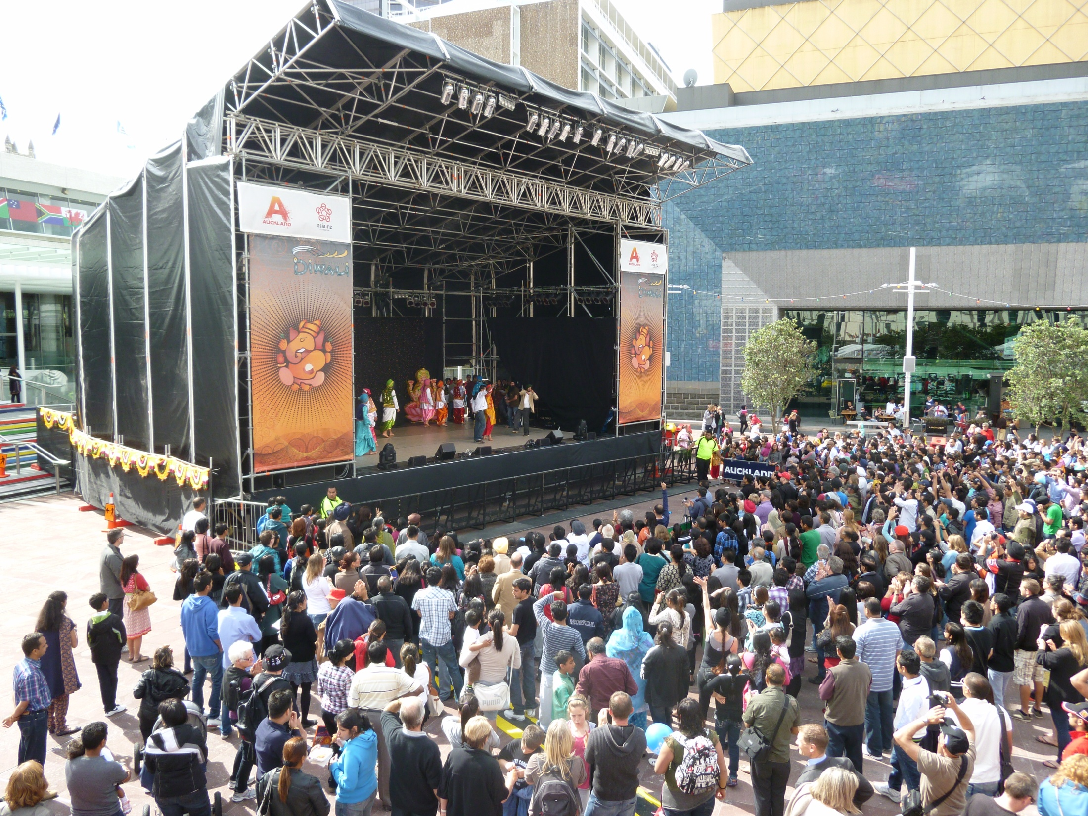
Whose Diwali is it?
The case of the Indian Community and Auckland City Council
Alison Booth
AUT Dec 2013 in preparation for Indian Musicological Society Mumbai Jan 2014

Slide 2
Focus of the Enquiry
Ethnographic research
Auckland Based
Focus
  Cultural representation and the role of the producer
Observation
  Over the past 12 years these has been a management change in the production practices of the event Diwali: Festival of Lights
Method
  Producer Network Maps developed in my PhD research at University of Otago

Slide 3
Case Study
“Diwali: Festival of Lights”
  Production practice transformation 1998- 2013
  Community celebration to ‘Major Civic Event’
  Cultural organisation to government agency producers
  Executive decisions align with larger tourism and economic development strategies
  Co-production to exclusive management production
Notes:
Cultural organisation to government agency producers
1997 Government recognized the potential political and economic benefits of cultural celebrations
2002 Asia 2000 launched Diwali: Festival of Lights with AIA.
2004 Auckland Council increasing control over management until today
Festivalisation is a term that was developed in the literature of German urban sociology (Haussermann & Siebel, 1993; Roth & Frank, 2000). Festivalisation refers to the politics of big events and the political and economic consequences on the host environment (Roth & Frank, 2000, p. 219). Festivals may have a significant impact on their local economic, social, and environmental settings over both the long and short term. The social functions and the symbolic meanings of festivals are framed within a series of overt values that communities recognise as essential to their common ideologies and worldview.
Festivals embrace a community’s social identity, unity, historical continuity, and sustainability (Wood, 2009). Festivals are resource-dependent and as they mature they begin to act more like institutions that are united for a specific purpose creating and that become permanent, legitimate and valued new segment of society. It has been argued that festival organisations must strive to become institutions in their resource environment to become sustainable and that very few festivals organisations are likely to reach this status (Getz, Anderson, & Larson, 2007, p. 121).

Slide 4
Research Questions
How do relationships to event resources change under the influence of ‘festivalisation’?
How do such changes affect the communities that the resultant events allegedly represent?

Slide 5
Historical Background
1997: the NZ government recognised the benefits of cultural celebrations
1998: Auckland Indian Association (AIA) organised its first community Diwali celebration in response to the rapidly growing Indian community population
2002: Asia2000 (now Asia: NZ) launched “Diwali: Festival of Lights” with AIA.
2004: Auckland Council and Asia: NZ collaborate and grow Festival
Notes:
1998, Auckland Indian Association started a public Diwali celebration
Rapidly growing Indian community population
Collective expression and enjoyment of one of India’s most important cultural celebrations
2002 Asia 2000 launched Diwali: Festival of Lights with AIA.
2004 Auckland Council increasing control over management until today

Slide 6
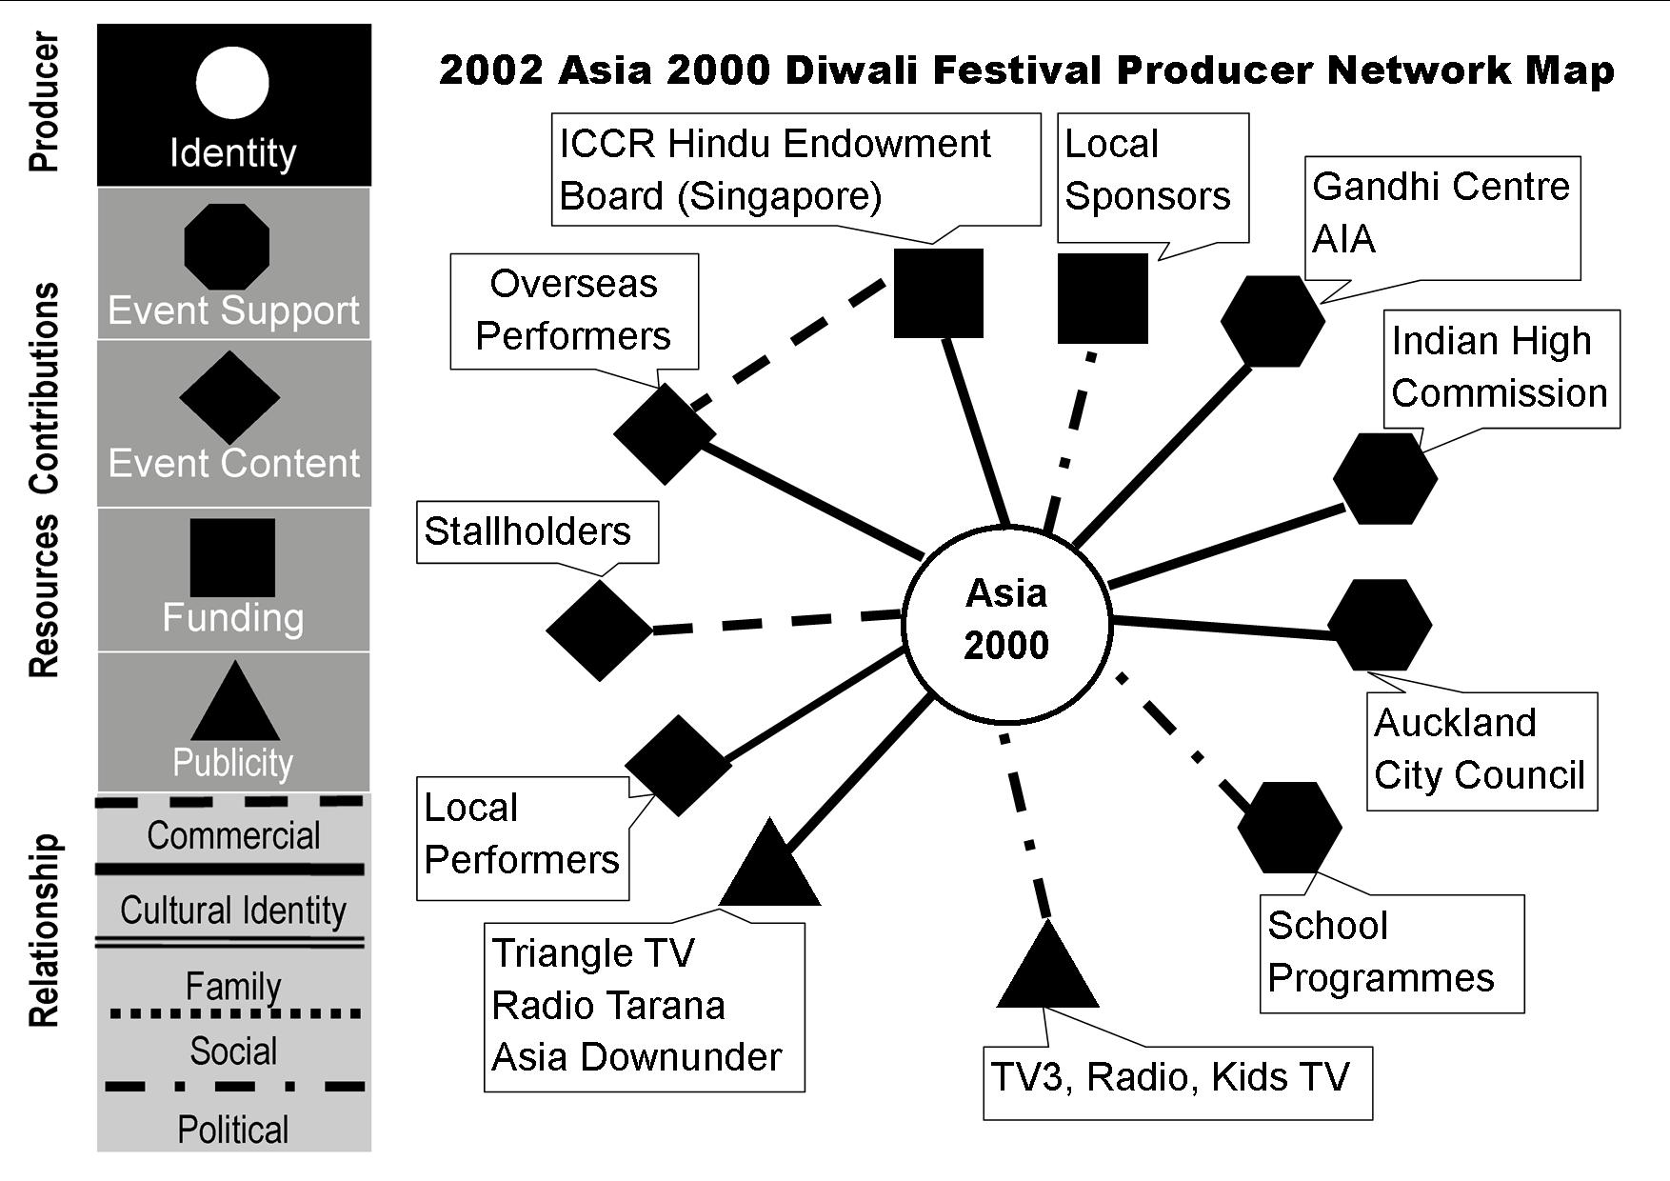
2002 Diwali: Indian Community Focus
Producer had a strong relationship with the Indian Community
Asia200 is a producer with a cultural focus endeavouring to create a “traditional‘ event that engages the community (King 2002)
Relationships with overseas Indian government cultural resources
Notes:
Broad-based Indian community support
· Estimated audience 40,000
· AIA membership reflects Indian community demographics
· International performers in council supported community and school performances
· Modelled on Asia 2000’s successful Chinese Lantern Festival
· Wide variety of community performers represented
· Endeavoured to make a “traditional‘ event that engages the community (King 2002)

Slide 7
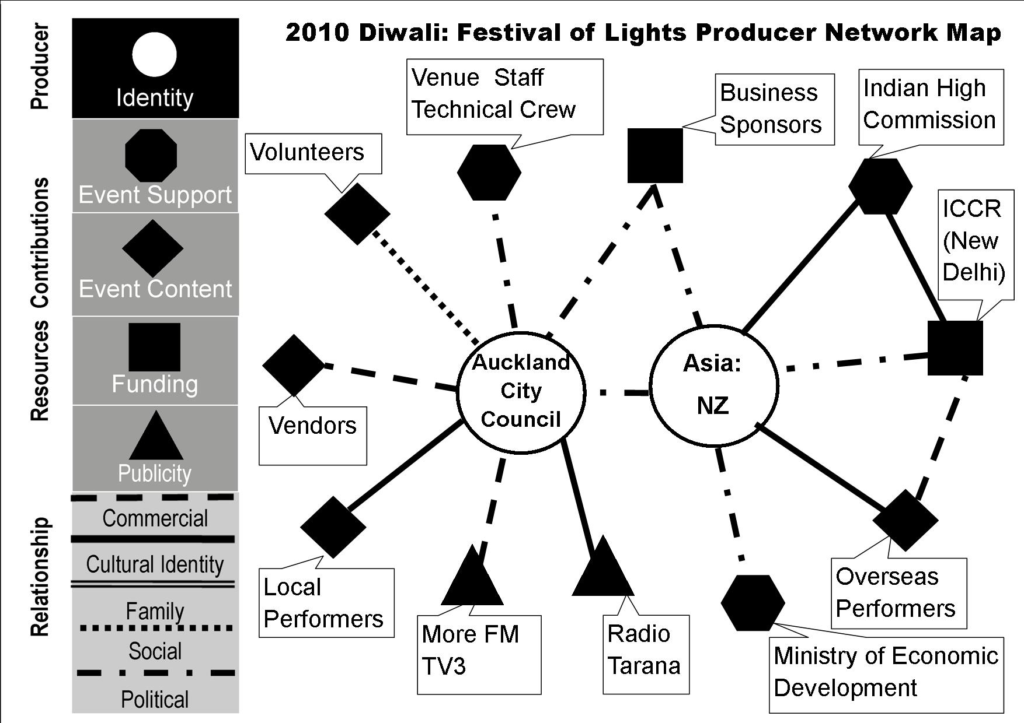
2010 Diwali: Community to Auckland City Council Focus
·Auckland City Council and Asia:NZ (formally Asia 2000) become co-producers
Co-producers share resources
Asia:NZ management of overseas performers, and government funding resources from NZ and India
Auckland Council venues, vendors, local businesses and event support
Estimated audience: 110,000
Notes:
· Auckland City and Council Asia:NZ (formally Asia 2000) co-producers
·· Ministry Economic Development (MED) funding channelled through Asia: NZ
·Ghandi Centre replaced (2004) by large, “neutral” public venue under Council control
Event trialling newly restored venue for the upcoming RWC, 2011
· Estimated audience: 110,000
· A wide variety of community performers and genres represented

Slide 8
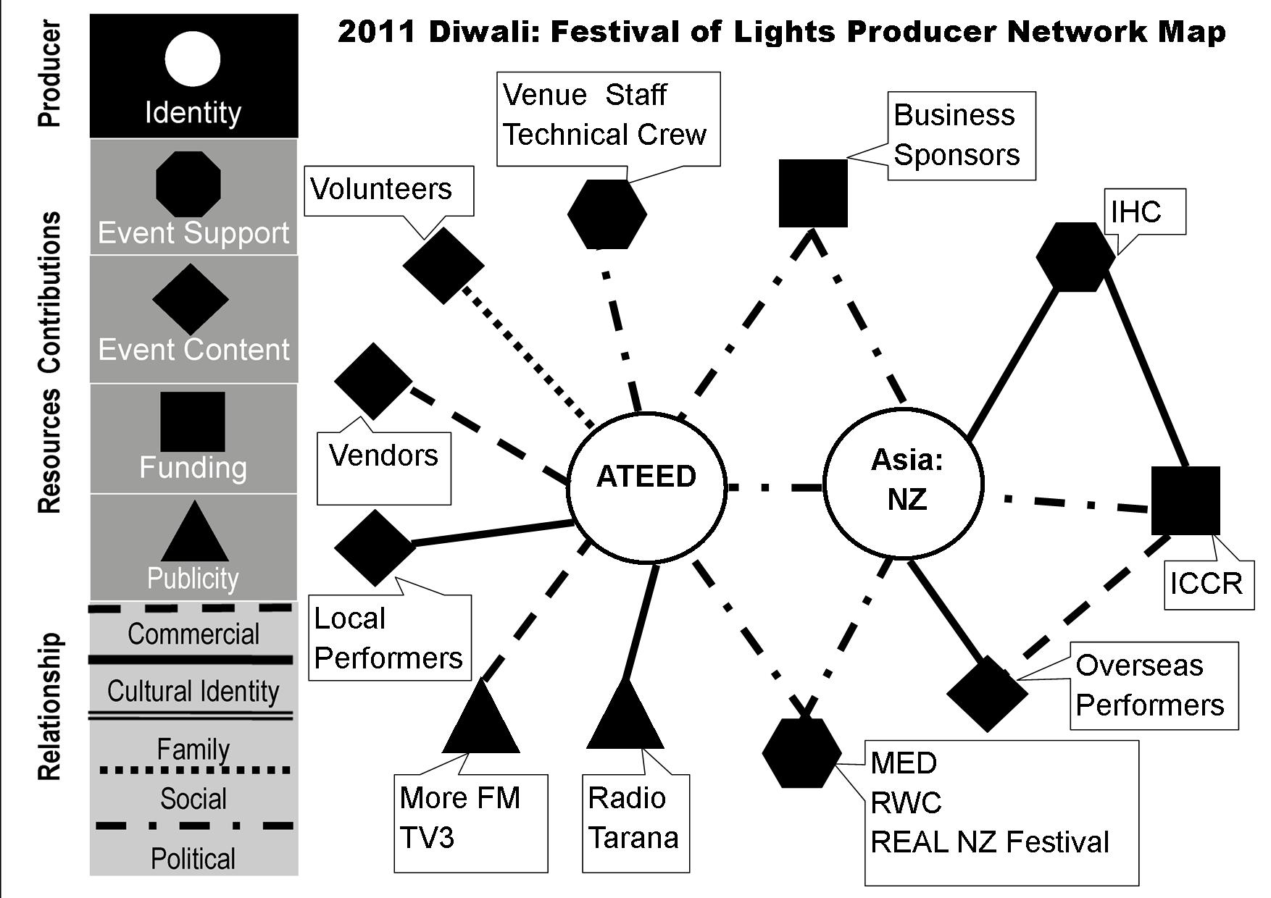
2011 ATEED and Auckland hosts the RWC Focus
Festival Council management
re-located to the portfolio of ATEED
Less community consultation and increased stallholder fees
ATEED relationships to other RWC government agencies/agendas- notably MED, RWC and REAL NZ Festival and sponsors
85,000+ RWC fans expected to bring 25-30% increase in attendees
Attendance down 25-30%

Slide 9
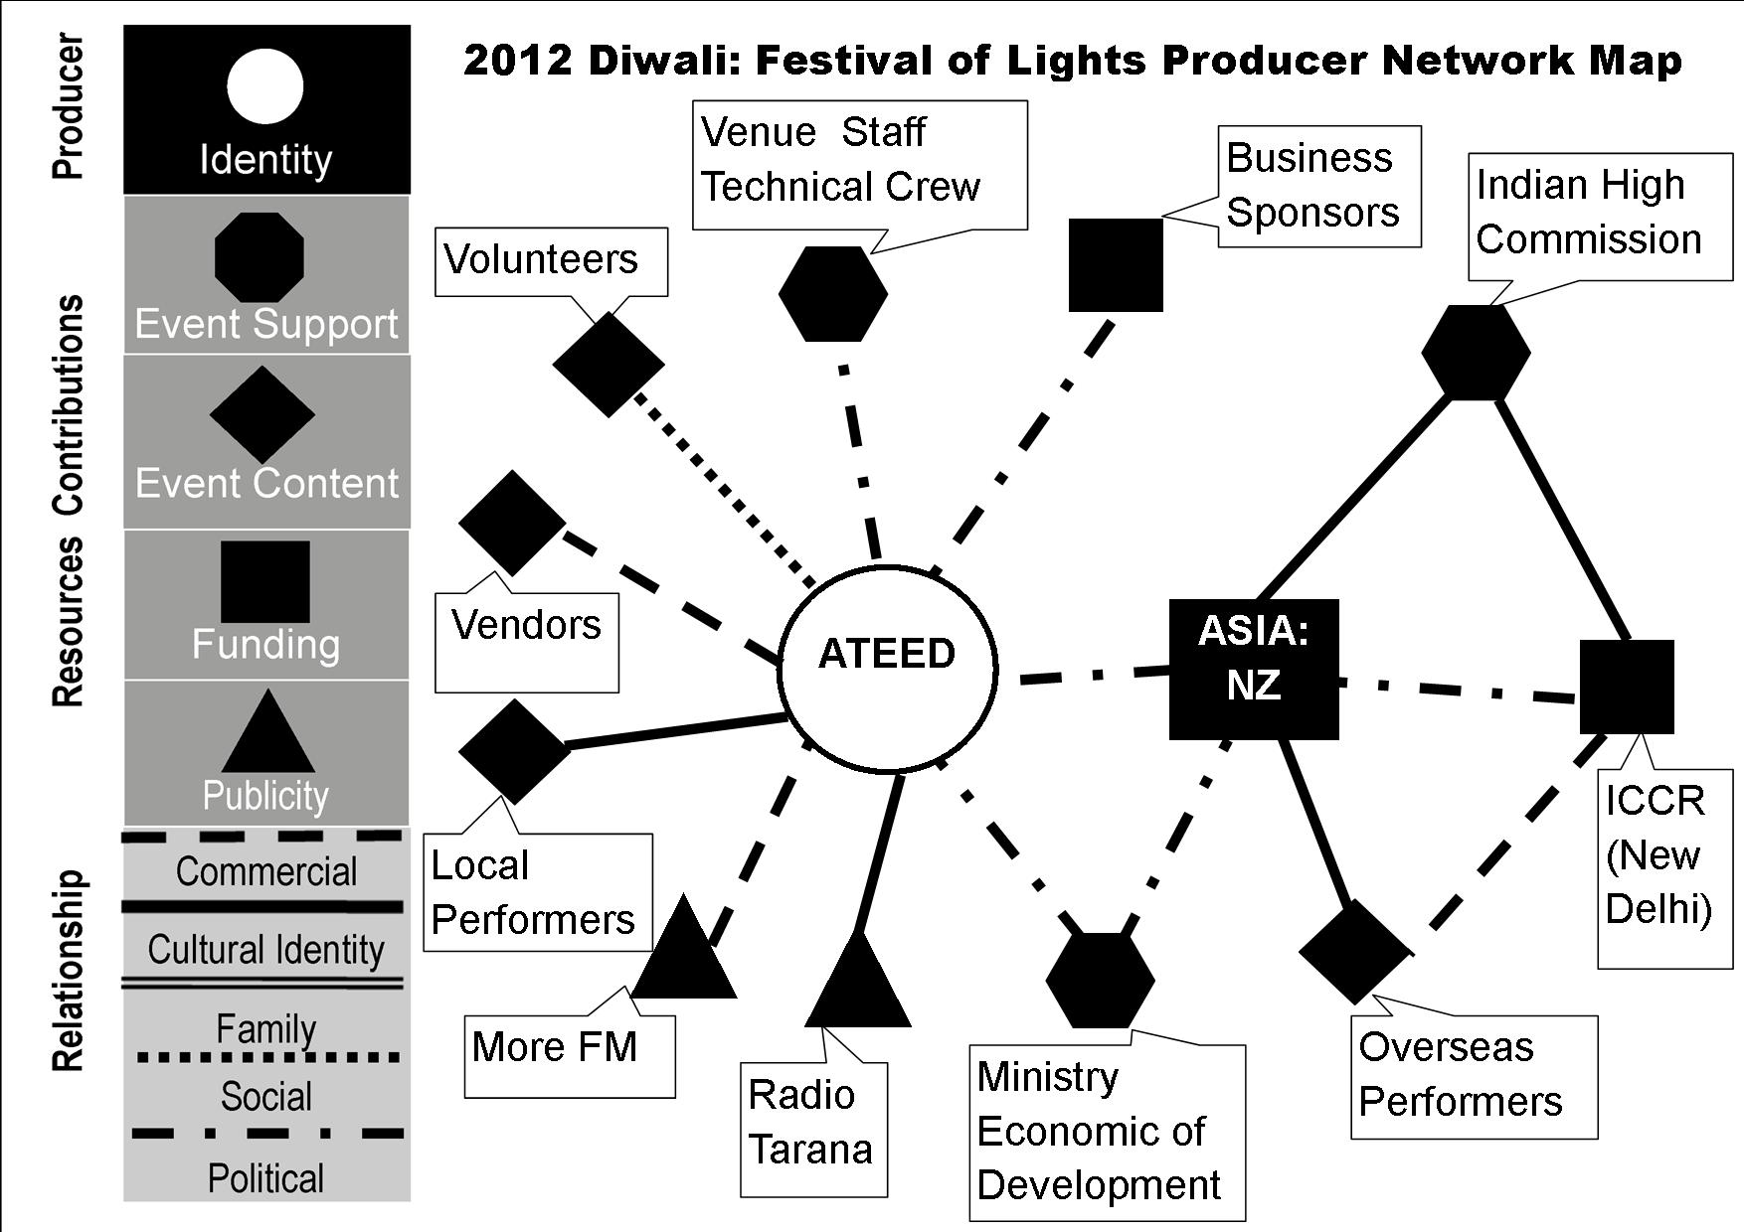
2012 ATEED Control Focus
New brand “Kiwi festival with an Indian flavour”
Resources relationship access based on strategic economic development stakeholders
ASIA:NZ relationships reduced to funding and as a source for overseas performers
Further rises in stallholder fees and performer diversity reduced
Significant decrease in stallholder and audience participation
Significant increase in Indian community Diwali celebrations closer to the actual Hindu calendar dates
Notes:
ATEED control of branding, sponsorship and event content except overseas performers
“Kiwi festival with an Indian flavour”
· Further rises in costs to stallholders
· One size fits all generic festival model, stylistic and performer diversity reduced
Event content , support and funding shift to City Council relationships based on strategic economic development stakeholders
· Asia: NZ role shifted co-producer to role of sponsorship
· Festival organization, production, timing re-arranged to suit needs of Council
· Significant decreases in stallholder and audience participation
· Festival and entire month before Hindu calendar dates for Diwali celebrations
· Indian community chose to produce their own events

Slide 10
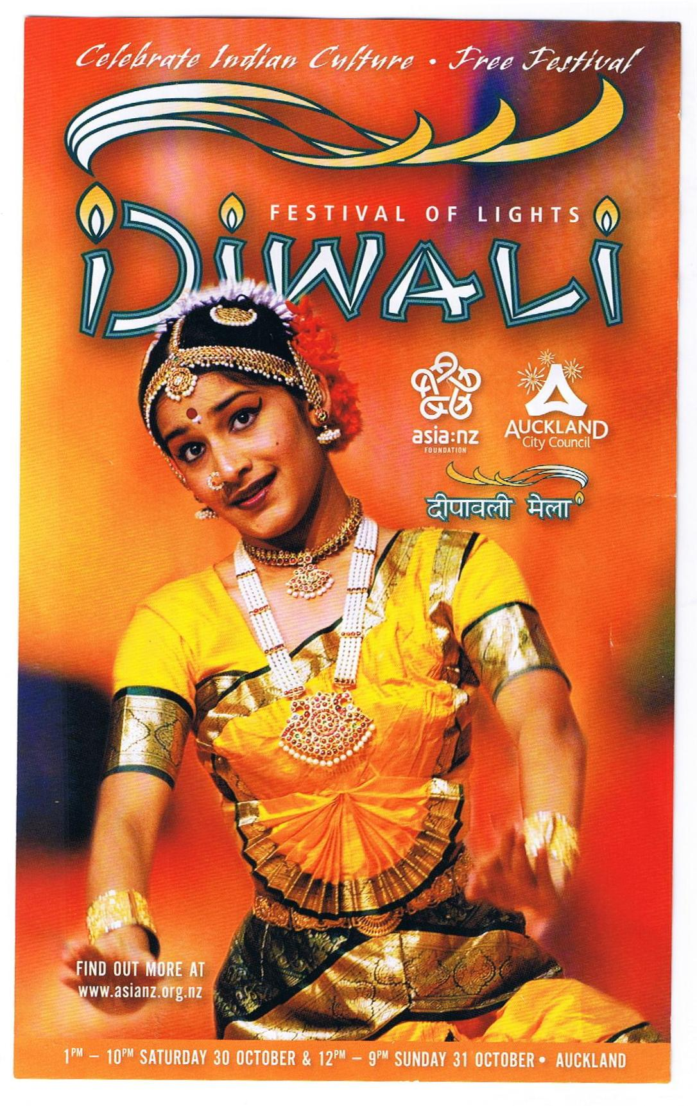
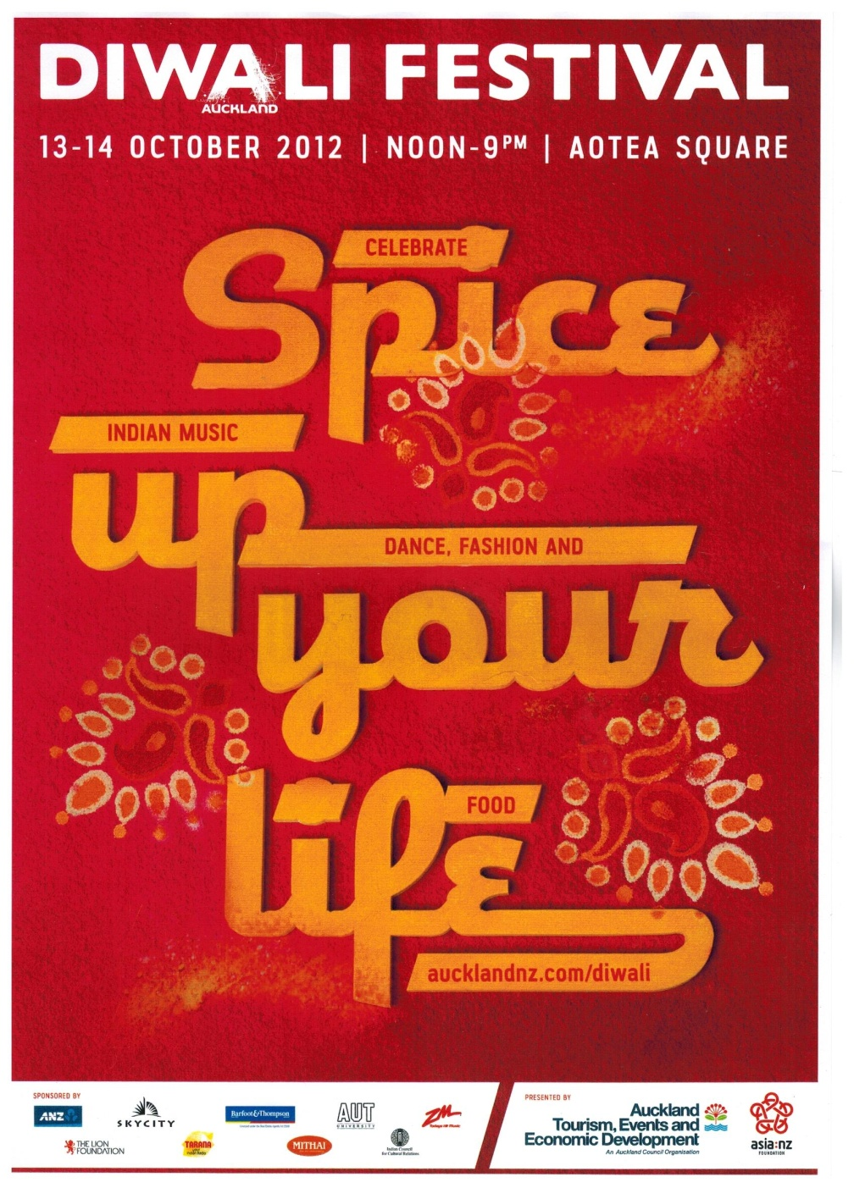
2010 Diwali: Festival of Lights Poster
2012 Diwali: Festival of Lights Poster

Slide 11
We feel Diwali needs to retain its theme and not be swept by the increasing effects of commercialization, westernization and Hollywood and Bollywood influence. Therefore while mindful of the increasing social bonding significance of Diwali, its theme should not be diluted to such an extent that it merely becomes yet another Western event bereft of any worthy cultural, traditional or religious significance that it currently holds. It is for this reason that Waitakere Indian Association links with its affiliate, Waitakere Hindi Language and Cultural School to portray the real theme of Diwali event.
Singh, T. R. (2012, October 04). Waitakere Diwali changes cultural landscape while maintaining tradition. Indian Weekender. Retrieved from http://www.indianweekender.co.nz/Pages/ArticleDetails/7/3268/New-Zealand/Waitakere-Diwali-changes-cultural-landscape-while-maintaining-tradition

Slide 12
Outcomes
Voices of dissent
  Bollywood/Panjabi content
  representation of Indian performance culture
  management decisions
    Council and their selected sponsors
Growth of community celebrations outside of government control

Slide 13
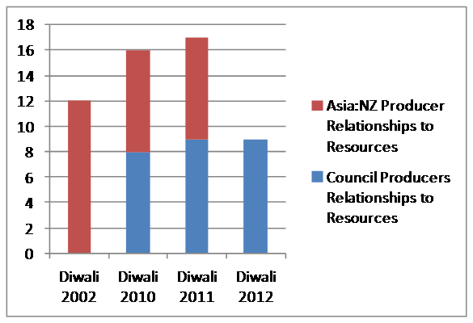
Findings Summary: Producer Relationship Access to Resources
Number of Relationships

