Slide 1


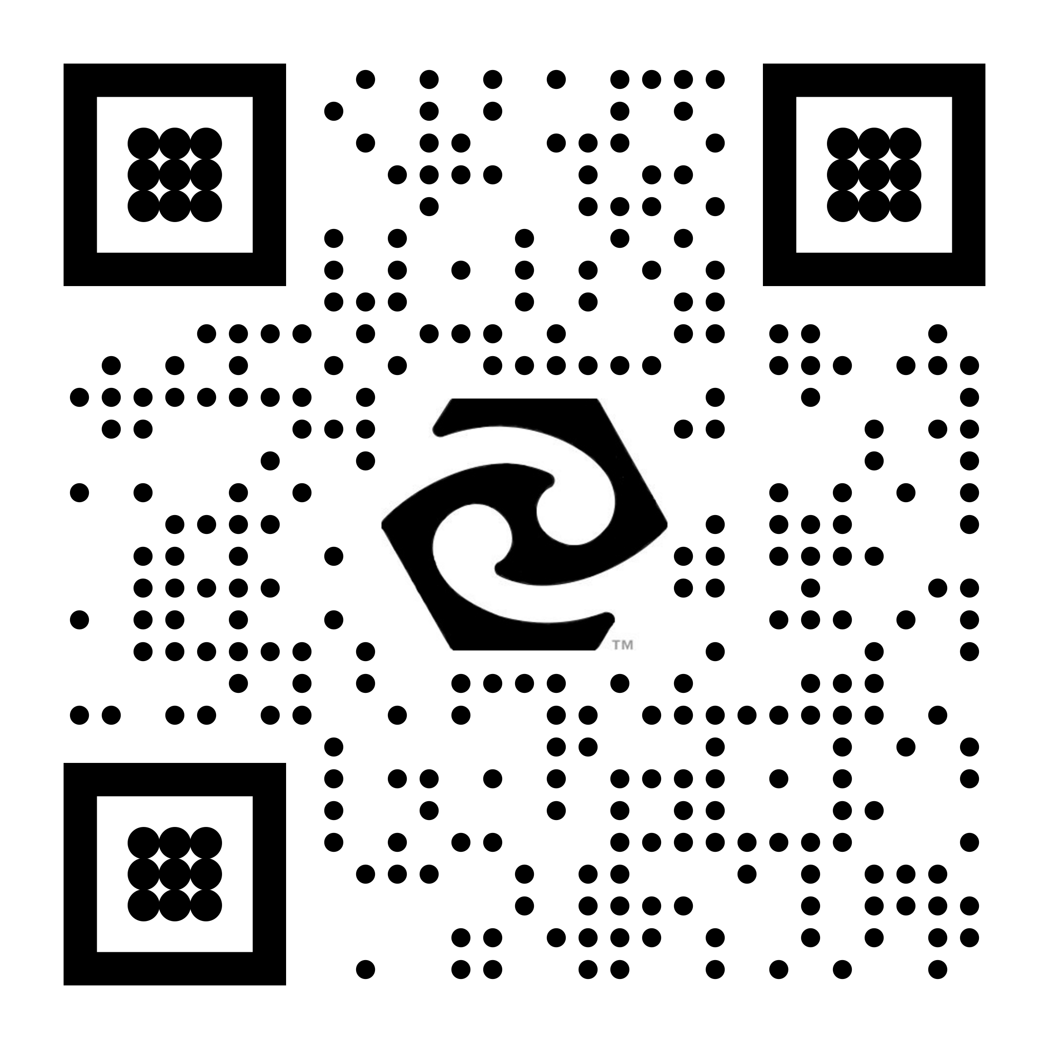
AUT Centre for Kode Technology Innovation
Hangarau auaha koiora - Technology to shape life
Advanced Serologic Kodecytes G (ASKG™) Trial Kit
designed to enable teaching of IgG serologic reactions
Cat. no. 074659-ASKG-T2KIT
www.tiny.cc/ASKG

Slide 2
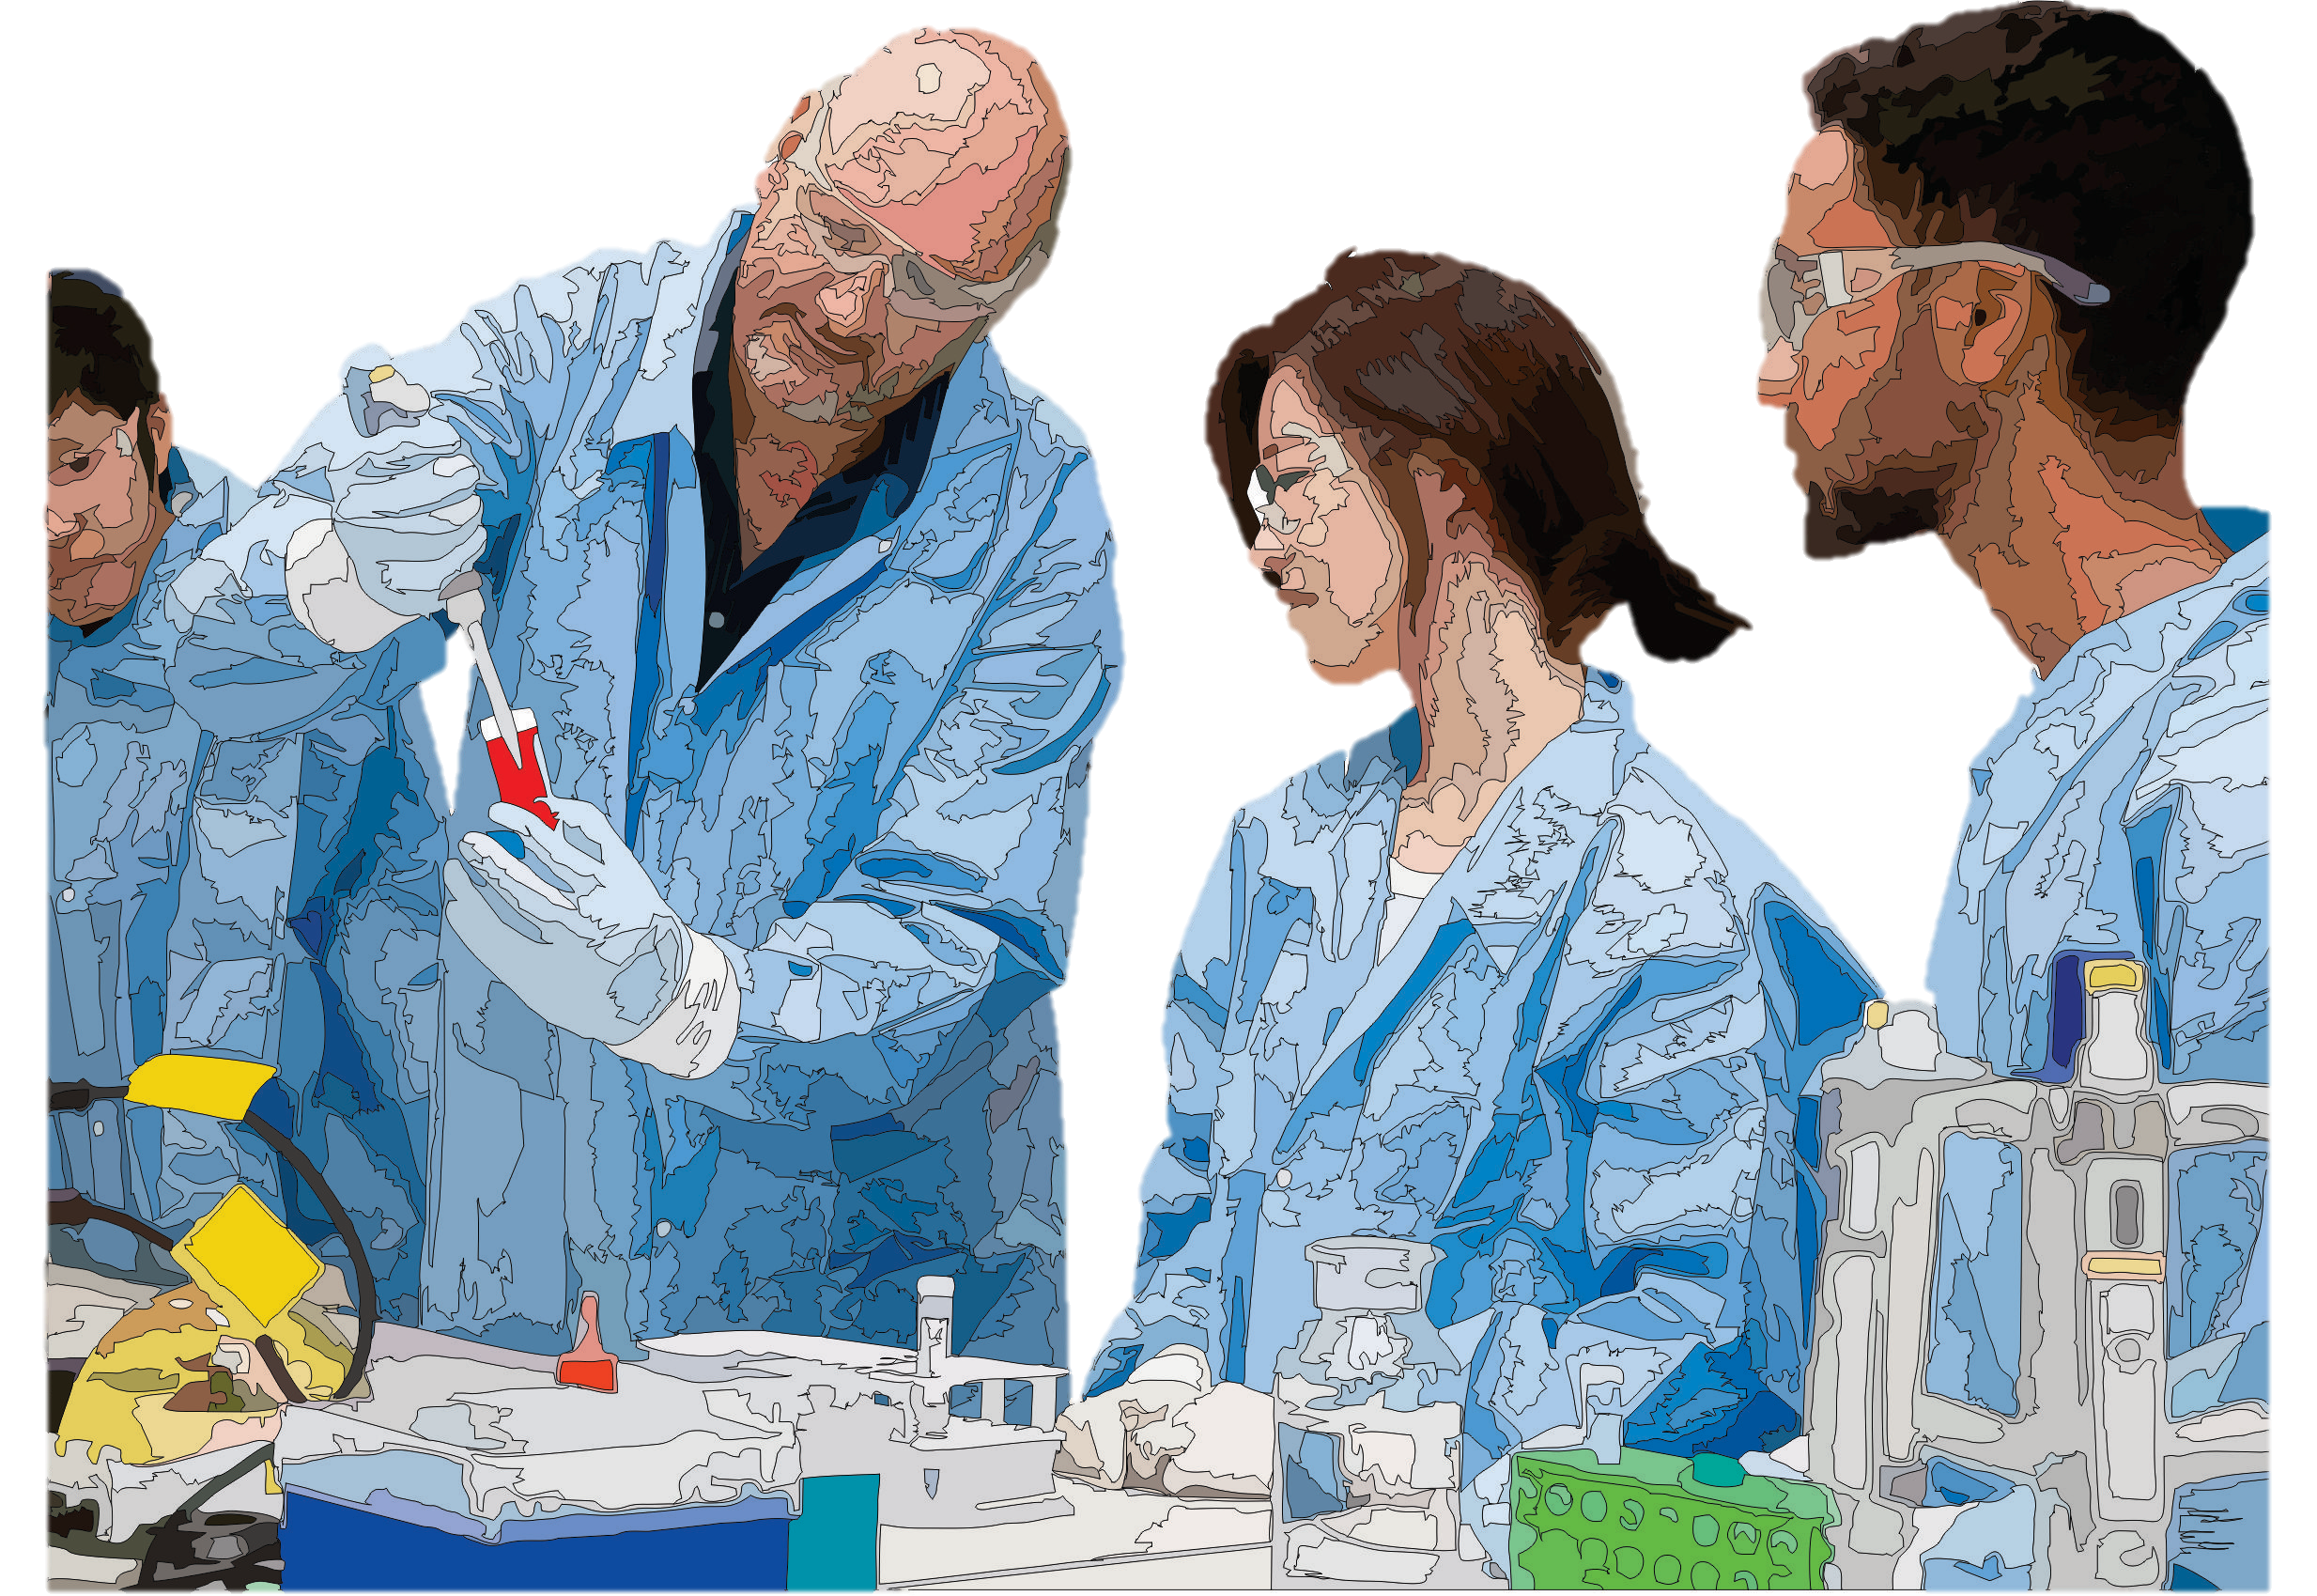
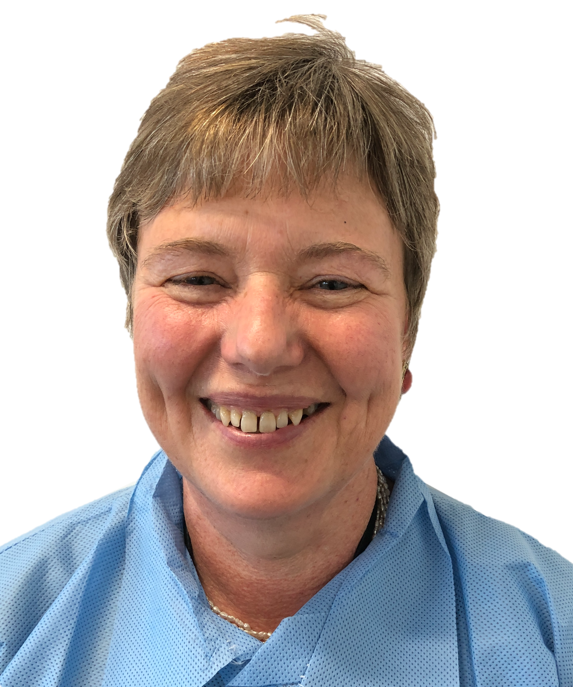
Advanced Serologic Kodecytes G (ASKG™) red cells designed for
teaching, training and quality control use
Modified red cells - genuine antibody serological reactions
Designed for teaching recognition and grading of IgG serologic reactions
Allow for creation of artificial antibody identification panels
Advanced yet simple to use
Simply reconstitute FSL-ASKG and incubate with washed red cells to create ASKG-kodecytes
Select your own ASKG antibody positive and negative plasma/serum samples from random donors
With just one group O red cell sample and a few selected plasma/serum samples you will have ability to make
  IAT reactions from weak to strong
  common and rare antibody reactions
No need for rare antibodies or ID panel cells
Compatible with most serological platforms, including automated and manual tube & CAT
Editable handouts, notes and worksheets, easily adapted for your training manual, and available online at www.tiny.cc/ASKG
“We have used kodecytes for about five years now and I find them invaluable for teaching serology to medical laboratory science students” – Holly Perry, Senior Lecturer, AUT University

Slide 3
REAGENT & PRODUCT DESCRIPTION
The Advanced Serologic Kodecytes G (ASKG™) Trial Kit consists of two vials of FSL-ASKG-SC2-L1 Kode™ Technology function-spacer-lipid constructs for use in the preparation of ASKG-kodecytes. When used according to recommended methods ASKG-kodecytes can be prepared to give defined IgG reactivity against samples selected to contain ASKG antibodies in the antiglobulin assay (anti-IgG). By arranging ASKG-kodecytes and unmodified cells in patterns representative of antibody identification (ID) panels antigen profiles, mimic ID panels can be created for teaching purposes that will react against samples containing ASKG antibodies. Changing the order of the kodecytes and unmodified cells in a mimic ID panel will create a different antibody specificity. Similarly changing the antigen strength of the ASKG-kodecytes within an ID panel can be used to create antigenic variance and mimic reactions including dosage. The user will initially prepare ASKG-kodecytes to identify their own supply (preferably bulk) of plasma and/or serum samples with and without IgG antibodies against the ASKG antigen. These ASKG antibody positive and negative samples together with a range of ASKG-kodecytes and unmodified cells will allow the user to create almost any serological reaction grade and pattern.
FSL-ASKG-SC2-L1 is a Kode™ Technology function-spacer-lipid construct where the ASKG antigen is a 16 amino acid peptide linked to a N-carboxylmethyl glycine (CMG2) spacer linked to a DOPE lipid. The molecular weight is 3748Da and the 0.19 mg of product in each vial is freeze-dried.
STORAGE CONDITIONS
Store unopened Advanced Serologic Kodecytes G (ASKG™) Trial kit and FSL-ASKG-SC2-L1 vials at temperatures below 10℃. Transport at ambient temperature is acceptable. Once product is reconstituted aliquot and freeze (below minus 10℃) the 100 μmol/L stock solution for up to 2 years. Do not refreeze.
FSL-ASKG constructs require no handling precautions, ASKG-kodecytes should be handed with blood precautions
BACKGROUND & PRINCIPLE OF THE REAGENTS
The detection of the presence of IgG antibody bound to the surface of the red cell (sensitization) is the primary diagnostic in transfusion medicine. Serologic methods for the detection of IgG sensitized red cells vary and range from manual techniques in tubes and columns through to fully automated methods. In most cases these methods also require the use of antiglobulin (anti-IgG) reagents. Typically immunohematology antibody screening and identification (ID) methods use red cells with known antigen reaction patterns to determine the specificity of an unknown antibody in plasma and serum samples. The reactivity pattern of the antibody sample against the ID panel with selected antigen profiles allows for the probable identification of antibody specificity. Generally antibodies to red cell antigens are uncommon and some specificities are very rare. Furthermore, these antibodies are usually identified in patients where access to sample is both difficult and volumes available severely limited. Consequently training students, or improving competency of trained practitioners with clinical samples is problematic and often limited to using common antibody specificities.
Kode™ Technology is a method designed to attach small molecules including antigenic components onto the outside of cells, and without changing the basic functionality of the cell modified. Kode™ Technology is well established for modification of red cells. Present in human serum are many different antibodies directed against environmental and microbial antigens, antigens which are not present or even related to human antigens. By analyzing human serum against a series of microbe-related antigens, it was possible to identify peptides that reacted predominantly against IgG antibodies randomly present in the general population. One such peptide identified was called the ASKG antigen as it can be used to make Advanced Serological Kodecytes that are predominantly IgG reactive. The ASKG antigen does not represent any known infectious agent and cannot be screened for with any known diagnostic assay. With Kode™ Technology this unknown-microbe-related ASKG peptide antigen was constructed as a function-spacer-lipid construct (FSL-ASKG) and attached onto red cells. The resultant ASKG-kodecytes are essentially normal red cells except they now also bear a foreign microbe-related antigen which will react with IgG antibodies present in about 30-50% of random donors. The immunological reactions are real and caused by IgG antibody reacting with cell-bound antigen (albeit one artificially attached to the red cell), and is observable by most standard serological techniques.
SAMPLES AND PREPARATION
Reconstitution of FSL-ASKG as a 100 μmol/L stock solution
FSL-ASKG is supplied as a freeze-dried powder for reconstituting as a 100 μmol/L stock solution, which is aliquoted (4 × 120 μL) and stored frozen. Each 120 μL aliquot can make between one to three 10 mL batches of 3% ASKG-kodecytes depending on the concentration of FSL-ASKG used (Table 1).
Label 4 × clean 1.5 mL centrifuge tubes (with caps)
Open a vial of FSL-ASKG-SC2-L1 containing 0.19 mg of freeze-dried product
Add 500 μL of a Red Cell Preservative Solution (RCPS) – note (i)
Mix (vortex) and allow to rest for 5 minutes and mix again
Aliquot 120 μL into each of the 4 labelled tubes
Cap and store frozen (below minus 10℃) until required – do not repeatedly freeze/thaw
Notes:
i. The selection of red cell preservative solution (RCPS) can be any commercially available product or any other red cell buffer that does not contain lipid or detergent. Avoid unbuffered saline and acidic buffers.
Advanced Serologic Kodecytes G (ASKG™) Trial Kit
Cat. no. 074659-ASKG-T2KIT
2 × 0.19mg FSL-ASKG-SC2-L1
For research use only

Slide 4
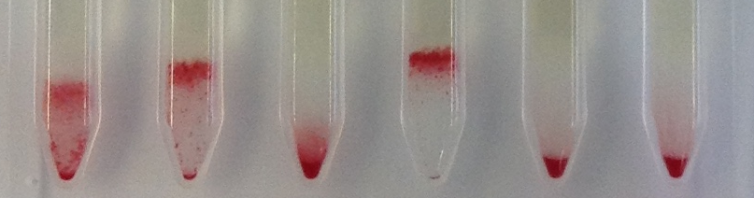
Preparation of ASKG-30-kodecytes (∼ 10 mL of 3% cell suspension)
ASKG-kodecytes can be prepared with a range of different antigen strengths (Table 1). Typically the strongest kodecytes required are ASK-30-kodecytes prepared with a 90 μmol/L solution of FSL-ASKG. ASKG-kodecytes with different concentrations of antigen are simply prepared by using different concentrations of FSL-ASKG.
To prepare ASKG-30-kodecytes thaw a 120 μL aliquot of FSL-ASKG (100 μmol/L) stock solution
Prepare three-times washed packed red cells (600 μL of hard-packed cells are required) – note (ii).
Label two clean 5 mL plastic or glass tubes (“ASKG-30-kodecytes” and “unmodified”)
Into the “ASKG-30-kodecytes” labelled tube add 90 μL of FSL-ASKG 100 μmol/L stock solution and 210 μL of RCPS (30 μmol/L) – see also note (iii).
Into the “unmodified” labelled tube add 300 μL of RCPS
Into both tubes add 300 μL of packed red cells
Mix and incubate for 2 hours at 37℃ (with mixing at 1h)
After incubation dilute cell suspensions with RCPS – do not wash
Use immediately or store at 4℃ – note (iv).
Table 1. Dilutions require to make
ranges of kodecytes
Advanced Serologic Kodecytes G (ASKG™) Trial Kit
Cat. no. 074659-ASKG-T2KIT
ASKG-n-kodecytes | Stock solution (μL) | RCPS (μL)
40 | 120 | 180
30 | 90 | 210
25 | 75 | 225
20 | 60 | 240
15 | 45 | 255
10 | 30 | 270
5 | 15 | 285
Notes:
ii. Red cells used should be reasonably fresh (< 1 week). The selection of the red cells are typically group O but can be any blood group depending on other requirements. By using cells with other antigens, e.g. A and/or D then further antibody complexities can be introduced into scenarios.
iii. The concentration of kodecytes required is dependent on the platform being used. The method described above is to prepare 10 mL of the ASKG-30-kodecytes. Different volumes of kodecytes and/or with different levels of ASKG antigen can be prepared by varying volumes and concentrations. See Table 1 for 10 mL variations.
iv. Storage of cells and kodecytes overnight in buffers may marginally improve their agglutination characteristics, presumably due to deformations in shape. As a consequence overnight buffer stored cells may have slightly stronger reactions than cells used immediately after preparation
Preparation of ASKG IgG-predominant antibody samples
You will need to provide your own serum and/or plasma samples and initially screen them against ASKG-kodecytes to determine antibody status. Using strong (20-40 μmol/L) ASKG-kodecytes to screen random donors it is expected that ∼10-30% of samples will be antiglobulin (IgG) reactive of which some may also be saline reactive (see notes iii & v). After screening samples you will have a range of samples that are reactive and unreactive against ASKG-kodecytes. Different samples will have different concentrations of anti-ASKG (Figure 1) and therefore a selection of samples (or dilutions of them) are required to give different reaction grades against a kodecyte of a single concentration. Variations of reactivity of a single sample is achieved by using kodecytes of different concentrations. Samples reacting strongly with ASKG-40-kodecytes will react weaker with ASKG-20-kodecytes and ASKG-10-kodecytes.
Prepare strong (20-40 μmol/L) ASKG-kodecytes
Test against undiluted serum or plasma samples by standard serological methods (Figure 1)
Identify positive and negative samples giving desired reactions
Conduct additional testing of positive reactive samples against ASKG-kodecytes of other strengths (optional)
Label and store aliquots of positive and negative samples
2 × 0.19mg FSL-ASKG-SC2-L1
For research use only
Notes:
v. As the strength of the kodecytes is increased (i.e. prepared with stronger FSL-ASKG concentrations) then more reactivity will be observed. Different platforms will show differences in sensitivity.
Figure 1. Typical reactions of random donor samples against strong ASKG-(4+)-kodecytes in CAT.
Preparation of ASKG screening and antibody identification training panels – (not for clinical or diagnostic use)
By arranging ASKG-kodecytes as an antibody screening or identification panel along with unmodified cells (ASKG negative) specific antibody reactivity patterns can be created. The order of the ASKG-kodecytes and unmodified cells in the ID panel format will represent antibody specificity, while the reaction strength for each sample will be sample dependent but can also be controlled by using kodecytes with more or less antigen e.g. ASKG-(2+)-kodecytes vs ASK-(4+)-kodecytes (See Supplementary Notes for further preparation notes and examples)
LIMITATIONS OF PROCEDURE & PRECAUTIONS
Do not use in an environment where there is a risk of accidental diagnostic/clinical use
Do not mix kodecytes with unmodified cells as antigen transfer may occur during long term storage.
Different platforms and ionic strength solutions may show variations in sensitivity
Antibody induced haemolysis may be seen with serum samples (use plasma to avoid hemolysis if desired)
FSL-ASKG constructs may show variable results with different enzymes (modify after enzyme treatment)
FSL-ASKG constructs require no handling precautions,
ASKG-kodecytes and plasma/serum samples should be handed with normal blood precautions
Handle and store kodecyte as normal red cells, but avoid storage buffers with lipids/detergents

