Slide 1
Teacher professional learning and development for a future-oriented education system
– a “wicked problem”?
Jane Gilbert (AUT University) & Ally Bull (NZCER)
Paper presented to the joint conference of the
Australian Association for Research in Education (AARE)
and the New Zealand Association for Research in Education (NZARE)
Queensland University of Technology, Brisbane
3rd December 2014

Slide 2
Plan
Background
  future-oriented education ‘story’
  ‘problem’
The project
  preliminary findings
Issues

Slide 3

Future-Oriented Education – last 10-15 years....
The world has changed forever.
Education hasn’t kept up.
Major change is needed.
System change is needed, not “school improvement”
Today’s system was set up to meet 20th century, Industrial Age needs
We’re now in the Network or Knowledge Age
Things are different
Why?
Notes:
Story produced via international body of work – by OECD and number of influential writers, most of whom not education academics...
Story reified in policy rhetoric – curriculum statements etc – largely uncritically.
But practice goes on much as usual...
Story goes like this....

Slide 4


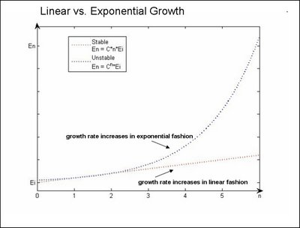
Why change is needed – the usual gloss …
The system needs to do better …
- need higher achievement by more students
- need nearly everyone to be “tertiary ready”
2. Globalised economic change
→ intense focus on knowledge
    knowledge has a new meaning
The digital revolution
  exponential growth in power and reach of digital technologies

Slide 5


BUT...
1. Many people think future-focused education means doing more or less what we do now - but with better technology …
Digital pedagogies
Modern Learning Environments
Digital resources
Connected learning …
MOOCS
Khan Academy
Flip the Classroom
2. All the focus on students’ learning needs
  little work on demands this places on teachers
  educated in 20th century system
  teachers being asked to imagine/create a system
  way outside their experiences and/or ways of knowing.

Slide 6
The problem
“future-oriented” education – sloganised, superficial
  - uncritically accepted (or rejected)...
much of what is happening under this banner
likely to make things worse, not better ...e.g....
  exacerbate existing inequalities
  reduce opportunities for epistemic progress - breadth not depth
→ Teachers need access to opportunities to think critically about “future-oriented education discourse
  3 levels ....
    functional/decoding
    cultural
    critical

Slide 7
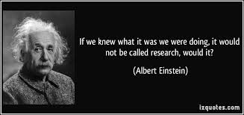
Research project “On the Edge”
small pilot 2012 7 participants
funding (TLRI) 2 years (2013-14)
  now 33 participants
Part 1: Teacher PLD programme
  University Masters level course (Educational Futures)
      students enrolled invited to participate in research project
  Workshop on adult development
Part 2: Research project
  Interviews before course, immediately after course, & a year later
  Monthly “double loop” reflections
  In-course observations
  Interviews with PLD providers.

Slide 8
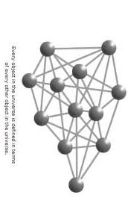
Action research
long-term relationships
    researchers — PLD providers —participants
multiple parts - inextricably connected
“Object/s of Inquiry” ...
∆ teachers’ thinking
→ relationships → networks → systems
“informational” vs “transformational” learning
teachers experiencing kinds of thinking they are supposed to be providing for their students

Slide 9
What did we find out?

Slide 10
Was the PLD transformative?
I don’t think it’s changed me except that it’s given me more ammunition and an authority to speak and a passion to speak – a sense of urgency of the need to keep talking about this and begin some action.
It’s actually shifted my whole perspective on the world.
I’m not the same person I was 8 weeks ago.
Notes:
Participants were asked; “Have you found yourself thinking, engaging or acting differently?
For a few it clearly wasn’t transformative but still considered a worthwhile experience.
The majority though believed it had been transformative in some way.

Slide 11
How did participants feel about the PLD?
...as painful as it was I really, really valued that.
It’s scary – it’s fun but it’s scary!
It’s exciting but it’s doing my head in!
It’s daunting – and fascinating
I swing from being absolutely frozen to absolute excitement.
Notes:
Those who reported it to have been transformational all held these conflicting emotions about the course. When talking about the future of education they also positioned themselves as explorers- not knowers. More comfortable with uncertainty.
Those who did not indicate it was transformational either said things like it was exciting, energising or it was frustrating or did not express any emotion. Much more likely to think the course had given them confidence to tell people stuff.

Slide 12
Helpful components of PLD
Journal reflections on the “readings”
To read it to the level where I could review it and form an opinion on it that was quite a big step in terms of making me think about things, making me challenge my own thinking.
Work load
It’s like running a marathon
Opportunities to discuss ideas with others
Notes:
Related to the reflections were comments about the importance of going into things in depth. All talked about the work load - For some the work load was just too big but others recognised this as an essential part of the course.
Opportunities to discuss ideas – opened up new perspectives and helped clarify own. Gina’s quote
Nobody mentioned that the course itself set out to give the adults the sort of learning experiences we say are important for students. This is something that could be picked up on as a next step. Perhaps some sort of “split screen” thinking where the teacher makes explicit her intentions.

Slide 13
Acting differently
It’s quite challenging to do when a school culture is already quite successful
I’m aware that I’m no longer being challenged and that feels dangerous. I’m worried I won’t continue to examine ideas critically and I will slip unwillingly towards complacency.
Notes:
Range of experiences here – from lots of power to virtually none. This didn’t seem to be limited just to position in school.
Keeping the momentum going when returning to school also hard – helps to have supports but having more than one person from the school attending was not always as positive an experience as we thought it might be. For example it could up set power dynamics (eg Gina) and Ngaire got worried staff were becoming “evangelical” and putting others off! Some who were working on their own in schools were able to develop and sustain extensive networks that nurtured their growth.
Initially we focused on individual growth and development but as project developed we became much more interested in interactions between people and the systems.

Slide 14

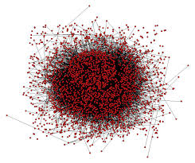
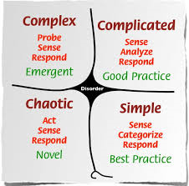
Shift in project over time …
Tracking individual thinking processes
↓
Participants individual agents/actors in a system - that they are constructed by, but also contribute to …
↓
Education as complex system
- “spaces between” parts
- possibility of emergence
Have we achieved what we set out to do..?
Not really ... project has produced more questions than answers...

