Slide 1
Minor Parties and Employment Relations Policy Change: The New Zealand Experience
Julienne Molineaux and Peter Skilling
AUT University

Slide 2
Why Study Minor Parties?

Slide 3
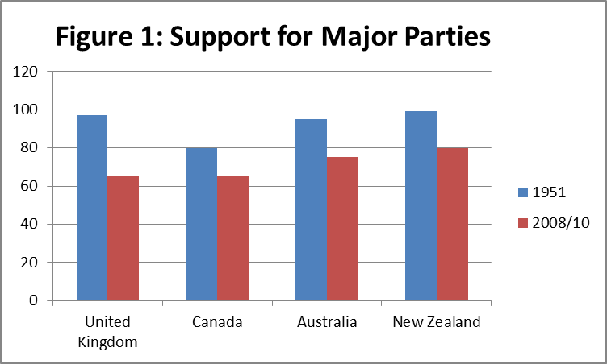
Source: Brenton (2013)

Slide 4
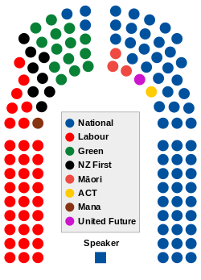

Slide 5
Three Key Variables
The Nature of the Electoral System: what avenues exist for minor parties to gain votes and achieve office?
The Bargaining Power of Minor Parties: how reliant will the major party be on the minor party to advance its agenda?
The Policy Priorities of Minor Parties: how important is it to the third party to influence ER policy? How central is ER policy to the party’s branding and voters and activists?

Slide 6
“Surplus Majority” Governing Arrangements since 2008
 | 2008 election | 2011 election
Votes needed to pass legislation | 61 | 61
National | 58 | 59
Act | 5 | 1
Māori | 5 (4)* | 3
United Future | 1 | 1

Slide 7
Table One: Summary of ER Positions of the Minor Parties, 2008-2011
 | ER policy closest to: | Number of MPs | ERA Bill (No. 2) | Holidays Amendment Bill | ERA (Film Production Work) Bill | Minimum Wage | Youth Minimum Wage
ACT Party | National | 5 | Support | Support | Support | Opposed to increases to minimum wage and sceptical of the very concept | Support
Green Party | Labour | 9 | Oppose | Oppose | Oppose | Increase “to 66% of the average wage, with an immediate increase to $15 an hour” | Oppose
Maori Party | Labour | 4 | Oppose | Oppose | Support (3 votes only) | Increase to $15/hour | Oppose
Mana Party | Labour | 1 | Oppose | Oppose | Oppose | Increase to $15/hour, and to 2/3 of the average wage by April 2013 | Oppose
NZ First | Labour | - | - | - | - | Increase to $15/hour | Unclear
United Future | National | 1 | Support | Support | Support | Unclear | Unclear
Source: Skilling & Molineaux (2011)

Slide 8
National and the Maori Party: 2008-2014
 | 2008 election | 2011 election
Votes needed to pass legislation | 61 | 61
National | 58 | 59
Act | 5 | 1
Māori | 5 (4)* | 3
United Future | 1 | 1

Slide 9
 | ER policy closest to: | Number of MPs | ERA Bill (No. 2) | Holidays Amendment Bill | ERA (Film Production Work) Bill | Minimum Wage | Youth Minimum Wage
ACT Party | National | 5 | Support | Support | Support | Opposed to increases to minimum wage and sceptical of the very concept | Support
Green Party | Labour | 9 | Oppose | Oppose | Oppose | Increase “to 66% of the average wage, with an immediate increase to $15 an hour” | Oppose
Maori Party | Labour | 4 | Oppose | Oppose | Support (3 votes only) | Increase to $15/hour | Oppose
Mana Party | Labour | 1 | Oppose | Oppose | Oppose | Increase to $15/hour, and to 2/3 of the average wage by April 2013 | Oppose
NZ First | Labour | - | - | - | - | Increase to $15/hour | Unclear
United Future | National | 1 | Support | Support | Support | Unclear | Unclear
Labour and the Green Party: 2014 (??!)

