Slide 1
The concatenation of meaning and power: A photo-essay of asymmetries in the communication process
Antonio Díaz Andrade
Auckland University of Technology, New Zealand

Slide 2
Motivation
The introduction of computer technology in communities, which have been historically disenfranchised, can
  Reproduce traditional forms of hierarchical communication that reinforce the position of powerful players
  Create new communicative relationships among members of the community
Dynamic interplay between systems of symbols and power relations in the communication process
How does the interplay between meaning and power influence the communication process in rural communities?
SIG GlobDev 9th Annual Workshop | 10/Dec/2016
Dublin, Ireland

Slide 3
Communication
Communication reduces ambiguity (Dervin, 1977)
  Without communication “men wouldn’t be able to live, or their lives would be precarious, poverty-stricken, and perpetually threatened” (Foucault, 1994b, p. 319)
Communicating information is an “explicit encouragement or discouragement of certain action” (King, 1994, p. 4)
  The sender of information conveys meaning in a way that orients the behavior of the receiver (Weber, 1947)
Communication is a materially and socially mediated goal-oriented practice (Engeström, 2015)
  Material properties manifest through conventions and technical artefacts
  Social practices govern the distribution of information (Kapitzke, 2003)
Computer technology has not modified the intrinsically situatedness nature of the communication process (Lamb & Kling, 2003)
  Social relations invariably shape the consequences of computer-mediated information (Brown & Duguid, 2002; Kallinikos, 2006)
SIG GlobDev 9th Annual Workshop | 10/Dec/2016
Dublin, Ireland

Slide 4
Meaning
Communicating meaning orally is immediate yet ephemeral
  “Writing constitutes an essential stage in the … fashioning of accepted discourses, recognized as true, into rational principles of action” (Foucault, 1994c, p. 209)
Inscribing information into formalized conventions makes possible traversing the abstract nature of its content (Sokolov, 2010)
  The use of symbols makes possible the separation between meaning and how it is formulated (Kress & Van Leeuwen, 2001)
The semiotic and interactive properties of computer technology blur the lines between the sign maker and the audience
  “The affordance of the new technologies of representation and communication enable those who have access to them to be ‘authors’ of a new kind …. to produce texts, to alter texts and to ‘write back’” (Kress, 2003, p. 173)
In ICT4D initiatives context matters
  “Context is inextricably interlinked with issues of power and who gets to speak for whom” (Hayes & Westrup, 2012, p. 27)
SIG GlobDev 9th Annual Workshop | 10/Dec/2016
Dublin, Ireland

Slide 5
Power
The production and diffusion of meaning that governs social actions are subject to power
  Power sets the tone of discursive practices that encourage or discourage certain actions (Foucault, 1994e)
  Relations of power can manifest not in spite of freedom but through freedom (Foucault, 1994a)
Information exchange follows a predominantly unidirectional flow
  Asymmetry in the flow of information engenders the accumulation of symbolic capital (Bourdieu, 1984)
Actors can exploit the interactive properties of computer technology to influence the construction of meaning (Castells, 2009)
  ICT4D initiatives are not immune to power imbalance (Kleine & Unwin, 2009)
The construction of meaning and the exercise of power constitute an inextricable dyad
  “Power relations are exercised, to an exceedingly important extent, through the production and exchange of signs; and they are scarcely separable from goal-directed activities that permit the exercise of a power” (Foucault, 1994d, p. 338)
SIG GlobDev 9th Annual Workshop | 10/Dec/2016
Dublin, Ireland

Slide 6
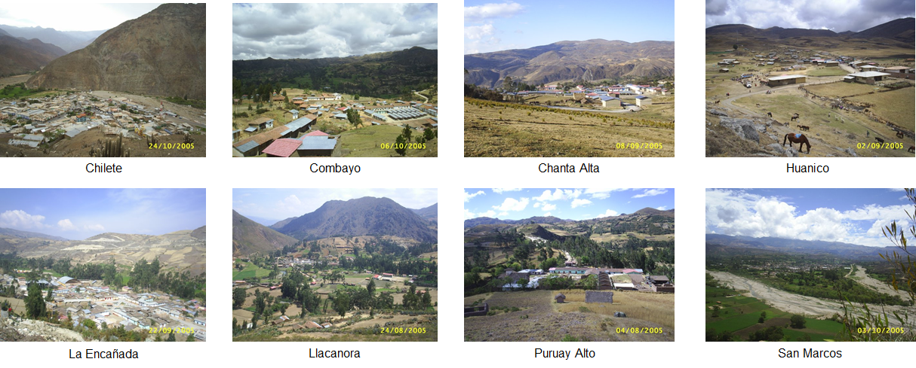
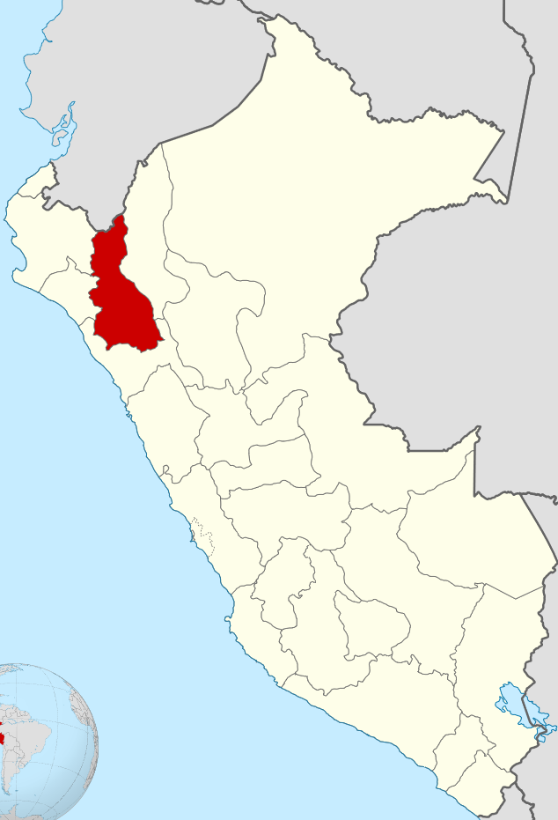
Fieldwork and data collection
Between July and November 2005:
36 in-depth, one-on-one interviews with infocentro users, managers as well as project sponsors
200+ pages of field notes
165 photographs
SIG GlobDev 9th Annual Workshop | 10/Dec/2016
Dublin, Ireland

Slide 7
Photo-essay
Mixed approach:
  Opportunistic photographing (Pauwels, 2010)
  Disgressive search (Sorenson & Jablonko, 1995)
Minimization of obtrusiveness (Pauwels, 2010)
Photographs as “epistemic objects” (Ewestein & Whyte, 2009)
  Interpretation supported by a flow of ideas triggered by observing the photographs
  Interpretation of both content and socio-cultural context in which they were produced (Banks, 2001; Rose, 2012)
Photographs show idiosyncratic traits that can hardly be communicated with words and numbers (Tardy, 2005)
  To provoke a sensory reaction on the reader/viewer
Thoughtful selection of photographs
  What elements of participants’ world was captured
  How elements of participants’ worId was represented
SIG GlobDev 9th Annual Workshop | 10/Dec/2016
Dublin, Ireland

Slide 8
The context

Slide 9
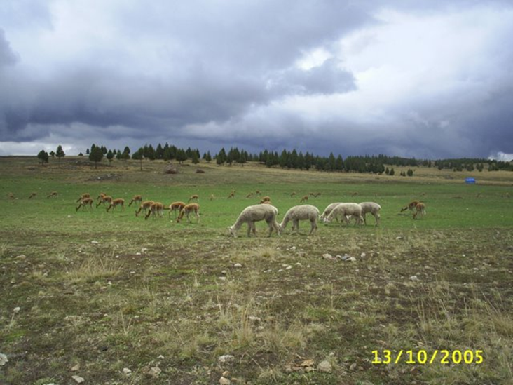
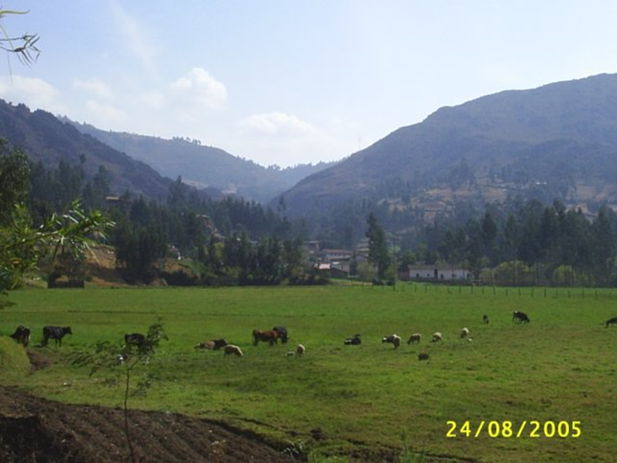
Pre-Hispanic times: alpacas and vicuñas
Today: cows and sheep
SIG GlobDev 9th Annual Workshop | 10/Dec/2016
Dublin, Ireland

Slide 10
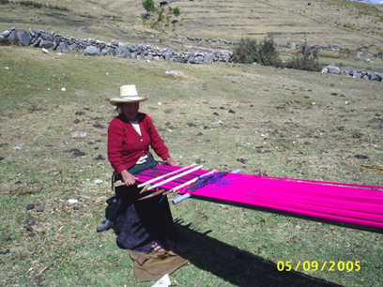
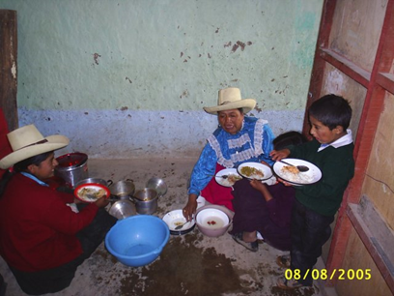
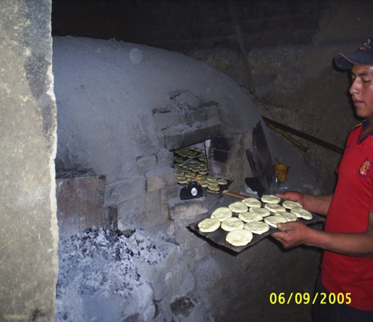
Brick oven bakery
Traditional weaving
Modest family lunch
SIG GlobDev 9th Annual Workshop | 10/Dec/2016
Dublin, Ireland

Slide 11
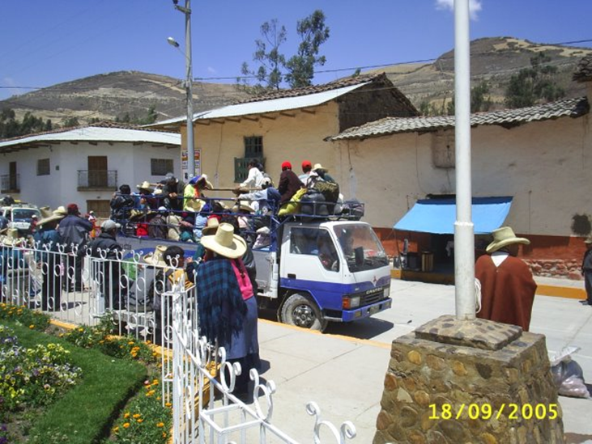
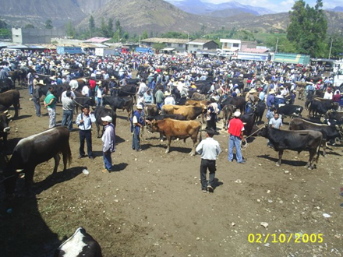
Public transport
Weekly open-air market
SIG GlobDev 9th Annual Workshop | 10/Dec/2016
Dublin, Ireland

Slide 12
Meaning and power in the communication process

Slide 13
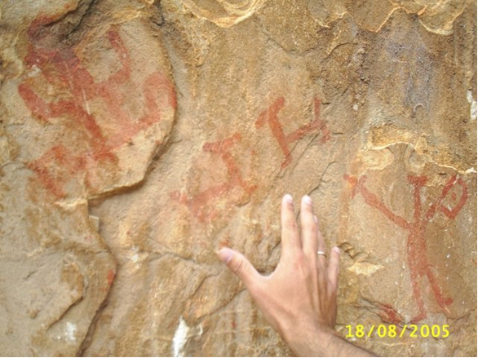
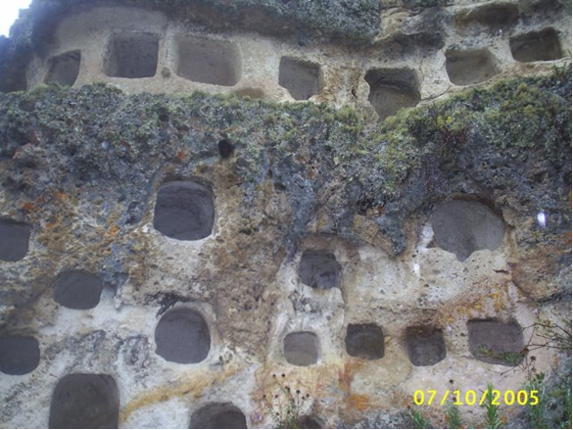
Qayaqpuma rock painting (8,000 B.C)
Combayo necropolis (1,500 B.C.)
SIG GlobDev 9th Annual Workshop | 10/Dec/2016
Dublin, Ireland

Slide 14
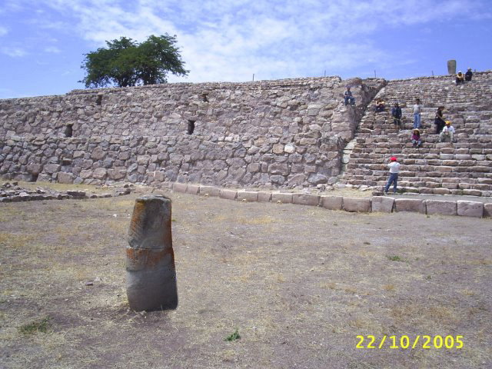
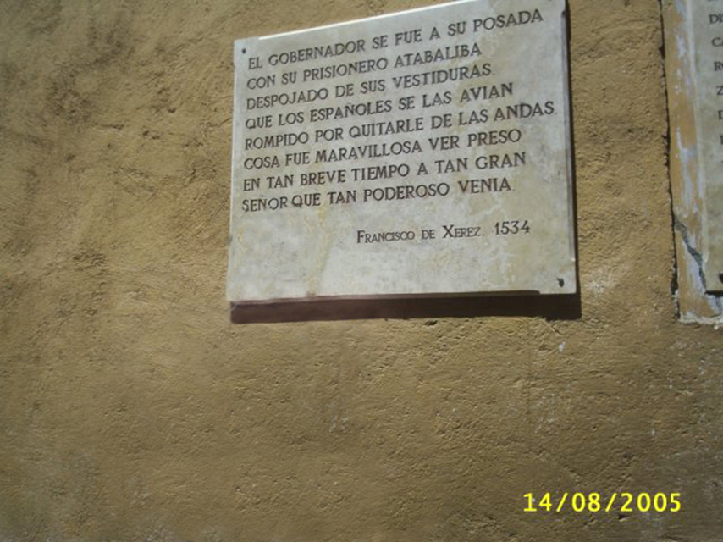
Kuntur Wasi ceremonial center (900-500 B.C)
Ransom room (1,532 A.D.)
SIG GlobDev 9th Annual Workshop | 10/Dec/2016
Dublin, Ireland

Slide 15
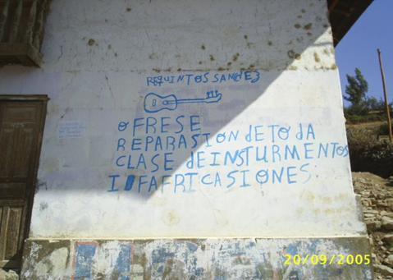
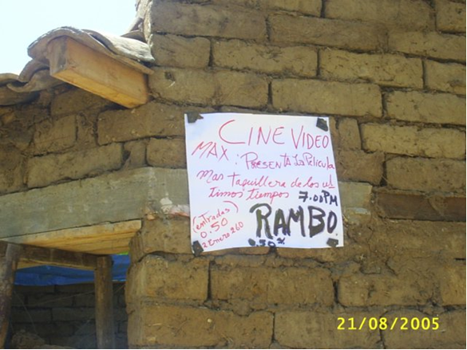
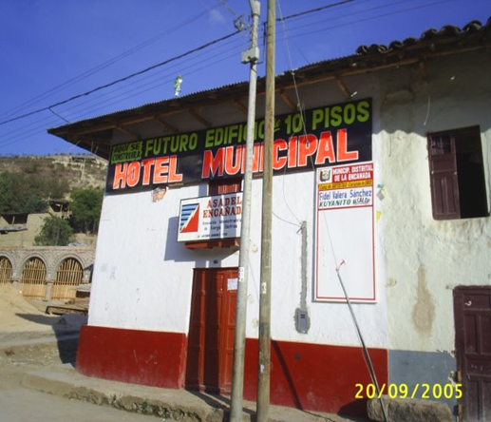
Council banner
Musical instruments repair ad
Movie ad
SIG GlobDev 9th Annual Workshop | 10/Dec/2016
Dublin, Ireland

Slide 16
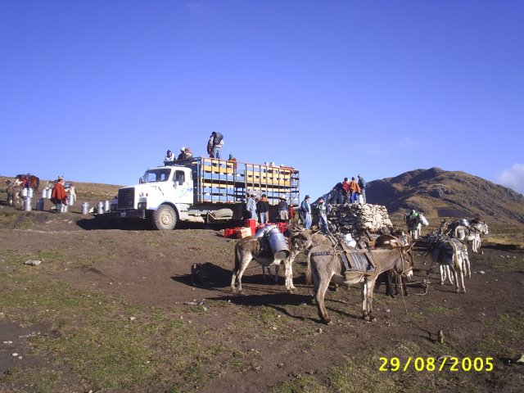
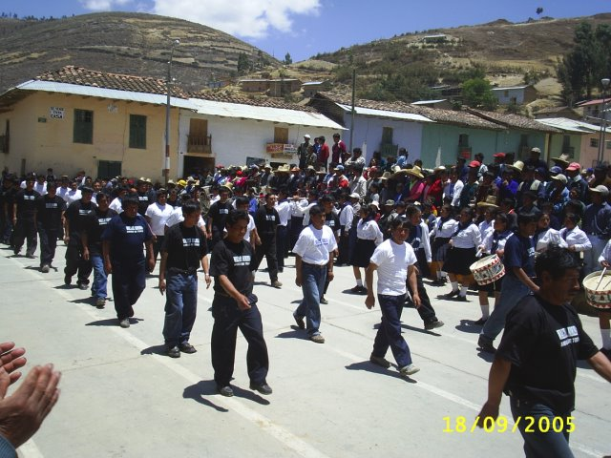
The informal messenger
The formal messenger
SIG GlobDev 9th Annual Workshop | 10/Dec/2016
Dublin, Ireland

Slide 17
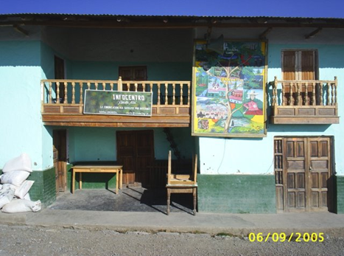
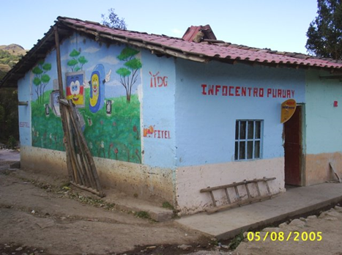
Chanta Alta infocentro
Puruay Alto infocentro
SIG GlobDev 9th Annual Workshop | 10/Dec/2016
Dublin, Ireland

Slide 18
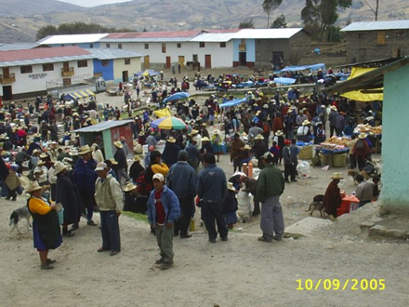
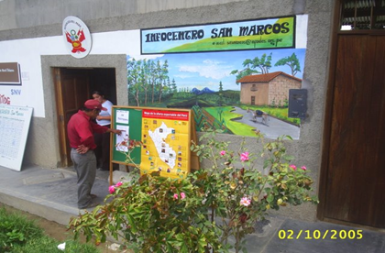
Infocentro’s loudspeaker
Infocentro’s pinboard
SIG GlobDev 9th Annual Workshop | 10/Dec/2016
Dublin, Ireland

Slide 19
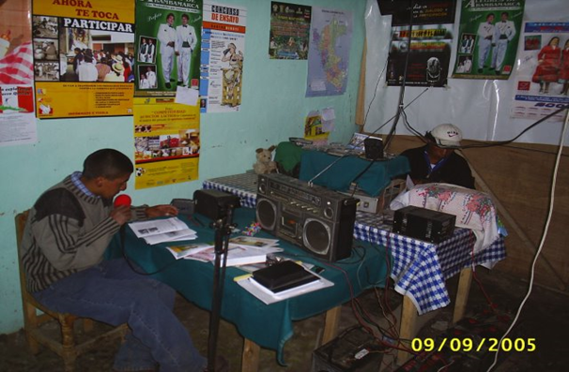
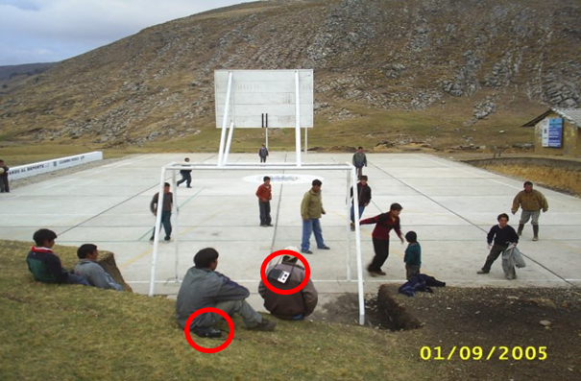
Infocentro’s message broadcast sender
Infocentro’s message broadcast receivers
SIG GlobDev 9th Annual Workshop | 10/Dec/2016
Dublin, Ireland

Slide 20
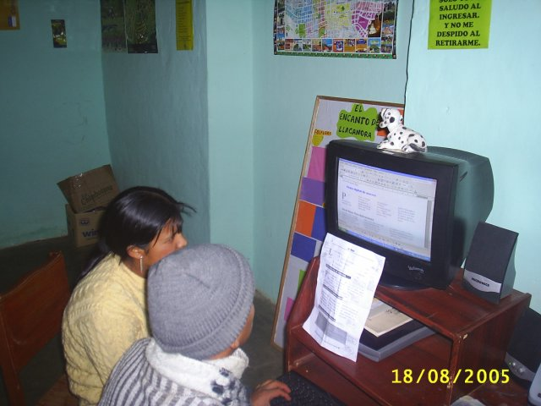
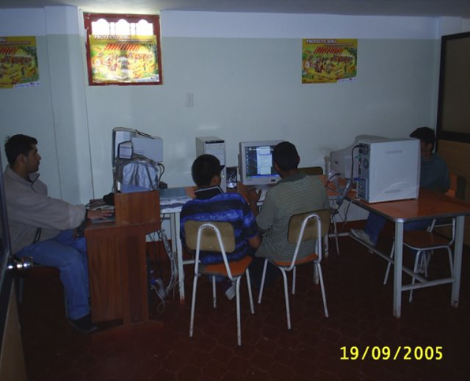
The visible more knowledgeable
The invisible more knowledgeable
SIG GlobDev 9th Annual Workshop | 10/Dec/2016
Dublin, Ireland

Slide 21
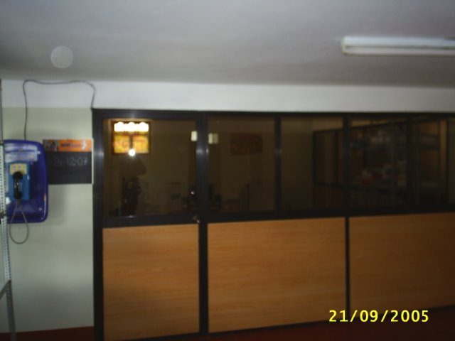
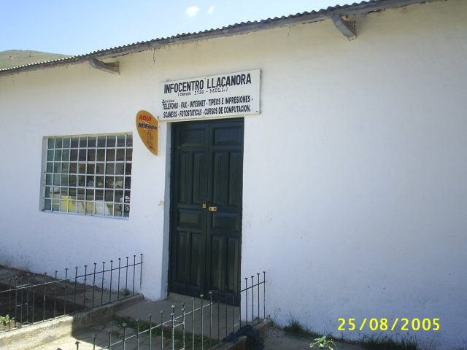
Control on the access of ICT resources
Control on the access to ICT resources
SIG GlobDev 9th Annual Workshop | 10/Dec/2016
Dublin, Ireland

Slide 22
Discussion
Vertical asymmetric communication
Meaning
Power
Meaning
Power
Horizontal asymmetric communication
SIG GlobDev 9th Annual Workshop | 10/Dec/2016
Dublin, Ireland

Slide 23
Theoretical contribution
The coexistence of vertical and horizontal asymmetries in the communication process in rural communities
The introduction of computer technology has:
  Contributed to the democratization of information consumption and production
  Created new, emergent structures of power within ordinary people – unintended consequences of technological intervention (cf. Kleine & Unwin, 2009)
SIG GlobDev 9th Annual Workshop | 10/Dec/2016
Dublin, Ireland

Slide 24
Methodological contribution
The reader/viewer invited to inspect the photographs directly
  To provoke a sensory response
Photo-essay as a genre to be implemented in ICT4D research (cf. Gomez & Vannini (2015), Nemer (2013))
SIG GlobDev 9th Annual Workshop | 10/Dec/2016
Dublin, Ireland

Slide 25

