Slide 1
Machinations in Fleet Street:
Roy Thomson, Cecil King, and the creation of a magazine monopoly
Howard Cox and Simon Mowatt
ABH Annual Conference
UCLAN 27-28 June 2013
Notes:
Paper draws on the research undertaken for our business history of Britain’s magazine industry
A major turning point for the industry occurred in the late 1950s when a period of rapid firm consolidation led to the emergence of IPC as the dominant firm
Research sought to analyse why such a clear monopoly position was allowed to emerge

Slide 2
Leading English Magazine Publishers Jan 1957
ODHAMS PRESS
Daily Herald
The People
Woman
Illustrated
HULTON PRESS
Picture Post
AMALGAMATED PRESS
Daily Telegraph
Woman’s Weekly
Woman’s Illustrated
Everybody’s
Southern Television
GEORGE NEWNES
Woman’s Own
Tit-Bits
Notes:
Other than DC Thomson in Dundee, by the late 1950s Britain’s magazine industry was dominated by 4 firms, two of which owned newspapers along with many leading magazine titles (Blue = General Mags; Red -= Women’s)
This “collusive” oligopoly was facing two significant problems:
increased competition from other media for advertising revenue which affected general magazines in particular
power of the printing unions leading to rising labour costs
Only in Scotland, where DC Thomson had barred the trade unions and Roy Thomson had introduced working practices that paralled those operating in his Canadian publishing firms, was the problem of industrial relation less of an issue.

Slide 3
Leading English Magazine Publishers Jan 1959
ODHAMS PRESS
Daily Herald
The People
Woman
Woman’s Realm
Illustrated
HULTON PRESS
Picture Post
FLEETWAY PRESS
Daily Mirror
Sunday Pictorial
Woman’s Weekly
Woman’s Illustrated
Everybody’s
Associated Television
GEORGE NEWNES
Woman’s Own
Woman’s Day
Tit-Bits
Notes:
Hulton closed Picture Post in June 1957
In the first half of 1958 Newnes launched Woman’s Day and Odhams launched Woman’s Realm into the weekly women’s magazine market
Response of Amalgamated Press owner Michael Berry was to put his ailing magazine business up for sale in November 1958
Following a bidding war between Odhams and the Mirror it was purchased by Cecil King’s Mirror Group and rechristened it Fleetway Press
King and his leading editor Hugh Cudlipp took steps to revitalise the weekly women’s magazines raising the competitive pressure further

Slide 4
Leading English Magazine Publishers in Jan 1961
ODHAMS PRESS
Daily Herald
The People
Woman
Woman’s Realm
Woman’s Own
Woman’s Day
Tit-Bits
Illustrated
FLEETWAY PRESS
Daily Mirror
Sunday Pictorial
Woman’s Weekly
Woman’s Illustrated
Everybody’s
Associated Television
Notes:
Early in 1959 Odhams appointed Christopher Chancellor from Reuters as its new Vice Chairman who immediately negotiated with Edward Hulton the purchase of Hulton Press which it renamed Longacre Press.
Within a month, Odhams trumped a bid by the News of the World for the George Newnes publishing business, placing Odhams in the position of Britain’s pre-eminent magazine producer
The consolidations allowed for potential tit-for-tat magazine title closures to help rationalise the industry and provide financial consolidation.
On taking over Amalgamated Press, King had closed some leading titles including Everybody’s
In December 1960, King proposed to Chancellor of Odhams a merger of the two firms’ women’s magazines into an Odhams-majority-owned joint venture
Chancellor took the “offer” from King as a veiled takeover threat and sought sanctuary in a white knight.

Slide 5
A Marriage of Convenience
ODHAMS PRESS
Daily Herald
The People
Woman
Woman’s Realm
Woman’s Own
Woman’s Day
Tit-Bits
Illustrated
THOMSON NEWSPAPERS
The Scotsman
Sunday Times
Other newspapers, mainly provincial
Scottish Television
Notes:
Odhams’ white knight was Roy Thomson, whose rapidly-expanding publishing empire was seeking to develop its holdings of newspapers – particularly a national daily such as Odhams’ Daily Herald
Intense negotiations led to the proposal to create the Thomson-Odhams Group in which Roy Thomson would hold the minority controlling interest
In announcing the merger as a done deal, Thomson referred to it as a “Marriage of Convenience” – a very 1960s concept.

Slide 6
A Monopoly of Convenience
ODHAMS PRESS
Daily Herald
The People
Woman
Woman’s Realm
Woman’s Own
Woman’s Day
Tit-Bits
Illustrated
Around 40 magazines
FLEETWAY PRESS
Daily Mirror
Sunday Pictorial
Woman’s Weekly
Woman’s Illustrated
Everybody’s
Over 100 magazines
Associated Television
Notes:
Before the marriage could be consummated, however, King put forward a hostile takeover bid for Odhams , whether or not the merger went through
The effect of this would have meant Thomson losing control of his own company, which King promised would be sold off when the takeover had been completed
The Mirror bid for Odhams raised the spectre of the Daily Herald, 49% owned by the TUC, being absorbed into the much more profitable Daily Mirror
The ownership of the Herald, together with the speed of the changes taking place, acted to bring the machinations into the political sphere

Slide 7
Political considerations
Possible closure of the Daily Herald was more likely in Mirror than Thomson takeover so remedy proposed by King and Cudlipp
Attorney General expressed doubts over value of referring takeover to Monopolies Commission – despite breach of one-third market share – but argued that referral should not be ruled out in advance
Widespread clamour for enquiry was met instead by setting up of Royal Commission to investigate the economic efficiency of the press, notably:
  Trade union power
  Influence of advertisers
Notes:
On the question of the Herald, King and Cudlipp devised a strategy whereby the Mirror pledged not to close the paper for a minimum of seven years
This allayed political concerns amongst sections of the Labour Party
With no power to control mergers, PM Macmillan was advised that reference to the Monopolies Commission, whilst feasible, was likely to be of value given the limited public interest concerns of monopoly in the magazine industry
Following the Mirror’s takeover of Odhams, the clamour for an investigation was met by a decision to establish a Royal Commission of the Press headed by Lord Shawcross of the Shell Oil Corp.
Cabinet files indicate that:
“such an enquiry might bring out facts about restrictive practices by the unions and by the newsprint suppliers, and show how far newspapers [not magazines] were dependent on advertising revenue.”

Slide 8
Conclusions
Magazines given scant attention by Royal Commission
Takeover led to very little change in the range of periodicals produced by the newly formed IPC
Lord Shawcross argued that in the case of the magazine industry “Big was Efficient”
Notes:
Report by the Royal Commission virtually ignored popular magazines in taking evidence
Apart from closing two women’s weeklies, the three magazine publishing entities (Fleetway, Odhams and Newnes) were allowed to continue to operate with relative autonomy under the Mirror’s management

Slide 9
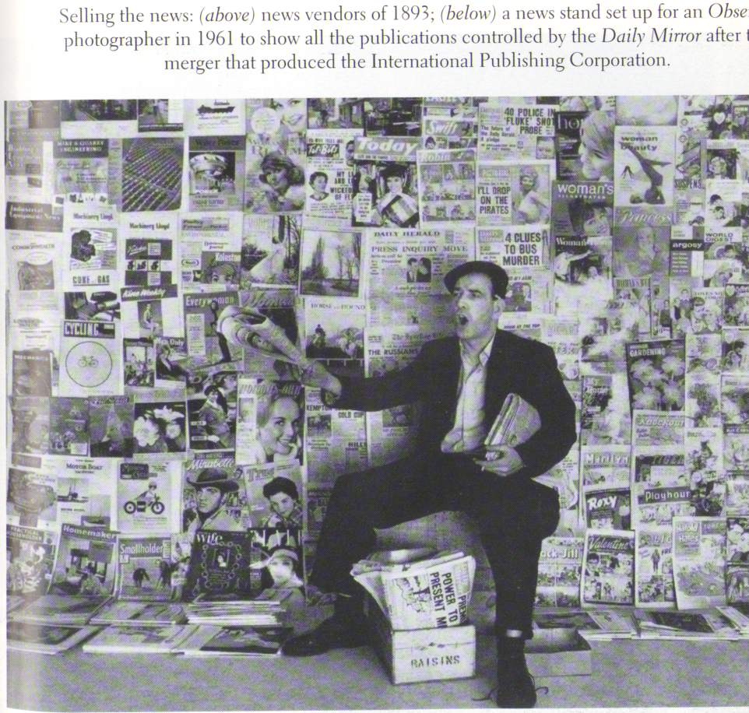

Slide 10
References
Cudlipp, H. (1962) At Your Peril, Weidenfeld and Nicolson, London
King, C. (1969) Strictly Personal, Weidenfeld and Nicolson, London
Thomson, R. (1975) After I was Sixty, Hamish Hamilton, London
CAB 21/5960 Amalgamation of Newspapers, National Archives, Kew

