Slide 1
Evidence for a question: where is the Solomons diaspora?
Richard Bedford
University of Waikato and AUT

Slide 2
A new diaspora for a new century?
2007 – 2011 over 2,000 visas issued to Solomon Islanders for temporary work in New Zealand, most under the Recognised Seasonal Employer Work Policy
2012 Access to Australia’s seasonal work programme extended to Solomon Islands – 8 workers head for Tasmania, January 2013
Will these temporary flows contribute to a rebirth of a diaspora that was arrested over 100 years ago?

Slide 3
Themes
Looking back – a 19th century Solomons diaspora
A disappearing diaspora, 1901-1945
A Pacific population explosion in Australia and New Zealand, 1966-2006
A missing group -- where are the migrants from the Solomon Islands?
A global stock-take around 2000
Developments between 2001 and 2011
Australia’s Solomons population, 2011

Slide 4
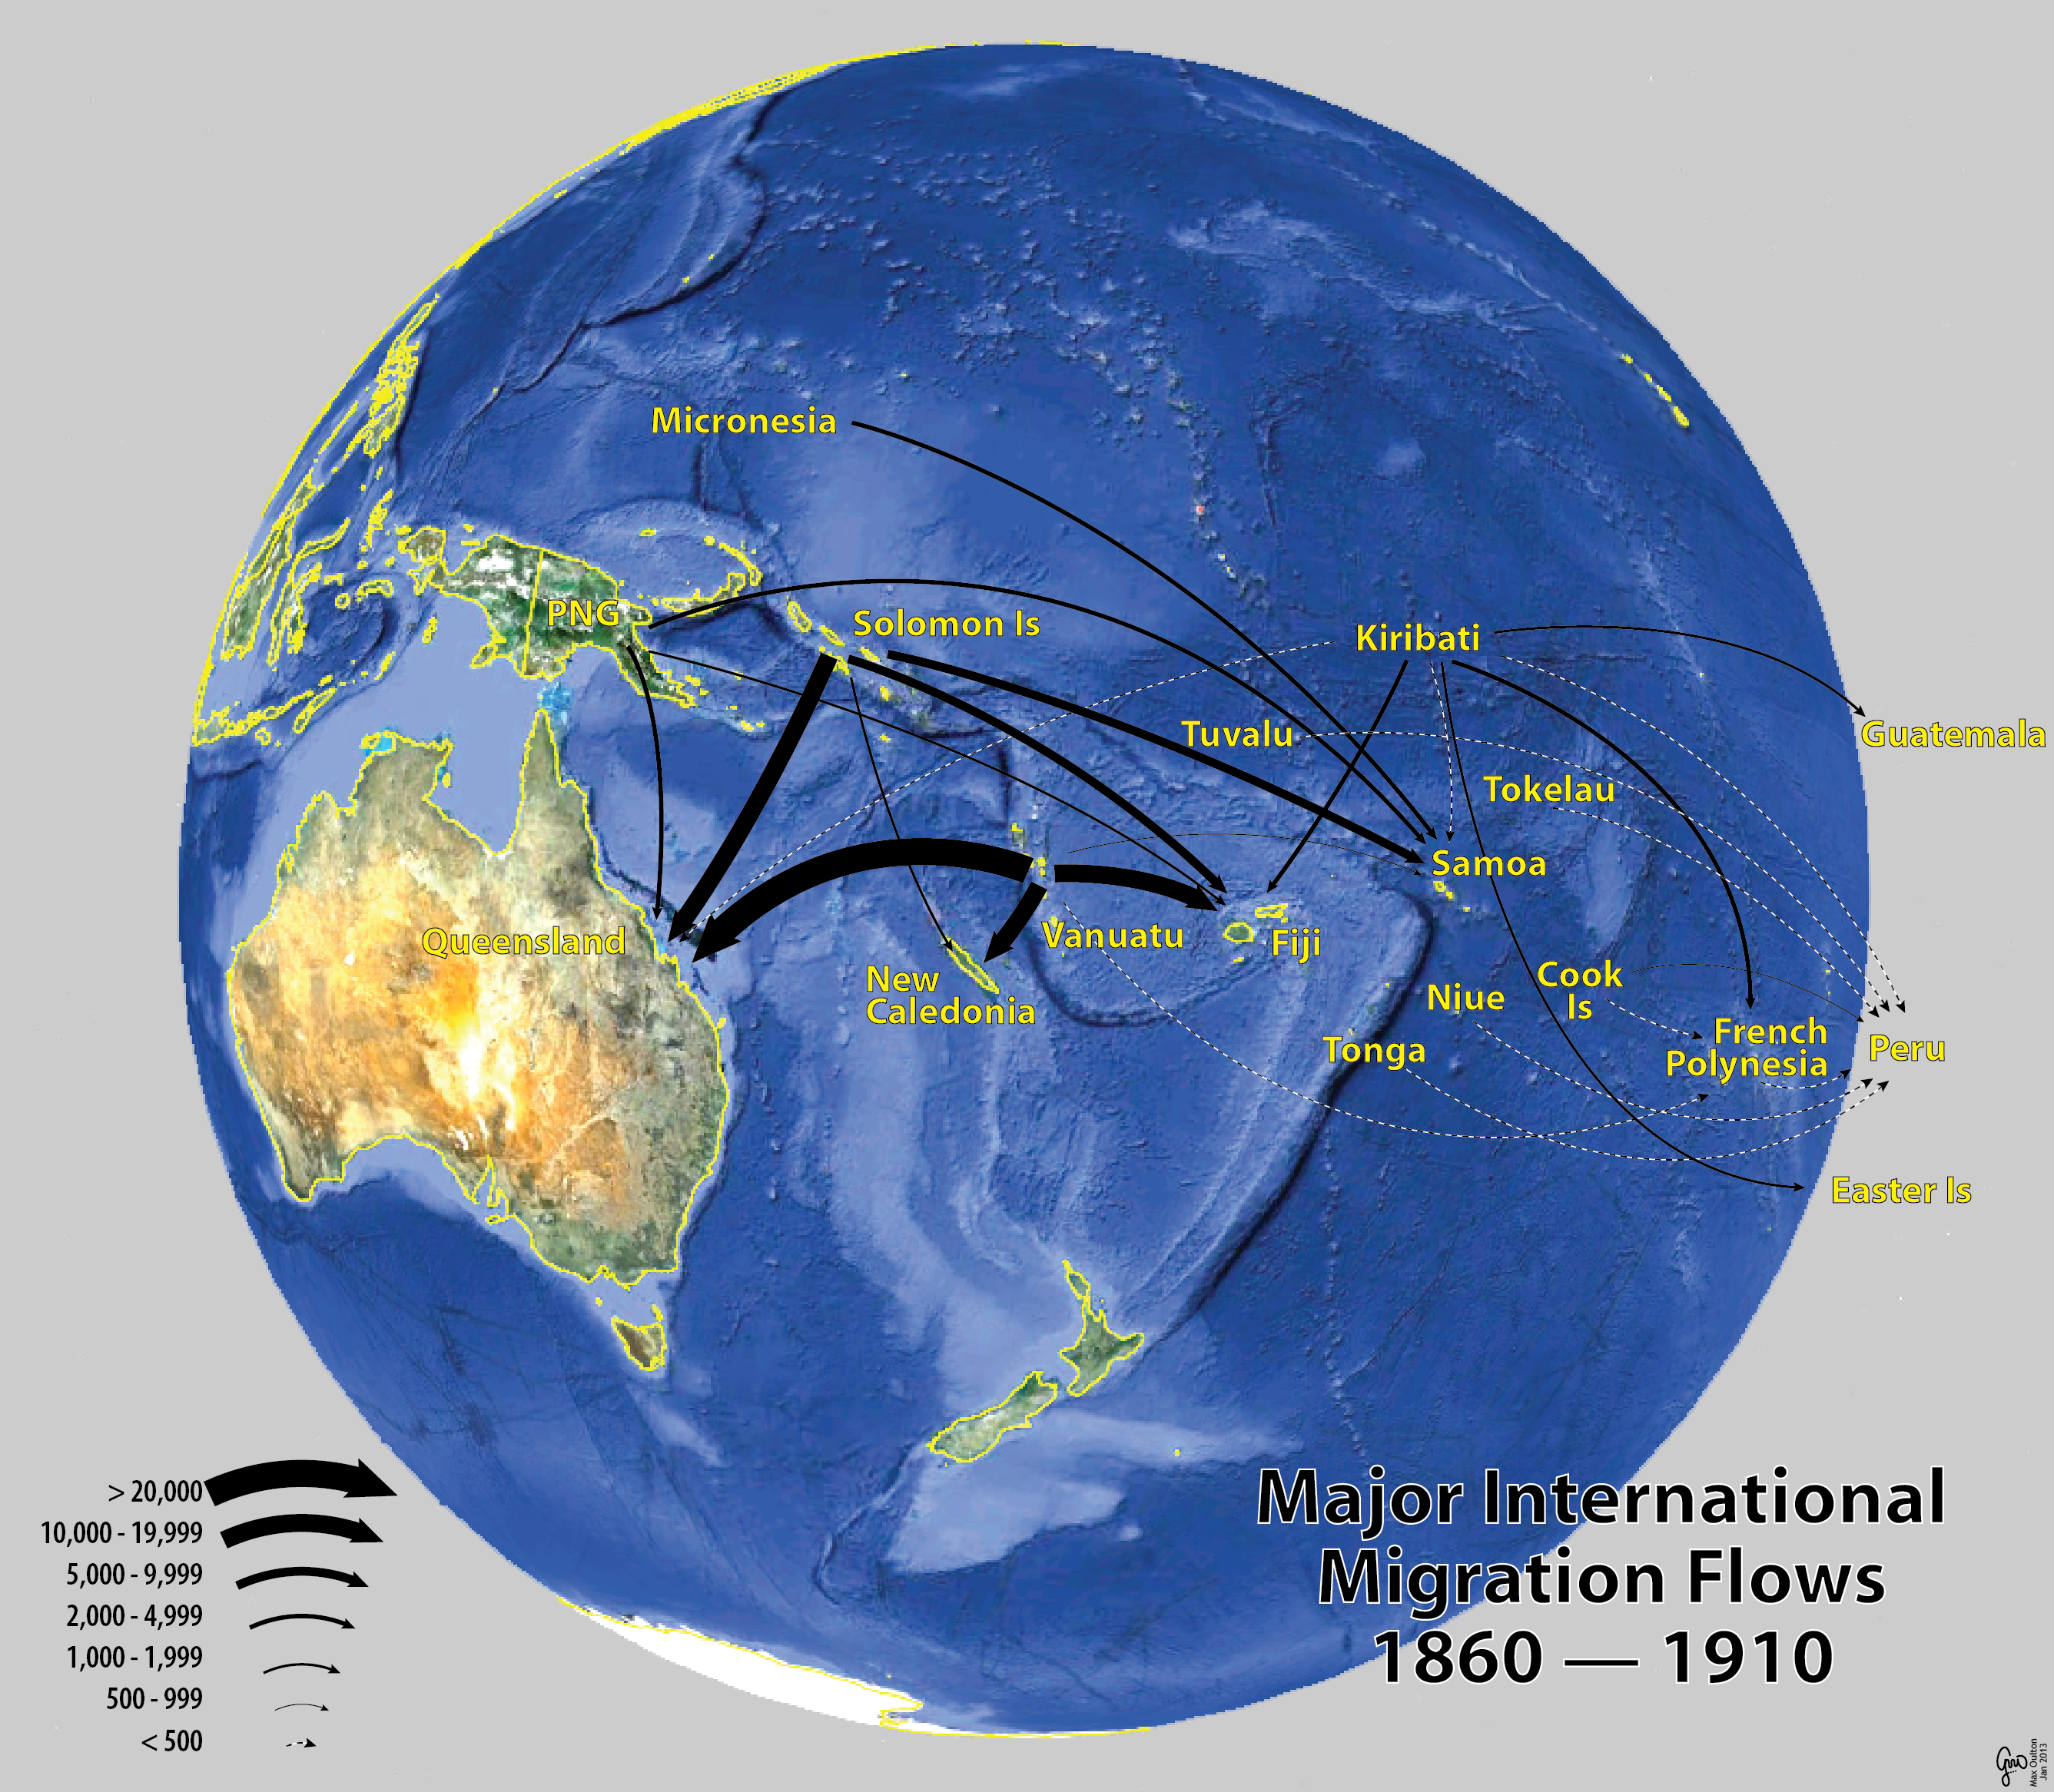

Slide 5
Pacific-born populations, ANZ, 1901-1947
Year | Australia | New Zealand | ANZ
1901 | 10,363 | 403 | 10,766
1911 | 3,410 | 204 | 3,614
1921 | 3,519 | 1,272 | 4,791
1933/36 | 3,510 | 1,737 | 5,247
1945/47 | 4,417 | 3,030 | 7,447

Slide 6
Solomons-born, ANZ, 1901-1947
Year | Pacific | Solomons | % Solomons
1901 | 10,766 | 2,000? | 18.6?
1911 | 3,614 | 210 | 5.8
1921 | 4,791 | 235 | 4.9
1933/36 | 5,247 | 98 | 1.9
1945/47 | 7,447 | 134 | 1.8

Slide 7
Pacific-born populations, ANZ, 1966-1986
Year | Australia | New Zealand | ANZ
1966 | 11,853 | 22,520 | 34,373
1976 | 26,038 | 49,652 | 75,690
1986 | 50,608 | 72,738 | 123,346
1996 | 86,718 | 99,264 | 185,982
2006 | 106,907 | 138,432 | 245,339

Slide 8
Solomons-born, ANZ, 1966-2006
Year | Pacific | Solomons | % Solomons
1966 | 34,370 | 600 | 1.7
1976 | 75,690 | 850 | 1.1
1986 | 123,350 | 1,150 | 0.9
1996 | 185,980 | 1,570 | 0.8
2006 | 245,340 | 2,050 | 0.8

Slide 9
Solomons-born in ANZ as percentage of Solomons population, 1901-2006
Year | Solomons | ANZ | % ANZ
1901 | 110,000? | 2,000? | 1.8
1946 | 110,100 | 130 | 0.1
1986 | 285,200 | 1,150 | 0.4
2006 | 492,700 | 2,050 | 0.4

Slide 10
Solomons Diaspora, 2000-2002
Place of residence | Number | Percent
Other Melanesia | 1,400 | 33.3
Australia/NZ | 1,800 | 42.8
UK/Europe | 490 | 11.7
Asia/Middle East | 250 | 6.0
Americas | 220 | 5.2
Africa | 40 | 1.0
Total diaspora | 4,200 | 100.0

Slide 11
NZ Visa Approvals, Solomon Islanders, 2002-2011 (June Years)
Visa category | 2002-06 | 2007-11 | 2002-11
Residence | 115 | 132 | 247
Study | 800 | 602 | 1,402
Temporary work | 338 | 1,699 | 2,037
Visit | 1,852 | 2,500 | 4,352
Total | 3,105 | 4,933 | 8,038

Slide 12
PLT Migration of Solomon Islanders to ANZ, 2002-06 (June Years)
Flow | Australia | New Zealand | Total
Arrivals | 857 | 383 | 1,240
Departures | 703 | 368 | 1,071
Net gain | 154 | 15 | 169
MER (%) | 7.3 | 2.0 | 7.3

Slide 13
PLT Migration of Fiji Citizens to ANZ, 2002-06 (June Years)
Flow | Australia | New Zealand | Total
Arrivals | 14,555 | 12,087 | 26,642
Departures | 3,693 | 1,760 | 5,453
Net gain | 10,862 | 10,327 | 21,189
MER (%) | 59.5 | 74.6 | 66.0

Slide 14
Solomon Is-Born Populations in Australia and NZ, 2001 and 2006
Year | Australia | New Zealand | Solomon Is
2001 | 1,326 | 505 | 428,000
2006 | 1,498 | 549 | 493,000
Change | + 172 | +42 | +65,000
% change | 8.3 | 12.8 | 15.2

Slide 15
Solomon Is-Born Populations in Australia and NZ, 2006 and 2011
Year | Australia | New Zealand | Solomon Is
2006 | 1,498 | 549 | 493,000
2011 | 1,757 | (705?) | 553,300
Change | + 259 | (+155?) | +60,300
% change | 17.3 | (28.2?) | 12.2

Slide 16
Australia’s Solomons population, 2011
Birth/ancestry | Solomons | Vanuatu | PNG
Born in islands | 1,757 | 1,107 | 26,787
Ancestry | 1,405 | 705 | 15,460
Ancestry+ Is born | 697 | 289 | 8,752
Ancestry+ Aust born | 584 | 377 | 6,294

Slide 17
Age structure of Solomons in Aust, 2011
Age group | Solomons | Vanuatu | PNG | Pacific
0-14 | 13.1 | 8.8 | 7.5 | 6.3
15-24 | 16.9 | 13.4 | 8.7 | 8.9
25-39 | 28.4 | 28.5 | 30.1 | 30.1
40-59 | 36.4 | 34.6 | 44.1 | 43.0
60+ | 5.1 | 14.7 | 9.5 | 11.7
Total | 1,757 | 1,107 | 26,652 | 122,357

Slide 18
Young Adults (15-24), 2010 and 2050 (000’s)
Area | 2010 | 2050 | Difference
Melanesia | 1,658 | 2,757 | 1,099
Micronesia | 96 | 100 | 4
Polynesia | 126 | 129 | 3
New Zealand | 628 | 679 | 41
Australia | 3,147 | 3,671 | 524

Slide 19
Western Melanesia-born in Australia, 2011 as a share of total population in island countries
Country of birth | In Australia | Pop of country | % in Australia
Solomons | 1,757 | 553,200 | 0.32
Vanuatu | 1,107 | 251,800 | 0.44
PNG | 26,787 | 7,200,000 | 0.37
All Pacific | 125,498 | 10,012,400 | 1.25

