Slide 1
ART + BOOK
Symposium, Dunedin 2014
Lesley Kaiser
AUT University
THEME: ‘Art and Book’/‘Against the Odds: The Editing, Design and Production of Books’
The Naughty Nineties movable book prototype (1981), and the paper-engineering roll-on effect in tertiary teaching
Notes:
RECORD
‘Art and Book’/‘Against the Odds: The Editing, Design and Production of Books’
The Naughty Nineties movable book prototype (1981), and the paper-engineering roll-on effect in tertiary teaching

Slide 2
Abstract summary
‘Movable books’ epitomise the work of art in book form
the movable books created by Lesley Kaiser.
The Naughty Nineties [Popup book prototype] for a commercial version + one-off artists books
Paper-engineering incorporated into the Communication Design degree at AUT University
‘How old and new technologies might be combined to retain the best of analogue/interactive books, and how movable books can retain value in a world of growing digital interactivity.’
Notes:
‘Movable books’ is the term that best encompasses the wide range of paper-engineered books, and includes those with pull-tabs, pivots, flaps, and pop-up mechanisms.
Movable books epitomise the work of art in book form and date back many hundreds of years – the first know example was created in the thirteenth century – and it is an art form that is still very much alive today. ‘
This paper looks first at the movable books that I have created, which range from my Naughty Nineties prototype for a commercial version to one-off artists books.
It then looks at how paper-engineering has been incorporated into the Communication Design degree at AUT University, Auckland. It uses as case studies the first-year and second-year Graphic Design papers History, Culture, Context 1 and Elective Project 11.
Lastly, it explores the question ‘How might old and new technologies be combined to retain the best of analogue/interactive books, and how might movable books retain value in a world of growing digitally interactivity.’

Slide 3
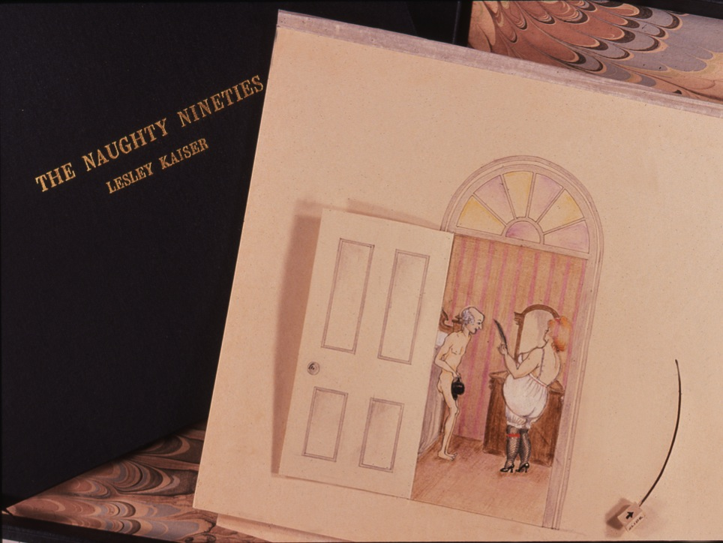
Notes:
This Naughty Nineties final protoype was shown at the Frankfurt BookFair 1981 and was used to pre-sell the commercial version that became an international best seller in 1982.
I came up with the concept back in 1978 when my daughters were young. We had bought one of the new wave of popup books that had just started to be produced. I had a flash of inspiration one night (after a few drinks) that this children’s alphabet book could be adapted to an erotic ADULTS popup book. My husband John Barnett was then publishing books at Penguin books NZ and he immediately saw the potential as a multi-million dollar idea. So I set about teaching myself paper-engineering and illustration and over the next 3 years developed three versions. The first version was an Adults ABC, but the Alphabet format was limited in terms of it’s translation into different languages, and I ended up Creating the Naughty Nineties instead, based on the erotic postcard at the end of the nineteenth century. I was inspired by a book of early erotic Postcards which we also had in our bookshelves. Like so many creative ideas, this one came from combining ideas inspired by two very unconnected books.
Show short 2.5 minute ViDEO of third draft that was sent to the Franfurt book Fair to pre-sell the book

Slide 4
Show Naughty Nineties pop-up book video
This video is also on my website LesleyKaiser.com
Notes:
SHOW VIDEO 2mins 35secs
This video is on my website LesleyKaiser.com
My prototype consisted of a folder with each of the mechanisms in it, and the concertina book of the line drawings for the settings (final colour illustrations happens after the factory adaption of the paper-engineering). This is In the current Exhibition next door.

Slide 5
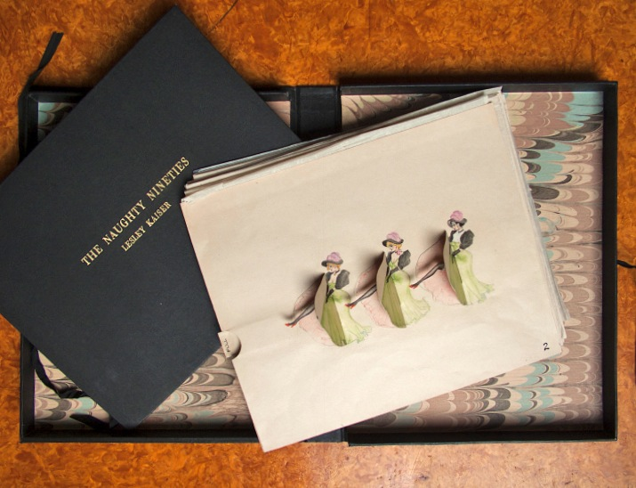
Notes:
Video
I placed this final mockup with Collins publishers as they were the predominant publisher of popup books at the time, and they sent it over to Intervisual Communications, which, in 1981, was the only company world–wide set up to produce the new wave of pop-up books.
To publish a popup book you needed to pre-sell at least 100,000 copies to justify the expensive manufacturing set-up costs of the die-cutting and assembly, so the publishers took it to The Frankfurt Book Fair to get pre-sales for the concept.
I had great difficulty holding onto my author rights, as Intervisual Communications are an American company that had a team of writers, paper-engineers and illustrators governed by unions and all popup books they produced to date were in-house team efforts and they had not been approached before by an outsider.

Slide 6
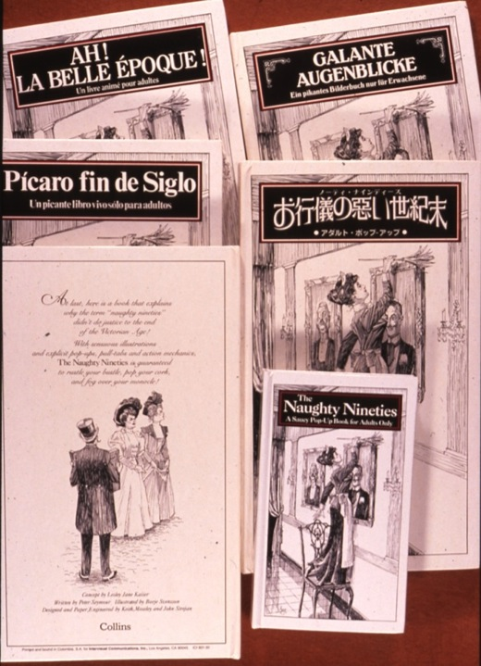
The commercial editions
The Naughty Nineties: A Saucy Pop-up Book for Adults Only
Intervisual Communications
Concept: Lesley Kaiser
Sold over 300,000 copies
Notes:
To cut a long and painful story short, Intervisual took my work and created their own version and added an inane text,
changed the illustrations to the style of American artist Charles Dana Gibson rather than in the style of early French erotic postcard artist Xavier Sager whose work I had based my work on with historical accuracy.

Slide 7
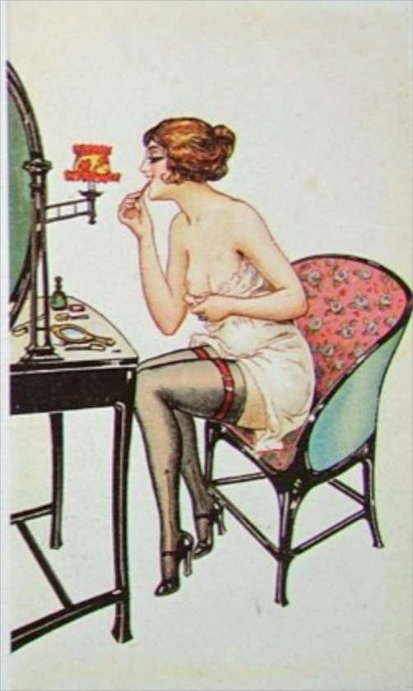
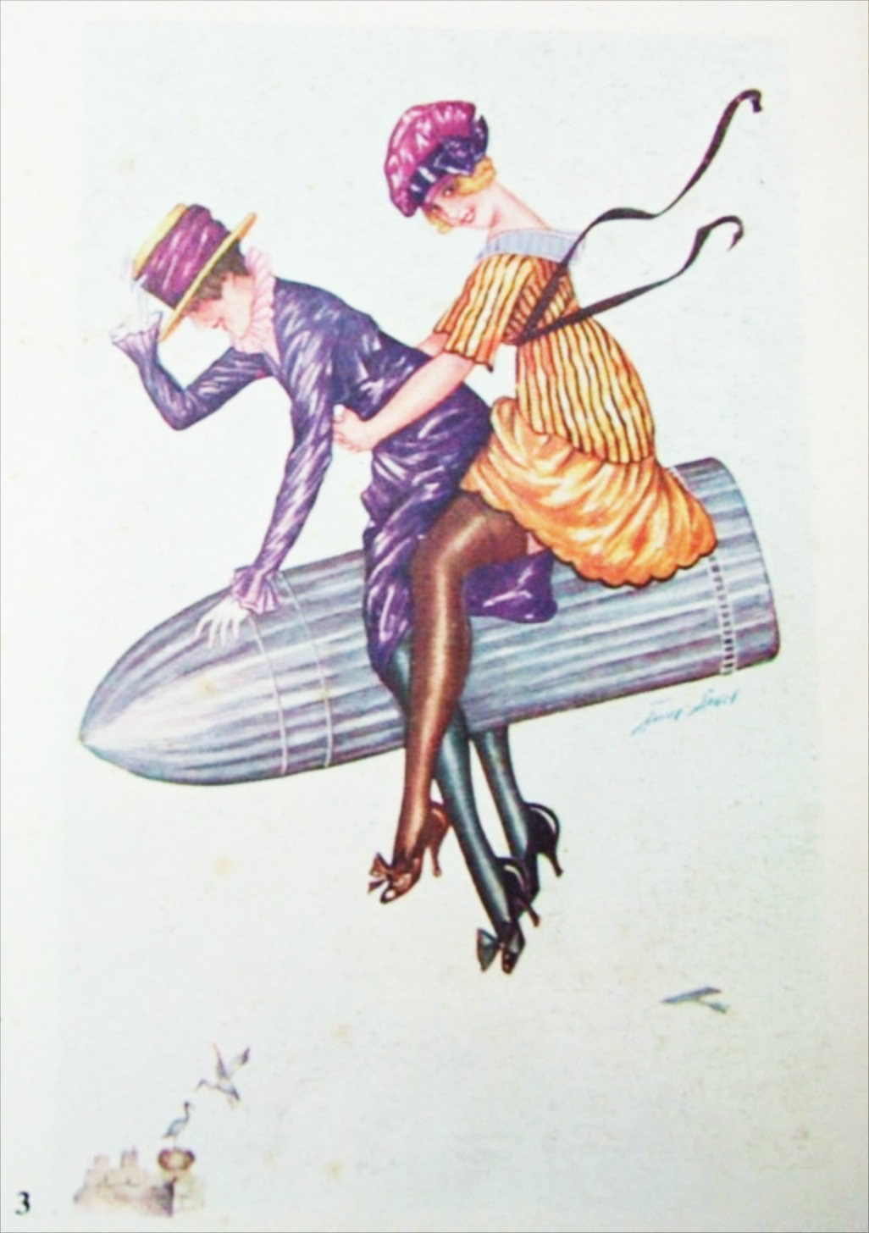
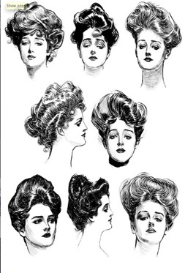
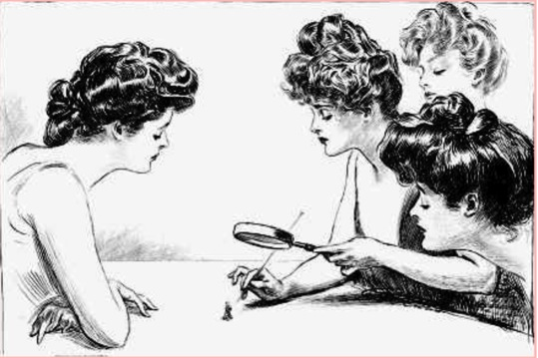
Xavier Sager 1870- 1930
From Google images
Charles Dana Gibson 1867-1944
Notes:
Examples of European artist Xavier Sager on the left, whose work I had based my work on and on the right is American artist Charles Dana Gibson.
The American company had changed the book (without any consultation with me) and had the audacity to suggest they only pay me a nominal fee for the concept!
I refused to allow them to proceed but could not stop them publishing their version, so in the end Collins, who were acting now as my agents, accepted a 10% of usual 10% authors royalty for me.

Slide 8
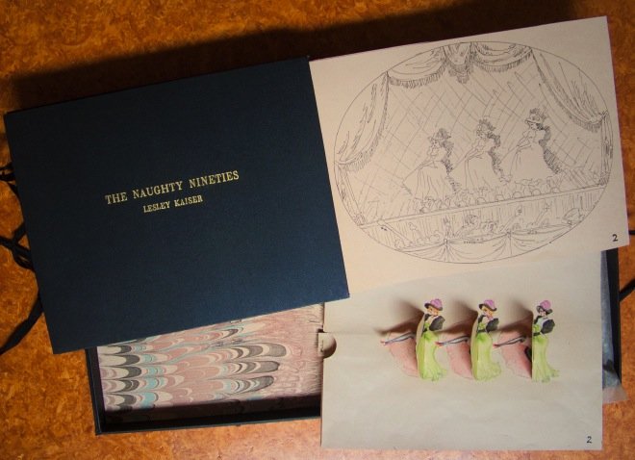
Notes:
I aimed at celebrating the vitality of the can-can dancers such as the highly paid and independent Jane Avril who danced at the Moulin Rouge.

Slide 9
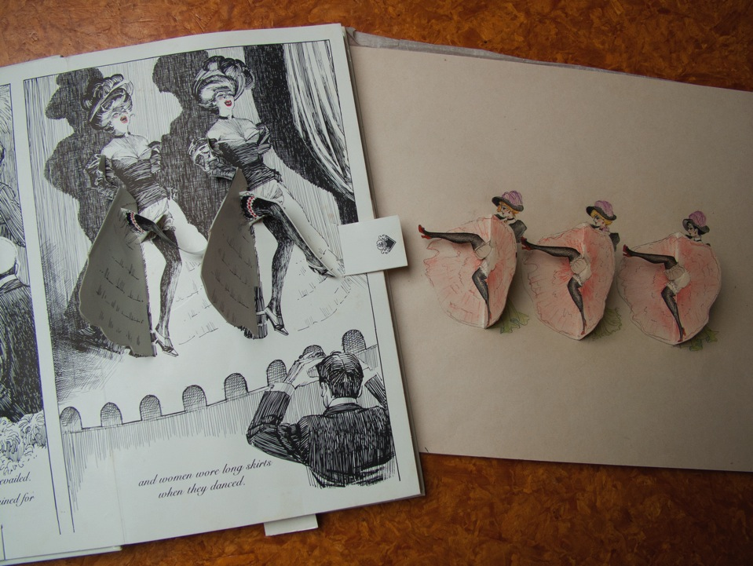
Male gaze introduced
Notes:
One of my main objections to the Intervisual version was their undermining of my work by introducing a sexist slant,
with the introduction of the male gaze and a sexist focus, when I had been careful to keep a more feminist perspective where women were the initiators and not passive.

Slide 10
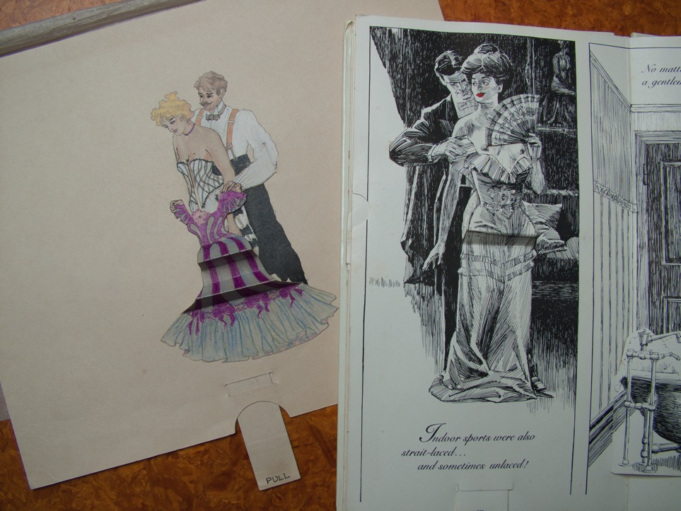
Historical inaccuracy introduced
Notes:
What concerned me most about losing artistic control was the change of focus from a beautiful, historically accurate reference to the turn of the century erotic postcard, to a sexist American version
In this comparison of the two versions, you can see my original mechanism on the left (where the an elaborate Victorian corset is revealed on the pull of the tab), and on the right their titillating (forgive the pun) rip-of version that revealed a women not wearing underwear (which is historically inaccuracy)
As I was not at all happy with the Intervisual version, I refused to have my name used as the author of the bastardised version, and ended up being credited with the concept.

Slide 11
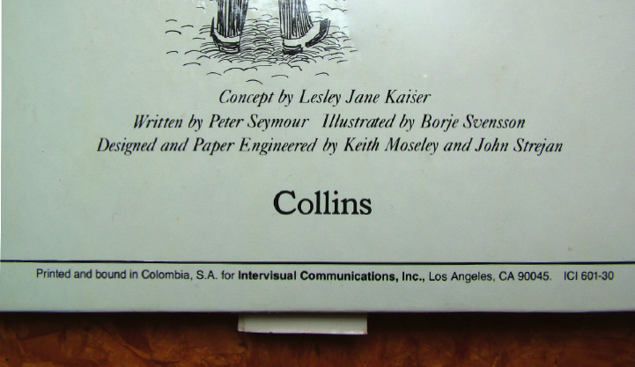
Concept credit on back cover of first edition
Note lack of paper-engineering credit for Lesley Kaiser
Notes:
Concept credit on back cover of first edition
Note lack of paper-engineering credit for Lesley Kaiser

Slide 12
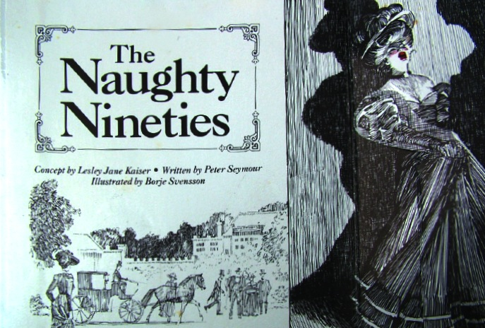
CONCEPT credit
Credits on inside front cover of the miniature edition.
No paper-engineering credits at all this time
Notes:
Credits on inside front cover of the miniature edition.
No paper-engineering credits at all this time

Slide 13
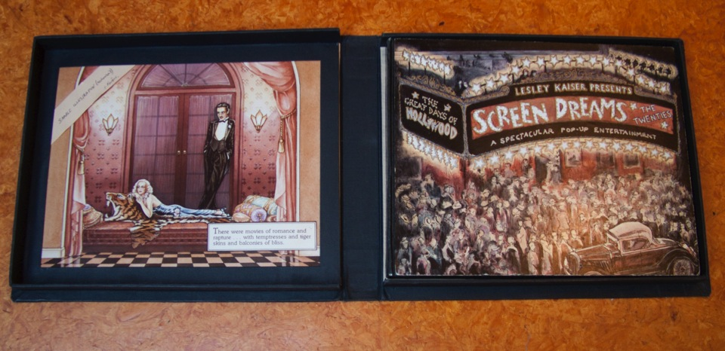
Screen Dreams: A Spectacular Pop-up Entertainment
Based on the silent movies of the 1920s. Lesley Kaiser, 1986
SHOW: Movable Books Lesley Kaiser [YouTube Video]
Notes:
In an attempt to regain artistic control over my own work, I created a sequel to The Naughty Nineties, The Roaring Twenties, but my publisher mentioned it to Intervisual and they independently created a really bad Roaring Twenties Pop-up book themselves that didn’t sell well at all and put a damper on the market for adult popup books for a number of years.
I then turned my 1920s version into a new pop-up book titled Screen Dreams A Spectacular Pop-Up Entertainment that was all about the nineteen twenties silent movies.
As usual, I started with a dance mechanism – Rudolf Valentino doing the Tango.
This mockup was sent to the Frankfurt bookfair and created interest for around 60,000 copies, has never been commercially produced as it did not make the 100,000 pre-sales needed to go into production, so what you see in the exhibition are the only copies of it.
Show Movable Books

Slide 14
See: Movable Books Lesley Kaiser
[YouTube Video]
Also showing at the ART + BOOK exhibition
and it is on my Website at
www.lesleykaiser.com
Notes:
SHOW Movable Books Lesley Kaiser [YouTube Video]

Slide 15
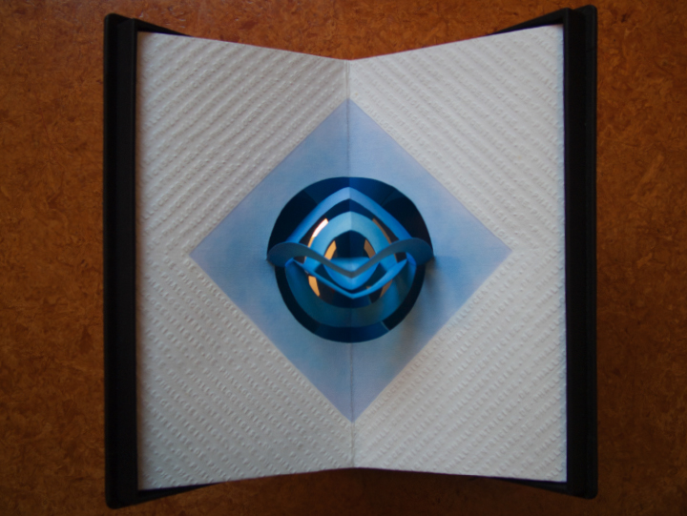
Kaiser, L. (1988) Discourse of Circles [De-phallocentricise]
Notes:
Kaiser, L. (1988) Discourse of Circles [De-phallocentricise]

Slide 16
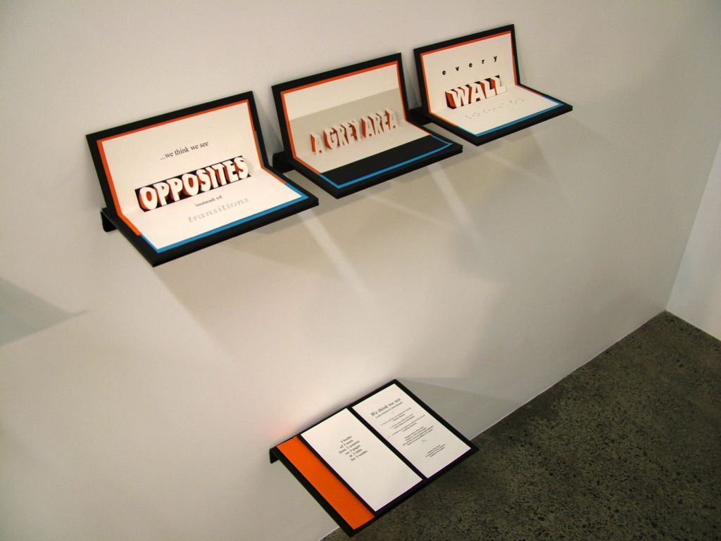
Install artiists book (old work)
Notes:
OTHER POPUP BOOKS in the ART + Book exhibition. Many in collaboration with my husband John Barnett
We think we see … (1997) Lesley Kaiser & John Barnett

Slide 17
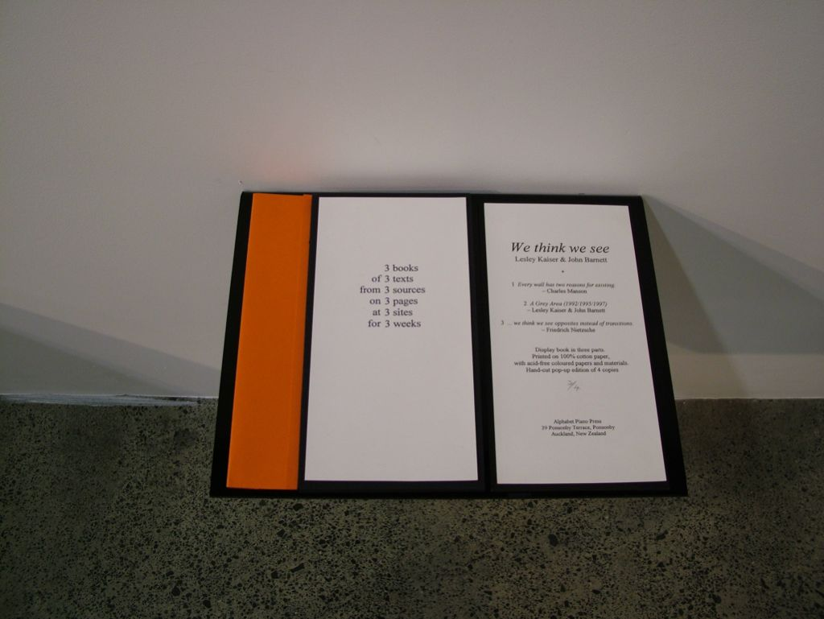
Install artists book info sheets
We think we see … (1997) Lesley Kaiser & John Barnett
Notes:
We think we see … (1997) Lesley Kaiser & John Barnett

Slide 18
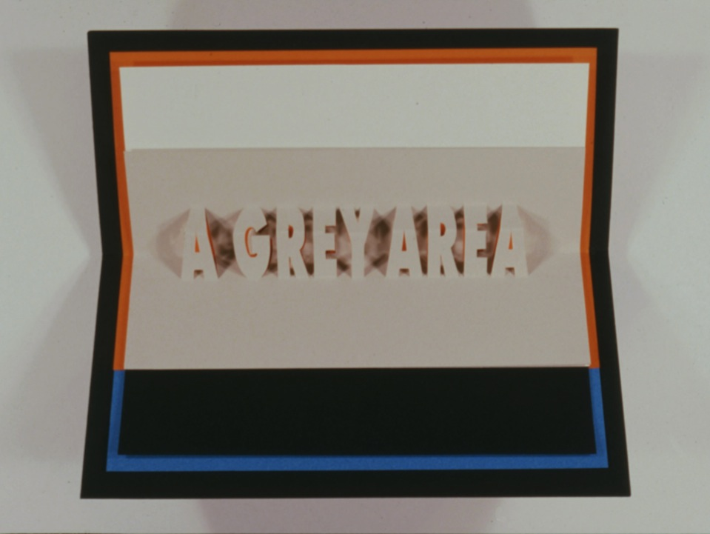

Slide 19
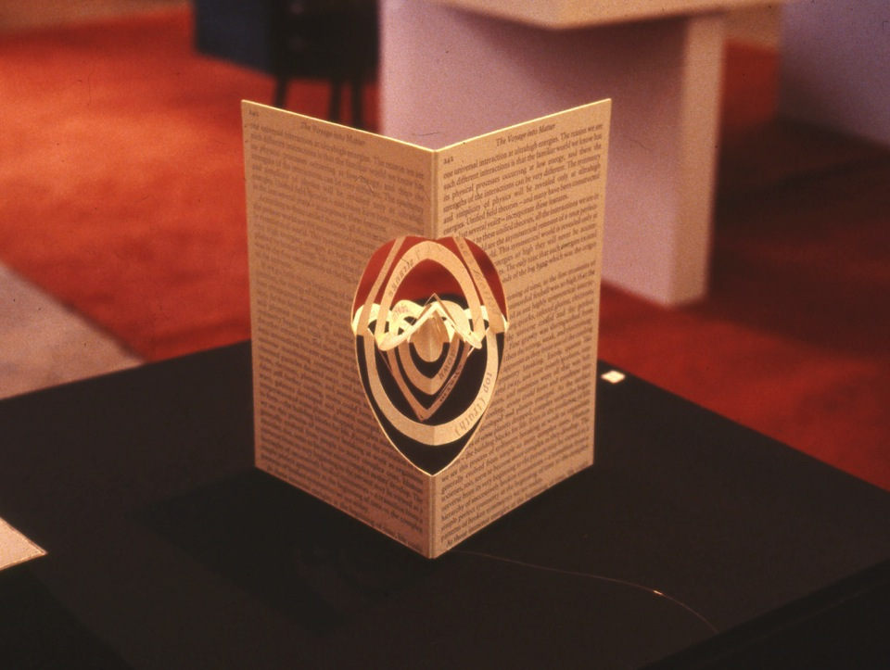
Lesley Kaiser, The Voyage into matter, 1988
Notes:
The Voyage into matter, L. Kaiser, 1988

Slide 20
Methodology for inventing the mechanisms:
Heuristic exploration along with reflection and action research
Notes:
METHODOLOGY for inventing mechanisms
I don’t have time here to go into my methodology, but my process is basically heuristic exploration (Moustakas, 1985) along with reflection, and action research (Schon, 1983; Keitsch, 2006). Basically I start by playing with card and 2-side tape, and utilise an intuitive knowledge and love of Euclidian geometry (it was my favorite subject at school and I my father was an engineer).
I always seem to start with a dance mechanism as that was another passion when I was young.

Slide 21
CONTEXT
History of movable books - dates back seven centuries
from 1200 AD
(SEE: Ellen Rubin, A History of Pop-up and Movable Books:
700 Years of Paper Engineering, 2010).
Initially created for philosophical and scientific texts,
not for children until 1765
First erotic ‘movables’ were postcards
in the late 1990s, which provides the perfect context for
My Naughty Nineties pop-up book
Notes:
CONTEXT
History of movable books - dates back seven centuries, from 1200 AD
SEE: A History of Pop-up and Movable Books: 700 Years of Paper Engineering (2010) YOUTUBE Video of a lecture given by Ellen Rubin at the Smithsonium Libraries website
Movable books were initially created for philosophical and scientific texts. Pop-up books for children came much later in 1765
First erotic ‘movables’ were postcards in the late 1990s, which provides the perfect context for
My Naughty Nineties pop-up book
Example: Movable Postcard – 1906. Roller mechanism to reveal women’s legs under their skirt
A History of Pop-up and Movable Books: 700 Years of Paper Engineering (2010). Video of a lecture given by Ellen Rubin on the history of pop-up and movable books. Smithsonium Libraries website

Slide 22
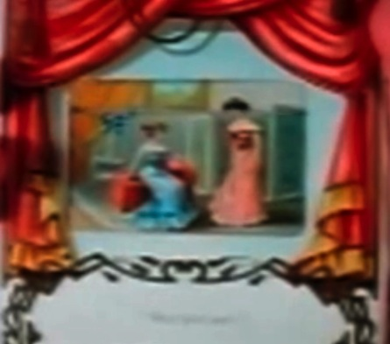
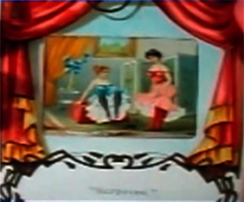
Movable Postcard – 1906. Roller mechanism
A History of Pop-up and Movable Books. (2010). Ellen Rubin
Notes:
Example: Movable Postcard – 1906. Roller mechanism to reveal women’s legs under their skirt
A History of Pop-up and Movable Books: 700 Years of Paper Engineering (2010). Video of a lecture given by Ellen Rubin on the history of pop-up and movable books. Smithsonium Libraries website

Slide 23
1800s
The First Golden Age of Pop-ups
Lothar Meggendorfer (1847-1925-German) invented rivets for multiple action with one tab. He is considered the genius of all time for paper engineering.
Founding father of artists books, he wrote illustrated and paper-engineered his books
One individual artists creation
(which is what I attempted to do).
AGAINST THE ODDS
In a contemporary context
Notes:
1800s
The First Golden Age of Pop-ups
The printing for most of these books was done in Germany where the chromolithography was best.
Lothar Meggendorfer (1847-1925-German) invented rivets for multiple action with one tab. He is considered the genius of all time for paper engineering.
Often regarded as the Founding father of artists books, he wrote illustrated and paper-engineered his books as one individual artists creation, and this is what I attempted to do with my Naughty Nineties prototype.
AGAINST THE ODDS
This is necessary when creating complex pivoted mechanisms, as all three aspects have to be designed in unison, unlike most modern day popups that just Pop-up in 3D rather than involve intricate sets of action

Slide 24
Abstract summary
Second section of paper
Paper-engineering incorporated into the Communication Design degree at AUT University
First-year Graphic Design paper: History, Culture, Context 1
Second-year: Elective Project [Paper Engineering].
‘How old and new technologies might be combined to retain the best of analogue/interactive books
Notes:
This brings me to the second section of my paper,
Which discusses how I have incorporated the teaching of paper-engineering for pop-up books into the Communication Design [which was formally the Graphic Design] degree at AUT University, Auckland.
I use as case studies the
First-year Graphic Design paper History, Culture, Context 1 and
Second-year: Elective Project [Paper Engineering].
I expore
How old and new technologies might be combined to retain the best of analogue/interactive books, and how movable books can retain value in a world of growing digitally interactivity.’

Slide 25
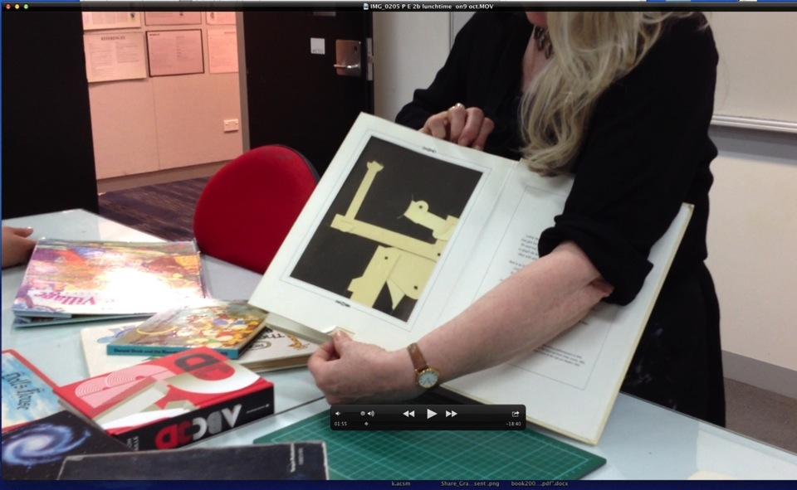
Practical demonstration of Lothar Megendorfer’s paper-engineering pivoted action and the principles of euclidean geometry
Notes:
History, Culture, Context 1 is a theory paper I ran with a BOOKWORKS output, so I gave the students the option of incorporating paper-engineering if they wished, but could not spend more than an hour in tutorials teaching the 130 students the basics of paper-engineering, so offered a voluntary lunchtime workshop for those interested
This is a Practical demonstration of Lothar Megendorfer’s paper-engineering showing pivoted action and the principles of Euclidean geometry at work

Slide 26
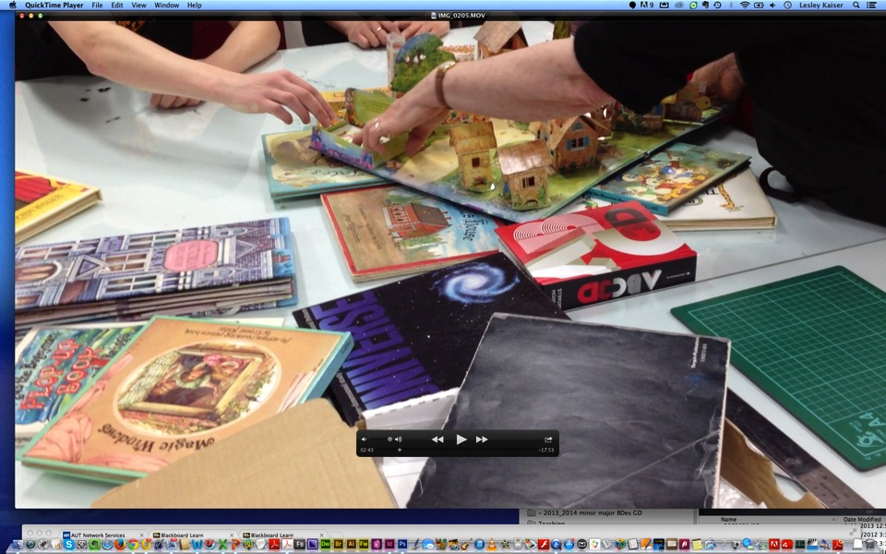
I show examples of pop-up books in my personal collection
Notes:
I show examples of pop-up books in my personal collection to inspire them and demonstrate possibilities

Slide 27
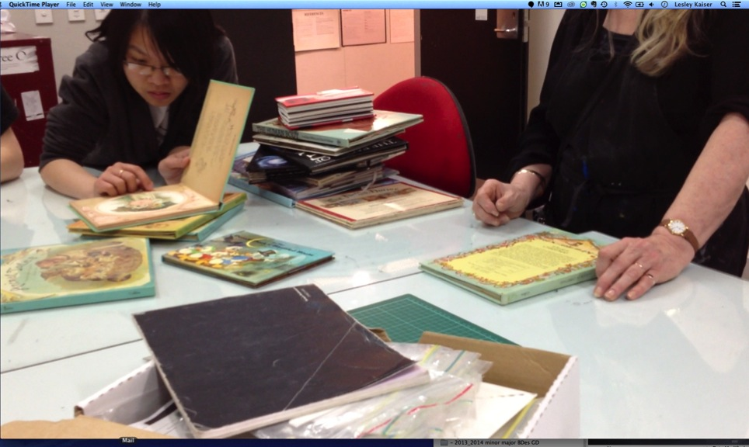
I show examples of pop-up books in my personal collection
Notes:
I showed a lot of examples of popup books in my personal collection

Slide 28
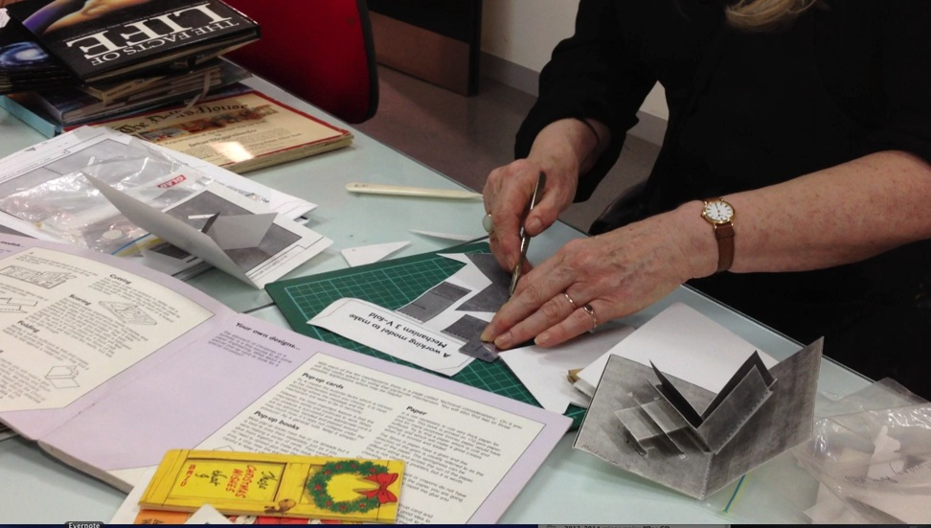
Practical demo using instructional books I have put in AUT’s library
Notes:
Practical demo from instructional books I put in AUT’s library

Slide 29
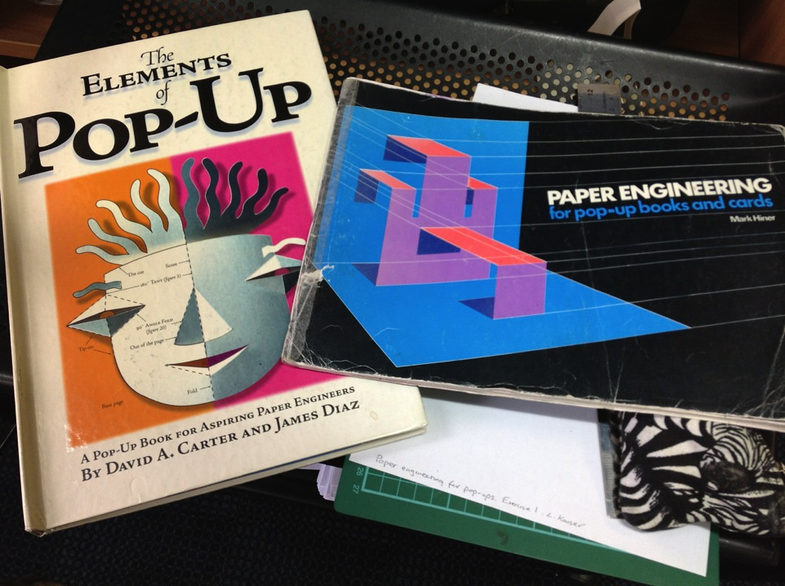
The Elements of pop-ups Carter/Diaz
Copies in AUT library on High Demand
Notes:
The Elements of POP-UP by Carter and Diaz is great as all the templates for mechanisms can be downloaded from the internet
Mark Hiner’s Paper-engineering for pop-up books is also an invaluable resource that I encourage students to buy

Slide 30
Paper engineering demo 1
David A.Carter and James Diaz, (1999),
The Elements of Pop-Up
Mark Hiner, (1996), Paper Engineering for pop-up
Three copies in AUT library (two on High Demand)

Slide 31
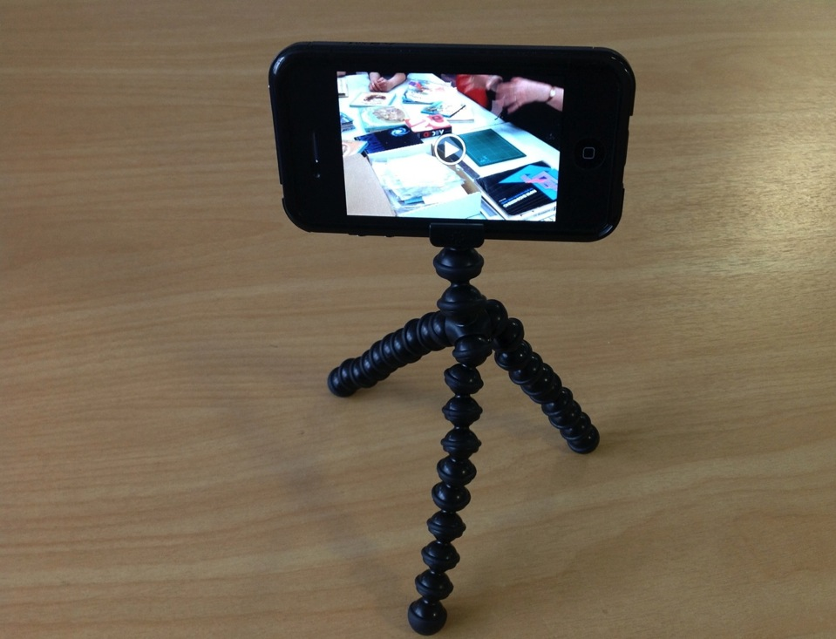
iPhone used to video/photo:
paper-engineering and
book-binding tutorials.
lectures, and guest lectures
Notes:
iPhone used to video/photo tutorials and resources put online:

Slide 32
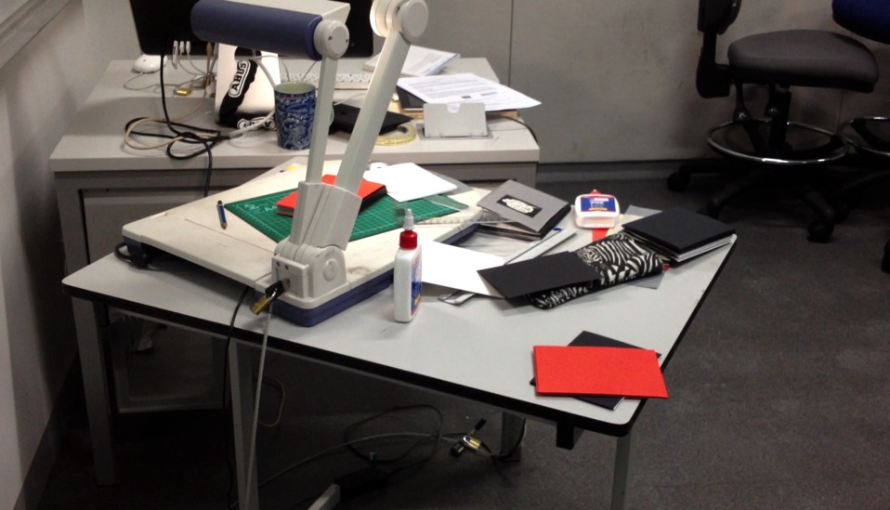
To demo techniques to 130 students at once
I use an over-head projector connected to a data show –
cooking show format with pre-made components
Notes:
To demo techniques to 130 students at once
I use an over-head projector connected to a data show –
cooking show format with pre-made components

Slide 33
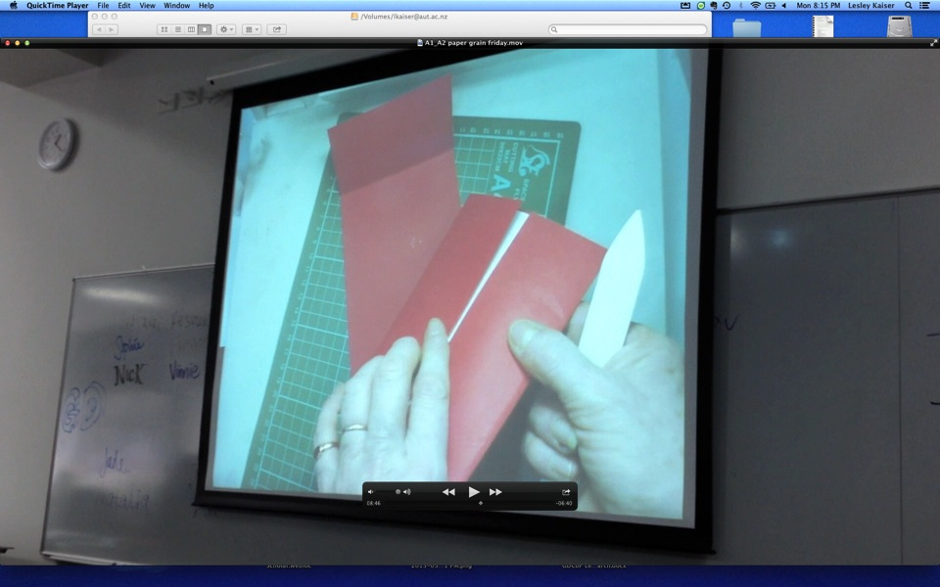
overhead projector connected to a data show – to demo basics to students in lecture mode

Slide 34
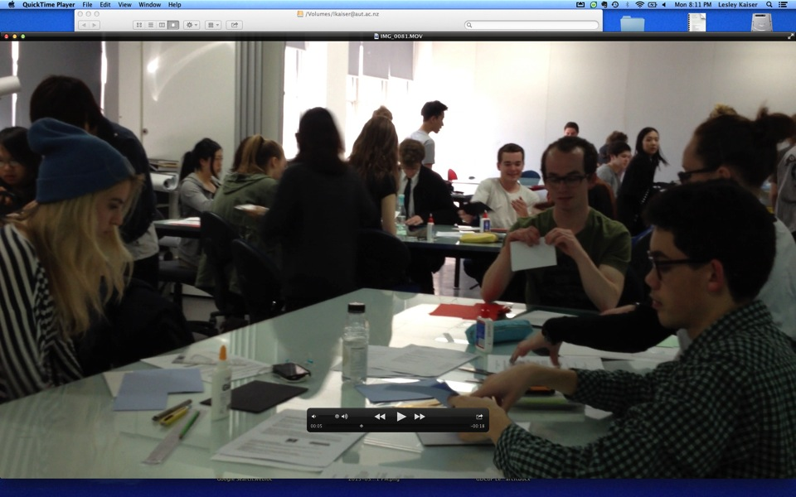
Demo followed by workshop for students using pre-cut components
Notes:
Demo followed by workshop for students using pre-cut components

Slide 35
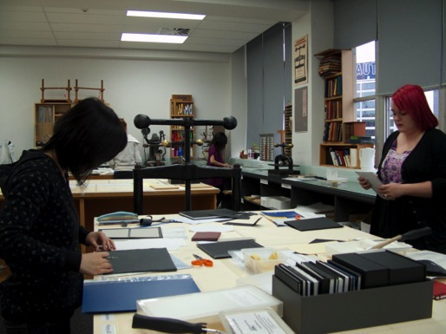
AUT University bindery 2012
Notes:
We are fortunate to have one of the best binderies in the southern hemishere at AUT, which was manned by an excellent bindery technician which made this Booworks assignment possible

Slide 36
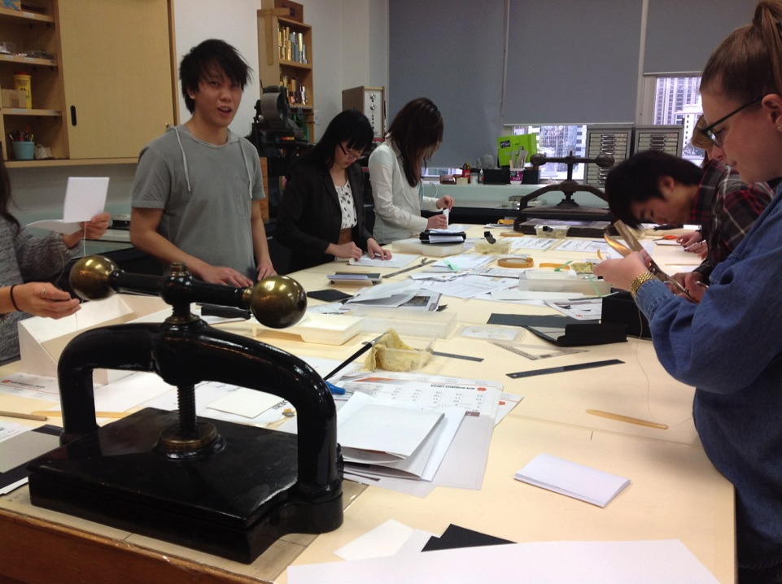
Students make good use of the bindery
Notes:
Students make good use of AUT bindery

Slide 37
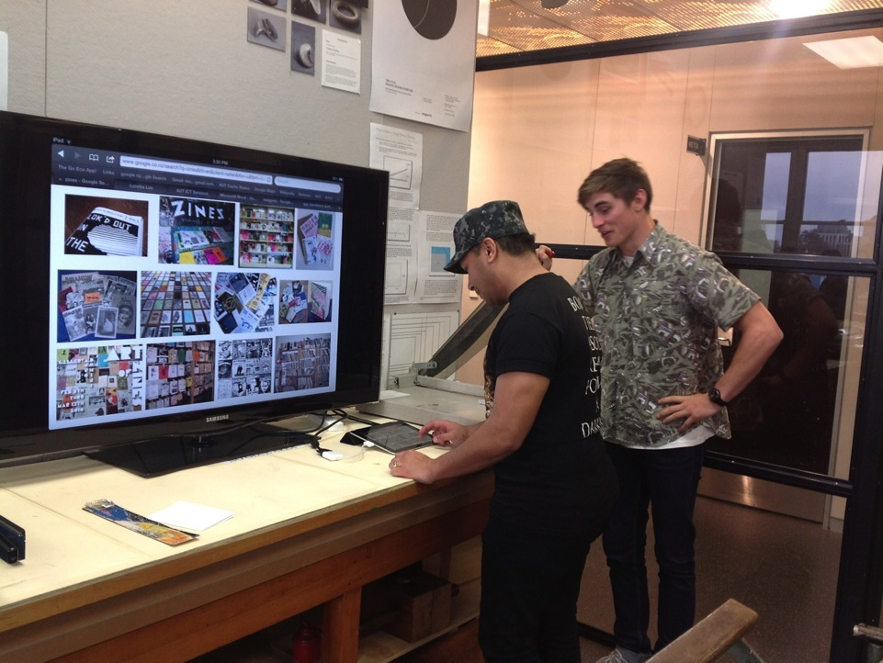
Screen and iPad installed in the bindery to
give internet access for online resources
and YouTube instructional videos
Notes:
I successfully applied for a grant to get a Screen and iPad installed in the bindery to give internet access for online resources and YouTube instructional videos

Slide 38
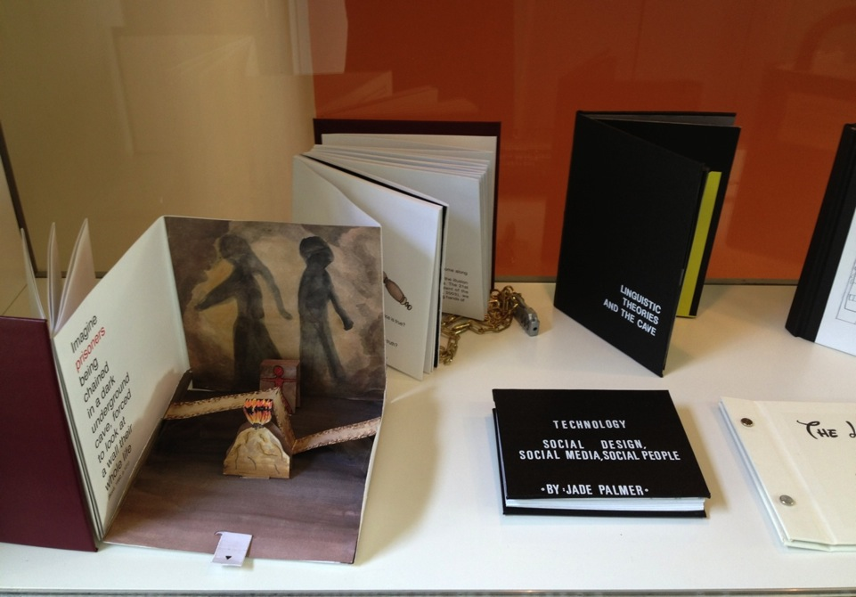
Some students use paper-engineering in multimodal bookworks
Modern Caveman, Vinnie Bi, 2012. Contemporary interpretations of Plato’s cave
Notes:
Some students use paper-engineering in multimodal bookworks
Modern Caveman, Vinnie Bi, 2012. Contemporary interpretations of Plato’s cave

Slide 39
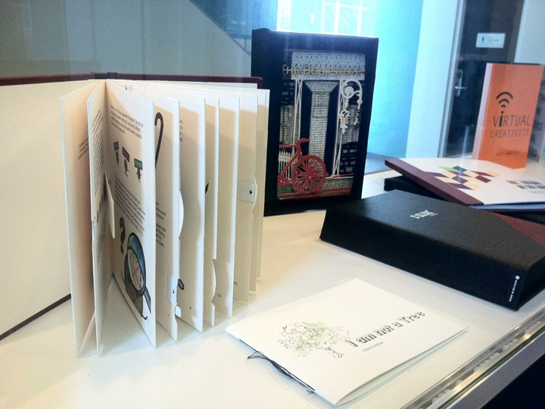
Notes:
More examples follow

Slide 40
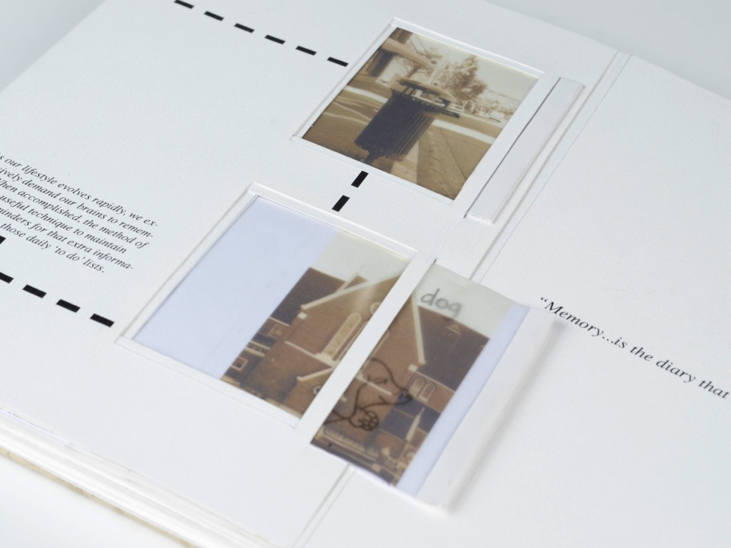
Morgan Taipei, Memory
Notes:
Morgan Taipei Memory

Slide 41
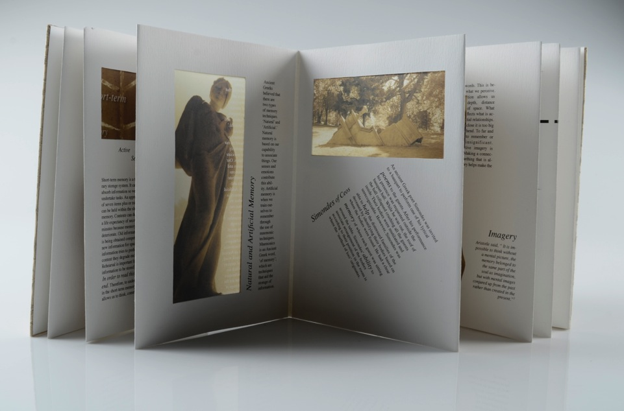
Morgan Taipei, Memory
Notes:
Morgan Taipei Memory

Slide 42
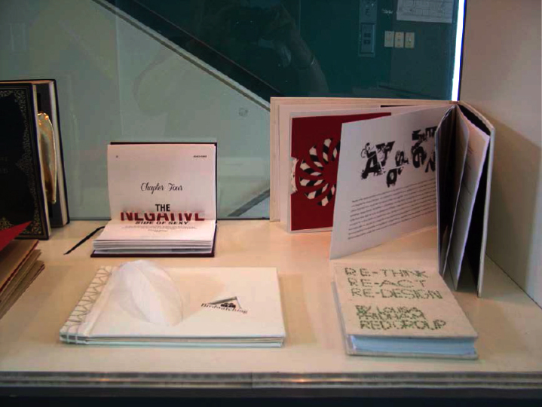
Examples of student Bookworks 2012
Notes:
Examples of student Bookworks 2012

Slide 43
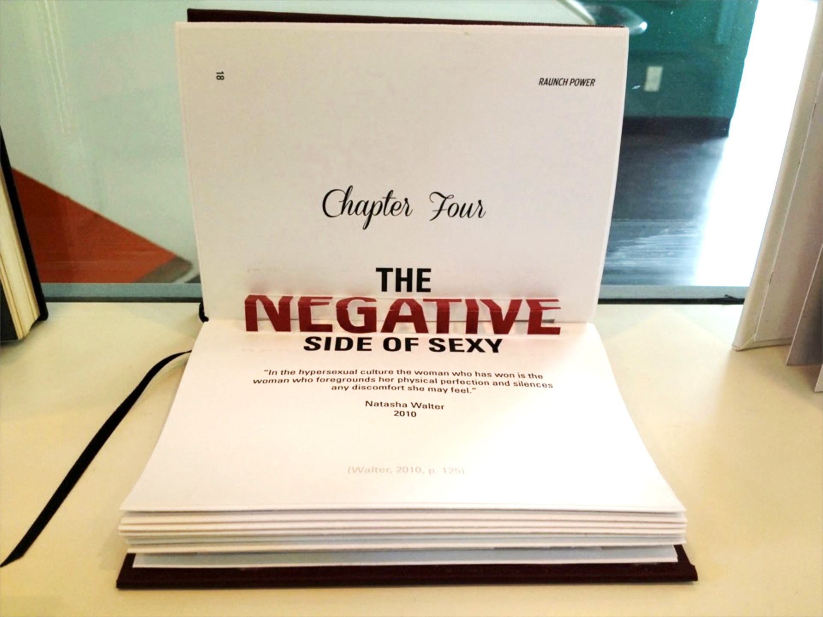
RAUNCH POWER, Madeleine Duthie, 2012

Slide 44
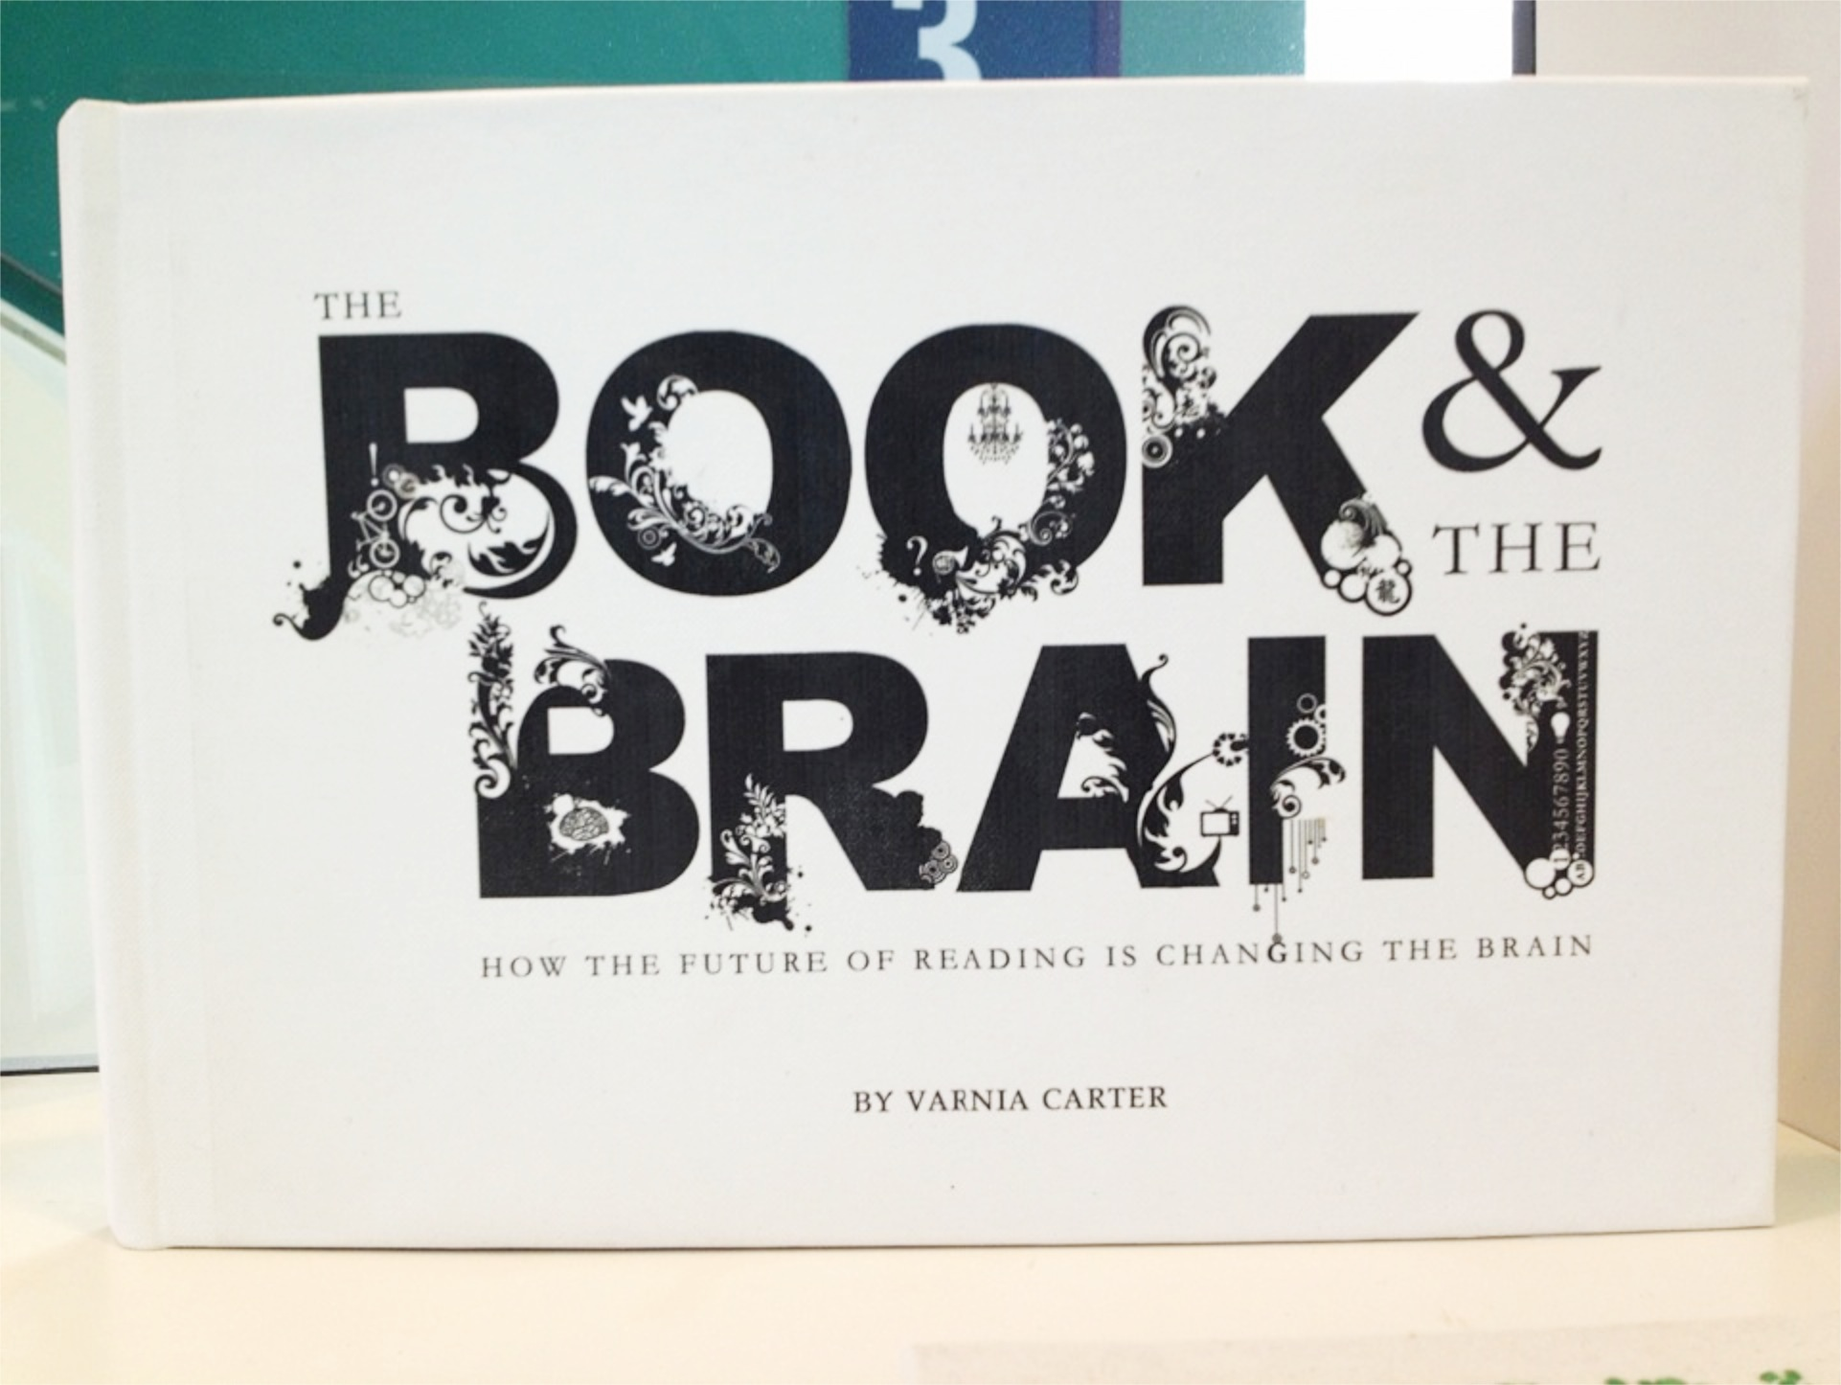
Notes:
Pioneering transfer technology onto bookcloth in print-room
Old and new technologies

Slide 45
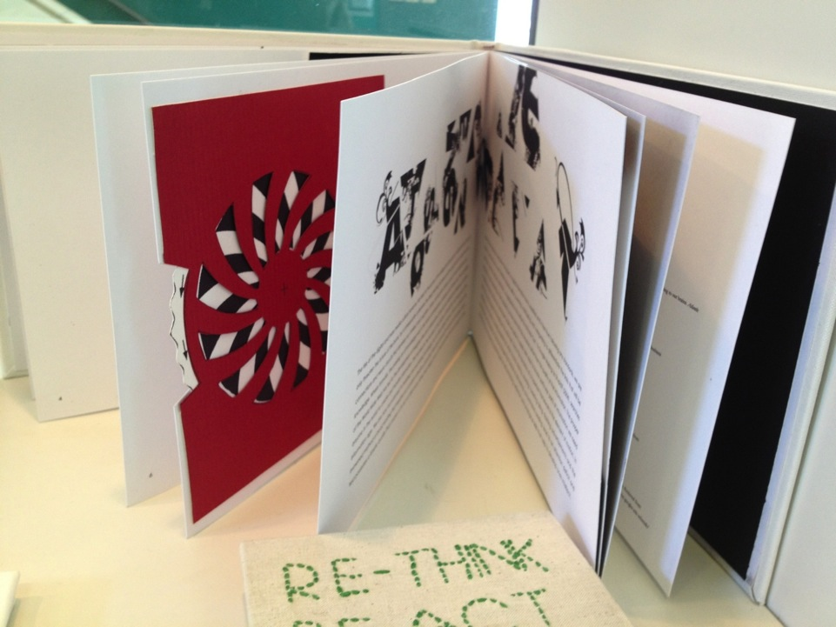
The Book & the Brain, Varnia Carter, 2012

Slide 46
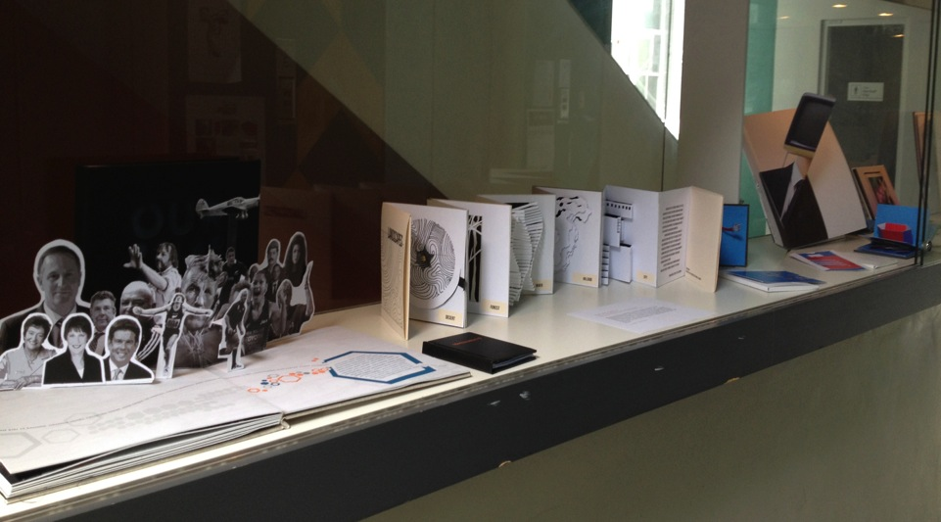
Elective Project : Paper-engineering 2013
Notes:
Elective Project : Paper-engineering 2013

Slide 47
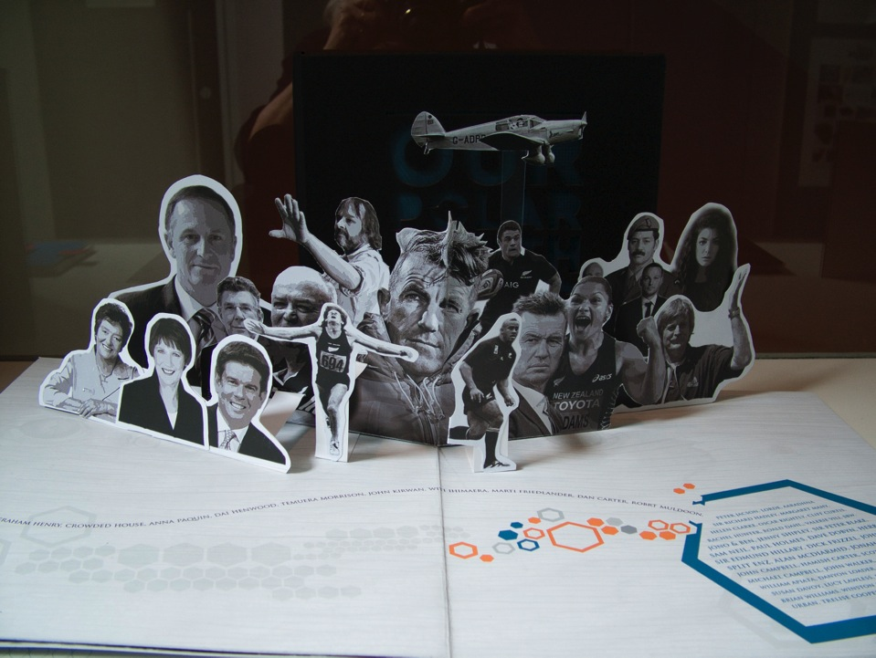
Home, 2013, Varnia Carter.
Laser-cutter technologies in paper-engineering.
Notes:
Home, 2013, Varnia Carter.
Great use of new technologies in paper-engineering. She used the laser cutting lab at AUT to cut the design into her cover as well as using the laser cutter for paper cut-outs

Slide 48

Home, 2013, Varnia Carter
Notes:
Home 2013 Varnia Carter. Great use of new tehcnologies in paper-engineering. She used the laser cutting lab at AUT to cut the design into her cover as well as using the laser cutter for paper cut-touts

Slide 49
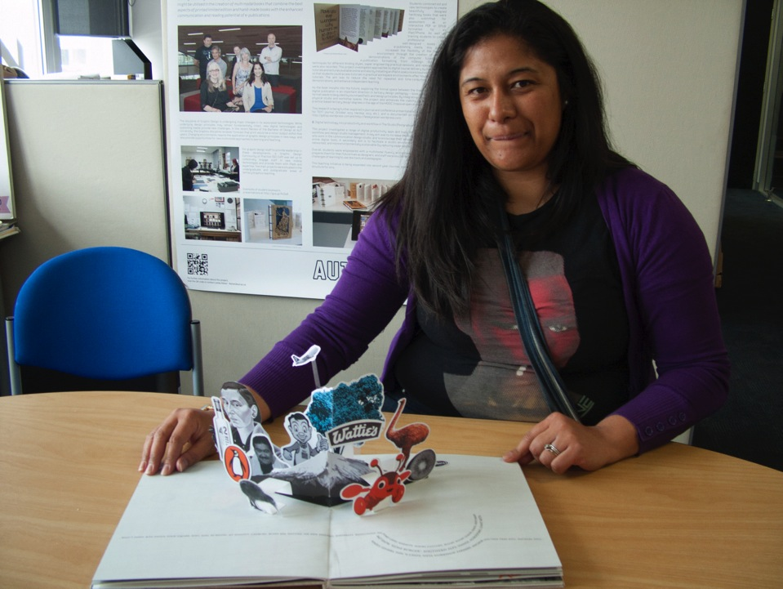
AK 05 The End
Varnia Carter
Notes:
Home 2013 Varnia Carter. Great use of new tehcnologies in paper-engineering. She used the laser cutting lab at AUT to cut the design into her cover as well as using the laser cutter for paper cut-touts

Slide 50
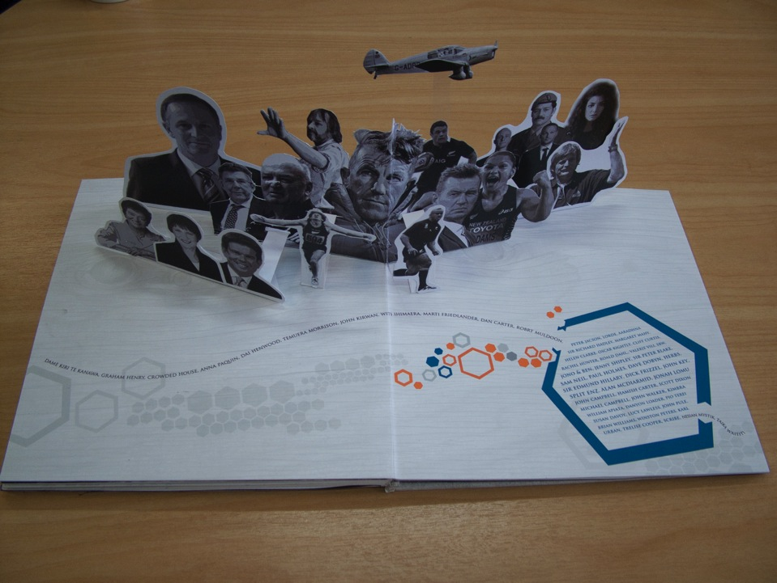
Home, 2013, Varnia Carter.
Notes:
Home, 2013, Varnia Carter.

Slide 51
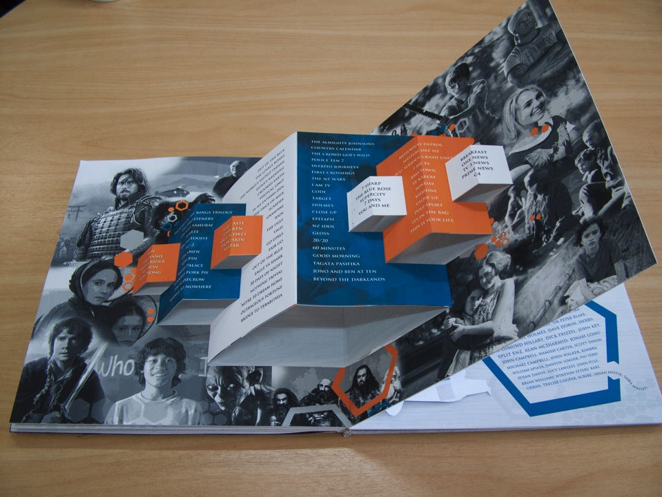

Slide 52
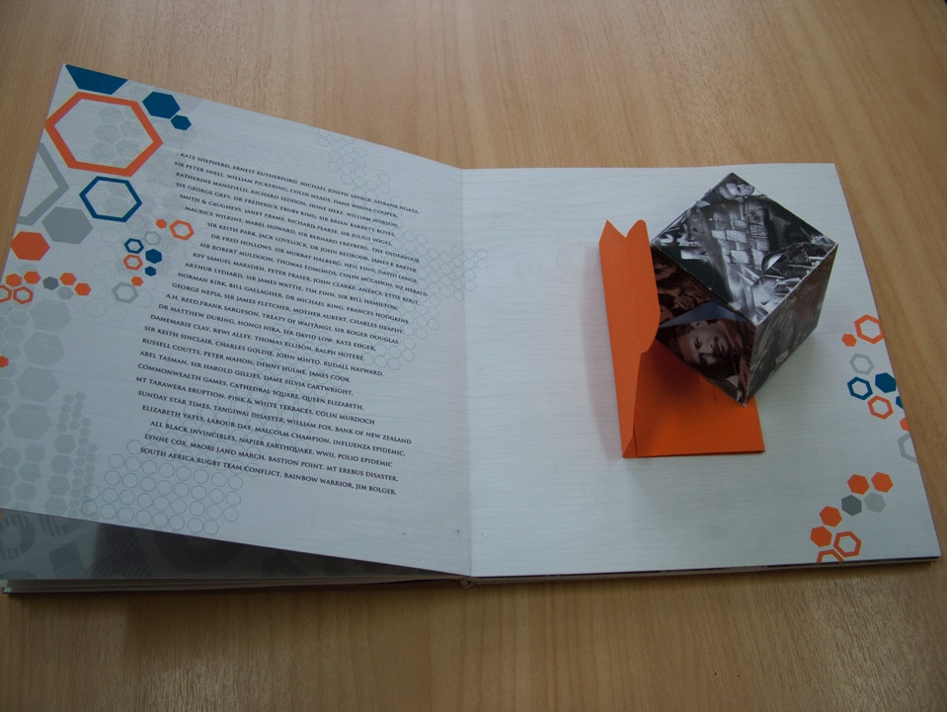
Elastic band popup
Notes:
Elastic band Up-Pop

Slide 53
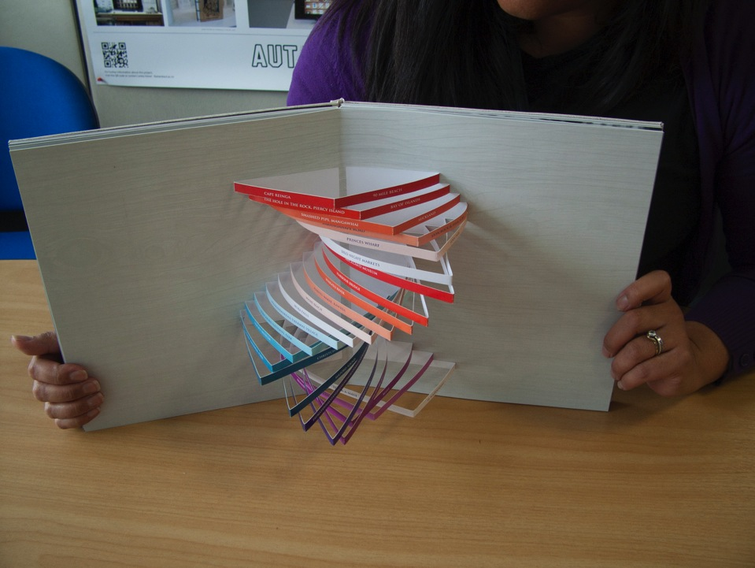
AK 05 The End

Slide 54
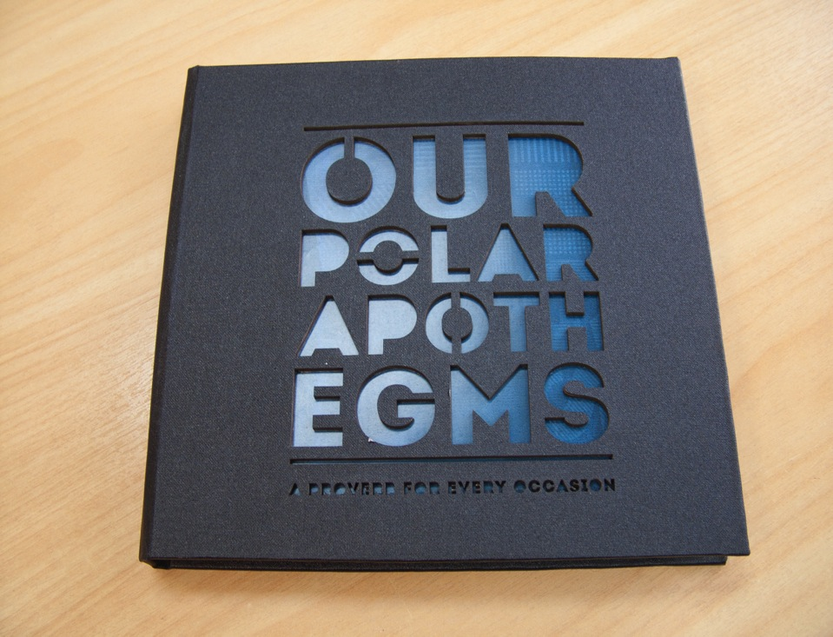
Varnia Carter, Our Polar Apothegms, 2012. Laser cut cover
Notes:
Varnia Carter, Our Polar Apothegms, 2012

Slide 55
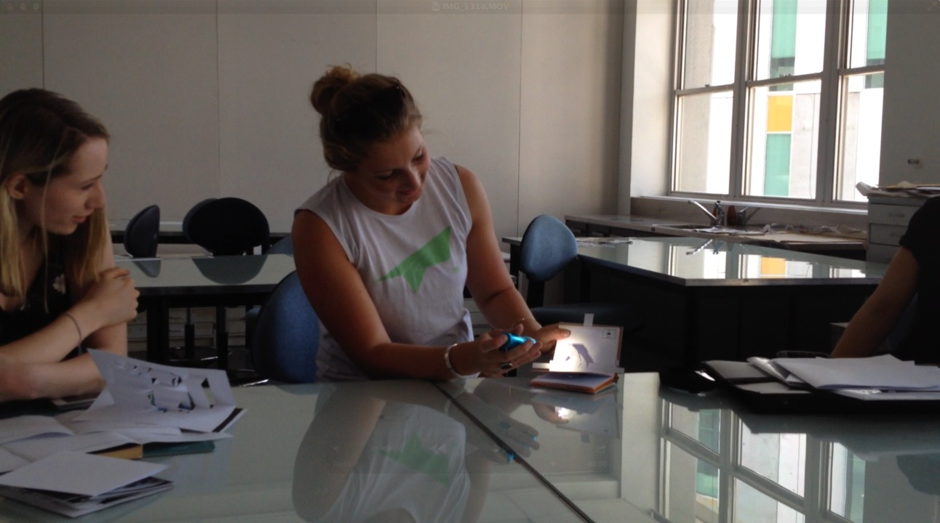
Lise Koks, 2013, Hand Shadow Puppets
Notes:
Lise Koks, 2013, Hand Shadow Puppets

Slide 56
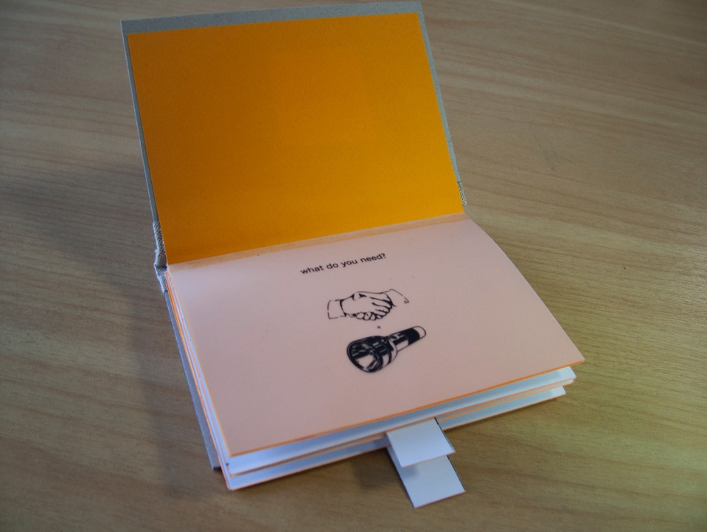
AK 05 The End
Lise Koks, 2013.
Notes:
Lise Koks, 2013

Slide 57

AK 05 The End
Lise Koks, 2013.
Notes:
Lise Koks, 2013

Slide 58

AK 05 The End
Lise Koks, 2013.
Notes:
Lise Koks, 2013

Slide 59

Paper-engineering
Elective 2013
Notes:
Paper-engineering
Elective 2013
Sample mechanisms plus self-directed pop-up book

Slide 60

Who needs winds to fly, 2013, Elisa Metz
Notes:
Who needs winds to fly, 2013 Elisa
Metz
about Jean Batten

Slide 61

Who needs winds to fly, 2013, Elisa Metz

Slide 62

Early days of animation, 2013, Astrid Möller
Notes:
Early days of animation, 2013, Astrid Möller

Slide 63

Early days of animation, 2013, Astrid Möller
Notes:
Early days of animation, 2013, Astrid Möller

Slide 64

Astrid Möller
Notes:
Early days of animation, 2013, Astrid Möller

Slide 65

Sailor Sam
Lucy Hawkins
Notes:
Sailor Sam, 2013, Lucy Hawkins

Slide 66

Analiese van de Kwaak, Caricatures
Notes:
Analiese van de Kwaak, Caricatures

Slide 67

Use of metal rivets
Pop-Up Music, Caitlin Finnerty
Notes:
Use of metal rivets
Pop-Up Music, Caitlin Finnerty

Slide 68

Julia-Telford Brown, Landscapes
Notes:
Julia-Telford Brown, Landscapes

Slide 69

AK 05 The End
Julia Telford-Brown, 2013, Landscapes
Notes:
Julia Telford-Brown, 2013, Landscapes

Slide 70

Julia Telford-Brown, 2013, Landscapes
Notes:
Julia Telford-Brown, 2013, Landscapes

Slide 71

AK 05 The End
Julia Telford-Brown
Notes:
Julia Telford-Brown, 2013, Landscapes

Slide 72

Paper-engineering elective, 2014
Currently on display at AUT WE block 3rd floor lift foyer
Notes:
Paper-engineering elective 2014

Slide 73

Paper-engineering elective 2014
Esther Keyte Beattie, Circus Royale
Notes:
Paper-engineering elective 2014.
Esther Keyte Beattie
Circus Royale

Slide 74

Paper-engineering elective 2014
Moana Hibbs, 2014, Business card.
Notes:
Moana Hibbs, 2014, Business card

Slide 75

Paper-engineering elective 2014
Hina Patel, Chacharoh Bandit case files
Notes:
Paper-engineering elective 2014
Hina Patel, Chacharoh Bandit case files

Slide 76

Paper-engineering elective 2014
The Kiwi Kids Guide to Time Travel, Casey Clark, 2014
Notes:
Paper-engineering elective 2014
Hina Patel, Chacharoh Bandit case files
Paper-engineering elective 2014
Hina Patel, Chacharoh Bandit case files

Slide 77

The Kiwi Kids Guide to Time Travel
Casey Clark, 2014
Paper-engineering elective 2014
Notes:
Paper-engineering elective 2014
Hina Patel, Chacharoh Bandit case files

Slide 78

Paper-engineering elective 2014
Black + White House, Kino Chu, 2014
Notes:
Black + White House, Kino Chu, 2014
Paper-engineering elective

Slide 79

Paper-engineering elective 2014
Kino Chu
Notes:
Black + White House, Kino Chu, 2014
Paper-engineering elective 2014

Slide 80

Paper-engineering elective 2014
Makiro Oygania
Notes:
Paper-engineering elective 2014
Makiro Oygania

Slide 81

Paper-engineering elective 2014
Emma Stewart
Notes:
Hang 10, Emma
Stewart
Paper-engineering elective

Slide 82

Paper-engineering elective 2014
Hang Ten, Emma Stewart
Notes:
Paper-engineering elective 2014

Slide 83

Paper-engineering elective 2014
Raspberry French Macaron Recipe, Anne Lee
Notes:
Min Kyung (Anne) Lee
Raspberry French Macaron recipe

Slide 84

The Wizard of Oz
Angelina Kim
Paper-engineering elective 2014
Notes:
Paper-engineering elective 2014

Slide 85

Paper-engineering elective 2014
Notes:
Paper-engineering elective 2014

Slide 86
ART + BOOK
Last Section of Abstract
How can movable books can retain value in a world of growing digital interactivity?
Analogue and Digital complement each other.
Maria Popova showed The Naughty Nineties pop-up book as animated gifs on her Brain Pickings blog
Immediately after this blog, the price of the second–hand copies of the Naughty Nineties shot up in value ten-fold for a few weeks
http://www.brainpickings.org/index.php/2012/07/12/the-naughty-nineties-pop-up-book-for-adults-only
Notes:
This brings me to the last section of my paper,
I want end on an example of how movable books retain value in a world of growing digital interactivity.
When Maria Popova showed the Naughty Nineties pop-up book that she discovered in the New York Library as animated gifs on her excellent Brain pickings blog,

Slide 87


21st century revival of The Naughty Nineties: A Saucy Pop-Up Book for Adults (1982). Mechanisms shown as animated gifs
Notes:
Maria Popova showed the Naughty Nineties pop-up book that she discovered in the New York Library as animated gifs on her excellent Brain pickings blog,
Immediately after this blog the price of the second–hand copies of the Naughty Nineties shot up in value ten-fold for a few weeks

Slide 88
AGAINST THE ODDS
Pop-Up books carry on in digital age
Animated gifs capture movement
explosion of pop-up book videos on YouTube in the last decade
The ready availability of laser cutting facilities means that limited edition Pop-Up books are starting to proliferate as small editions of artists books
the first children’s pop-up books as iPad apps have appeared from LOUD CROW INTERACTIVE, Inc. Internet/software
Notes:
In addition to an explosion of pop-up book videos on TouTube in the last decade, the first children’s pop-up books as iPad apps have appeared from LOUD CROW INTERACTIVE, Inc. Internet/software

Slide 89



Screenshots of the app PopOut! Peter the Rabbit – Lite.
Paper-engineering cleverly adapted to the iPad screen.
Free to download from iTunes
Download full version from iTunes App store or view video at PopOut! The Tale of Pete#801BFB
Notes:
http://www.brainpickings.org/index.php/2012/07/12/the-naughty-nineties-pop-up-book-for-adults-only/
These wonderful reading aids have children of all ages fascinated and interacting
I am currently looking at Pop-up books for IPads

Slide 90
Currently looking at Pop-up books for iPads
For more, see my related paper accepted for The International Journal of the Book
‘Multimodal books in a tertiary context: Bridging the gap between traditional book arts and new technologies’.
Lesley Kaiser, 2014.
Thank You
Email: lesley.kaiser@aut.ac.nz
Website: http://lesleykaiser.com
BLOG: lesleykaiser http://lesleykaiser.wordpress.com/
Notes:
So looking to the future, I am exploring the possibilities of Pop-up books for Ipads
See my related paper accepted for The International Journal of the Book
‘Multimodal books in a tertiary context: Bridging the gap between traditional book arts and new technologies’. Lesley Kaiser, 2014/15
Thank You

Slide 91

‘Multimodal books in a tertiary context: Bridging the gap between traditional book arts and new technologies’.
The International Journal of the Book
Lesley Kaiser, 2014

Slide 92

AK 05 The End
© Lesley Kaiser, 2006
The End
Notes:
The End

