Slide 1


Married Female Emirati Students Pursuing Higher Education: Striking a balance
Round Table Discussion – March 14th 2012

Slide 2
Married Female Emirati Students Pursuing Higher Education: Striking a balance
Presenters: Dr. Lilly Tennant, Dr. Patricia Stringer,
Ms. Sumaya Saqr, Ms. Amal Abdulla & Ms. Wadha Al Kurbi

Slide 3
Overview of the Research Study
This Research Study funded by Emirates Foundation
Research Aim:
  To gain an insight on the current challenges and supports of Emirati married students who are in teacher education
  To identify future possibilities of support and include implications for higher education institutions
Mixed Design – Quantitative and Qualitative methods
Phases of the Study
  Phase 1 – Survey Emirati married students at ECAE
  Phase 2 – In-depth interviews – selected married students and their spouses
  Phase 3 – Focus group discussions with ECAE Student services staff
  Phase 4 – Putting it all together – Data Analysis of Results/Discussion

Slide 4
Focus for this session
Discuss the phase 1 of the research study
Design of the survey questionnaire
Participants
Context of the study
Presentation of Findings
Discussion

Slide 5

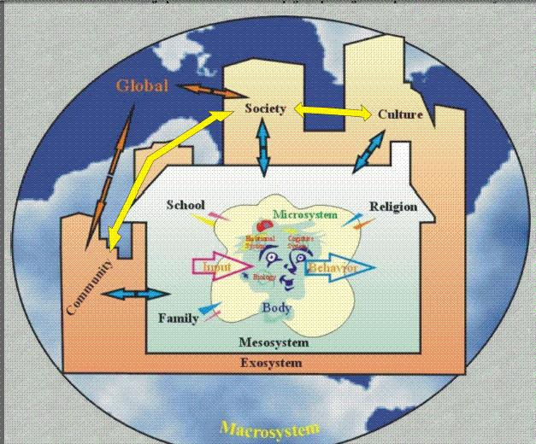
Rationale: Survey Questionnaire Design

Slide 6
Conceptual Framework of the Study
Daughter/Wife/Mother/Sister/Aunt
Context of Family, Community
Global Society
Student Teacher
ECAE
Context of Higher Education
Future Teacher
Context of School Reform and ADEC's 2030 Vision

Slide 7
Construction of Survey
Theory
Survey construction links
Main categories
Informal conversations
Ethics
Pilot

Slide 8
Piloting of the Survey
Pilot study was conducted to get feedback and refine the survey questions – 36 respondents from different institutions in teacher education
Fine tuning and item reduction
Final survey questions were developed using the software esurveyspro.com
101 respondents for main study
esurveyspro software program was used to design the survey and to manage for initial data analysis

Slide 9
Survey Instrument
Invitation to Participate
  Introduction, bilingual
  Question types & format
Main parts of the survey:
  Demographics
  Types of Supports
  Motivating Factors
  Challenges at different levels
  Supports at different levels
  Possibilities
  Concluding statements

Slide 10
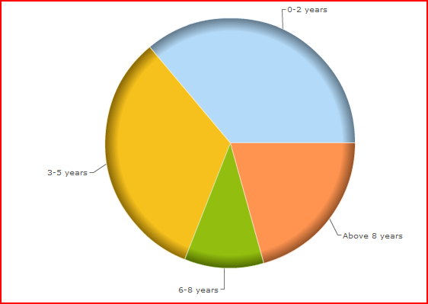
Study Participants
Age group: 20-24yrs – 60%, 25-30 yrs – 28%, above 30 yrs – 12%
ECAE female students in Bachelor of Education – over 50% were from Year 4, 20% from years 1 and 2 and over 10% for year 3,
  Number of years married:
36%
33%
21%
10%

Slide 11

Context of the Study
Total Population in the UAE - 8,248,000
Citizens: 948,000, Expats: 7.3 million
(Gulf News p. 16, March 11, 2012)
Funded and Sponsored by ADEC, Abu Dhabi Emirate
ECAE initiated in 2007, students enter from High School
Over 400 students from the Abu Dhabi Emirate and supported by about 40 faculty
Abu Dhabi public schools in the midst of educational reform and often referred to as the “New School Model”
Video clip

Slide 12
Key Findings of the Survey
Motivating Factors of becoming a teacher:
Expected Responses Over 80% strongly agreed | Surprises Only about 45% agreed on these
To be an educated parentأن أصبح والدة متعلمة | Teaching is desirable occupation for women التعليم مهنة مرغوبة لدى النساء
Add to my knowledge and experience كي أضيف إلى خبرتي ومعرفتي | Improve my financial situation تحسين وضعي المادي
Be an active member in society and honor my country أن أصبح عضواً ناشطاً في المجتمع و أشرف بلادي | Peer encouragement تشجيع أقراني لي

Slide 13
Key Findings of the Survey
Challenges at the Family level
Expected Responses About 50% strongly agreed | Surprises
Spending less quality time with my husband قضاء وقت أقل جودة مع زوجي | My extended family members (including husband’s) do not offer support – 20% أفراد عائلتي الممتدة (بما فيهم عائلة زوجي) لا يقدمون العون
Spending less quality time with my children قضاء وقت أقل جودة مع أولادي | Difficulty meeting family and study commitments صعوبة التوفيق بين الالتزامات الدراسية و الأسرية – 39%
Spending less time with relatives and sharing social life قضاء وقت أقل مع الأقارب و المشاركة في الحياة الاجتماعية

Slide 14
Key Findings of the Survey
Challenges at the College level
Expected Responses | Surprises
Too many courses and assignments to be done per semester - 70% وجوب إنهاء الكثير من المواد و الواجبات في كل فصل | Inflexible deadlines for submitting assignments – 37% عدم المرونة في مواعيد تقديم الواجبات
Lack of facilities on campus: (e.g. child care nursery, majlis, prayer room, study area) نقص التسهيلات في الحرم الجامعي ( حجرة عناية بالأطفال، مجلس، مصلى، حيّز للدراسة ) – 65% | Teaching and Learning in English is a challenge - 45% التعليم و التعلّم باللغة الإنجليزية هو تحدٍ بذاته
 | Transportation challenge المواصلات - 45%

Slide 15
Key Findings of the Survey
Challenges: College & Family Interaction
Expected Responses Strongly agreed | Surprises Strongly agreed
Family identifies me as a married person first and student second الأسرة تراني شخصاً متزوجاً في المقام الأول وطالباً في المقام الثاني - 50% | College faculty not understanding family situation – 22% عدم تفهم مدرسي الكلية للحالة الأسرية
Lack of communication between student services at the college and family -24% - neutral category ضعف التواصل مابين قسم الخدمات الطلابية في الكلية والأسرة | College faculty inflexibility towards married students – 33% عدم مرونة مدرسي الكلية مع الطالبات المتزوجات
 | Family member not understanding college expectations -22% عدم تفهم أفراد الأسرة لمتطلبات الكلية

Slide 16
Key Findings of the Survey
Challenges: Society Level
Expected Responses Strongly agreed | Surprises Strongly agreed
As a female, married Emirati student I see myself as a teacher contributing to developing the education system – 75% كطالبة إماراتية متزوجة، أرى نفسي معلمة تسهم في تطوير النظام التعليمي | My choice of employment in terms of location is limited to working in close proximity to my home – 57% خياري الوظيفي ، فيما يتعلق بالموقع ، محدود بالعمل في نطاق قريب من منزلي
As a female, married Emirati student my employment opportunities are limited to a female only school environment – 47% كطالبة إماراتية متزوجة ، فرص توظيفي مقتصرة على بيئات مدارس الإناث | As a female, married Emirati student my professional development for further education opportunities offered in Abu Dhabi are limited – 44% كطالبة إماراتية متزوجة ، الفرص المتاحة أمامي للتطوير المهني من أجل المزيد من التعليم محدودة في أبوظبي

Slide 17
Key Findings of the Survey
Challenges: Cultural Context
Expected Responses Strongly agreed | Surprises Strongly agreed
The teaching profession is respected in my culture – 74% مهنة التعليم محترمة في ثقافتي | Working as a teacher will allow me to spend more time with my family – 9% عملي كمعلمة سيسمح لي بقضاء وقت أكثر مع أسرتي
 | The working hours of the teaching profession is acceptable in my culture – 17% عدد ساعات العمل لمهنة التعليم مقبول في تقافتي

Slide 18
Key Findings of the Survey
Supports
Expected Responses Strongly agreed | Surprises Strongly agreed
My husband helps me with child care duties زوجي يساعدني في واجبات العناية بطفلي – 22% | The college supports me with a free education and course resources -28% تدعمني الكلية بتوفير تعليم و مصادر منهاجية مجانية
I plan and prioritize my family and study commitments – 59% أخطط لوضع التزاماتي الدراسية والأسرية كأولوية | My college respects my cultural values تحترم كليتي قيمي الثقافية – 25%

Slide 19
Key Findings of the Survey
Possibilities
Expected Responses Strongly agreed | Surprises Strongly agreed
Distance education courses will support me to complete my college degree – 50% مناهج التعليم عن بعد ستساعدني على إكمال شهادتي الجامعية | Opportunities to be employed as a future teacher in the public schoolsفرص توظيفي كمعلمة في المدارس الحكومية مستقبلاً - 44%
Policies for better college support for married women such as extended maternity leave, child care facilities on campus.- 68% سياسات تنظيمية لتقديم دعم أفضل للمتزوجات كتمديد إجازة الأمومة ، و وجود تسهيلات للعناية بالأطفال داخل الكلية. | My education degree will offer me better opportunities for promotion– 49% درجتي التعليمية ستوفر لي فرصاً أفضل للترقية
A mix of online and face to face course work will support me to complete my college degree. – 51% مزيج من المناهج الألكترونية و المناهج الحضورية سيدعمني في إكمال شهادتي الجامعية

Slide 20
Discussion Questions
How much harder is it in terms of teacher education in the Emirati culture to strike a balance versus other cultures?
Are our assumptions stereotyping the “teaching profession” for Emirati women? What would be the most favorable occupation for an Emirati woman in the sustainable future?
To what extent do higher education institutions consider or tailor programs specific to the needs of married women who pursue further education?
ltennant@ecae.ac.ae

Slide 21
"I can picture the future of the woman in my country ... I see her becoming more aware and understanding to all the surrounding circumstances and to the duties required from her. I see her and her sister hand in hand to ascend together the ladder of development and civilization established by the fixed foundations, as this is the beginning of the road for returning the favor to the motherland. "
(H.H Sheikha Fatima Bint Mubarak, 2010).
THANK YOU!

