Slide 1
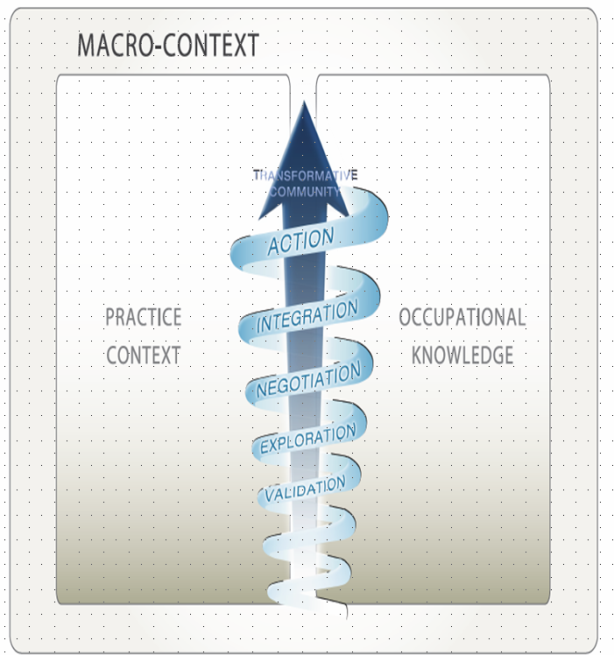

Research & EBP
Poster #: PRE-21-148
enichols@aut.ac.nz
作業療法実践の変革における重要な瞬間
Sagyō ryōhō jissen no henkaku ni okeru jūyōna shunkan
Critical Moments in the Transformation of Occupational Therapy Practice
Dr Ellen Nicholson, Professor Clare Hocking & Professor Marion Jones
Auckland University of Technology, New Zealand
Context
Equally prioritising biological & occupational needs disconnects occupational therapists from the profession's philosophy & contributes to our oppression (Whiteford & Townsend, 2011)
Research Questions
How do OTs working with children, young people and families translate ‘knowledge’ to inform occupational practice?
2. How does participation in the project empower occupational therapists to recognise and address concerns about the legitimacy of ‘accepted’ (privileged) practices with children & families?
Methodology & Design
Critical participatory action (add a ref citation)
Eight co-researchers
Collective action in a transformative community of practice over 12 months
Enabling Occupation II (Townsend & Polatajko, 2007) used as a ‘map’ for meetings & practice change
Dialogue collected as data; analysis used iterative & reflective methods
Health & Disability Ethics Committee (#NTX/09/10/092) and AUT Ethics Committee (#10/110) approval
Key Findings: The VENIA Model
A knowledge-translation model that describes five critical moments in practice transformation
A process for navigating the ‘space between’ the practice context and a conceptualisation of ‘occupational knowledge’ as useful for occupational practice in context
Action for Occupational Praxis
Authentic expression of practice as meaningful, occupational, family centred, & culturally responsive.
Integration
Increased confidence with language & practice; exploiting opportunities to sustain occupational practice (such as supervising students); signalling change through recertification, CPD, & supervision.
Negotiation
Transforming practice through reframing barriers as opportunities; challenging expectations about the OT role; using occupational language overtly.
Exploration
‘Trying on’ occupational practice by accessing & critiquing knowledge; using occupational language covertly; managing information carefully; and accessing social media.
Validation
Acknowledgment that change could not begin without recognition of the barriers to occupational practice, and the significant trust, courage, and resources required to change practice.
Working with others to construct & critique knowledge & practice was imperative to changing practice
References:
Nicholson, E. (2013). Collective action and the transformation of occupational therapy practice. Unpublished doctoral thesis; Auckland University of Technology, New Zealand.
Rodger, S., Ashburner, J., & Hinder, E. (2012). Sensory interventions for children: Where does our profession stand? (Invited editorial). Australian Occupational Therapy Journal, 59, p. 337-338.
Whiteford, G. & Townsend, E. (2011). Participatory occupational justice framework (POJF, 2010): Enabling occupational participation and inclusion. In F. Kronenberg, N. Pollard, & D. Sakellariou (Eds). Occupational therapy without borders (2nd ed., pp.65-84). Edinburgh, UK:
Elsevier Churchill Livingstone.
And ref added for critical participatory action

