Slide 1
Character Acting:
A Case for Better Animation Reference
Jason Kennedy
Lecturer in 3D Animation
Auckland University of Technology

Slide 2
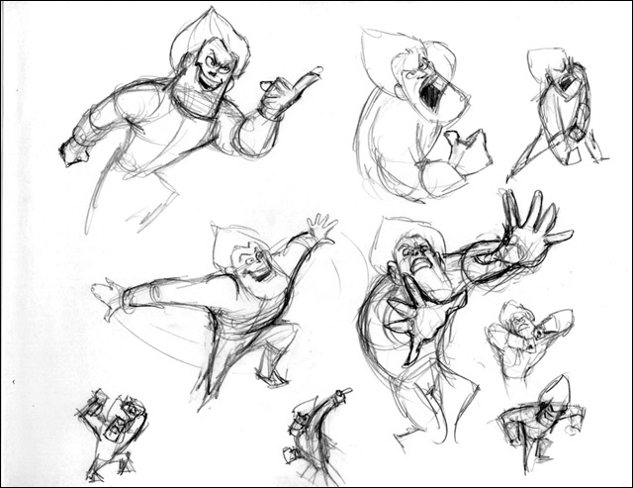
Reference? What’s that?
Some animators simply sit down and start drawing (or posing)
  Works well for quickly getting ideas on paper
  But... susceptible to cliché, repetition of ideas, and incorrect assumptions about movement and emotions
Gathering reference involves:
  Studying/drawing from life
  Sifting through relevant visual material
  Recording someone acting out your character’s performance
(Navone, 2004)

Slide 3

You really think you know better?
Buddy, you’ve got some nerve.
Just look at all the quality
animation that’s out there.
We’ve been doing this for years
and I think we’ve worked it out
pretty damned well.
Perhaps, but consider this:
  Most animators are not trained actors
  Animators act out their own reference
  Most animation lacks emotionally-connected performances.
  Emotional acting is difficult even for trained actors

Slide 4
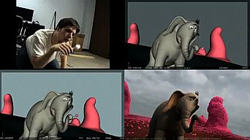
Video Reference
A loose blueprint of acting choices used to provide additional inspiration a guidance to physically and emotionally complex movements.

Slide 5



Video Reference

Slide 6
Acting for Live-Action vs Animation
Actor
Performance flows naturally
Actor is own instrument
Creates a performance on its own
Does not focus on specific gestures
Spontaneity
Organic interactions with a cast (natural chemistry)
Immediate feedback
Animated Character
Animator injects performance
Functionally useless by itself
Specifically crafted gestures to tell story
Illusion of spontaneity
Each performance constructed separately by animator
Delayed feedback

Slide 7
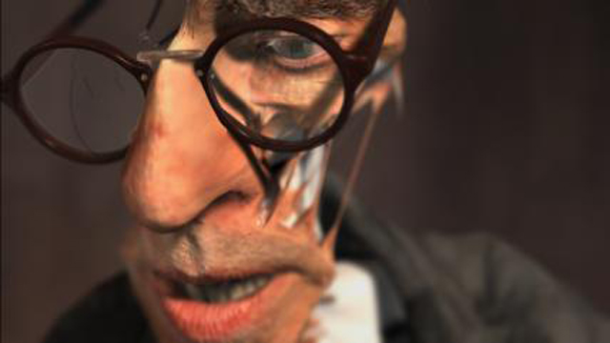
Appropriateness of Method
Emotionally-connected
reference would best serve
an animation that necessarily
involves a large emotional
range.
  Many animations do not have such requirements and can subsist off of superficial acting
Character-driven stories are also good candidates

Slide 8
Acting “Methods”
Stanislavski “method acting” most common among animators with some acting training
  Too often leads to recall of emotions rather than active engagement with emotions
  Actor can lose awareness of personal reality while trying to operate within a specific method technique
Morris’ BEING technique provides a better foundation for creating emotionally-centred reference for animation
  Dynamic engagement with emotions
  Active and unpredictable, just like life

