Slide 1

Distractions, Distrust, Enemies & Selfishness: Social Liabilities at Work
Keith Macky & Rachel L Morrison (AUT University, Auckland, NZ)
APS 11th IO Psychology Conference, 2-4 July Melbourne
The Context in Brief – social networks in the workplace
Employee social capital
Employee Social Liability (ESL)
Sources of employee social liabilities
Measurement approach and findings to date
What next?

Slide 2
1. The Context – Workplace Social Networks
All employees are embedded within a social network
This network comprises patterns of ties or relationships with other individuals (Newman, Hanges, Duan & Ramesh, 2008) .
Social networks:
impose opportunities and constraints on action,
channel the flow of resources between network members (actors)
and therefore potentially provide resources and benefits to an individual (Bourdieu & Wacquant, 1992; Nahapiet & Ghoshal, 1998; Wasserman & Faust 1994).
Relationships may be internal and external to the firm, proximal or distal, strong or weak, emergent or stable, desired or undesired, valued or not, but are nonetheless ubiquitous to being employed...

Slide 3
2. Social Networks & Employee Social Capital
Social capital is a multilevel construct applied as an attribute of nations, economic regions, communities, organisations, groups and, more recently, individuals (Coleman, 1990; Kouvonen et al., 2006; Labianca & Brass, 2006; Portes, 1998)
Employee social capital accrues from the network of social ties that assist in functioning at work and is the sum of the resources that individuals acquire from those networks (Bourdieu & Wacquant, 1992).
Because of their location within and across different social networks, some people will have more social capital than others (Bordieu 1986; Sobel 2002; Glaeser, Laibson, & Sacerdote, 2002)
Workplace social networks characterised by trust and reciprocity will generate more social capital - on a continuum from low to high(Kouvonen et al., 2006; Suzuki et al., 2010)

Slide 4
3. So what are Employee Social Liabilities (ESL) ?
Theoretical Point of Departure 1 – depending on the nature of the relationships contained within them, workplace social networks can also hinder an individual’s functioning and achievements at work.
Workplace social networks generate social liabilities when social ties work against the interests of an individual located within that network.
Theoretical Point of Departure 2 – Social liabilities are more than simply the absence of, or having low, social capital. This is not a zero-sum relationship. It is possible for someone to accrue both social capital and liabilities from their workplace social network(s).

Slide 5
The Social Network Capital and Liability Matrix
Social Liability
Low Social Capital High Social Liability
High Social Capital High Social Liability
Low Social Capital Low Social Liability
High Social Capital Low Social Liability
Social Capital

Slide 6
4. Employees acquire social liabilities from…?
Social networks containing:
Relationships characterised by distrust and suspicion
A lack of reciprocity and cooperation from colleagues
Exposure to negative relationships and behaviours at work, including interpersonal sabotage & undermining (enemies?) + ambivalent relationships (frenemies) (Labianca and Brass 2006; Duffy, Ganster, & Pagon 2002; Uchino et al. 2004)
High social demands and interpersonal distractions at work; e.g. from time wasters, chatterers and attention seekers.

Slide 8
5. Measurement approach and findings to date
Study 1:
Structurally analysed the prior literature and used 6 focus groups of employees to generate an initial pool of 85 items aimed at measuring the four ESL components.
Study 2:
Used an online Q-sort method involving 32 subject matter experts who were asked to sort the items provided into categories of items with what they thought were similar in meaning. Identified clusters were trust/distrust, cooperation, emotional support, social distractions, friendships, and negative behaviours / relationships.
SMEs were also asked to rate each item on a 7-point likers agree-disagree scale in terms of whether it described their network (to eliminate items with too little variance).
From this, 31 items were eliminated as being redundant and 11 were discarded either because less that 20% used them to describe their network or they were not consistently categorised in the Q-sort.
This left 43 items, including those clustered as support and friendship, for the next phase.

Slide 9
Study 3: Online Qualtrix panel survey of 1000 Australian employees
55% female; mean age = 46.8 SD = 12.7; median tenure 6.3 years; median years in career = 12.4; 65% employed full-time
“With reference to your current place of work and the relationships you have with others who work there, please indicate the extent to which you agree or disagree with the statements below” (1 strongly disagree, 7 strongly agree)
Principal Axis Factor Analysis with oblique direct oblimin rotation
Distrust of Others: 3 items, coefficient alpha = .82, mean = 3.44, SD=1.45
People I work with cannot be trusted to do as they say;
People I work with are mostly looking out for themselves;
I can’t be too careful in dealing with the people I work with;

Slide 10
Study 3 continued…
Lack or reciprocity/low cooperation: 6 items reverse scored, coefficient alpha = .90 mean = 2.53 SD=1.01
Most people I work with cooperate with each other; most of the time people I work with try to be helpful; My co-workers and I assist each other in accomplishing assigned tasks; etc.
Negative relationships: 10 items, coefficient alpha = .95 mean = 3.31 SD=1.62
Some people I work with have insulted me; People at work have spread gossip and rumours about me; Some people I work with have undermined my efforts to be successful on the job; etc.
Social Distraction: 6 items, coefficient alpha = .84 mean = 3.18 SD=1.19
My friends at work often keep me from my job requirements; I am often distracted by others at work; Some of the people I work with are very needy, demanding a great deal of my attention; etc.

Slide 11
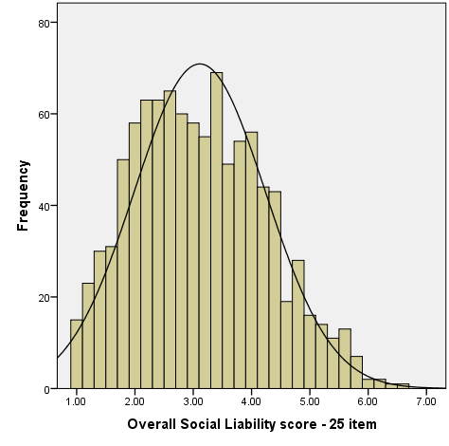
Study 3 continued
Overall Employee Social Liability scale:
25 items
Coefficient alpha = .95
High scores = high social liability
Mean = 3.11; SD = 1.13; SE = .04
Median = 3.04
Skew = .31
Kurtosis = -.46

Slide 12
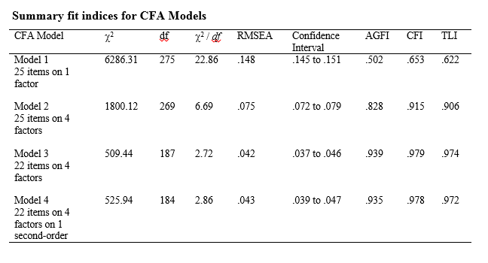
Study 3 CFA

Slide 13
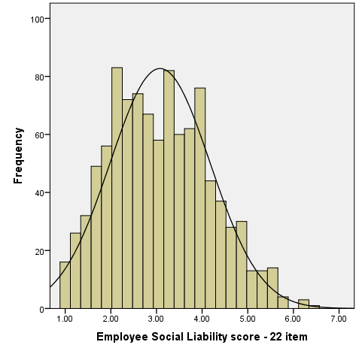
Study 3 continued
Final Employee Social Liability scale:
22 items (less 3 neg. beh. items with high standardised residual covariances)
Coefficient alpha = .94
High scores = high social liability
Mean = 3.08; SD = 1.10; SE = .03
Median = 3.05
Skew = .30
Kurtosis = -.47

Slide 14
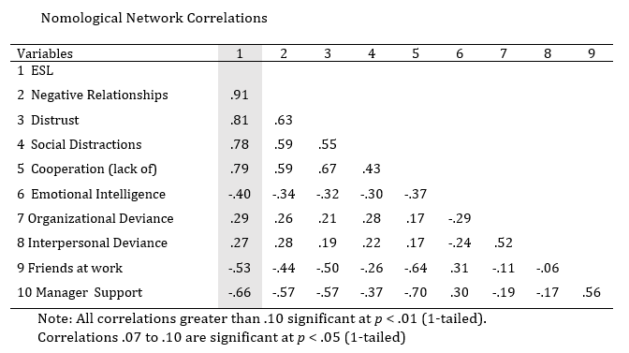
Study 3 Nomological Network

Slide 15
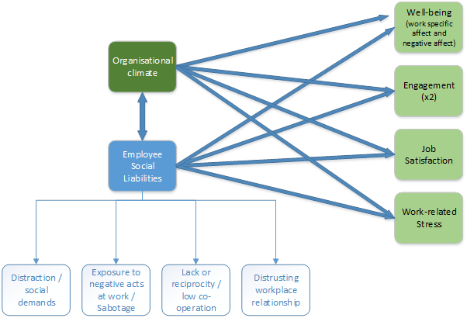
6. Where to next? Address the “so what” question

Slide 16
Thank you.
Questions?

