Slide 1


The Impact of Cultural Diversity in Corporate Boards on Firm Performance
Auckland Finance Meeting
19 December 2014
Helena Címerová Olga Dodd Bart Frijns
Auckland University of Technology

Slide 2
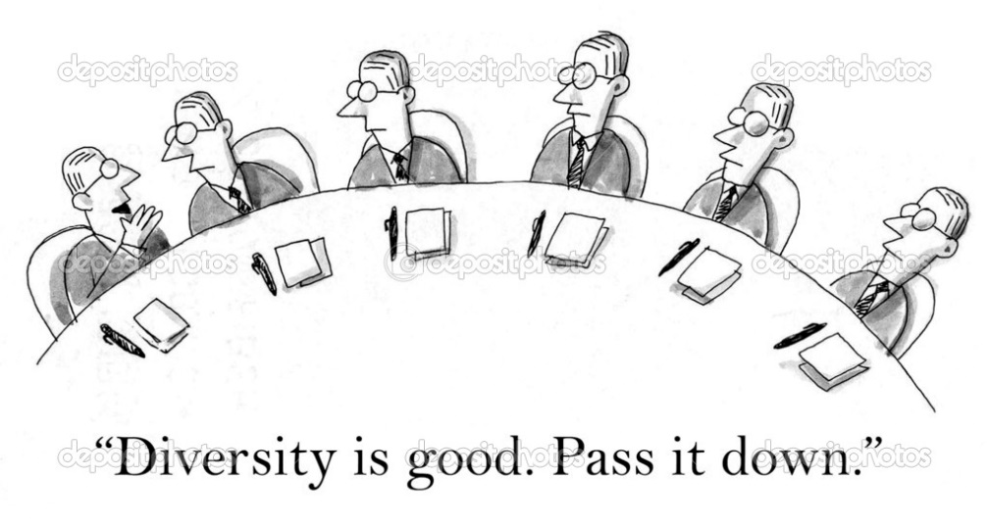
Motivation
Boards of directors: “groups of diverse individuals who have different biases and prejudices and whose behaviour is affected by social constraints and power relations” (Ferreira, 2010)
Economic value of cultural diversity?
  Gender, age, experience, race, etc.
Our paper: cultural diversity in boards and firm performance

Slide 3

Outline
Summary of findings
Cultural diversity and its measurement
Data
Baseline results
Endogeneity
  Dynamic specification
  IV/2SLS
Robustness results
  Foreignness
  Firm operations
  Alternative culture framework
  Individual culture dimensions
Conclusion

Slide 4
Findings
Cultural diversity (CD) in boards negatively affects firm performance
  Firms at the 75th percentile of the CD distribution achieve a Tobin’s Q that is 0.18 less than firms at the 25th percentile
  ROA is 1.26% lower for firms at the 75th percentile compared with firms at the 25th percentile
Robust finding (considerable explanatory power of our CD measure)
Firm complexity and firms’ presence in foreign markets are mitigating factors
Some cultural dimensions matter more than others

Slide 5
Culture
“the collective programming of the mind distinguishing the members of one group or category of people from others” (Hofstede, 1980)
Captured by discrete dimensions of cultural values, which are formed during early childhood, remain relatively stable throughout one’s lifetime, and are shared within a nation
Hofstede framework (1980, 2001)
  individualism, masculinity, power distance, uncertainty avoidance + pragmatism + indulgence

Slide 6
The “double-edged sword” of cultural diversity
Inherent type of diversity (Maznevski, 1994)
Advantages
  Culture-generic: worldviews, perceptions, intepretations, etc.
  Culture-specific: knowledge of foreign culture, communication networks, linguistic resources, etc.
Disadvantages
  misunderstandings, communication slower and more difficult (attribution of meanings),…
  most disruptive to group-decision making processes (Adler, 1991)

Slide 7
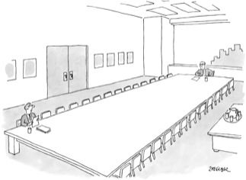
Measuring cultural diversity

Slide 8
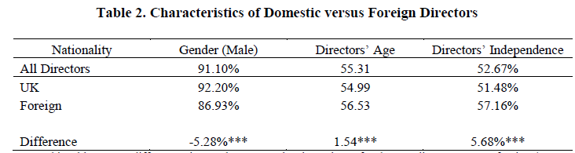
Data
UK public companies (95% of mkt cap)
2002-2012 biannually, 1,290 firm-year observations
Firms: Datastream
Directors (11,185 individuals): Orbis, annual reports

Slide 9
Tests
Baseline regressions
Causality hints:
  Dynamic model specification
  IV regression (2SLS w/ UK small town & directors’ average age as instruments)
Robustness:
  “Foreignness” of board and firm
  Firm operations – firm complexity and foreign operations
  Alternative culture frameworks
    Tang and Koveos (2008), GLOBE – House et al. (2004), Schwartz (2006)
  Individual culture dimensions

Slide 10
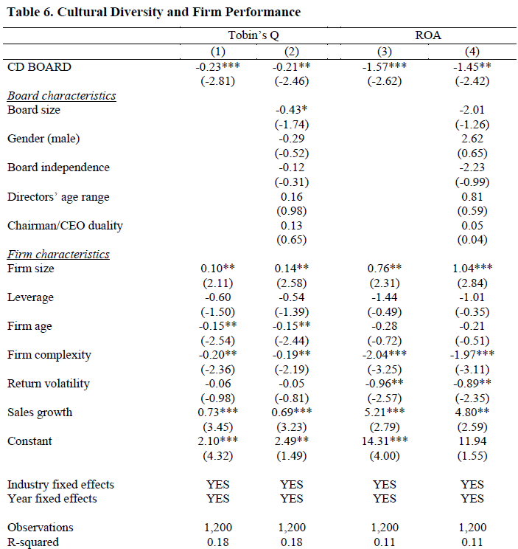
Baseline results

Slide 11
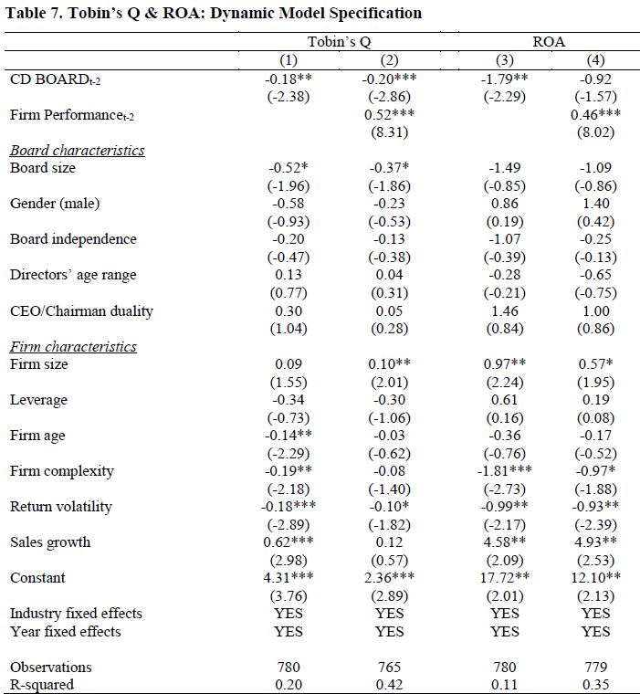
Dynamic specification

Slide 12
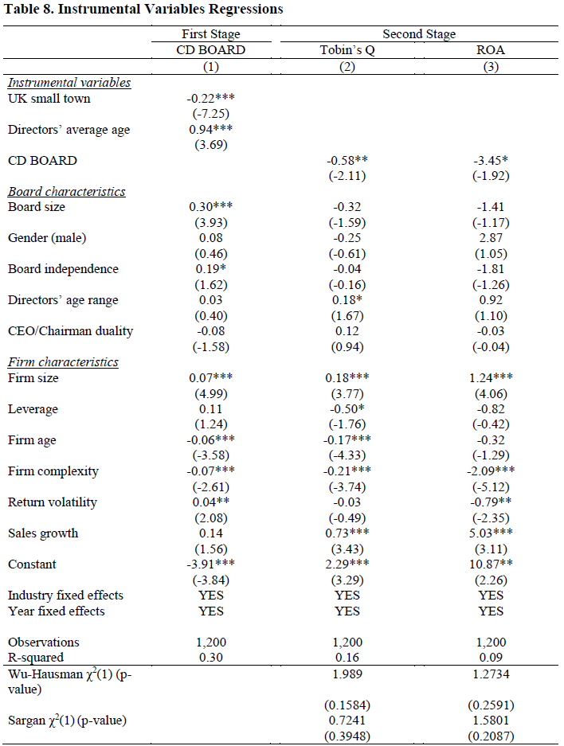
IV – 2SLS

Slide 13
Are we measuring “foreignness”?
  CD only for firms with FDs
  Board-level
  Foreign directors share
  Nationalities ratio
  Foreign independent director (FID) dummy
  FID share
Firm-level
  Foreign sales
  Foreign assets
  NYSE listing
  Foreign listing
cf. Masulis et al. (2012)

Slide 14
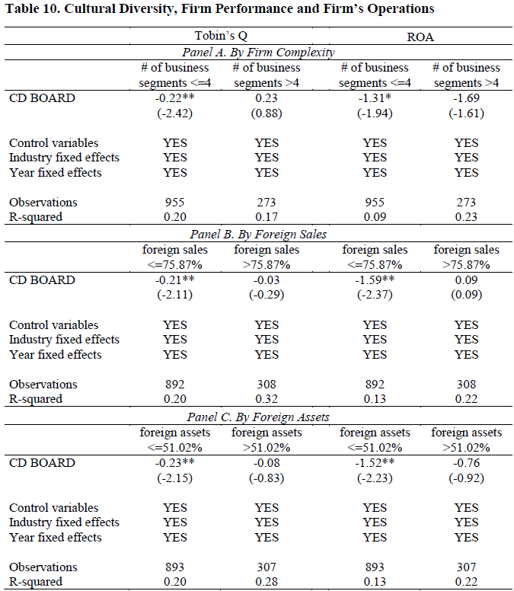
Firm operations
cutoff point
for subsamples =
75th percentile
cf. Anderson et al. (2011)
cf. Masulis et al. (2012)

Slide 15
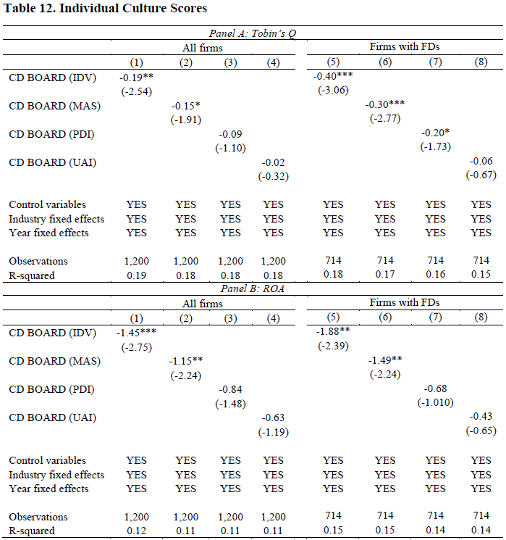
Individual culture scores

Slide 16
Conclusions
CD in boards economically important
On average, negative relationship btwn CD in boards and firm performance (frictions outweigh advantages)
But disadvantages of CD mitigated in more complex firms or firms with more foreign operations (match between firms’ needs and expertise of foreign directors)
A more nuanced story of board diversity: “ticking boxes” does not add value to companies

Slide 17
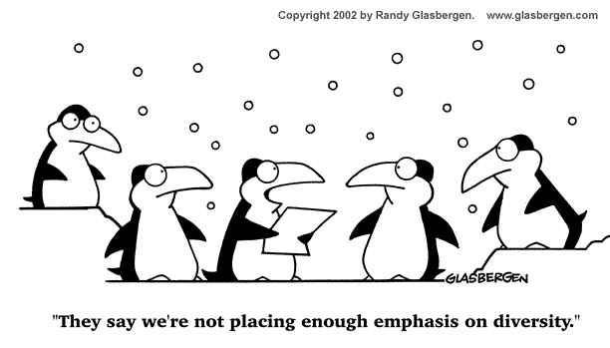
Thank you.

Slide 21
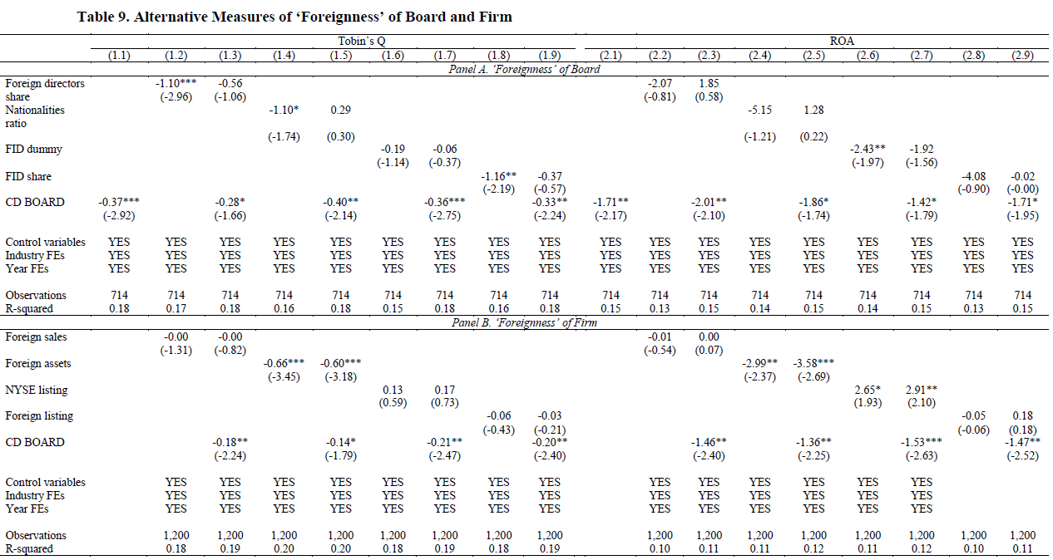

Slide 23
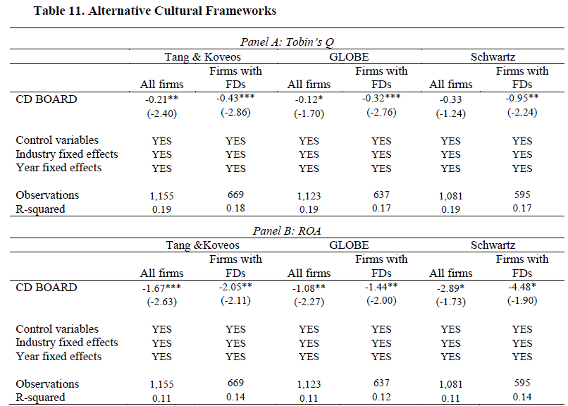

Slide 25
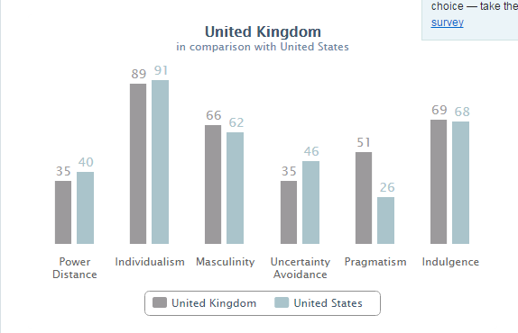
Cultural distances (UK vs US)
Source: geert-hofstede.com

Slide 26

Cultural distances (UK vs Germany)
Source: geert-hofstede.com

Slide 27
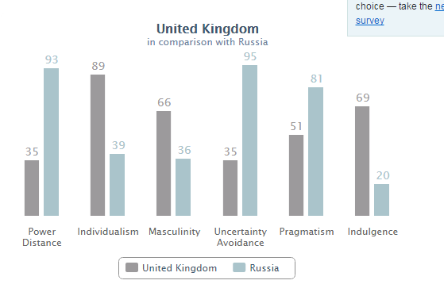
Cultural distances (UK vs Russia)
Source: geert-hofstede.com

