Slide 1


World Internet Project
New Zealand
Philippa Smith
Executive director, WIPNZ
Nethui, 9-11 July, 2014

Slide 2
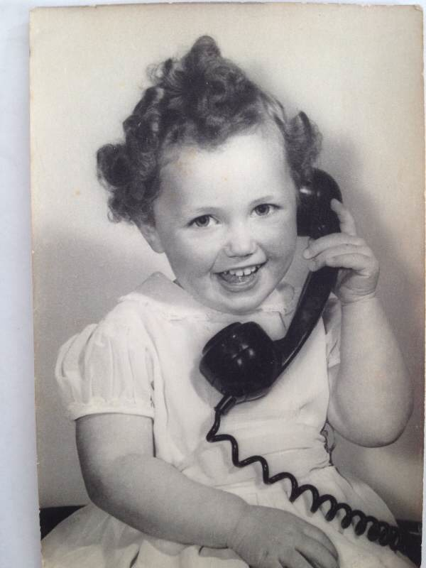
Digital immigrant

Slide 3
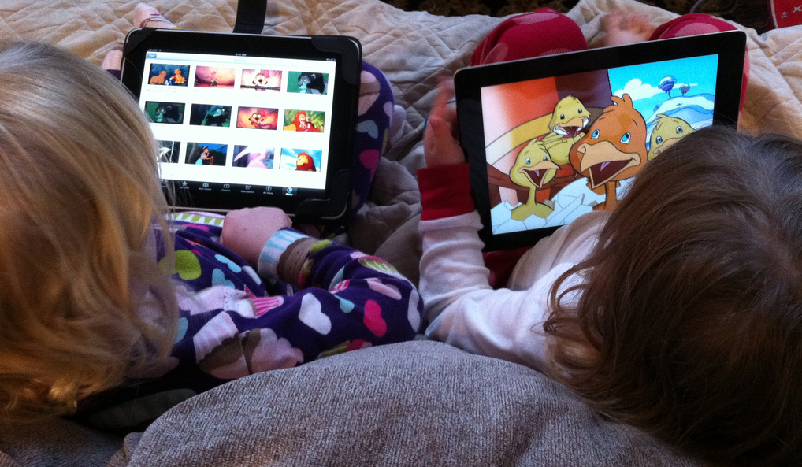
Digital native
Notes:
Just like these digital natives where the internet and social media are just part of life, understanding where we as Nzers have come from and where we sit amongst other countries in our internet use is extremely important.

Slide 4
World Internet Project – Background
International collaborative project involving 40+ countries
Social, political & economic impact of the internet and new technologies
WIPNZ surveys 2007, 2009, 2011, 2013
Shared questions allow international comparisons
Also questions designed specifically for NZ

Slide 5
Sample design
2007–2011 were telephone only surveys, 2013 included additional online component
Variables: gender, age, ethnicity, geographic location, household income
Exclusions: internet non-users without landlines; non-English speakers; those refusing
95% confidence intervals:
~ ±2.3% on full sample; ~ ±2.5% on internet users

Slide 6
Internet Trends in New Zealand
2007–2013
WORLD INTERNET PROJECT
NEW ZEALAND
Charles Crothers
Andy Gibson
Melissa Miller
Philippa Smith
Allan Bell

Slide 7
User status
User status

Slide 8
User status by age
Base: All respondents

Slide 9
Internet access
through various devices
Base: Internet users (n=1847) | Graphs with no year labels refer only to 2013 data

Slide 10
Use of wireless devices
Base: Users | Note: different questionnaire wording in different years

Slide 11
Device in household by income
Base: Users

Slide 12
Phone calls over the internet
(including video calls)
Base: Users

Slide 13
Social networking site membership
Base: Users

Slide 14
Online consumer activities
Base: Users

Slide 15
NZ a leader in online purchasing

Slide 16
Internet security issues
Base: Users

Slide 17
Government/Council services online
Base: Users

Slide 18
Opinions about internet governance
Base: Users

Slide 19
Importance of the internet to everyday life
Base: All respondents

Slide 20
Importance of internet as a source of information and entertainment, by age
Base: All respondents

Slide 21
User status by area
Base: All respondents

Slide 22
User status by ethnicity
for those aged 16–49
Base: All respondents aged 16-49, and excluding other ethnicities than the four groups shown
Note: Shows only under 50 due to very different age profile of NZ European compared to other ethnicities

Slide 23
Betty: Non-user to user
mid 70’s, high school educated, low income,
living in an urban centre
2007 non-user, said she was ‘not likely’ to start
  using the Internet
Radio was primary source of information and
entertainment
2009 started browsing the net for health information,
playing games online, and checking emails daily
Felt the internet decreased her contact with
local community
2013 the Internet was ‘very important’ to her daily life

Slide 24
Crystal: Confident user
30s, Asian, tertiary qualification, lives in a main city
Asian ethnicity, In her 30s,
Broadband Internet connection
Online activities include email, Facebook, browsing,
games, looking for work, chat rooms
Began paying bills online
Used non-English websites
High level of confidence in reliability of information
accessed online

Slide 25
Molly: Family rules
intermediate school
Satisfied with broadband connection at home
Uses Internet in her bedroom
2009 playing games online, listening to music, watching shows and movies
2011 joined Facebook, keeps a blog
Uses the Internet to support learning
House rules include not to visit some sites, not to give out personal information online, not to chat with strangers, not to meet up with someone met online

Slide 26
Richard: Alienation
In his 60s, from non-user to user, and back again
In 2007, did not have a computer and had
asked several people to do things online for him
2009 started using Internet at work, listening to the
radio online, streaming music and instant messaging,
felt the Internet increased time with family
2011 stopped browsing the web, felt the Internet
decreased time spent with family
After 3 years of Internet use, said it was too difficult
and stopped using Internet

Slide 27
Discussion Points
New Zealanders as online consumers,
‘digital natives’ increasingly become drivers of new online business models
“anytime-anywhere” internet
Internet is valued for:
  Consumer transactions – buying, paying bills
  Online telecommunications
  Social networking
  Source of Information

Slide 28
Discussion Points: Issues
Divides:
Availability and accessibiltiy
Impact of new technology
Ethnic groups
Geographic divides

Slide 29



WIPNZ Supporters
Department of Internal Affairs

Slide 30
For more information:
The World Internet Project in NZ
www.wipnz.aut.ac.nz
The World Internet Project - international
www.worldinternetproject.net
philippa.smith@aut.ac.nz

Slide 31
Anne: Non-user
60s, NZ European lives in a small town
Non-user in all 4 surveys
No computer at home and does not want one
TV is source of entertainment and information
2009 began texting family
2007 & 2009 had not asked for anyone’s help to do something on the Internet
2011 &2013 needed someone’s help with internet related tasks
(Even staunch non-users have increasing need to access Internet)

Slide 32
Hours spent online per day
Base: Users

Slide 33
Moana: Internet success story
50s, Maori, tertiary qualification, lives in main city
2007 avid TV watcher, checked email daily,
played online games weekly,
but Internet not important source of information
2013 reading online news every day, joined Facebook,
started watching videos online every day
Also began posting audio material and online banking
Had made friends online
Said the Internet had greatly increased her contact
with friends and local community
Whanau remained important source of information

Slide 34
Joan: Newspapers to online news
  mid 50’s, married, upper income, urban,
broadband in home office
  has been using the Internet since 1998
  2007 Internet not important as source of
information and entertainment
  2007 Newspapers ‘very important
  2009 began downloading music,
watching TV on demand, SNS, navigation sites
  2013 began commenting on people’s blogs,
using an e-reader, playing games online
  2013 Newspapers ‘not important’

Slide 35
Tane: Social networks
60s, Maori, high school qualification, low income
2007 confused by the Internet, unlikely to use it
TV and radio for entertainment and information
2011 and 2013, watched less TV, online games,
local news online, downloads music, reads blogs
Family, friends and community consistently
valued as source of information
Now uses Twitter and Facebook,
made friends online and met them in person
Emails and texts friends and family
Wary of Internet security and has never done banking online
Feels the Internet increases his sense of ethnic and national identity
and is now an important part of his life

Slide 36
Stanley: Buying and selling online
mid ‘70s, married, living on low income
2007 had dial-up connection,
never played games online
2009 changed to broadband,
began playing games every day
2013 communicated with friend on SNS,
occasionally posted content
Also began buying and selling items online

Slide 37
WIPNZ 2013 Supporters
Department of Internal Affairs

Slide 38
Uploading/sharing content on social networking sites
Base: Users who are members of a SNS

Slide 39
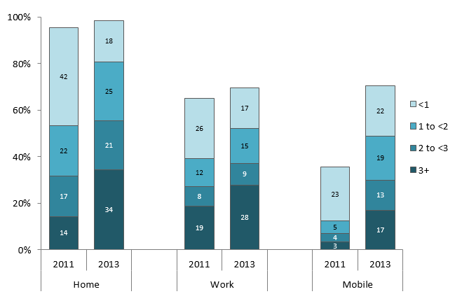
Hours online (average day)
Notes:
Looking at the number of hours on an average day for internet users, and in what location we can see that home was

