Slide 1
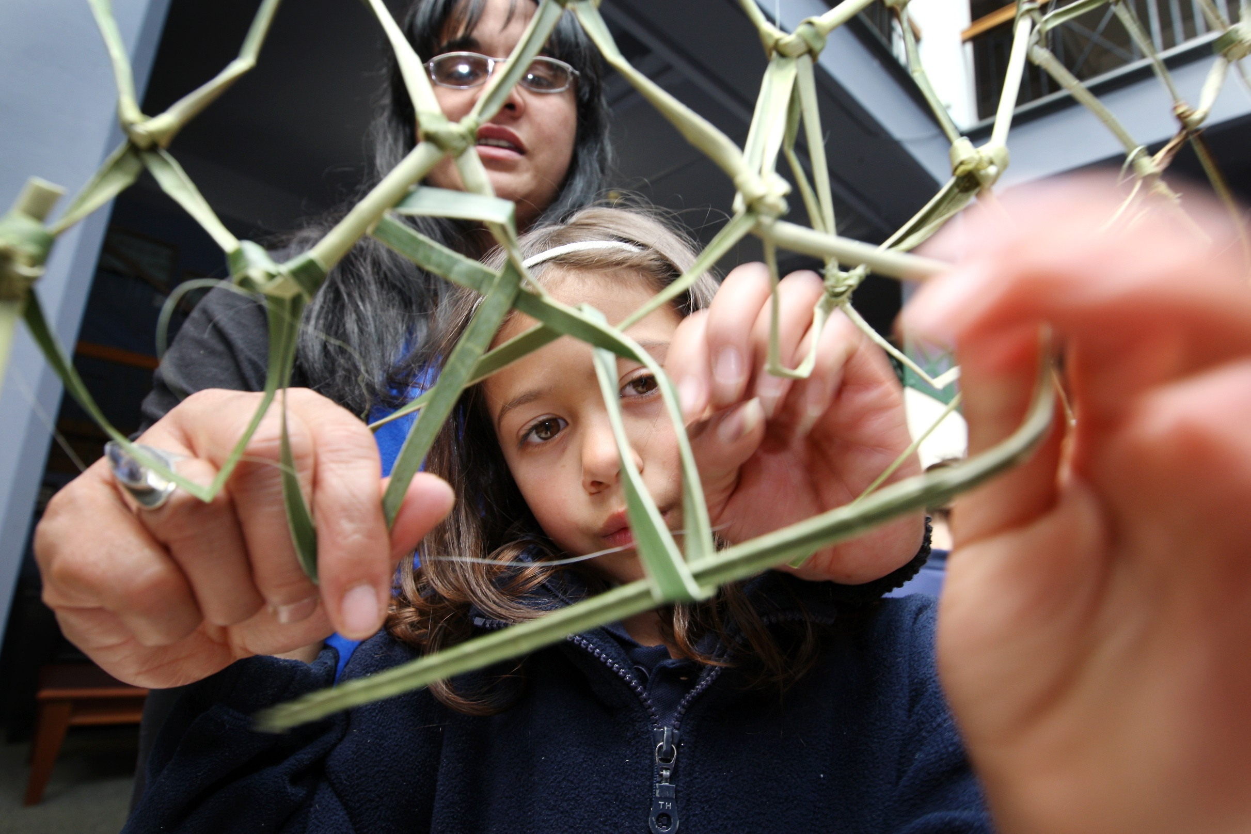


Poster Number
Development of a Community Focused Resource to Facilitate Children’s Participation after Traumatic Brain Injury (TBI)
Margaret Jones, Professor Clare Hocking & Professor Kathryn McPherson
Auckland University of Technology, New Zealand
WFOT Congress, Yokohama, Japan, June 2014
Contact: margjone@aut.ac.nz
Background
Children who sustain a TBI are at risk of poor participation outcomes. Findings from case study research in New Zealand confirmed that participation in shared occupations with their peers is important to children and their families, but others’ lack of understanding and skill restricts them. Guided by those findings, a resource was developed which included strategies to enskill communities in fitting participation contexts to children’s abilities and needs, and in crafting opportunities for their participation.
Objective
To evaluate the conceptual basis and feasibility of a draft community-focused resource to foster participation of 9-12 year old children in shared occupations after TBI.
Methodology & Method
Pragmatic action research (Greenwood & Levin, 2007).
Twenty participants, including family members, teachers, caregivers, and rehabilitation staff took part in two rounds of focus groups and provided feedback. Data were analysed using a cognitive mapping strategy (Northcott, 1996).
Ta Kupenga
Weaving a network of community connections
Results
Re-connecting with the community was likened to the traditional craft of net-weaving. Parents work with community members to gradually repair and extend their children’s connections, helping them go out into the world.
Discussion
The participatory study endorsed the resource and supported it’s evolution so that it reflects the context in which it will be applied. It provides evidence about how to enable children’s participation in shared occupations, by establishing community connections.
Conclusion
Feedback affirmed the utility of the resource across multiple contexts. It aims to weave a network of relationships through shared occupation in order to support participation.
References
Greenwood, D. J., & Levin, M. (2007). Introduction to action research: Social research for social change (2nd ed.). Thousand Oaks, CA: SAGE.
Northcott, N. (1996). Cognitive mapping: An approach to qualitative data analysis. Journal of Research in Nursing, 1, 456-464. doi:10.1177/174498719600100610
Acknowledgements
The study was partially funded through an
award from the Health Research Council of
New Zealand.

