Slide 1


Case study in analytical planning: Investigating the sensitivity of outcome measures to a Tai Chi Intervention in people with Multiple Sclerosis
Janet Pearson, Alain Vandal, Elizabeth Binns, Denise Taylor

Slide 2
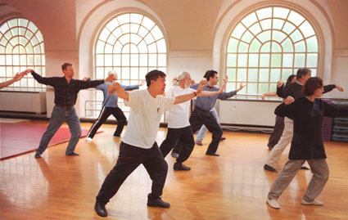
http://www.hcs.harvard.edu/~htctc/taichikung.php

Slide 3
Objectives of the pilot study
  Determine if the intervention (a course in Tai Chi) is acceptable and suitable to people with Multiple Sclerosis (MS)
  Determine how sensitive the outcome measures are in detecting changes in strength, balance and quality of life in response to the intervention (information will feed into a full study design)
  Quality of life
    Timed Up and Go test (TUAG) (↑↓)
    (measures functional mobility)
    MS Impact Scale (↓) (MSIS-29)
    -physical impact
    -psychological impact
    Chalder Fatigue Questionnaire (↓)
  Strength measures:
    30 second Chair stand test (↑)
  Balance:
    Step test (↑)
    Single-limb support test (↑)
    Berg balance test (↑)
(Expected direction of change in response to Tai Chi shown in brackets)

Slide 4
Study Design
Recruitment
Baseline Assessment
Week 0
Pilot, wait-list control study
Two groups each of 15 people with MS were randomised to either the Tai Chi intervention (‘Group 1’), or to the waiting control (‘Group 2’)
Group 1
Tai Chi
1x/wk for 20 weeks
Group 2
Waits (no intervention)
Control group
Weeks 1-20
Assessment 2
Week 21
Group 1
Waits (no intervention)
Group 2
Tai Chi
1x/wk for 20 weeks
Weeks 22-42
Assessment 3
Week 43

Slide 5
Outline
Objectives
Data
Comparison to process for full trial
Analysis options
Results
Sensitivity of the outcome measures
Conclusions

Slide 6
Objectives
Give a comparison to what would have been done for a trial in search of conclusive answers rather than searching for signals for planning for a full study
Present different options for the analysis
Give ‘best of all worlds’ analysis results
Discuss sensitivity of the outcome measures
Give a comparison of the ‘best of all worlds’ analysis to the alternative analyses just for the continuous outcomes

Slide 7
The Data – how collected
  Convenience sample
    Adverts placed in Multiple Sclerosis newsletters (MS Auckland and MS North Shore Society); invitation included in information pack for an ongoing study
    15 participants were needed for each of the 2 groups (i.e. classes) - volunteers were chosen on a “first come first served” basis
    People who met the study criteria were invited for a baseline assessment
  People were either in Waitakere City or North Shore City. These two groups were randomised by tossing a coin to decide which received the Tai Chi input first.
  Trained assessors blinded to treatment allocation, completed all assessments

Slide 8
The Data - characteristics
Numbers
  Class 1 (Tai Chi, followed by waiting):
    15 people (one that never attended; 3 withdrew from class after baseline)
    assessment 3 ‘sustainability of tai chi’ information: 2 people had totally missing information, and 4 had limited information (due to being via post)
  Class 2 (Waiting, followed by Tai Chi)
    15 people (3 withdrew from class after baseline)
    assessment 3 ‘after tai chi’ information: 1 had totally missing information, and 1 had limited information (due to being via post)
Characteristics
  Gender (Class 1 – 64% female; Class 2 – 87% female)
Age
 | Mean | Std Dev | Minimum | Maximum
Class 1 | 54 | 11.1 | 38 | 76
Class 2 | 54 | 11.5 | 37 | 78

Slide 9
Why is this an important study?
MS (Multiple Sclerosis) is a chronic inflammatory demyelinating disease of the central nervous system, characterised by the formation of sclerotic plaques in the white matter of the central nervous system – leads to various symptoms (loss of balance, muscle weakness, fatigue etc)
Strength and balance are two common symptoms of MS that are modifiable and have a large impact on people’s functional ability levels (Lord, Wade, & Halligan, 1998)
Improving strength and balance may result in people with MS maintaining functional independence and hence have a positive impact on their quality of life
Tai Chi (TC) reported benefits include psychological, improved flexibility, strength, balance, and cardiovascular and respiratory function (Wang, Collet, & Lau, 2004) however little research has explored the effects of TC in people with MS.
If TC is acceptable and potentially beneficial to people with MS, the findings from this research may strengthen the case for further research into this activity and for funding to be sought to provide TC programmes for people with MS (some already funded by ACC for older people).

Slide 10
Comparison of process to analysis for a conclusive trial
Would have a pre-specified analysis plan, including the significance level that we would be using to assess our hypotheses
Analyst would also have been blinded as to which group received the intervention first
Would only keep covariates in that were significant before un-blinding
Direction of my Sustainability hypothesis for TUAG would have been set a priori instead of after viewing the direction of effect for the main hypothesis
… here however, we are searching for signals (trying to identify which outcomes are the most sensitive to the intervention) on a small pilot data set to inform planning for a full study

Slide 11
Analysis possibilities
Analyse data in the flow diagram in three parts, using three separate models:
  Data Part 1. Assessment 2
  Two sample t-test comparing first tai-chi class post-pre to the control post-pre
  Data Part 2. Assessment 3 vs Assessment 2 for Group 1
  One sample t-test to test sustainability of the intervention (for Group 1)
  (Data Part 3. Combining Tai Chi Assessments to utilise both sets of Tai Chi data
  Combine the post-pre data from the two Tai Chi classes together and do a one sample t-test of no effect)
Random effects analysis - ‘Best of all world’s analysis - analyse all the data together in one model, enabling:
  Comparison of Tai Chi to Control, with increased power
  Assessment of sustainability of the intervention
  Utilising both sets of Tai Chi data in the one model makes Data Part 3 above redundant (we really want to compare to control)

Slide 12
Analysis possibility 1: Data Part 1
Independent samples t-test (i.e. Tai Chi vs Control) if had normally distributed data
H0: Group 1 (Assessment 2- Baseline) = Group 2 (Assessment 2- Baseline)
H1: Group 1 (Assessment 2- Baseline) ≠ Group 2 (Assessment 2- Baseline)
Recruitment
Baseline Assessment
Group 1
Tai Chi
1x/wk for 20 weeks
Group 2
Waits (no intervention)
Control group
Similarly:
Could perform an ANCOVA testing for no difference in means between the two groups at assessment 2, adjusting for baseline value plus gender and age.
Assessment 2
Advantages:
Comparison to a control group, can detect if ‘no change’ in Tai Chi group is good if there is otherwise natural deterioration over time
Baseline values are taken into account (and other individual covariates are adjusted for)
Disadvantages
Does not utilise Group 2’s post-Tai-Chi data
Needs normally distributed data in the groups
Group 1
Waits (no intervention)
Group 2
Tai Chi
1x/wk for 20 weeks
Assessment 3

Slide 13
Analysis possibility 1: Data Part 2
Recruitment
Testing sustainability of intervention – non-inferiority of Post-Tai Chi compared to Tai Chi – paired t-test.
H0: Group 1 Assessment 3 < Group 1 Assessment 2
H1: Group 1 Assessment 3 >= Group 1 Assessment 2
Where larger is better (signs reversed where outcome is better if smaller).
Baseline Assessment
Group 1
Tai Chi
1x/wk for 20 weeks
Group 2
Waits (no intervention)
Control group
Assessment 2
Group 1
Waits (no intervention)
Group 2
Tai Chi
1x/wk for 20 weeks
Disadvantages:
Does not utilise the rest of the data
Assessment 3

Slide 14
Analysis possibility 1: Data Part 3 – to utilise Group 2’s Tai Chi data
Paired t-test combining data from both Tai Chi classes (if had normally distributed Post-Pre data)
H0: Post Intervention – Pre Intervention = 0
H1: Post Intervention – Pre Intervention ≠ 0
Recruitment
‘Pre’
Baseline Assessment
Group 1
Tai Chi
1x/wk for 20 weeks
Group 2
Waits (no intervention)
Control group
Advantages:
Utilising Group 2’s post intervention data increases our power to detect a change
Internally controlled (each person’s value compared to their baseline)
Disadvantages:
No external control – no change may be a good thing
Not controlling for seasonality (‘time’)
Not controlling for other variables
‘Post’
‘Pre’
Assessment 2
Group 1
Waits (no intervention)
Group 2
Tai Chi
1x/wk for 20 weeks
‘Post’
Assessment 3

Slide 15
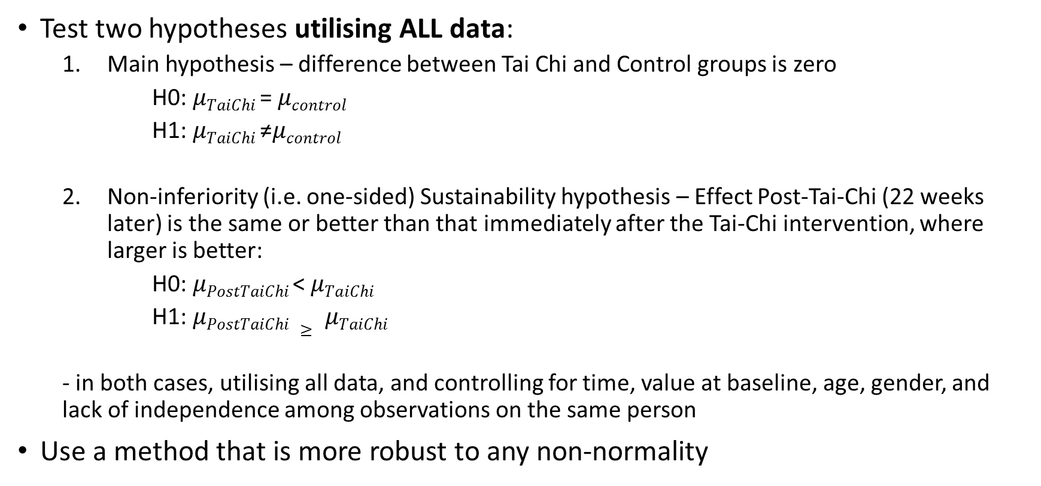
What we really want to be able to do
Test two hypotheses utilising ALL data:
  Main hypothesis – difference between Tai Chi and Control groups is zero
      H0: $μTaiChi$= $μcontrol$
      H1: $μTaiChi$≠$μcontrol$
  Non-inferiority (i.e. one-sided) Sustainability hypothesis – Effect Post-Tai-Chi (22 weeks later) is the same or better than that immediately after the Tai-Chi intervention, where larger is better:
      H0: $μPostTaiChi$< $μTaiChi$
      H1: $μPostTaiChi ≥ μTaiChi$
  - in both cases, utilising all data, and controlling for time, value at baseline, age, gender, and lack of independence among observations on the same person
Use a method that is more robust to any non-normality
Enter Analysis possibility 2: the ‘Best of all worlds’ analysis….

Slide 16
Analysis possibility 2: ‘Best of all worlds’ – random effects
Utilises all data at once in one model
$$Yijkg=β^{′}xj+μk+τi+σj+εijkg$$
Error term
Individual covariates:
Value at baseline
Age and gender
Individual random effect
Time (1 or 2)
Tai-Chi group
(different to randomisation group):
-Tai-Chi
-Control
-Post-Tai-Chi
Normal regression for scales, and time data
Using normal regression as an approximation for count data as means>=7
Logistic regression for data where the outcome has been dichotomised at ‘achieved maximum possible time/score’

Slide 17

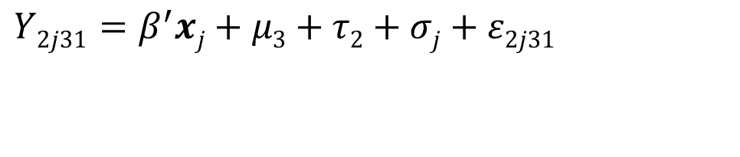
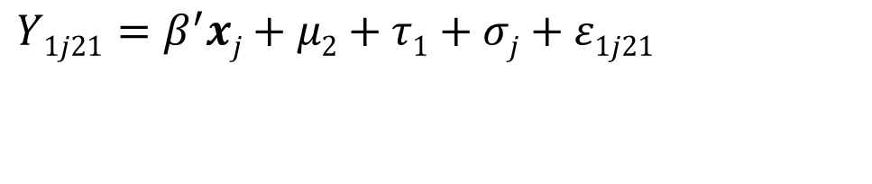
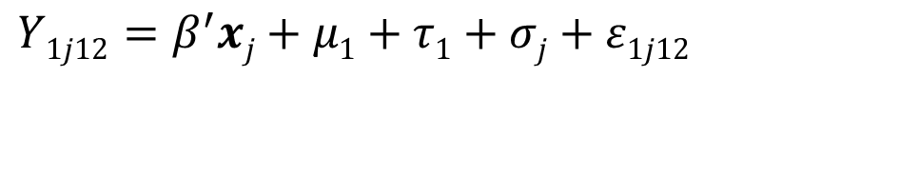
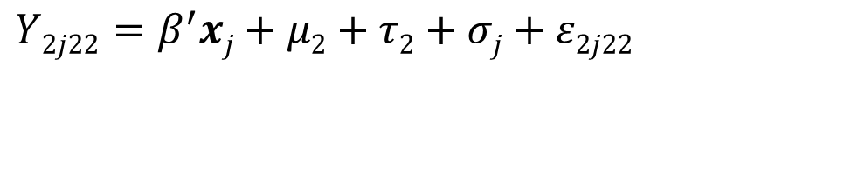
$$Yijkg=β^{′}xj+μk+τi+σj+εijkg$$
Recruitment
Baseline Assessment
Group 1
Tai Chi
1x/wk for 20 weeks
Group 2
Waits (no intervention)
Control group
Tai Chi mu group
Control mu group
$$Y1j21=β^{′}xj+μ2+τ1+σj+ε1j21$$
$$Y1j12=β^{′}xj+μ1+τ1+σj+ε1j12$$
Assessment 2
Group 1
Waits (no intervention)
Group 2
Tai Chi
1x/wk for 20 weeks
Post Tai Chi mu group
Tai Chi mu group
$$Y2j31=β^{′}xj+μ3+τ2+σj+ε2j31$$
$$Y2j22=β^{′}xj+μ2+τ2+σj+ε2j22$$
Assessment 3

Slide 18
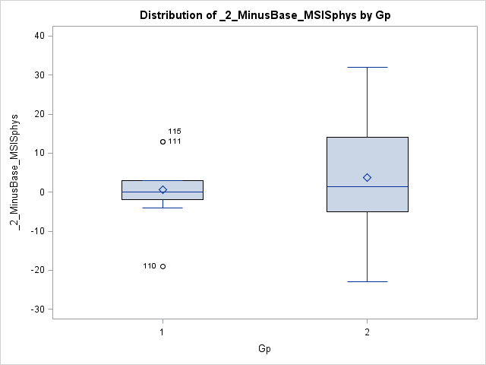

‘Best of all worlds’ analysis – random effects covariance structure
From exploratory graphs, decided to also have different residual variances depending on the randomisation group for some outcomes measures – for MSIS physical (below), MSIS psychological, Step Test
$εijkg\sim N(0,σgroup)$

Slide 19
‘Best of all worlds’ analysis – issues encountered
Small numbers:
  Significance no longer an indicator of whether to leave a covariate in or not
    SOLUTION: Present effect sizes of fully adjusted model, as we are just in search of a signal
  numerical problems (‘G matrix not positive definite’)
    SOLUTION: remove random effect, and note if results change
Inability, in logistic model to easily:
  Adjust for baseline value
  Adjust for time as well as including a random individual effect

Slide 20
‘Best of all worlds’ results compared to ANCOVA– main hypothesis – continuous outcomes
 | ‘Best of all worlds’ model |  | Analysis possibility 1 Data Part 1 – the ANCOVA**
 | Estimate* of µ _{tai-chi -} µ _{control} | P-value | Estimate of µ _{tai-chi -} µ _{control} | P-value
MSIS-29 (psychological impact)^ | -4.26 (-8.82, 0.29) | 0.06 | -4.01 (-8.72, 0.71) | 0.09
MSIS-29 (physiological impact) | -5.14 (-15.43, 5.16) | 0.31 | -5.57 (-16.31, 5.16) | 0.29
Chalder fatigue scale^ | 0.15 (-1.57, 1.88) | 0.85 | -0.34 (-1.81, 1.13) | 0.63
Step Test | 1.57 (-0.59, 3.73) | 0.15 | 1.72 (-0.26, 3.69) | 0.08
30 Second Chair stand test | 1.59 (-1.06, 4.23) | 0.21 | 1.70 (-0.77, 4.16) | 0.17
TUAG* | 17.8% increase (-0.5%, +39.5%) | 0.06 | 18.5% increase (+6.3%, +39.6%) | 0.04
*TUAG had a log transform applied first before modelling – results presented for TUAG are for geometric mean of % increase/decrease for Tai Chi group versus control group
**allowing for different residual variation in the two randomisation groups for MSIS psych, MSIS phys, and the Step Test.
^Estimated G matrix not positive definite – removing it gave similar significance

Slide 21
‘Best of all worlds’ results– main hypothesis –dichotomous outcomes
 | ‘Best of all worlds’ model
 | Odds Ratio (Tai Chi vs Control) | P-value
Single-Limb support (achieved 30 seconds)* | 1.37 (0.09, 20.26) | 0.81
BERG (achieved maximum score 56)* | 1.48 (0.10, 22.45) | 0.76
* Time and baseline value unable to be adjusted for.

Slide 22
‘Best of all worlds’ results compared to one sample t-test
– sustainability hypothesis – continuous outcomes
 | ‘Best of all worlds model’ |  | Analysis possibility 1 Data Part 2 One sample T-test *
 | Estimate* of µ _{post-tai-chi -} µ _{tai-chi} | P-value | Estimate* of µ _{post-tai-chi -} µ _{tai-chi} | P-value
MSIS-29 (psychological impact)^ | -1.94 (-inf, 2.14) | 0.21 | -0.89 (-inf, 2.21) | 0.30
MSIS-29 (physiological impact) | 1.18 (-inf, 10.09) | 0.59 | -0.67 (-inf, 4.67) | 0.41
Chalder fatigue | -0.67 (-inf, 0.84) | 0.23 | -0.56 (-inf, 0.73) | 0.22
Step Test | -0.05 (-2.11, +inf) | 0.52 | -2.00* (-4.38, +inf) | 0.93
30 second chair stand test | 0.48 (-2.17, +inf) | 0.38 | -0.4 (-inf, 0.45) | 0.19
TUAG** | 23.57% increase (+3.9%, +inf) | 0.03 | 4.3% increase (-6.8%,+inf) | 0.24
*analysis done on average over left and right leg for a person
**TUAG had a log transform applied first before modelling – results presented for TUAG are for geometric mean of % increase/decrease for tai chi group versus control group

Slide 23
‘Best of all worlds’ results – sustainability hypothesis – dichotomous outcomes
 | ‘Best of all worlds’ model
 | Odds Ratio (Post Tai Chi vs Tai chi) | P-value
Single-Limb support (achieved 30 seconds)* | 14.02 (0.96, +inf) | 0.05
BERG (achieved maximum score 56)* | 5.55 (-0.40, +inf) | 0.13
*Time and baseline value not able to be adjusted for.

Slide 24
Sensitivity of Measures
Sensitivity of measures:
  Of the Balance Outcome measures, the Step test seems to be the most sensitive to picking up changes (lower p-value for the main hypothesis, and didn’t have to be dichotomised), although was insignificant. However in terms of picking up a sustainability of effect, Single Limb Support looks promising (although the effect immediately after Tai Chi was insignificant).
  Of the quality of life measures, the psychological impact of MS, and TUAG seem the most sensitive to the intervention which were both significant at the 10% level, and changed in the expected direction.
  The strength measure ‘30 second chair stand test’ showed an effect in the expected direction, but it was highly insignificant.

Slide 25
Conclusions
Tai Chi had a significant (at the 10% level) effect on the psychological impact of MS (a reduction), and on the time taken to complete the ‘Timed Up and Go Test’ in this small sample (an increase); a full trial will be needed to be conclusive
These outcomes were the most sensitive to the intervention
The effect on the TUAG time was sustained through to 22 weeks after the end of the intervention (this was significant at the 10% level)
Effect sizes may be clinically significant
Utilising all the data in a random effects analysis is preferable to doing fragmented analyses that do not take advantage of all the information available, and can give less reliable results

Slide 26
Acknowledgements
Funder – AUT Contestable Grants (Health and Environmental Sciences)
The people who participated in the study
Collaborators – Liz Binns, Denise Taylor, Alain Vandal, Kathryn McPherson, Nicola Kayes
Advice – Nick Garrett

