Slide 1
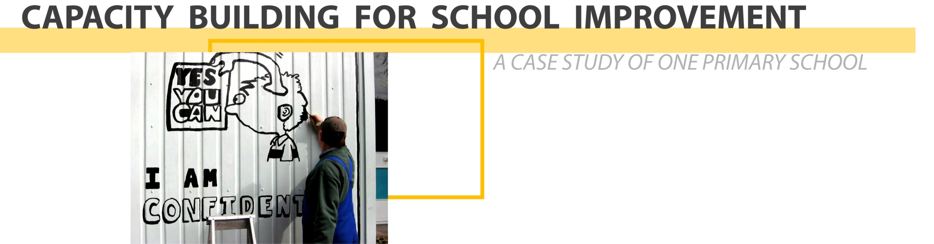
PATRICIA STRINGER / 2007

Slide 2

Tongan

Slide 3

Tongan

Slide 4

Samoan

Slide 5

Tongan

Slide 6

Indian

Slide 7
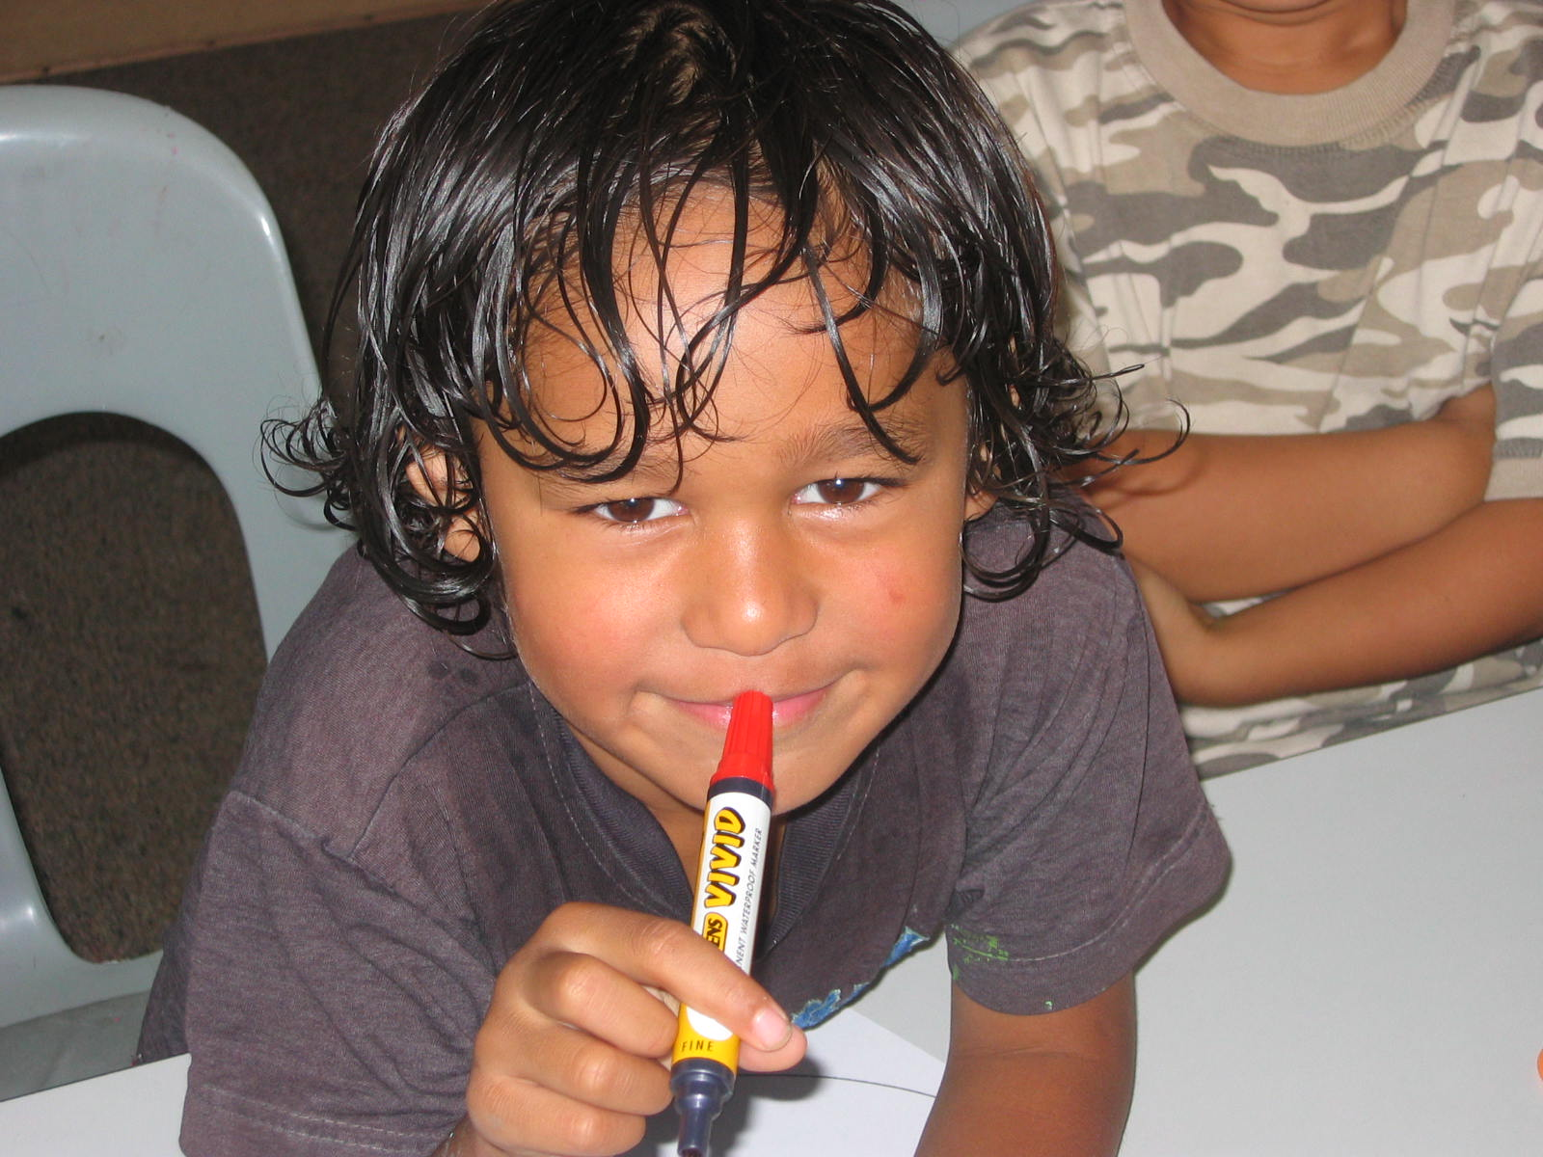
Maori

Slide 8

The concept is now aligned with school improvement however, limited empirical research on the topic exists.
Absence of debate on political, socio-economic and cultural trends with implications for capacity building. Situatedness and connectedness require investigation.
Concept lacks clarity given the complexity school stakeholders work within to build capacity for school improvement.
Valuable tool for taking a fresh look at what schools do to meet challenges of change in productive ways.
Personal interest.
Recording of one school’s journey.

Slide 9

Ministry of Education rhetoric – raising student achievement and reducing disparity.
Official documents / policies / projects
What the literature states – pressure on schools to respond to and / or confront deeply seated tensions in the quest to build capacity for improvement. For example:
  Funding
  Accountability
  Socio-ecomonmic factors
  Cultural diversity
How do schools build capacity for school improvement?

Slide 10

Two assumptions underscore the study:
External and internal environments play significant and influential roles in shaping/structuring what happens in schools.
Capacity building for improvement involves all stakeholders.
Guiding principles:
Study necessitates joint construction of meaning – positioning the study in the interpretivist paradigm and employing a case study approach.
Theory must be grounded in data.
The theory has to establish ‘fit’ with participants’ world views – Involvement of many stakeholders.
Discussion of tensions – Minimisation of limitations and maximisation of opportunities to build capacity.

Slide 11

Research questions:
How is capacity for school improvement defined – what are its feature?
How do internal school factors – vision, stakeholder activity, culture and professional development – evolve capacity?
In what ways do external wider societal factors influence the development of capacity?
What links exist between capacity building and school improvement in this school setting?

Slide 12

The study is concerned with participants’ perceptions of capacity building – a subjective reality. What is taken for reality is what is shared and accepted by participants, built through shared history, experience and dialogue.
Interpretivist paradigm - methodology that is participative and collaborative
Case study approach - Instrumental (Stake, 2003) / explanatory (Yin, 1994)
Grounded theory in data analysis (Straussian approach)

Slide 13
CASE STUDY
Strengths of the case studies:
Answers the “How?” and “Why?” questions in context
Encourages use of multiple sources of evidence and flexibility in data collection to obtain a complete account of social issues / processes
Incorporation of a chain of evidence stregthens internal validity
Facilitates examination of complexity
Tells its own story - researcher can be a teacher, teaching what has been learnt and learner, gaining knowledge through oint construction of meaning.
Limitations of the case studies
-A single case and lack of statistical data renders case study research incapable of generalisation - replication is impossible
-Concern with lack of rigour - researcher bias
-Length taken to complete the research and accumulation of massive amounts of data.
Justification: Inquiry focused on instrumental, explanatory value of the case, range of data collection tools employed and empolyment of grounded theory for data analysis helps establish rigour

Slide 14
Grounded Theory
Essential properties of a Grounded Theory:
fit, understanding, generality and control
Critique of Grounded Theory:
Fracturing the data reduces understanding of participants’ world
Curtails representation of both social world and subjective experiences
Relies on researcher’s authority as expert
Posits objectivist procedures for data analysis

Slide 15

School selection: purposeful sampling strategies:
intensity sampling; snowball or chain sampling; opportunistic sampling and criteria sampling
Entry to the school:
Evolving and fluid - October 2001 - principal’s powhiri; Meetings related to initiating school-based improvement (2002 – 2003); November 2003 - official invitation to school to participate in the research; March 2004 – three formal meetings to gain site entry; 2004 - site-based data collection.
Exit from the school:
Gradual easing out or transition from the field. Coinciding with end of the year activities was helpful.
Return visits provided opportunities to maintain contact with the school.

Slide 16
Ethical Issues relative to perception. This meant:
Conducting an inquiry dependent on face-to-face contact with participants
Maintaining confidentiality and anonymity
Building and preserving relationships of trust
Open negotiation of meaning with respect to participants’ views. A participative mode of inquiry was emphasised. Negotiation was enacted in ways data were collected and intitially interpretted.
Framing the study thoughtfully – knowing what to include and exclude and how to represent self (Lincoln & Guba, 2003).

Slide 17
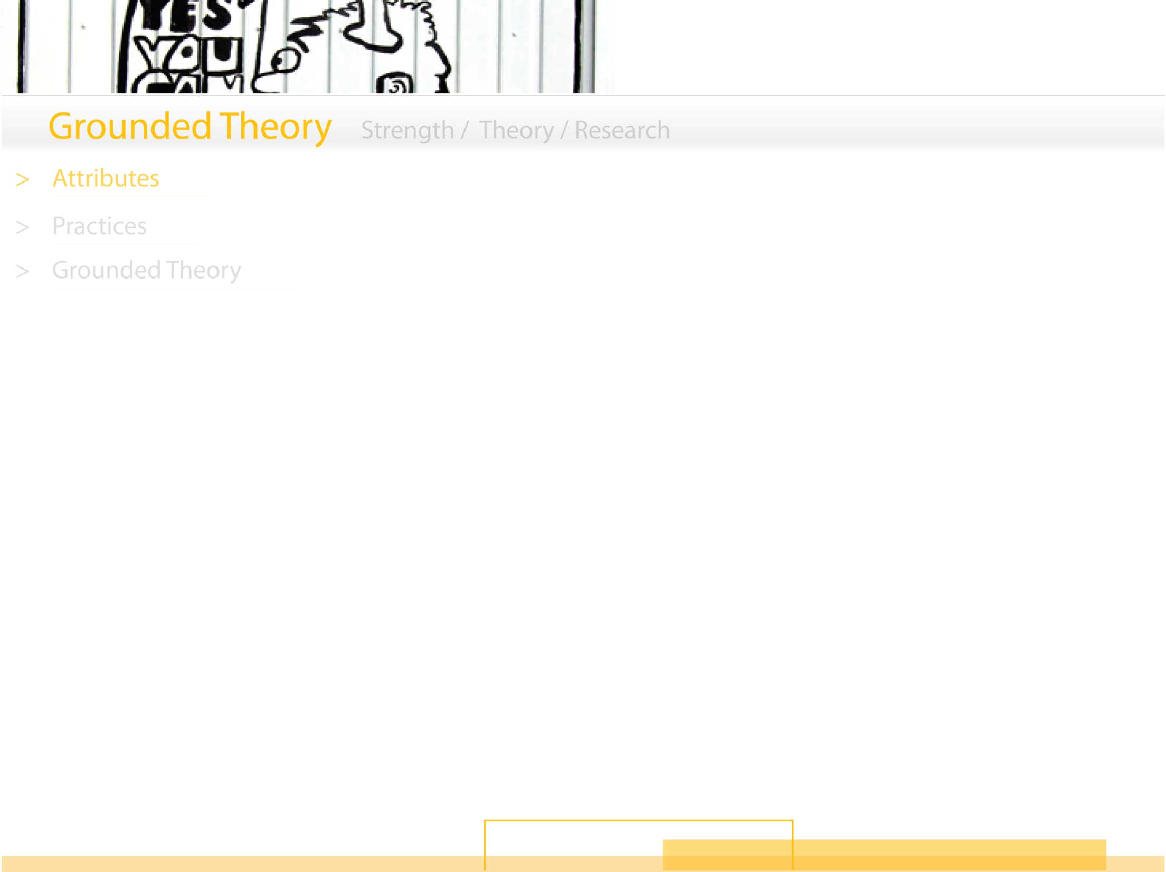
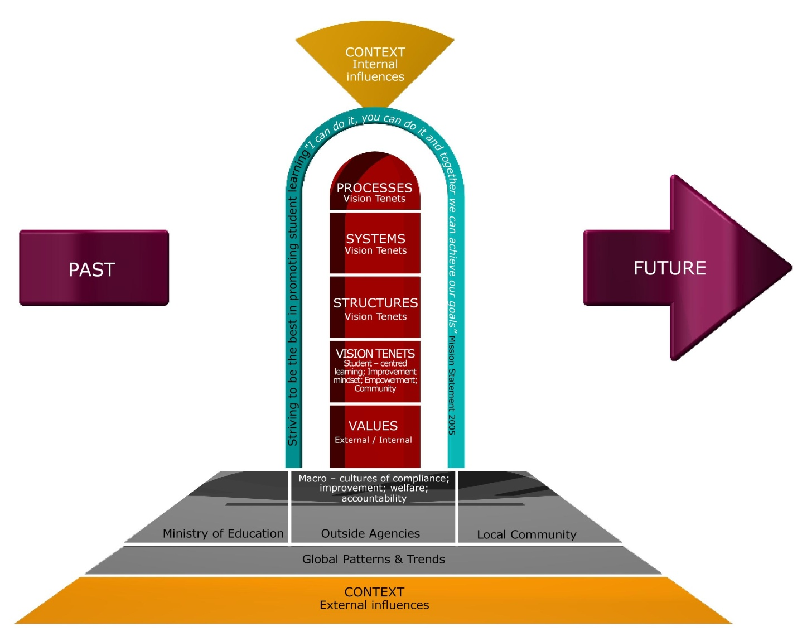

Slide 18
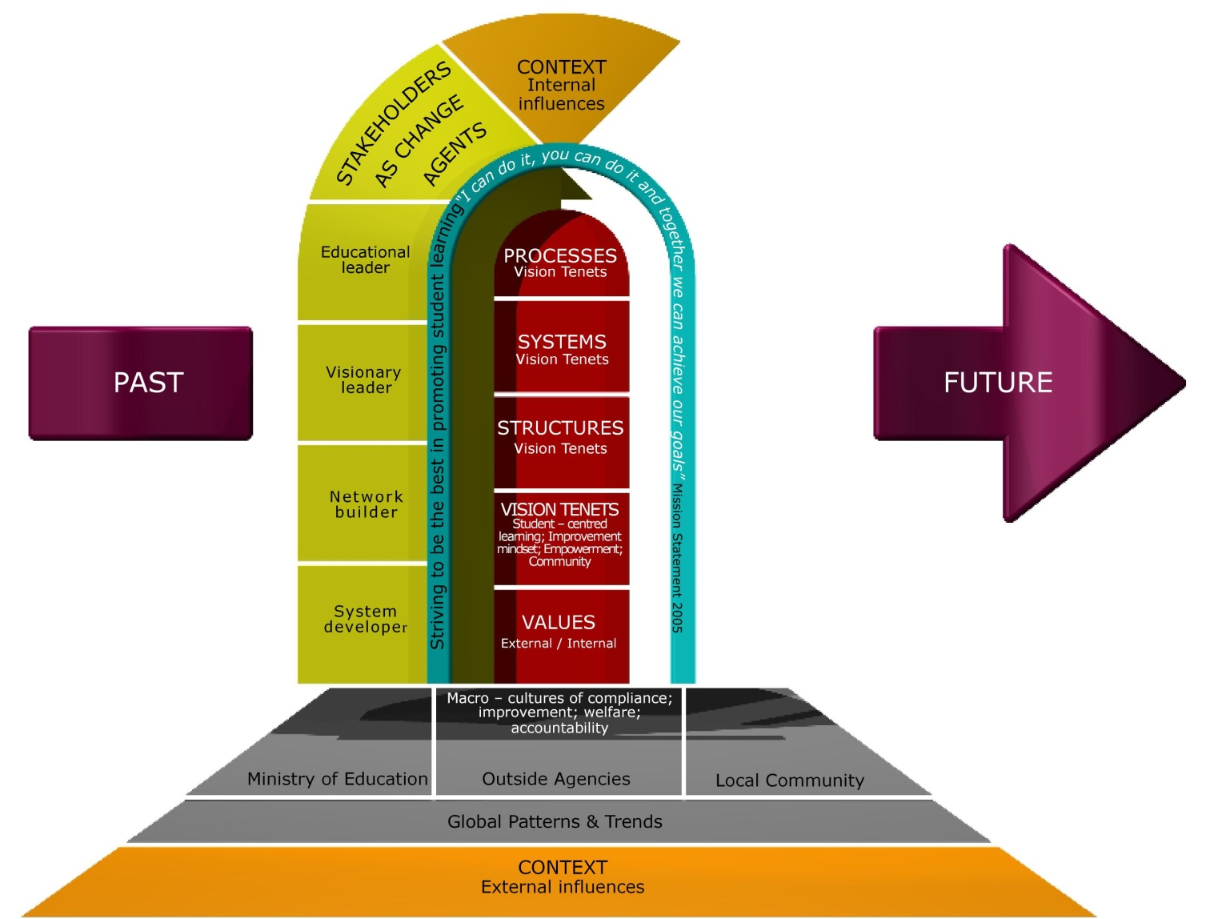

Slide 19
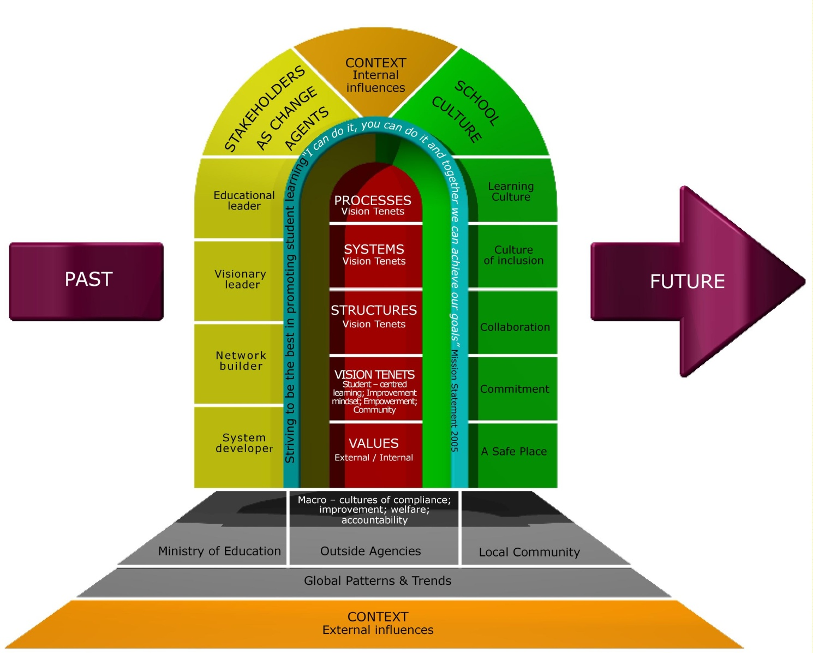

Slide 20
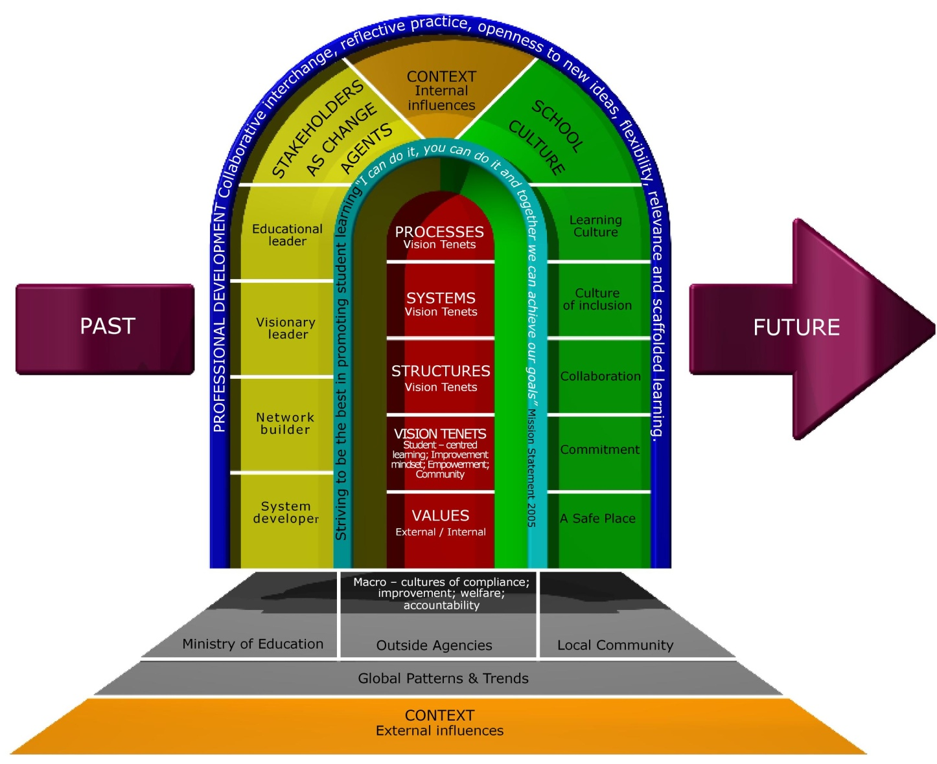

Slide 21

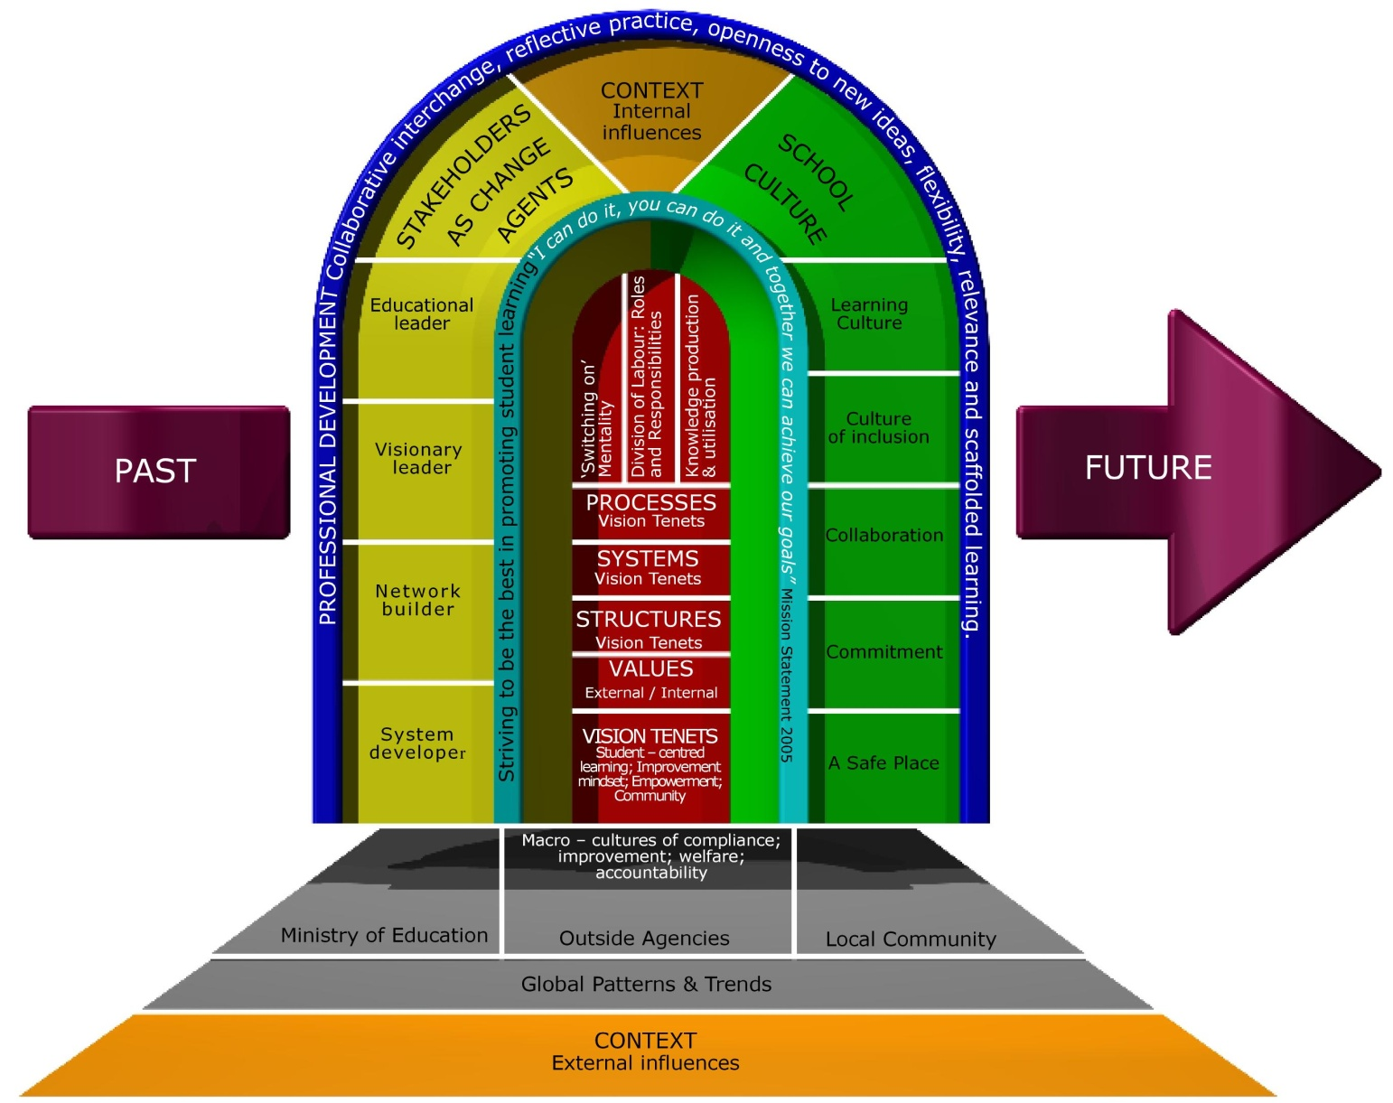

Slide 22
