Slide 1
INTRINSIC, EXTRINSIC OR TOTAL REWARDS
REMNET Annual Conference Nov 2014
Engaging Tomorrow’s People: Reward to Total Rewards
Associate Professor Keith Macky
Auckland University of Technology (AUT)
Department of Management
keith.macky@aut.ac.nz

Slide 2
Outline
My talk today outlines the latest international research on three areas relevant to the conference theme of rewards and total rewards:
Linking rewards to employee performance outcomes
How to use rewards to incentivise team and individual performance
The impact that pay dispersion has on employees, and how this might be managed

Slide 3
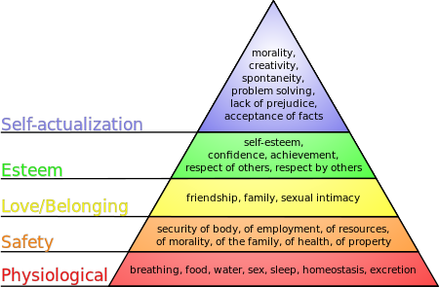

But first … a bit of history
The differentiation between extrinsic and intrinsic rewards goes back to the early motivational theories of Herzberg, Maslow and others of the 1950s and 60s. While these theories have now been superseded, the Extrinsic vs Intrinsic distinction has stood the test of time.
On the extrinsic side, the notion of Total Remuneration is also now no longer new. Total Rem = “the total monetary income value that an employee receives from an employer in exchange for their capacity for labour… includes all the (direct and indirect) components of a firm’s reward system which have a clear cash value for employees.” (Macky 2008, p. 345)

Slide 4


Plus…
3. We are also now much clearer about what we are trying to achieve from our rewards systems. This goes well beyond our historical emphasis on cost control to include:
Employee attraction and retention via a compelling employee value proposition answering the question: “Why should I work for you?”
Motivating employee discretionary effort to achieve beyond the minimum expected performance standards AND
Rewarding high performance, thereby strengthening the likelihood that it will be repeated - a much neglected aspect of performance management and central to all high-performance work systems (HPWS) (Macky & Wilson, 2013)

Slide 5


Enter… Total Rewards
A relatively new idea
All the monetary and non-monetary rewards available to an employer that can be used to attract, retain and motivate employees.
The reward elements include:
The usual intrinsic ones such as job variety, autonomy, recognition, and the sense of satisfaction that comes from achievement
Indirect and direct forms of remuneration, including all benefits (mandated and voluntary), skill development opportunities, and delayed forms such as Kiwisaver
that rewards can be derived from the social interactions that we have with others at work (belonging, companionship, friendships, positive climate & culture)
Work-life balance, a reduction in the intensity of work, and wellness / employee well-being interventions (aka QWL)

Slide 6
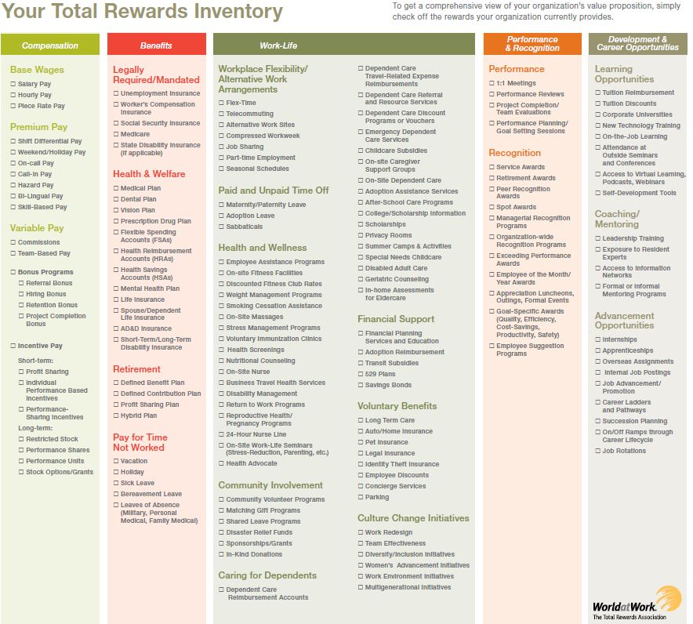

Slide 7
And the few studies on it are (mostly) positive…
See the 2012 Aon Hewitt Total Rewards study re the adoption of total rewards by high-performing companies.
Also their session this afternoon regarding total rewards and the employee value proposition
Example negative: Giancola (2009) in Compensation & Benefits Review – ‘total rewards’ have all the hallmarks of a management fad, as well as being characterised by confusion, disruption, and costs well in excess of any benefits.
HOWEVER …

Slide 8
The BIG debates that have dogged the area are starting to be resolved
ISSUE 1: Do rewards systems actually influence employee performance?
The answer might seem self evident but there have been influential naysayers. Examples:
Edward Deming – the father of TQM – performance pay is just a lottery because workers have little control over performance.
Alfie Kohn – 1993 Harvard Business Review – incentive rewards, particularly extrinsic, do not work because they cannot produce lasting behaviour change
Edward Deci & Richard Ryan et al. – providing extrinsic rewards undermines intrinsic self-motivation and creates an instrumentalist orientation (“what's in it for me?”) to work. Led to the development of Self-Determination Theory (SDT) – needs for competence, autonomy & psychological relatedness are what really drives self-motivated behaviour.

Slide 9
BUT what does the evidence tell us?
THE EARLY RESEARCH
Guzzo, Jette & Katzell (1985) - A meta-analysis of the pay-for-performance literature . Showed an average 20% increase in productivity above baseline. The range was from -5% to 75% .
McAdams & Hawk (1994) – Analysed 663 performance-based-pay schemes in US companies. Found the median gain per company was US$2,400 per employee per year. The median net return to the employer was 134% (range 68 to 378%).
Hale & Bailey (1998) - 614 US companies. Found firms paying employees for performance had annual total shareholder returns of 13.9%, nearly 40% higher than firms with weak links between employee performance and their pay.

Slide 10
More recent…
Nyberg, Pieper & Trevor (2013) – 11,939 finance sector employees in 517 US business units over 5 years. Found:
both merit pay (annualised % based on manager appraisal) and bonus pay (re-earnable lump sum % of salary) positively predict future job performance, with bonus pay having the stronger effect (213% ROI)
that short-term disappointments have less impact if employees are optimistic about the PFP future. Indicates such rewards systems are more durable in their influence than critics suggest
BUT when merit increases and bonuses are seen as insufficient or inequitable, employees are more likely to quit (more on this later!!)
Conclude employee responses to reward systems are not just short-term transactional events; instead reward expectations develop over time.

Slide 11
+ Garbers & Konradt (2014)
Meta-analysis of 146 samples involving 31,861 employees worldwide
Individual financial incentives have a positive effect on subsequent performance (g=.32)
More so for more complex tasks
And for when performance is measured subjectively (g=.39) rather than quantitatively (g=.28)

Slide 12

Cerasoli, Nicklin & Ford (2014)
A meta-analysis of 40 years of research in the intrinsic vs extrinsic rewards debate involving 183 independent samples totalling 212,468 people
Conclude
Intrinsic motivations are a medium to strong determinant of performance (.21 - .45 confidence interval)
The importance of intrinsic motivations remain irrespective of whether extrinsic incentives are available or not
But become less salient when extrinsic rewards are directly rather than indirectly tied to performance (a “crowding out” effect)
Intrinsic motivations have a stronger effect on the quality of performance
Extrinsic rewards have a stronger effect on the quantity of performance
Both are important to performance rather than antagonistic

Slide 13
Issue 2: How to reward team performance
The problems:
Should rewards be equally distributed among team members
Are other distribution methods better
What about “free riders”
Does giving unequal individual rewards to team members undermine cooperation and the intrinsic motivation to cooperate (see SDT needs)
Distribution Rules matter!
Equally distributed rewards positively effects cohesion in highly interdependent teams BUT
There is strong evidence that equitably distributed rewards does lead to higher team performance.

Slide 14
Garbers & Konradt (2014) again
Meta-analysis of 30 studies involving team-based rewards
Team based rewards positively effect subsequent performance (g=.45)
More so for equitably distributed rewards than for equally distributed rewards
The effect is stronger for more complex tasks
BUT it also depends on:
Team size – incentive effects are larger for smaller teams
Gender composition – incentive effects are stronger for mixed gender teams than for same sex teams

Slide 15
Issue 3: Pay Dispersion
Also referred to as pay variation or pay differentials.
The primary focus of research on pay structures, particularly tournament variants (steep pay differentials tied to relative rank rather than directly to performance)
The logic: tournaments motivate higher performance as people compete to move up the ranks, while attracting and retaining those who want to reach the top (Shaw 2014)
A fixed number of “winners” means that this is a competition based pay system that also reinforces organisational hierarchies.
The wider the pay differences and the less linear these are up the hierarchy, the greater the motivation to perform to get promoted upwards. This should lead to higher individual, team and thence organisational performance.
BUT DOES IT? A rather complex question!

Slide 16
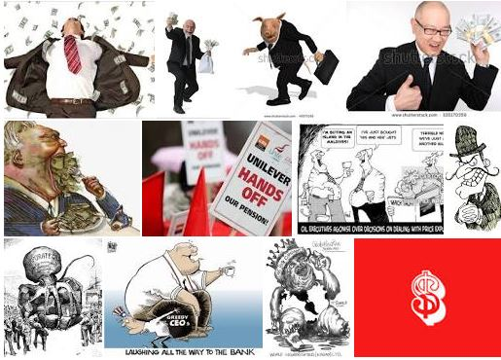
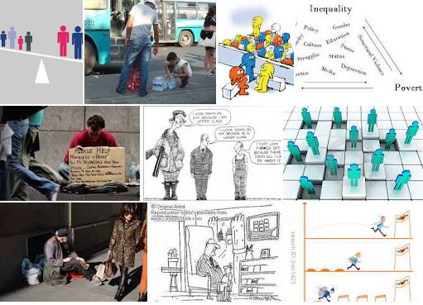
Social and public media link it to executive greed and thence to social inequality and unrest

Slide 17
Recent Scholarly Publications
1. Merriman 2014 – reviews the research on tournament based pay dispersion & working hours
Observes that they create ‘long work hours’ cultures (a ‘rat-race equilibrium’) of overwork at all levels, with stigma attached to those who work less than the norm
Longer hours worked MAY increase employee performance BUT
They also increase stress levels, burnout, and work-life imbalance (plus voluntary turnover among those with little chance of winning or who have topped out)
Paradox: The longer you stay, the harder it is to leave! (sunk cost loss aversion)

Slide 18
2. Downes & Choi (2014)
A systematic review of the research on different forms of pay dispersion and how employees react to them.
They note mixed results re the link to organisational performance – some positive, some negative
Both horizontal & vertical pay dispersion effectiveness depends on four specific contingencies:
Employees work independently of each other
The pay system is seen as legitimate by employees
It is well communicated and looks transparent & fair
Pay differences appear closely linked to actual performance (as opposed to seniority, favouritism or political game playing)

Slide 19
Pay dispersion conclusions?
Legitimacy and equity perceptions are everything!
If people come to believe that winning through performance is not possible and or that others have unfairly succeeded, INEQUITY perceptions will form.
Unlike some older motivation theories, Equity Theory mostly holds true – people are motivated to restore equity if they feel under rewarded for their efforts relative to others.
The more the perceived inequity, the stronger the motivation to restore it.
Strategies to restore equity include: reduction of effort (demotivation), disengagement, industrial / collective action, sabotage, theft, and voluntary turnover.

Slide 20
Final thoughts
1. Perceived equity is more important than equality!
Compressed or egalitarian rewards systems can lead to equal pay for unequal performance, thereby creating inequity issues
2. BOTH extrinsic and intrinsic rewards are important.
But reality check for remuneration specialists - using the latter require us to get involved in job (re)design and management development.
3. Pay dispersion systems based on standards based performance are preferable. Those based on subjective merit ratings can also work.
But subjective merit ratings using forced grading (restricting the number of winners to a pre-determined % and requiring a fixed % to fail) are a VERY BAD IDEA !!!
4. Employees develop their relationship with a total reward system over time. Stability in the system is important.

Slide 21
Best practices? (the application of common sense!)
In addition to transparency and equity, make sure that …
The behaviour rewarded is actually what is wanted by managers
The rewards offered by management are actually wanted by employees and at a level that will satisfy a need
Employees trust that management will deliver the rewards offered if they do what is required (so no goal-post shifting!)
Employees believe they can achieve the performance goals set (stretch goals, not aspirational ones!)
Performance measures are understood and can be defended.

Slide 22
Sources – email me at keith.macky@aut.ac.nz if you cant access them and want copies
Cerasoli CP, Nicklin JM & Ford MT (2014). Intrinsic motivation and extrinsic rewards jointly predict performance: a 40-year meta-analysis. Psychological Bulletin, 4, 980-1008.
Downes, PE & Choi D (2014). Employee reactions to pay dispersion: a typology of existing research. Human Resource Management Review, 24, 53-66.
Garbers Y & Konradt U (2013). The effect of financial incentives on performance: a quantitative review of individual and team-based financial incentives. Journal of Occupational and Organisational Psychology, 87, 102-137.
Macky & Wilson (2013). Rewards, Remuneration and Performance: A Strategic Approach. CCH Wolters Kluwer.
Merriman, KK (2014). The psychological role of pay systems in choosing to work long hours. Human Resource Management Review, 24, 67-79.
Nyberg, AJ, Pieper JR & Trevor CO (2013). Pay-for-performance effect on future employee performance: integrating psychological and economic principles towards a contingency perspective, Journal of Management, 1-31.
Shaw, JD (2014). Pay dispersion. Annual Review of Organizational Psychology and Organizational Behaviour, 1, 521-544.

