Slide 1


Do Good Starts Make Good Finishes?
The Case of CEO Pay
School of Economics and Finance Seminar Series
Victoria University of Wellington, 2 May 2014
Helena Címerová
Auckland University of Technology

Slide 2

Motivation
Is the market for CEOs efficient?
Source:
www.newyorker.com
Notes:
The emperor's new clothes: used in contexts where people are widely acclaimed and admired but where others question whether what they have created is of any value, refers to the willingness of people to engage into an unspoken contract to willfully disbelieve what they know to be true.

Slide 3
Outline
Under focus: CEO pay efficiency
Key findings
Cohort effects research & explanations for findings
Data + Empirical methodology
Results
Conclusions

Slide 4
Key results
The market for CEOs is efficient: initial luck not reflected in CEO pay
  No evidence of persistent rewards for CEOs for good first job
  No procyclical cohort effects, rather countercyclical (IV)
  A higher first CEO compensation if good first job (≈30% for top-ten firm), dissipates over time

Slide 5
Cohort effects research
Neumark (2002): early job mkt stability
Oyer (2006): PhD economists
Oyer (2008): MBA investment bankers
Kahn (2010): US male college graduates
Kwon et al. (2010): US & Swedish workers (recovery phase of business cycle)
Oreopulos et al. (2014): CAN college graduates
  Schoar and Zuo (2013): “recession CEOs”
> procyclical cohort effects <

Slide 6
Cohort effects research - explanations
Productivity-based explanations
(human capital disparities)
  Initial match quality
    procyclical effects
    countercyclical effects
Non-productivity based explanations
(downward rigidity in jobs, LT contracts,
signaling)

Slide 7

Data
S&P 1,500 universe – public CEOs
    13,378 obs.; 1,473 companies; 2,184 CEOs
    ExecuComp (1992-2007), BoardEx
    Compustat + CRSP
    NBER, US BLS, Fed
Full sample + subsamples; CS
Selection issues
Source: Adexchanger.com

Slide 8
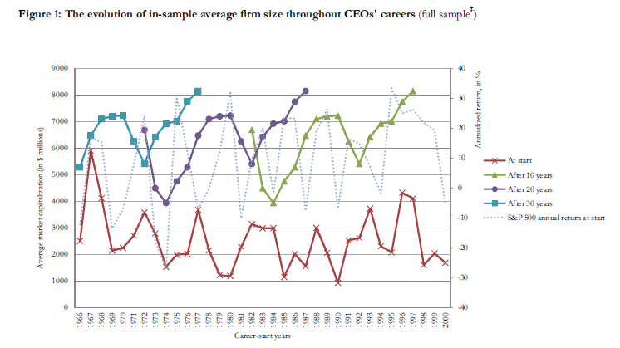

Slide 9
Empirical methodology
First placement success (firm size) → current placement success (CEO compensation)
Fixed effects estimation
Instrumental variables estimation / Two-stage least squares
Cross-section (first CEO pay)
Robustness checks

Slide 10
Empirical methodology (IV/2SLS)
Mkt. cap, total assets, …
first
firm size
CEO compensation
TDC1, TDC2
Controls:
Firm-level
size
inv. opportunity
firm performance
volatility of firm performance
CEO-level
tenure
duality
external hire
education
gender
CEO talent pipeline
macro cond. / fin. mkts
Instruments:
Related to macroeconomic conditions: recession indicator, U.S. unemployment rate, investment-grade bond yield spread
Related to financial markets:
  1-yr volume chng., 1-yr return, 2-yr std. dev. of S&P 500 index

Slide 11
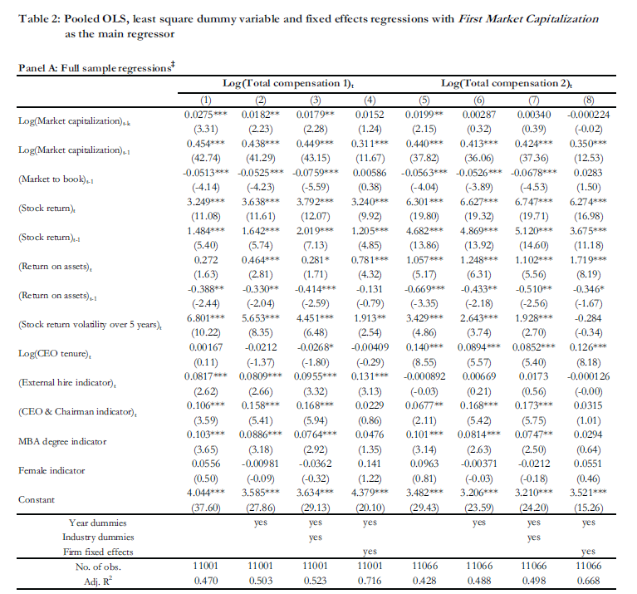

Slide 12
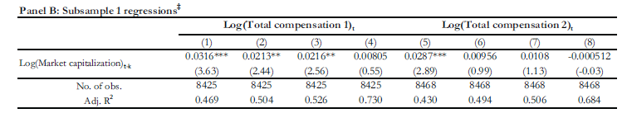
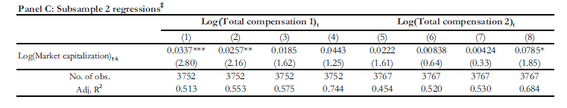

Slide 13
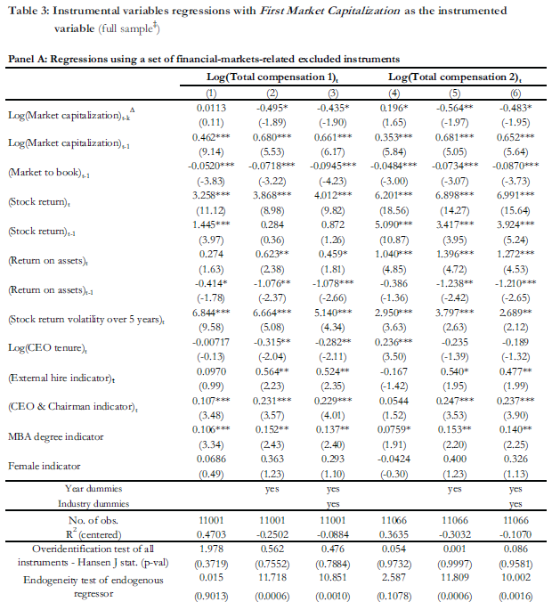

Slide 14
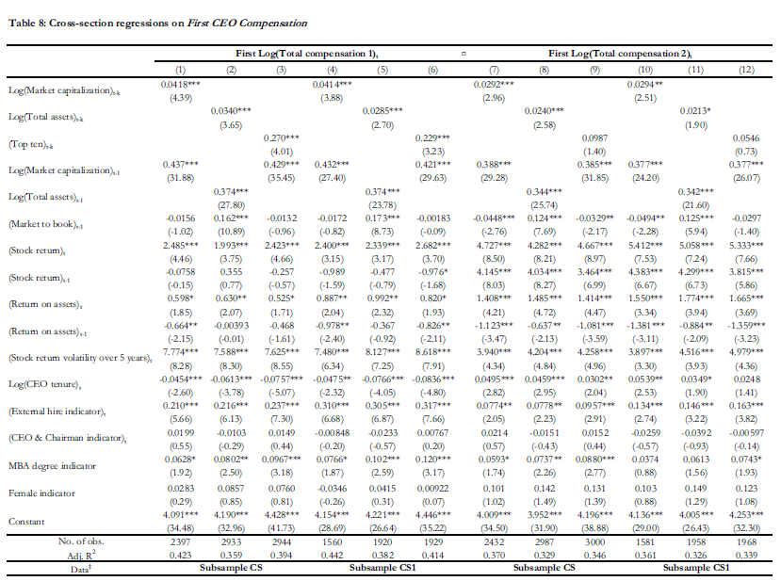

Slide 15
Results (1)
FEs (firm fixed effects): <4% / no effects or lack of support in the data?
  (firm rank 6-12% TDC1, top ten firm 12-14.5% TDC1)
IV: 30%-50% countercyclical cohort effects
  (single instrument, reduced-form regressions)
Cross-section: first CEO pay up to 30% higher if top-ten firm

Slide 16
Results (2)
Robustness:
  IV with employment growth rate: no cohort effects
  Cross-section: stable coefficients
  Weak-instrument robust estimation with CLR confidence sets: first firm size elasticity relat. to current CEO compensation <-1%

Slide 17
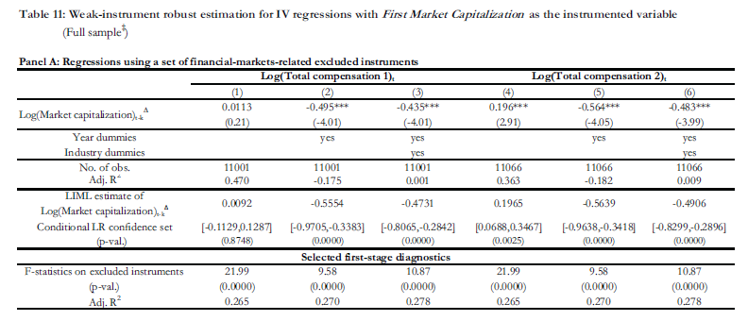

Slide 18
Conclusions / Contributions
another test of CEO market efficiency
existence and persistence of cohort effects seems to depend on the segment of labor market
efficient market for CEOs:
initial luck not reflected in CEO pay

Slide 19
Thank you.

Slide 20
