Slide 1
Sheet Metal Engineering
Research Roadmap
T. Neitzert
H. Heinzel
P. Bagshaw

Slide 2
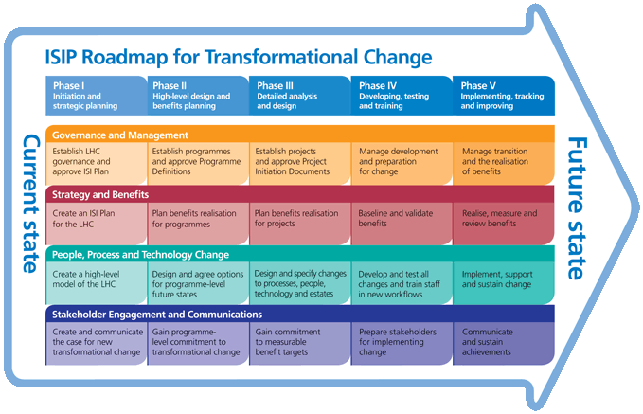
Research Roadmap Objectives
Well established Sheet-Metal Industry in NZ
Products as well as machinery
Export share is low
Innovative products and sector development needed
R&D roadmap useful tool in business-planning
Prioritise R&D projects and secure funding

Slide 3
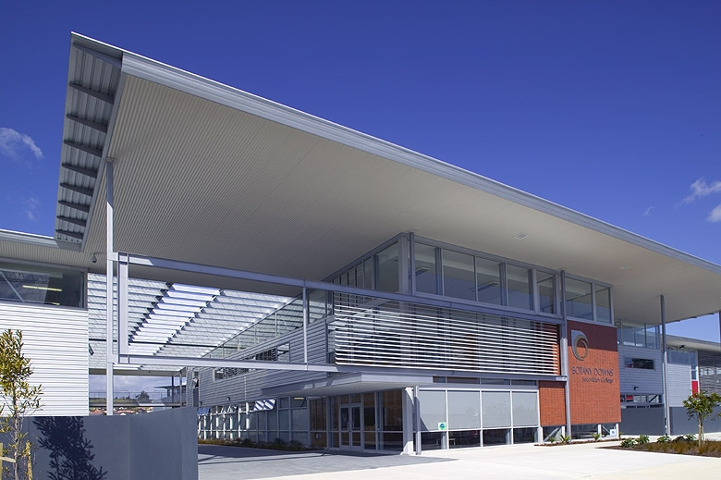
Industry Sectors
  Building Products
    Roofing
    Wall Cladding
    Framing
    Fencing
    Heating and Ventilation
    Doors
  Materials Handling/Transport
    Road based transport
    Marine transport
    Containers
    Tanks
    Shelving
    Food handling

Slide 4
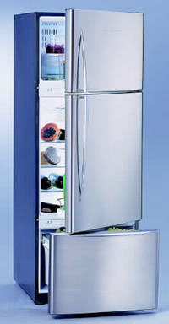
Industry Sectors cont.
  Manufactured products
    Furniture
    Appliances
    Cabinets
    Tools (e.g. saw blades)
  Agricultural
    Agricultural Machinery
    Sheds

Slide 5
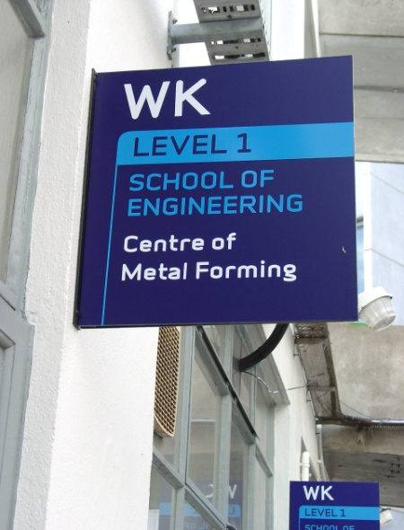
Research Providers – Tertiary Sector
  AUT Metal Forming Centre
    Forming centre
    Friction stir welding
    Metallurgy
  University of Auckland
    Nanotechnology
  University of Canterbury
    To be explored
  University of Waikato
    Nanotechnology

Slide 6
Research Providers cont.
Industry and private research providers
  HERA
    Composite Structural Assembly (CSA) research joint venture
    Structural Design Group (Structural Steel, NASH support)
    New Zealand Welding Centre (welding, joining)
  BRANZ
    Corrosion
  NZ Steel (link to Bluescope steel research capabilities)
Polytechnics
  Sheet metals engineering trade
CRI’s
  IRL (Material Focus, Corrosion)

Slide 7
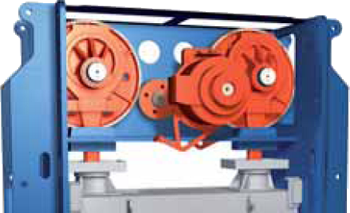
Trends in Sheet Metal Engineering
Forming Technology
Press forming trends
  Servo presses combining the low running costs and reliability of mechanical presses with the flexibility of hydraulic presses.
Roll forming trends
  Flexible roll-forming to produce curved shapes
Forming processes becoming faster as a result of productivity requirements
  High degree of automation, transfer of parts between presses and stations done by robots
Hydro forming
  Increase the forming limit of existing materials while at the same time
  Reduced tooling costs due to the omission of exactly manufactured die
  Higher accuracy
  Higher surface quality as there is only tool contact on one side
Hot Metal Gas Forming
Flexible blankholders
  Increase flexibility of presses

Slide 8
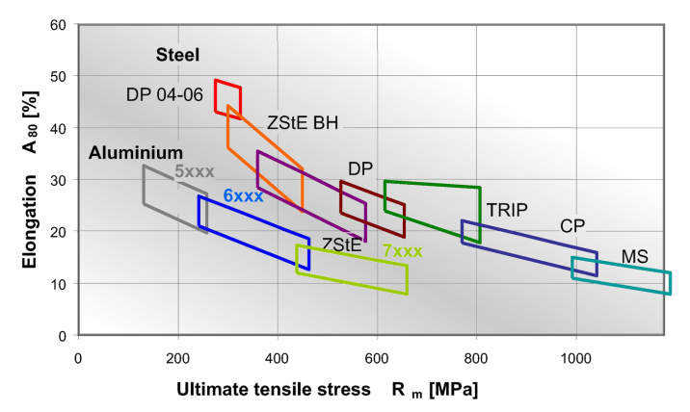
Trends in Sheet Metal Engineering cont.
Material Developments
Emerging of advanced high strength steels with UTS of up to 1700 MPa
  Challenge for tool material as material increases tool wear
  Leads to possible reduction in material thickness
Reduction of wall thickness (cost & sustainability perspective) – e.g. inclusion size becomes an issue
Plastic laminated steel sheets
  One side plastic coated
    Increase corrosion performance of sheet material
  Plastic layer in the middle of two steel sheets
    Adjustable vibration behaviour
    Formable like traditional steel
    Weldable
    Recyclable

Slide 9
Trends in Sheet Metal Engineering cont.
Fabrication Developments
Joining technology developments
  Mechanical joining – no consumable cost
    High reliability of joints
    Joining of dissimilar products
  ‘Cold’ welding processes e.g. MIG brazing
  Laser welding
    cost reductions
    less consumable cost
    narrow heat affected zone (HAZ)

Slide 10
Other Emerging Technologies
Coatings developments
  Water based coatings
  Printing on steel – precision lithography
  Anti-graffiti performance
Composite research
Nanotechnology
  Adjust material performance through nano-alloying

Slide 11
Development Opportunities
  Sector overarching
    Durability/Corrosion
      Fastening systems
      Exposed and structural elements
    Joining systems
      Consumable free fastening systems
      Penetration free attachment systems
      Seamless joints – no overlaps
    Coatings
    Composites - Laminated products

Slide 12
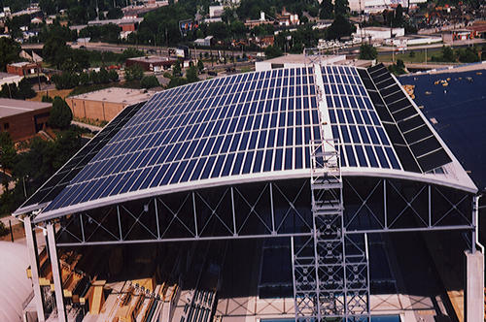
Development Opportunities cont.
  Building Products
    Roofing
      Purlin free roofing systems
      Long span
      Structural Roofs (truss-less)
      Penetration free roof cladding
      Integration of additional functionality into existing roofing systems
        Photovoltaic coatings
        Solar heat collectors air based
        Solar heat collectors water based
        Insulation
      Building solution
      Curved roofs

Slide 13
Development Opportunities cont.
    Wall Cladding
      Structural walls
      Decorative walls
      Explosion/blast resisting walls
      Pre-fabricated walls
      Load increases for items hanging off walls
      Noise reduced wall systems
    Framing
      Reduced steel usage and increased strength
      Building steel systems research
      Different cross sectional area members
      Transverse forming
      Modular construction
      Prefabrication
      Thermal efficiency increase (integrated thermal brakes)
      Composite steel frame

Slide 14
Development Opportunities cont.
    Heating and Ventilation
      Hollow steel elements as conducting elements
    Doors
      Garage doors with increased stiffness
      Composite doors
      Commercial doors

Slide 15
Development Opportunities cont.
  Materials Handling/Transport
    Road based transport
      Road barriers
      Removable road barriers
      Conical lamp post
    Containers
      Steel pallets (re-usability)
      Square containers
    Tanks
        Water tanks
        Containerised tanks
        Collapsible tanks (Australia)
    Shelving
      Understanding performance and steel grade relationship
      Be part of the building structure
    Food handling
      Coating developments

Slide 16

Research Requirements
Sector Overarching
Sustainable Steel
  Improving environmental foot print of the NZ steel based manufacturing industry (5-10 year sector overarching R&D program?)
  Improving Energy Efficiency of Steel Based Building Products
    Thermal Breaks in Steel Frames
    Laminated Steel Sheets
    Composite Structural Assemblies with focus on thermal efficiency
  Durability/sustainability of steel coating systems
    Understanding and improving existing products
    New coating systems

Slide 17
Research Requirements cont.
Increasing productivity
  Manufacturing Technology
    Metal forming
    Assembly/joining
    Cutting
  Business practices
  Providing skilled workforce

Slide 18
Research Requirements cont.
Sector specific
e.g. Light Steel Framing
    Treat steel frame and cladding systems as composite
    Different cross sectional area members
    Prefabrication/modular construction
    Thermal efficiency increase (integrated thermal brakes)
    Consumable free joining techniques (mechanical joints)

Slide 19
Where to from here?
Further investigation of New Zealand industry needs?
Individual R&D development projects?
Applications for funding?
Consortium approach?
?

