Slide 1
The Competency Requirements for HR Practitioners in
Domestic Firms and Multinational Enterprises
Karen Lo, Keith Macky & Edwina Pio
AUT University, New Zealand

Slide 2
Research Aim
To investigate HR competencies required for HR practitioners for their success in domestic firms and multinational enterprises (MNEs)
Adopts a situationalist competency perspective which focuses on the contextual nature of HR competencies by differentiating between generic HR competencies (i.e., universally applicable to HR practitioners) and context-specific HR competencies (i.e., relevant to a narrower range of settings)
Notes:
Research aim – focuses on identifying similarities and differences in HR competency requirements from the perspective of HR practitioners

Slide 3
Situationalist Perspective
Challenges the universalist perspective that focuses on identifying generic HR competencies (Ulrich et al., 2013; Long & Wan Ismail, 2009; Dainty, 2011)
Argues that there are context-specific HR competencies as well as generic ones (Caldwell, 2008; 2010; Graham & Tarbell, 2006; Roehling et al., 2005)
The HR literature suggests that MNEs are likely to promote a more strategic HR role (Björkman, Ehrnrooth, Smale & John, 2011; Sheehan & Scalfidi, 2005; Sumelius, Bjorkman, & Smale, 2008) and standardisation of HRM practices (Belizon, Gunnigle, & Morley, 2013; Farndale & Paauwe, 2005; Stiles & Trevor, 2006) than domestic firms
Notes:
Overseas-based MNEs are more likely to promote a strategically focussed HR department and standardisation of HRM practices due to:
Exposure to fluctuations in the global market
Larger customer base and interaction with government and local communities of multiple countries
Competitive strength in internally shared learning
Tendency to use shared service centres and international HRIS to maintain central control and coordination of global HRM policies
And that the HR function in domestic firms are more functionally and administrative oriented

Slide 4
Methodology
Phase 1:
Content Analysis
HR Job Descriptions
Phase 2:
Concept Mapping
Focus Groups
Mixed Method Research Design
Research Question:
What are the generic and context-specific HR competencies
for domestic firms and MNEs?
Phase 3:
Concept Mapping Online Survey

Slide 5
Concept Mapping Process
Step 1: Brainstorming Focus Groups
3 focus groups of 8 focus group HR participants + 2 HR experts brainstormed a list of 44 HR competencies
Step 3: Concept Mapping Analysis
Concept System software was used to produce concept maps
Step 2: Concept Mapping Online Survey
63 New Zealand HR practitioners sorted and rated the HR competencies
Step 4: Interpretation of Concept Maps
Researcher reviewed groupings and names of the clusters
Notes:
Step 1 involved using face-to-face focus groups facilitated by the researcher
These HR practitioners were from New Zealand and generated 104 statements that described the critical HR competencies required for success in their various HR roles and organisational backgrounds
These 104 statements were then further reduced to 44 HR competencies as input for the concept mapping online survey in Step 2
Step 2 involved asking HR respondents to group these 44 HR competencies by thematic similarity and labelling them and then rating each of these competencies by their perceived level of importance for job success in their current role and organisation
Step 3 was conducted by the researcher alone and involved using the Concept System propriety software to analysis the sorting and rating data to produce a series of concept maps and pattern matches
Step 4 was conducted by the researcher alone and involved reviewing the aggregated groupings of HR competency conceptual clusters and suggested labels given by the HR respondents

Slide 6
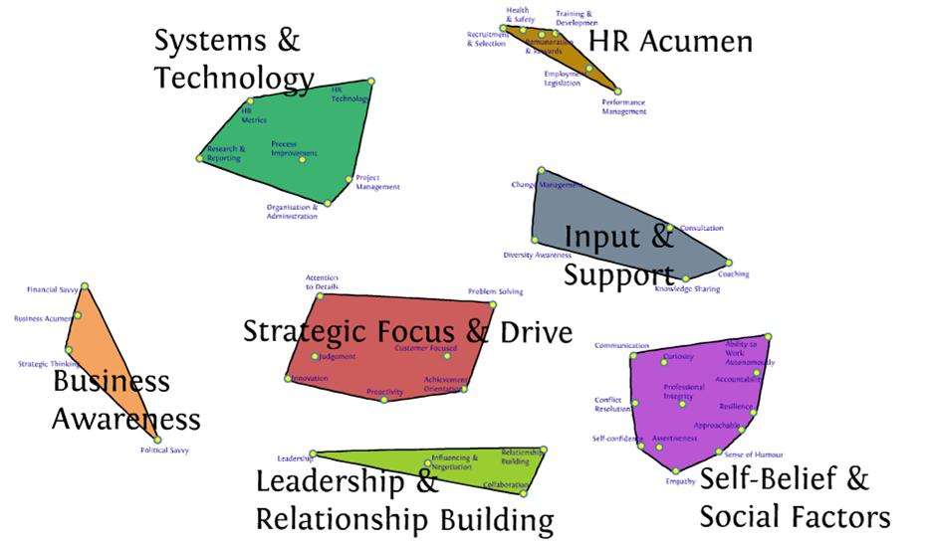
HR Competency Concept Map
Notes:
Interpretation of Cluster Map:
The cluster map distributes the 44 HR competencies into seven concepts resulting from the sorting activity. Clusters of HR competencies that were most frequently sorted together by respondents are displayed as “islands”. HR competencies contained in each cluster are displayed as numbered points and are listed in the table provided in the handout.
The size of the clusters indicates the variety of competencies they contain and the conceptual coherence of these competencies. For example, the largest cluster, strategic focus and drive, contains the broadest range of competencies and therefore has less coherence compared to smaller clusters such as HR acumen. The location of clusters in the map indicates perceptual links between concepts. For example, the proximity of the strategic focus and drive and leadership and relationship building clusters indicates that these competencies are conceptually independent but also perceptually linked by respondents.
The big picture emerging from the cluster map is the clear cut between strategic and functional HR competencies as indicated by the dashed line. Strategic HR competencies relate to strategic involvement and are clustered in the lower left region of the map. Whereas functional HR competencies relate to the delivery of HR practices and are located in the upper right region.
Strategic HR Competencies
Strategic Focus and Drive: includes a number of attributes required for achieving results that add value to the business
Leadership and Relationship Building: includes leadership, influencing and negotiation, collaboration and relationship building skills, which are important for reaching agreements with senior executives and other stakeholders
Business Awareness: includes an awareness of the internal and external business environment, political dynamics, financial savvy and strategic thinking skills
Functional HR Competencies
Self-Belief and Social Factors: contains mainly self-development and employee-related attributes (e.g. self-confidence, professional integrity, empathy and conflict resolution), as well as competencies that resemble Dave Ulrich and Wayne Brockbank’s ‘personal credibility’ dimension (e.g. communication and accountability)
Input and Support: includes internal consulting competencies required for supporting line managers and employees, including coaching, consultation, change management, diversity awareness and knowledge sharing
HR Acumen: represents specific HR functional knowledge, ranging from recruitment and selection, training and development to performance management
Systems and Technology: contains fairly technical HR knowledge and skills, such as knowledge of HR metrics and HR technology, project management, and organisation and administration skills.

Slide 7
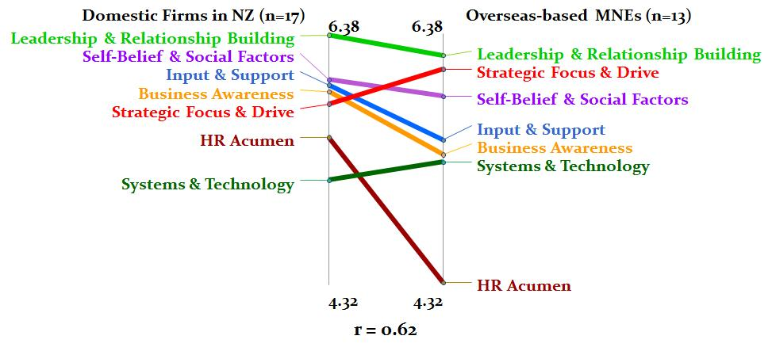
Domestic Firms vs Overseas-based MNEs
Notes:
Interpretation of Pattern Matches:
The pattern match compares the absolute average cluster ratings between domestic firms (in NZ) and overseas-based MNEs groups. Parallel lines represent agreement on the ratings between the two groups and deep slopes represent great differences between them. The Concept System software also generated a correlation coefficient (r) for the pattern match. A high r value indicates strong correlation of overall ratings between the two HR groups.
The most apparent difference relates to HR Acumen, with this cluster rated lower by overseas based MNEs (4.32) than by domestic firms (5.53), particularly for the competency expertise in recruitment and selection and knowledge of employment legislation, which were rated lower by overseas-based MNEs around 4 (4.38 and 4.54 respectively) compared to ratings of around 6 by domestic firms (6.18 and 5.82 respectively). These findings contradict that evidences in the literature (e.g., Antila, 2006; SHRM, 2010) which reported that HR practitioners in MNEs have higher requirements for knowledge of international employment legislation.
Also, overseas-based MNEs have stronger requirements for Strategic Focus and Drive competencies (5.91) than do domestic firms (5.38). This is in line with the findings of studies (e.g., Walsh, 2001; Sheehan & Scafidi, 2005) that HR practitioners in overseas-based MNEs tend to have more active involvement in strategic activities than domestic firms, albeit the difference identified in the present study is rather small.
The reverse was found for Business Awareness, which were perceived as less important by overseas-based MNEs, when compared to domestic firms. This finding contradicts that of Ulrich et al. (2008) who argue that MNEs require greater business knowledge because they have more interaction with the global business environment. One explanation is that the corporate HR headquarters of overseas-based MNEs may seek to retain tighter control over HR strategy planning at the international level, e.g., organisational change and movement of expatriates, whilst allowing the subsidiary greater autonomy in setting local HRM policy (Björkman & Yuan, 2001; Sumelius et al., 2008). This de-emphasises localised business knowledge required by local operations of overseas-based MNEs, as they are dependent on the corporate HR headquarters for their understandings on the international market and competition.
Overseas-based MNEs make slightly stronger use of Systems and Technology competencies (5.32) than domestic firms (5.17). However, further analysis revealed that the two respondent groups differed substantially in the most important and least important competencies within this cluster. Overseas-based MNEs considered HR technology as the top important competency (5.62) and organisation and administration as the least important competency (4.92). The reverse was found for domestic firms, which rated organisation and administration as the most important competency (5.47) and HR technology as the least important (4.71).
Similarities: consensus between both groups that Leadership & Relationship Building and Self-Belief & Social Factors were among the top 3 HR competencies (with ratings of above 6 and 5.7 respectively), particularly relationship building, professional integrity, communication and accountability. These competencies resemble the key elements of the personal credibility dimension (now known as credible activist) in Ulrich et al.’s HR competency framework, suggesting that these HR competencies are highly critical to job success in human resources in both business contexts.

Slide 8
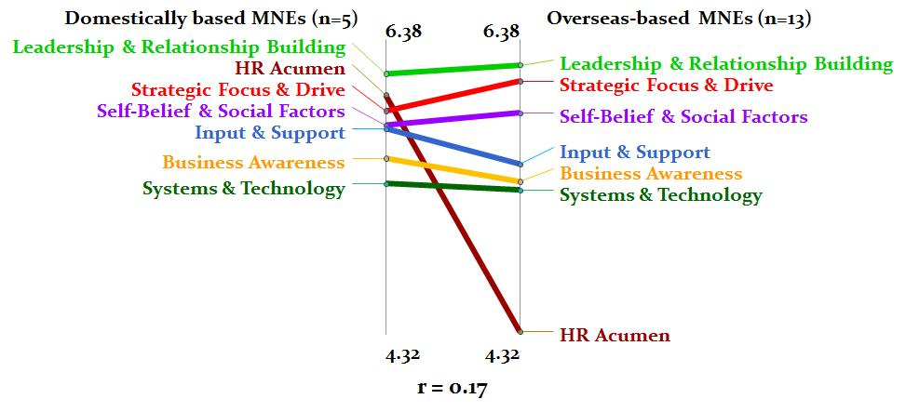
Domestically based vs Overseas-based MNEs
Notes:
The second pattern match compares the HR competency importance ratings between domestically-based and overseas-based MNEs.
The ratings were fairly similar for the two groups except for HR Acumen. This cluster was rated second highest by domestically-based MNEs (6.00), but lowest by overseas-based MNEs (4.32). While the literature suggests that MNEs are more likely to adopt a more sophisticated approach to HRM (Brewster et al., 2008; Edwards et al., 2013), our findings here are very mixed as the two groups of MNEs had very diverse views on the perceived importance of HR Acumen.
Two explanations are possible for such diverse ratings. First, overseas-based MNEs may look to their own parent organisations for models of HRM practices that they can implement in their domestic operations based on the view that parent HRM practices are superior, or alternatively, there is uncertainty about the suitability of various HRM practices in the domestic context (Björkman & Yuan, 2001; Sumelius et al., 2008). This reduces the requirement for HR practitioners in local operations of overseas-based MNEs to possess strong HR Acumen competencies as they are reliant on their parent organisations to provide written guidance and support on HRM policies. Likewise, domestically owned MNEs may be responsible for providing their overseas subsidiaries with access to information and guidance on the MNE’s central HRM policies, and are therefore required to possess stronger functional HR expertise.
Second, parent organisations of overseas-based MNEs may exert influence over the setting of local HRM policies by transferring parts of their home country or global HRM policies and practices to their domestic workplace (Edwards & Kuruvilla, 2005; Farndale & Paauwe, 2005). For instance, it is well established in the literature that US MNEs are more likely to adopt a formalised and centralised approaches to HRM, which in turn may reduce the discretion their subsidiaries have over HRM policy formulation (Almond, 2011; Fenton-O'Creevy et al., 2008; Ferner et al., 2011).

Slide 9
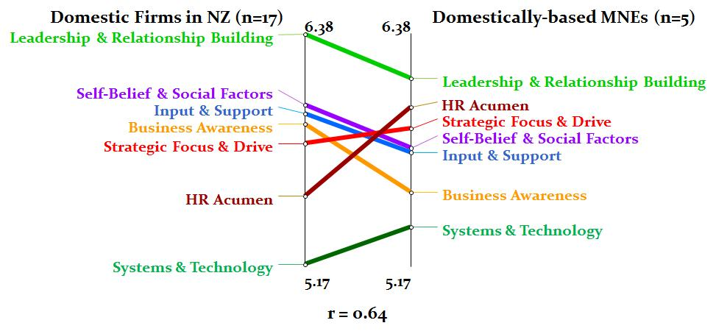
Domestic Firms vs Domestically based MNEs
Notes:
The last pattern match compares the HR competency importance ratings between domestic firms (in NZ) and domestically based MNEs
1. It confirms that domestically-based MNEs gave that highest ratings to HR Acumen competencies among all three groups.
2. It also confirms that both domestically-based and overseas-based MNEs have higher requirements for HR technology than domestic firms. This finding is consistent with researchers who have reported a widespread use of HR information systems among MNEs (e.g., Belizon et al., 2013; Meijerink, Bondarou, & Maatman, 2013; Stiles & Trevor, 2006).

Slide 10
Theoretical Contributions
Provides support for the situationalist approach
Generic HR competencies: Leadership & Relationship Building and Self-Belief & Social Factors
Context-specific HR competencies: HR Acumen
Functional HR competencies can be as important as the strategic HR competencies required for adding value in certain contexts (Antila ,2006; Brown et al., 2009; Truss et al., 2002)
Notes:
Theoretical contributions supporting the situationalist perspective:
Differentiated between generic and context-specific HR competencies for domestic firms and MNEs - this differentiation has important implications for the HR competency literature as it provides a nuanced perspective on the competencies required by HR practitioners in different types of organisations
Leadership and Relationship Building and Self-Belief and Social Factors were generic to domestic firms and MNEs.
This finding is contrary to the expectation that HR practitioners in MNEs make stronger use of strategic HR competencies (Björkman et al., 2011; Sumelius et al., 2008). Indeed, the findings of the present study suggest that competencies in setting shared visions and building effective relationships are critical to HR practitioners’ job success irrespective of type of organisation. HR leadership is important in engaging employees in organisational goals and its subsequent effect on organisational outcomes (Guest & Conway, 2011; McDermott, Conway, Rousseau, & Flood, 2013; Stanton, Young, Bartram, & Leggat, 2010).
Self-Belief and Social Factors as critical HR competencies is important given the growing attention to self-awareness (Buckley & Monks, 2004; Ulrich et al., 2013) and ethical issues (Gama, McKenna, & Peticca-Harris, 2012; Greenwood, 2013; Guest & Woodrow, 2012) in the HRM literature. Self-confidence and resilience are important for maintaining satisfactory performance in uncertain situations, especially during organisational change and crisis (Buckley & Monks, 2004; Crouse, Doyle, & Young, 2011; Lounsbury, Steel, Gibson, & Drost, 2008). Empathy and ethical concern for others are also valued by line managers and employees and are key to sustaining trust and respect from stakeholders (Francis & Keegan, 2006; Kulik, Cregan, Metz, & Brown, 2009; Lowry, 2006).
Our study confirms the contextual nature of HR Acumen competencies by demonstrating them as clear differentiators between domestically-based and overseas-based MNEs. This finding supports the argument that functional HR competencies can be as important as the strategic HR competencies required for adding value in certain contexts (Antila, 2006; Brown et al., 2009; Truss et al., 2002).

Slide 11
Practical Implications
HR Acumen competencies are highly context-specific
Domestic firms and domestically-based MNEs are still highly dependent on HR generalist knowledge
System and Technology are not important differentiators but MNEs make stronger use of knowledge in HR technology than domestic firms
Importance of Leadership and Relationship Building and Self-Belief and Social Factors in the selection and development of HR practitioners
Notes:
Practical Implications for the selection and development of HR practitioners:
HR Acumen as the most highly context-specific HR competencies - certain types of organisations, such as domestic firms and domestically-based MNEs, are still highly dependent on HR generalist knowledge for effective performance in human resources. This finding paints a positive picture for competent HR practitioners for entering into overseas-based MNEs.
Although Systems and Technology competencies (e.g., process improvement, organisation & administration), in general, are not important differentiators between domestic firms and MNEs, there is clear evidence MNEs make stronger use of knowledge in HR technology than domestic firms. Therefore, we recommend HR practitioners who are interested in moving into MNEs develop strong HR technology competency.
Leadership and Relationship Building and Self-Belief and Social Factors were reported as high relevant to both domestic firms and MNEs. Therefore, we recommend domestic firms and MNEs target at these competencies when selecting and developing HR practitioners. Also, tertiary institutions should encourage HRM students to develop Leadership & Relationship Building and Self-Belief & Social Factors through the use of group assessments (e.g., group project, presentation, peer evaluation, aimed at developing self-confidence, communication, interpersonal and conflict resolution skills). HR professional bodies should also emphasise the importance of self-awareness and employee-related competencies in development programmes for HR practitioners.

Slide 12
Research Limitations
Validate the research with a larger sample
More international comparative studies of a more qualitative nature to get a more nuanced view of HR competency requirements.
Include the opinions of other stakeholders (e.g., line managers, employees and trade unions)
Notes:
This study has several limitations which need addressing in future research. First, the concept mapping results were based on HR practitioners’ perceptions only, rather than multiple stakeholder perspectives (Han, Chou, Chao, & Wright, 2006; Selmer & Chiu, 2004). This may have provided a distorted picture of HR competency requirements as HR practitioners may have exaggerated the importance of specific HR competencies or their roles within their organisations due to self-interest bias (Boselie & Paauwe, 2005; Wright et al., 2001). Future research should include the opinions of other stakeholders, for example, line managers, employees and trade unions. As Graham and Tarbell (2006) and Han et al. (2006) argue, employees and line managers have different views from senior managers on what characterises an effective or reputable HR function given their divergent interests in the organisations.
In addition, though the findings of this study confirm the contextual nature of HR competencies, the focus is on the comparison between domestic firms and MNEs. More examination is needed to understand whether there are variations within a single MNE or across MNEs from different nationalities. For instance, it may be particularly interesting to compare the HR competency requirements between the parent company and subsidiaries of a MNE. Future research should also examine whether HR competency requirements between domestic firms and overseas-based MNEs is compounded by firm size in terms of number of employees.

Slide 13
THANK YOU
Future research should move away from the one-size-fits-all universalist approach and adopt a situationalist approach to enable more nuanced understandings on what shapes HR competency expectations.

