Slide 1
The deservingness of the rich: public opinion and public policy
Peter Skilling
Auckland University of Technology

Slide 2
Inequality in NZ, 1982-2012

Slide 3
Household income at decile boundaries

Slide 4
Inequality and public opinion

Slide 5
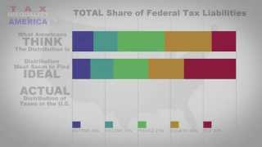
Perceptions and reality

