Slide 1
Sustainability
The Need to Bridge Disciplinary Silos and the Theory-Practice Divide
Professor Kate Kearins
Auckland University of Technology
New Zealand

Slide 2
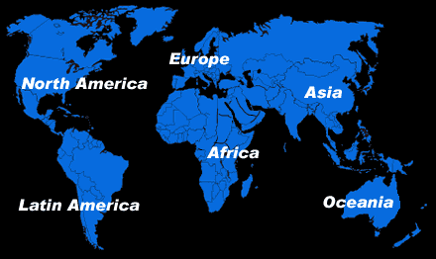


Slide 3
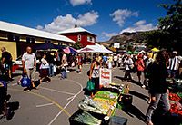
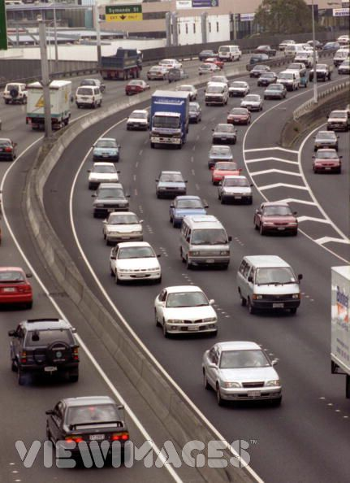
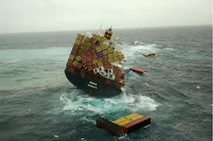
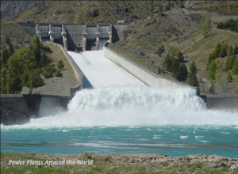
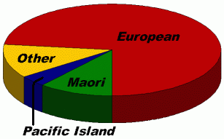

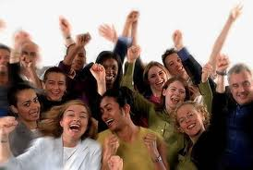
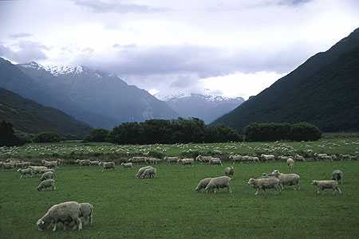
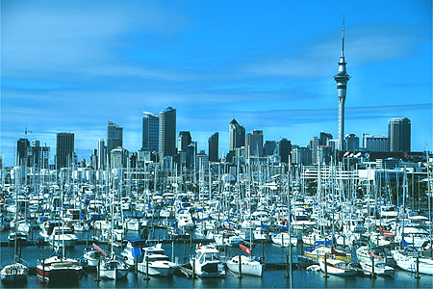
New Zealand
Notes:
New Zealand State of the Environment « Environment 2007 »
A picture of the health of NZ’s land, water, air, plants and animals.
Describes trends, and measures the impact of selected pressures on the environment such as transport, waste, energy and household consumption.
Uniqueness of our environment is stressed – we have a high proportion of unique species with some endangered species recovering, some not.
Population growth, greater consumption, driving bigger and older cars further. More people are using public transport. We are consuming more energy – especially from fossil fuels.
Most people now live in urban areas with consequences for water quality and soil health. Amount of waste sent to landfill has gone down and recycling rates are growing.
Aspects of air and water quality have improved as more controls on point source discharges are in effect. More land under management for pests, weeds and animals. More land is being protected for conservation. More fertiliser is being used.
Nutrient levels in fresh waters have risen. Range of some native species decreased and some fish stocks over-exploited.

Slide 4
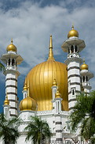
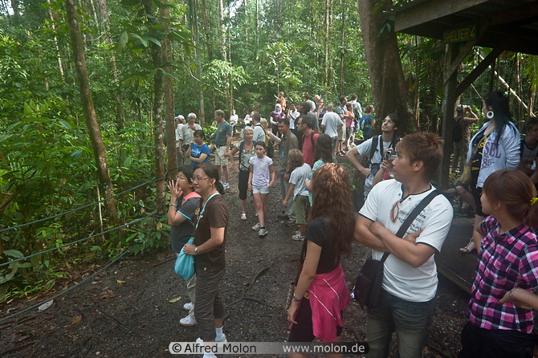
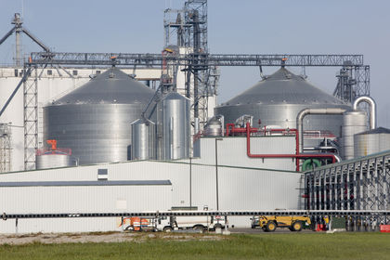
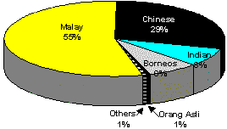
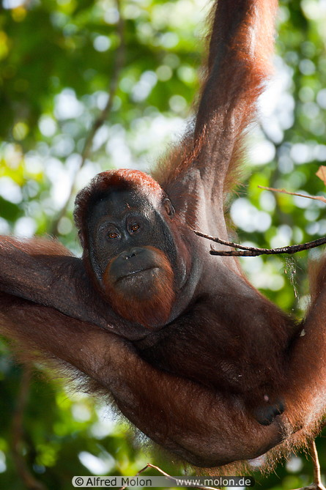
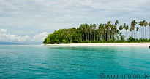
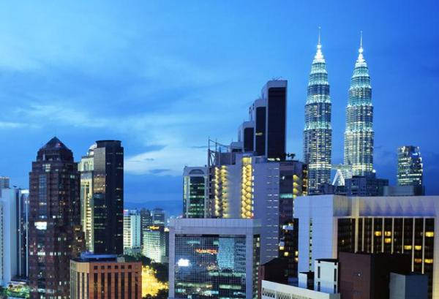
Notes:
Average ecological footprints of New Zealand and Malaysia very similar 4.86-9 global hectares per person
Globally 2.2 available.
Not as bad as UAE 10.07
US 7.99
But double the resource consumption and impact we should be having.

Slide 5
The Big Question
We have stunning resources…
We are living beyond the carrying capacity of our planet …
There are issues and problems we need to individually and collectively address to ensure a sustainable future…
SO HOW DO WE BECOME SUSTAINABLE?

Slide 6
Intellectual Concepts
  Sustainability the capacity to endure
    an aspirational goal,
    a dynamic systems state of environmental, social and economic prosperity that can keep going indefinitely to the benefit of all
  Sustainable development
    a process defined by the World Commission on Environment and Development - which may / may not lead to such a state
Notes:
« Human economic systems that are sustainable will be expected to last for a very long time; by definition, indefinitely, and will therefore be around for future generations to make use of, should they choose to do so «
Natural Step System Conditions (explained in class week 3)
The Four System Conditions...
In a sustainable society, nature is not subject to systematically increasing:
concentrations of substances extracted from the earth's crust (ie eliminate our contribution to the progressive buildup of substances extracted from the Earth's crust (for example, heavy metals and fossil fuels)
2. concentrations of substances produced by society (ie eliminate our contribution to the progressive buildup of chemicals and compounds produced by society (for example, dioxins, PCBs, and DDT ))
3. degradation by physical means (ie eliminate our contribution to the progressive physical degradation and destruction of nature and natural processes (for example, over harvesting forests and paving over critical wildlife habitat))
4. and, in that society, people are not subject to conditions that systemically undermine their capacity to meet their needs (i. eliminate our contribution to conditions that undermine people’s capacity to meet their basic human needs (for example, unsafe working conditions and not enough pay to live on))

Slide 7
Sustainable Development
“Development that meets the needs of the present without compromising the ability of future generations to meet their own needs. It contains within it two key concepts:
The concept of ‘needs’, in particular the essential needs of the world’s poor, to which overriding priority should be given; and
The idea of limitations imposed by the state of technology and social organisation on the environment’s ability to meet present and future needs” (WCED, 1987, p 43).

Slide 8
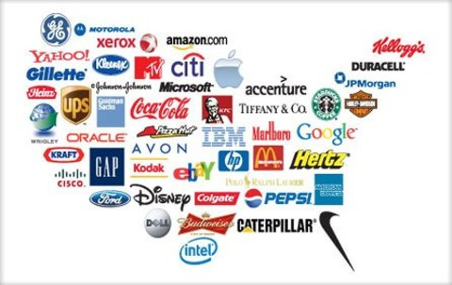

Needs?

Slide 9
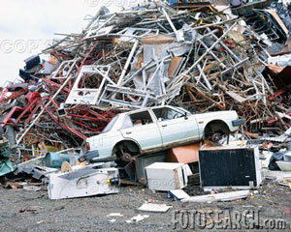
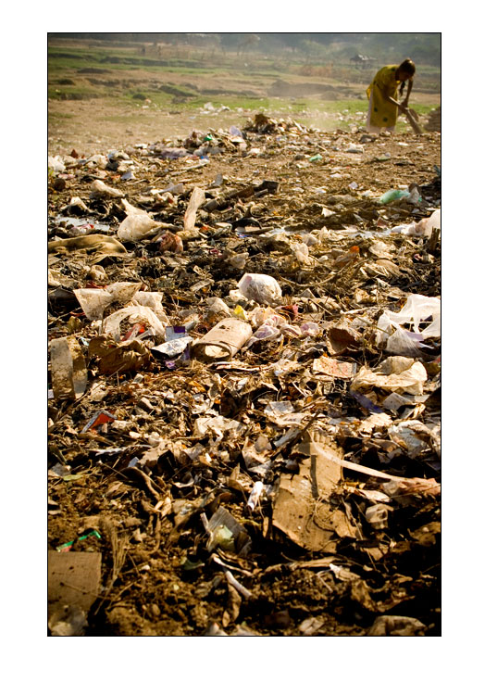
Limits?

Slide 10
Philosophical Explanations
Emphasising intergenerational equity
Emphasising social justice
Emphasising limits to growth
Emphasising ecosystems
Emphasising morality
Fundamentally querying the bases of capitalism

Slide 11
Political Economy of Capitalism
Private actors allowed to own and control the use of property and resources in accord with their own interests
Invisible hand of pricing mechanism coordinates supply and demand in markets in a way that is presumed to be in the best interests of society
Limited role for government in terms of responsibility for ‘peace, justice and tolerable taxes’

Slide 12

Owners of capital take risks and reap benefits

Slide 13
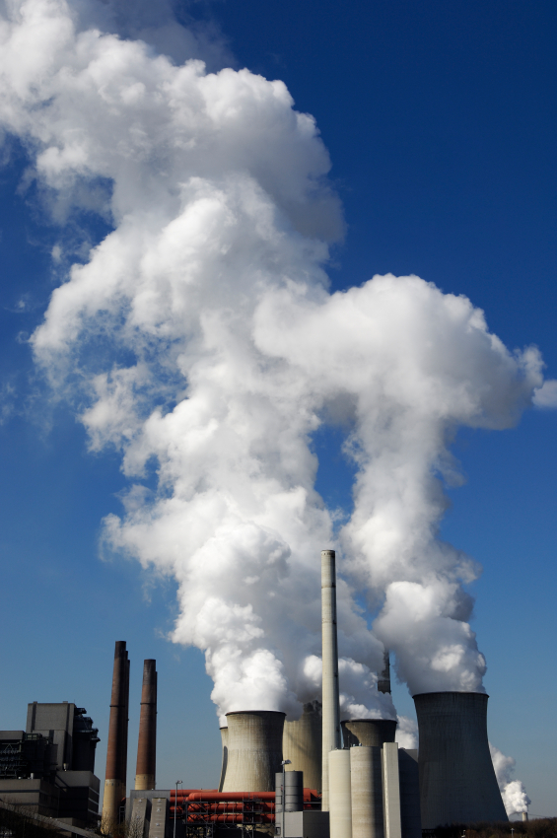
Others suffer through any externalities

Slide 14
Recent Research
MIT Sloan Management Review and Boston Consulting Research
Survey of 2,874 managers/executives from 113 countries
70% of companies that have placed sustainability on their management agendas have done so in the past six years; 20% have done so in just the past two years
Two-thirds of respondents said that sustainability was critically important to being competitive in today’s marketplace, up from 55% in the 2010 survey
Most companies are struggling to define sustainability in a way that is relevant for their businesses
31% of respondents say their companies are currently profiting from sustainable business practices
Notes:
http://sloanreview.mit.edu/the-magazine/2012-winter/53213/sustainability-nears-a-tipping-point/
The Leading Question
What are companies who are profiting from sustainable business practices doing differently?
Findings
“Harvester” companies are more likely to have strong CEO commitment to sustainability.
They are three times more likely to have a business case for sustainability.
They are more likely to collaborate with external groups
Harvesters - Those companies that are profiting from sustainability are likely to be out in front of both external and internal sustainability drivers.

Slide 15
The Business Case for Sustainable Development
Sustainable development is good for business and business is good for sustainable development (WBCSD)
Effective design can yield resource productivity improvements
Enabling technologies now exist to provide for eco-innovations
Improving resource productivity can lead to higher economic growth than business-as-usual, while at the same time reducing pressures on the environment and enhancing employment
Notes:
The World Business Council for Sustainable Development, founded in 1995, has formulated the business case for sustainable development and argues that "sustainable development is good for business and business is good for sustainable development". This view is also maintained by proponents of the concept of industrial ecology. The theory of industrial ecology declares that industry should be viewed as a series of interlocking man-made ecosystems interfacing with the natural global ecosystem.
According to some economists, it is possible for the concepts of sustainable development and competitiveness to merge if enacted wisely, so that there is not an inevitable trade-off[10]. This merger is motivated by the following six observations (Hargroves & Smith 2005):
Throughout the economy there are widespread untapped potential resource productivity improvements to be made to be coupled with effective design.
There has been a significant shift in understanding over the last three decades of what creates lasting competitiveness of a firm.
There is now a critical mass of enabling technologies in eco-innovations that make integrated approaches to sustainable development economically viable.
Since many of the costs of what economists call ‘environmental externalities’ are passed on to governments, in the long-term sustainable development strategies can provide multiple benefits to the tax payer.
There is a growing understanding of the multiple benefits of valuing social and natural capital, for both moral and economic reasons, and including them in measures of national well-being.
There is mounting evidence to show that a transition to a sustainable economy, if done wisely, may not harm economic growth significantly, in fact it could even help it. Recent research by ex-Wuppertal Institute member Joachim Spangenberg, working with neo-classical economists, shows that the transition, if focused on improving resource productivity, will lead to higher economic growth than business as usual, while at the same time reducing pressures on the environment and enhancing employment.
Wikipedia 2007

Slide 16
Against the Business Case
Capitalism privileges privatisation of profits over socialisation of losses
There is often a trade-off between sustainability and competitiveness
Values do not readily translate into behaviours
Business engagement may be more rhetorical than substantive
Sustainable development is made up of different often incompatible elements that are seen as beyond the mandate of business
Notes:
Self-interest tends to prevail
It is not always in business interests to do the ‘right’ thing
Lock-in may inhibit change efforts
Customers do not always want what is good for them

Slide 17
What is needed to promote sustainability?
Leaders, champions, and change agents
Regulation and/or voluntarism
Disasters, shocks, shortages
Creative solutions
More advanced technologies
Education, knowledge and skills
Collaboration and team work
A different consumption ethic

Slide 18
What can we do as individuals?
Experts from a range of disciplines can develop the skills to work together
We can work to define problems and get others to assist us to develop and implement solutions
We can seek to engage with people
  who care about where they live, work and play
  who are prepared to take decisions with a view to the long- term
  who do not substitute talking for action when action is really what is needed
  who are prepared to embrace change

Slide 19
What kind of enterprises will contribute to sustainability? (1)
Organisations that do not seek profit at all costs
Organisations that do not take undue risks as they appreciate their connections to and responsibilities for the environment
Organisations that take a long term ‘glocal’ view
Organisations that conserve resources, and ‘look after’ products across their lifecycle

Slide 20
What kind of enterprises will contribute to sustainability? (2)
Organisations that take social equity seriously
Organisations that work with rather than against the interests of diverse stakeholders
Organisations who work within the spirit of international conventions and frameworks to co-operate rather than compete on matters of fundamental importance

Slide 21
What sort of academics will make a difference?
Academics who engage with non-trivial issues, who ask the big questions and encourage reflexivity, critique and social action on the part of their students
Academics who are theoretically promiscuous, whose work is practice focused – not just practice-based – and whose work celebrates good practice and decries bad practice, and also offers a realistic prescription for enhanced performance

Slide 22
What hope?
Concluding Thoughts
Move beyond talk to taking substantive action
Take people with you
Work with the prescripts of positive psychology
Hail and be part of honest and substantive efforts to address needs (especially of the world’s poor) AND limits (especially ecological ones)
Work for the biggest prize – life itself

