Slide 1
Images 1 – 8,
Left to right,
Left hand side wall of the exhibition

Slide 2
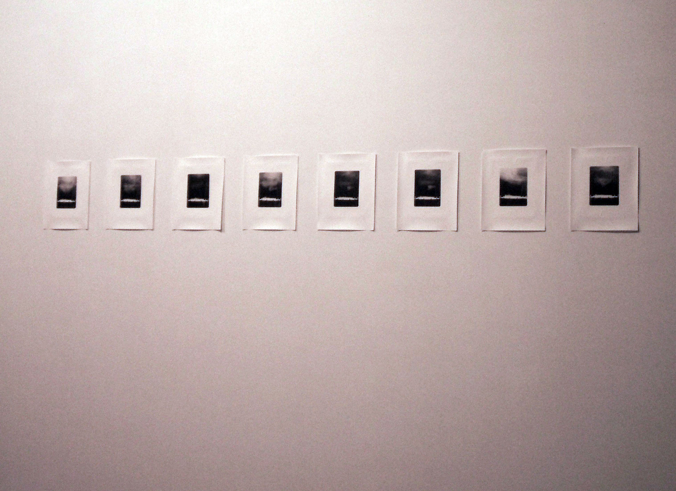
Notes:
Figure 1. Incandescent Silver (view of the left hand side wall of exhibition), Note the repeated image four photographs from the left , (x 8), 20.3 x 25 cm, September 2011, Selenium toned fibre base, dry embossed prints, Digital documentation.

Slide 3
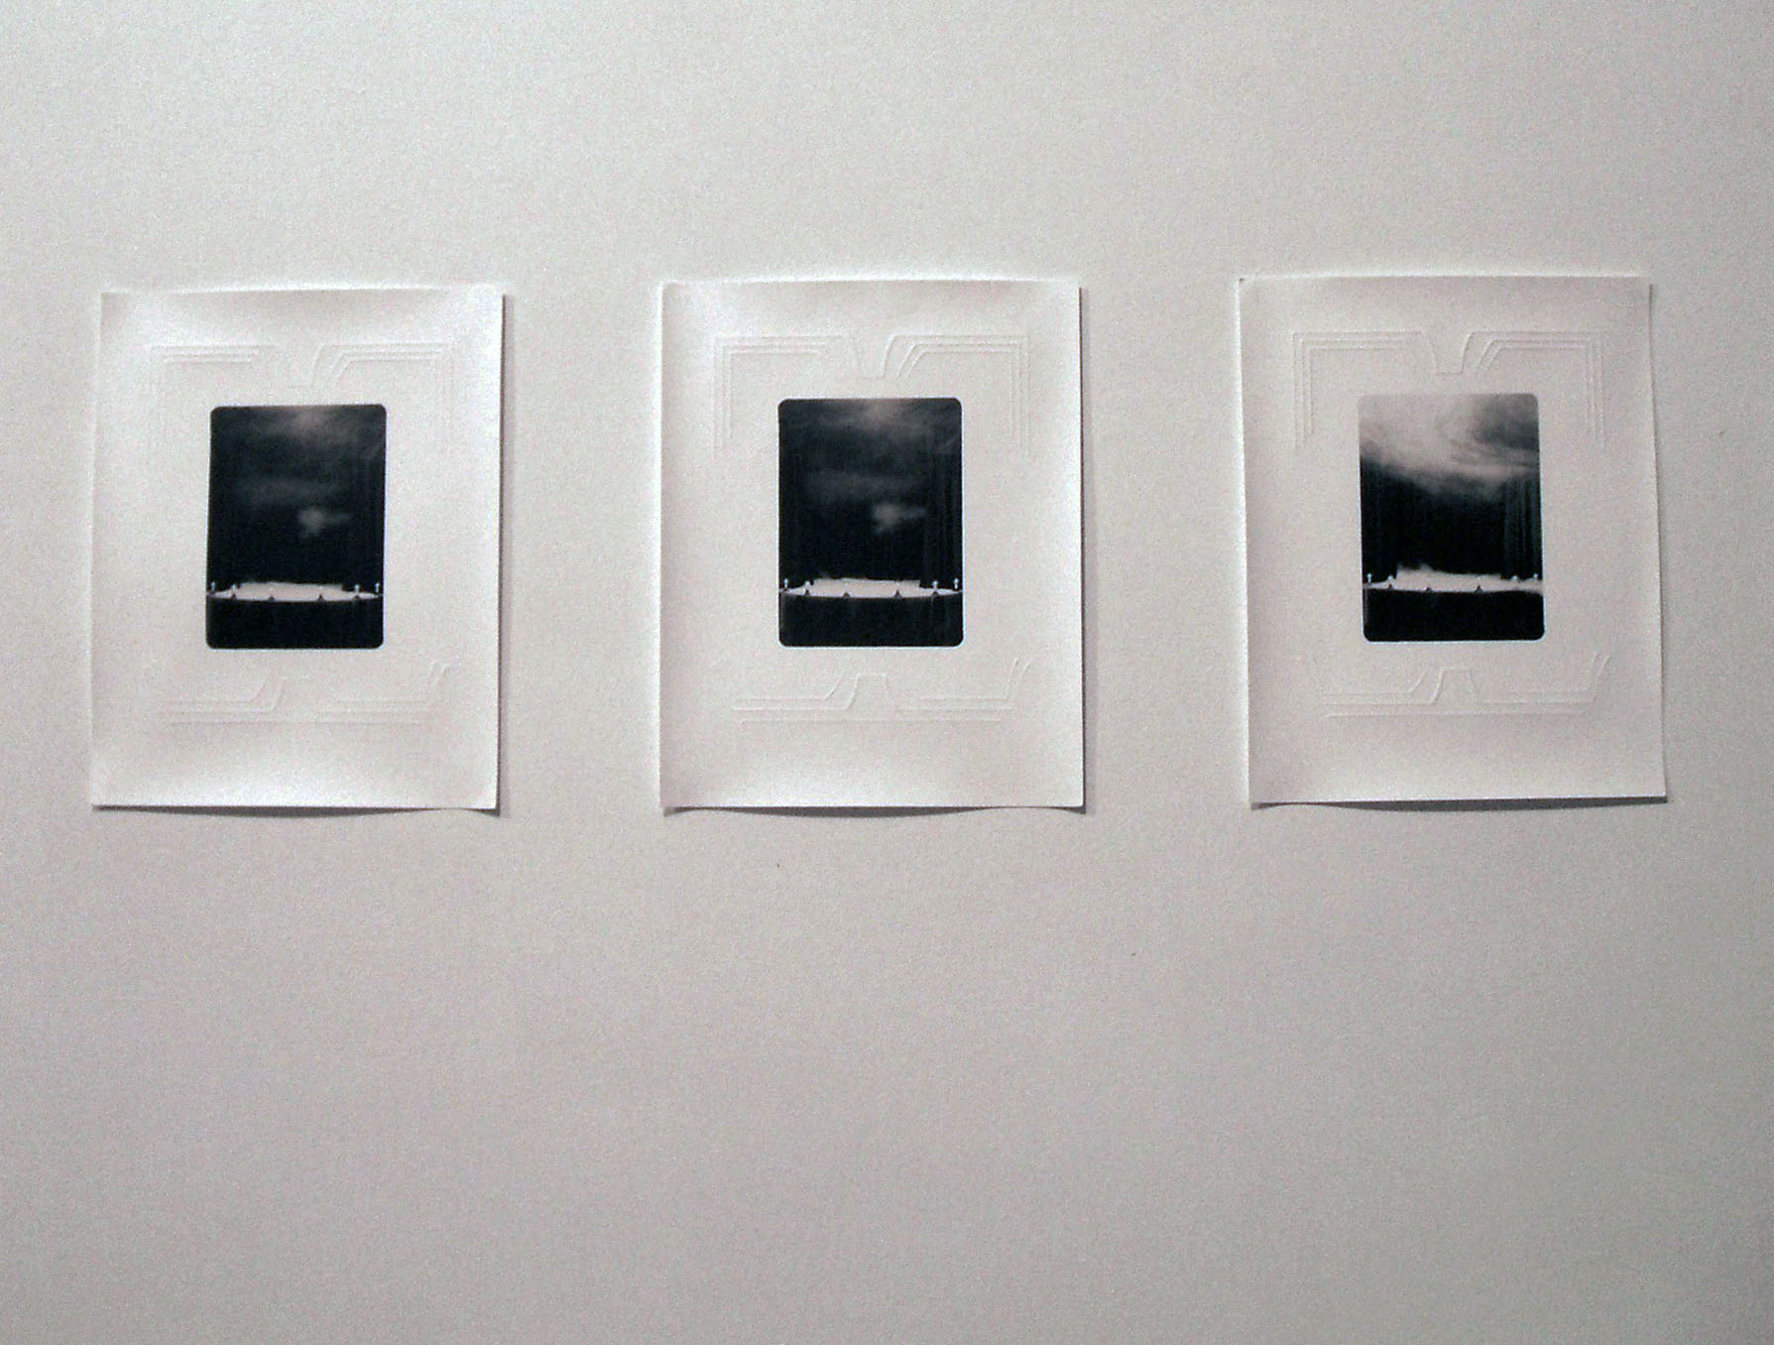
Notes:
Figure 2. Incandescent Silver (view of left hand side wall of exhibition), Detail of repeated photograph, (x 8), 20.3 x 25 cm, September 2011, Selenium toned fibre base, dry embossed prints, Digital documentation.

Slide 4
Notes:
Figure 3. 1/16, Photograph of Incandescent Silver, 20.3 x 25 cm, September 2011, Selenium toned fibre base, dry embossed prints, Scanned document.

Slide 5
Notes:
Figure 4. 2/16, Photograph of Incandescent Silver, 20.3 x 25 cm, September 2011, Selenium toned fibre base, dry embossed prints, Scanned document.

Slide 6
Notes:
Figure 5. 3/16, Photograph of Incandescent Silver, 20.3 x 25 cm, September 2011, Selenium toned fibre base, dry embossed prints, Scanned document.

Slide 7
Notes:
Figure 6. 4/16, Photograph of Incandescent Silver, 20.3 x 25 cm, September 2011, Selenium toned fibre base, dry embossed prints, Scanned document.

Slide 8
Notes:
Figure 7. 5/16, Photograph of Incandescent Silver, 20.3 x 25 cm, September 2011, Selenium toned fibre base, dry embossed prints, Scanned document.

Slide 9
Notes:
Figure 8. 6/16, Photograph of Incandescent Silver, 20.3 x 25 cm, September 2011, Selenium toned fibre base, dry embossed prints, Scanned document.

Slide 10
Notes:
Figure 9. 7/16, Photograph of Incandescent Silver, 20.3 x 25 cm, September 2011, Selenium toned fibre base, dry embossed prints, Scanned document.

Slide 11
Notes:
Figure 10. 8/16, Photograph of Incandescent Silver, 20.3 x 25 cm, September 2011, Selenium toned fibre base, dry embossed prints, Scanned document.

Slide 12
Images 9 – 16, left to right,
Right hand side wall of the exhibition

Slide 13
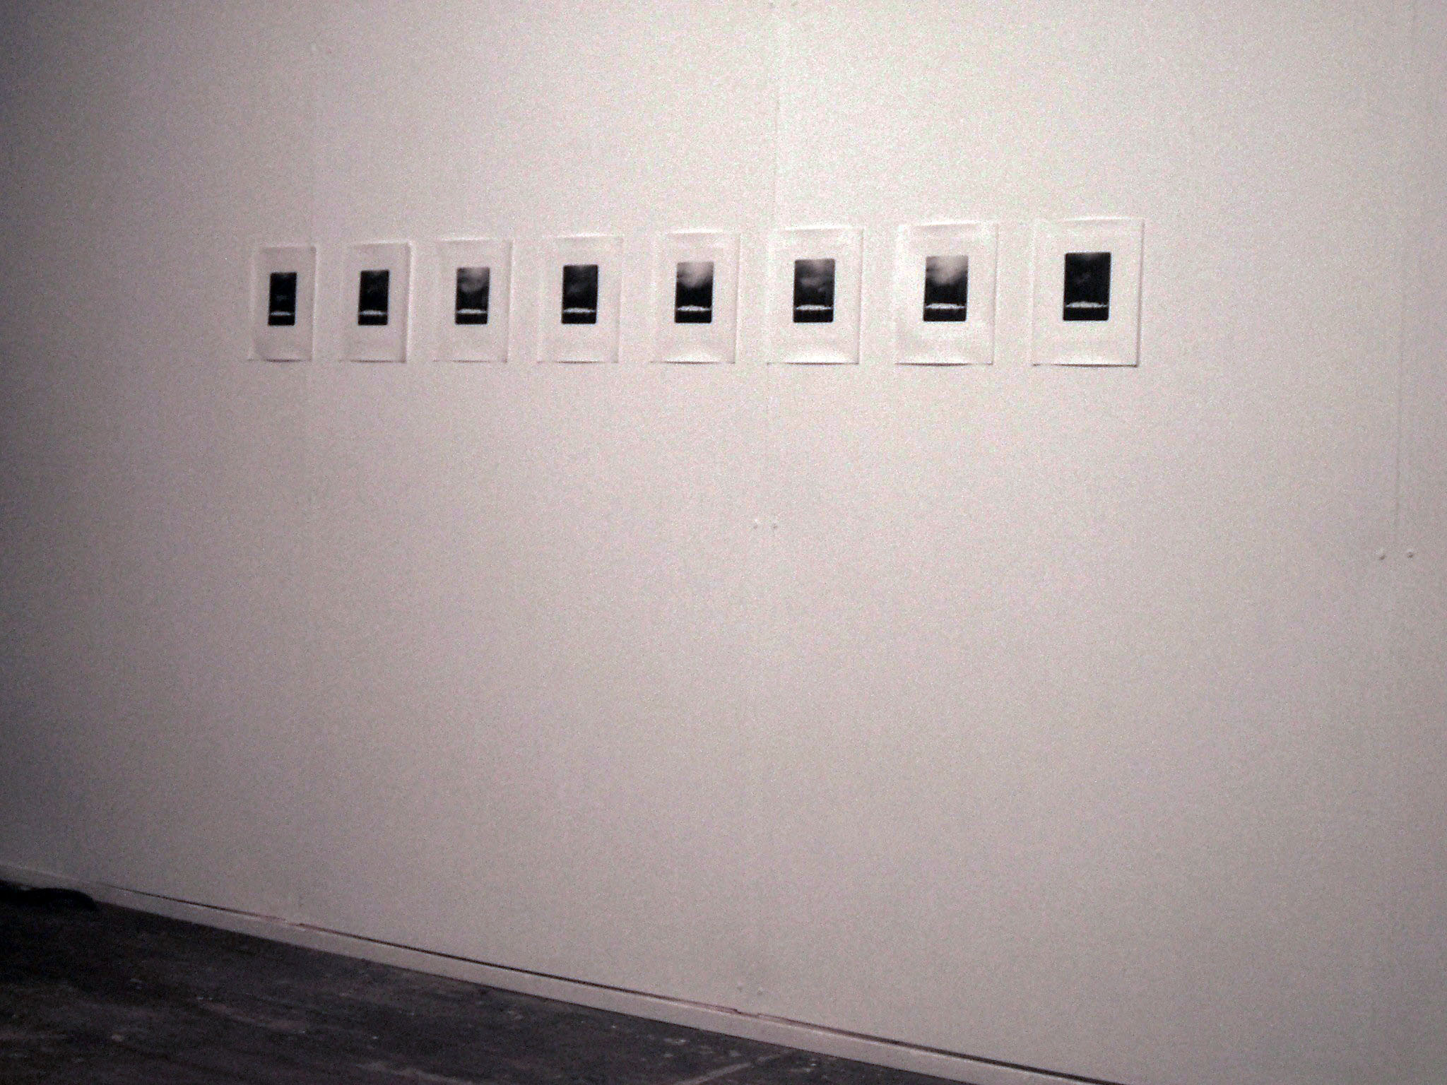
Notes:
Figure 11. Incandescent Silver (view of right hand wall of exhibition), (x 8), 20.3 x 25 cm, September 2011, Selenium toned fibre base, dry embossed prints, Digital documentation.

Slide 14
Notes:
Figure 12. 9/16, Photograph of Incandescent Silver, 20.3 x 25 cm, September 2011, Selenium toned fibre base, dry embossed prints, Scanned document.

Slide 15
Notes:
Figure 13. 10/16, Photograph of Incandescent Silver, 20.3 x 25 cm, September 2011, Selenium toned fibre base, dry embossed prints, Scanned document.

Slide 16
Notes:
Figure 10. 11/16, Photograph of Incandescent Silver, 20.3 x 25 cm, September 2011, Selenium toned fibre base, dry embossed prints, Scanned document.

Slide 17
Notes:
Figure 11. 12/16, Photograph of Incandescent Silver, 20.3 x 25 cm, September 2011, Selenium toned fibre base, dry embossed prints, Scanned document.

Slide 18
Notes:
Figure 16. 13/16, Photograph of Incandescent Silver, 20.3 x 25 cm, September 2011, Selenium toned fibre base, dry embossed prints, Scanned document.

Slide 19
Notes:
Figure 17. 14/16, Photograph of Incandescent Silver, 20.3 x 25 cm, September 2011, Selenium toned fibre base, dry embossed prints, Scanned document.

Slide 20
Notes:
Figure 19. 15/16, Photograph of Incandescent Silver, 20.3 x 25 cm, September 2011, Selenium toned fibre base, dry embossed prints, Scanned document.

Slide 21
Notes:
Figure 20. 16/16, Photograph of Incandescent Silver, 20.3 x 25 cm, September 2011, Selenium toned fibre base, dry embossed prints, Scanned document.

Slide 22
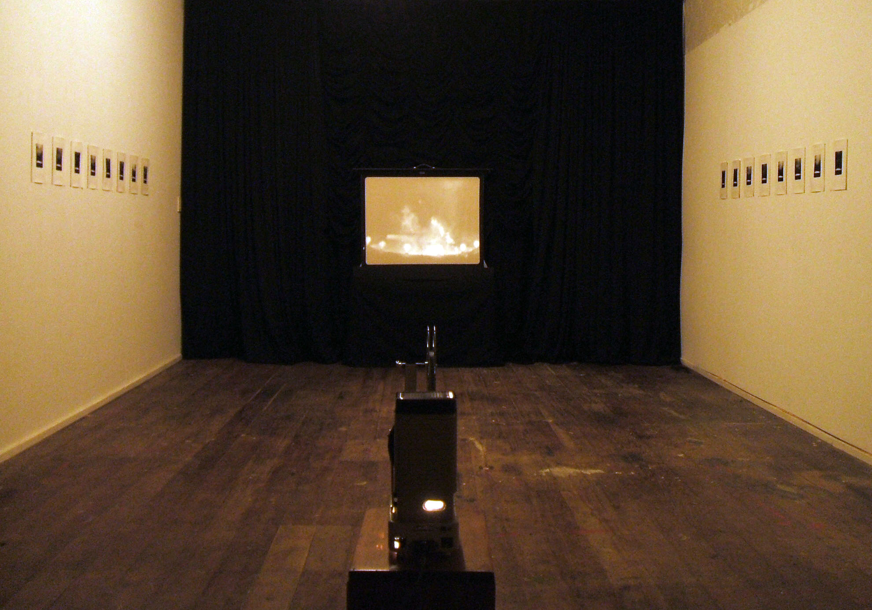
Notes:
Figure 21. Incandescent Silver (front on view of exhibition layout), 400 x 900 x 300 cm, September 2011, Digital documentation.

Slide 23
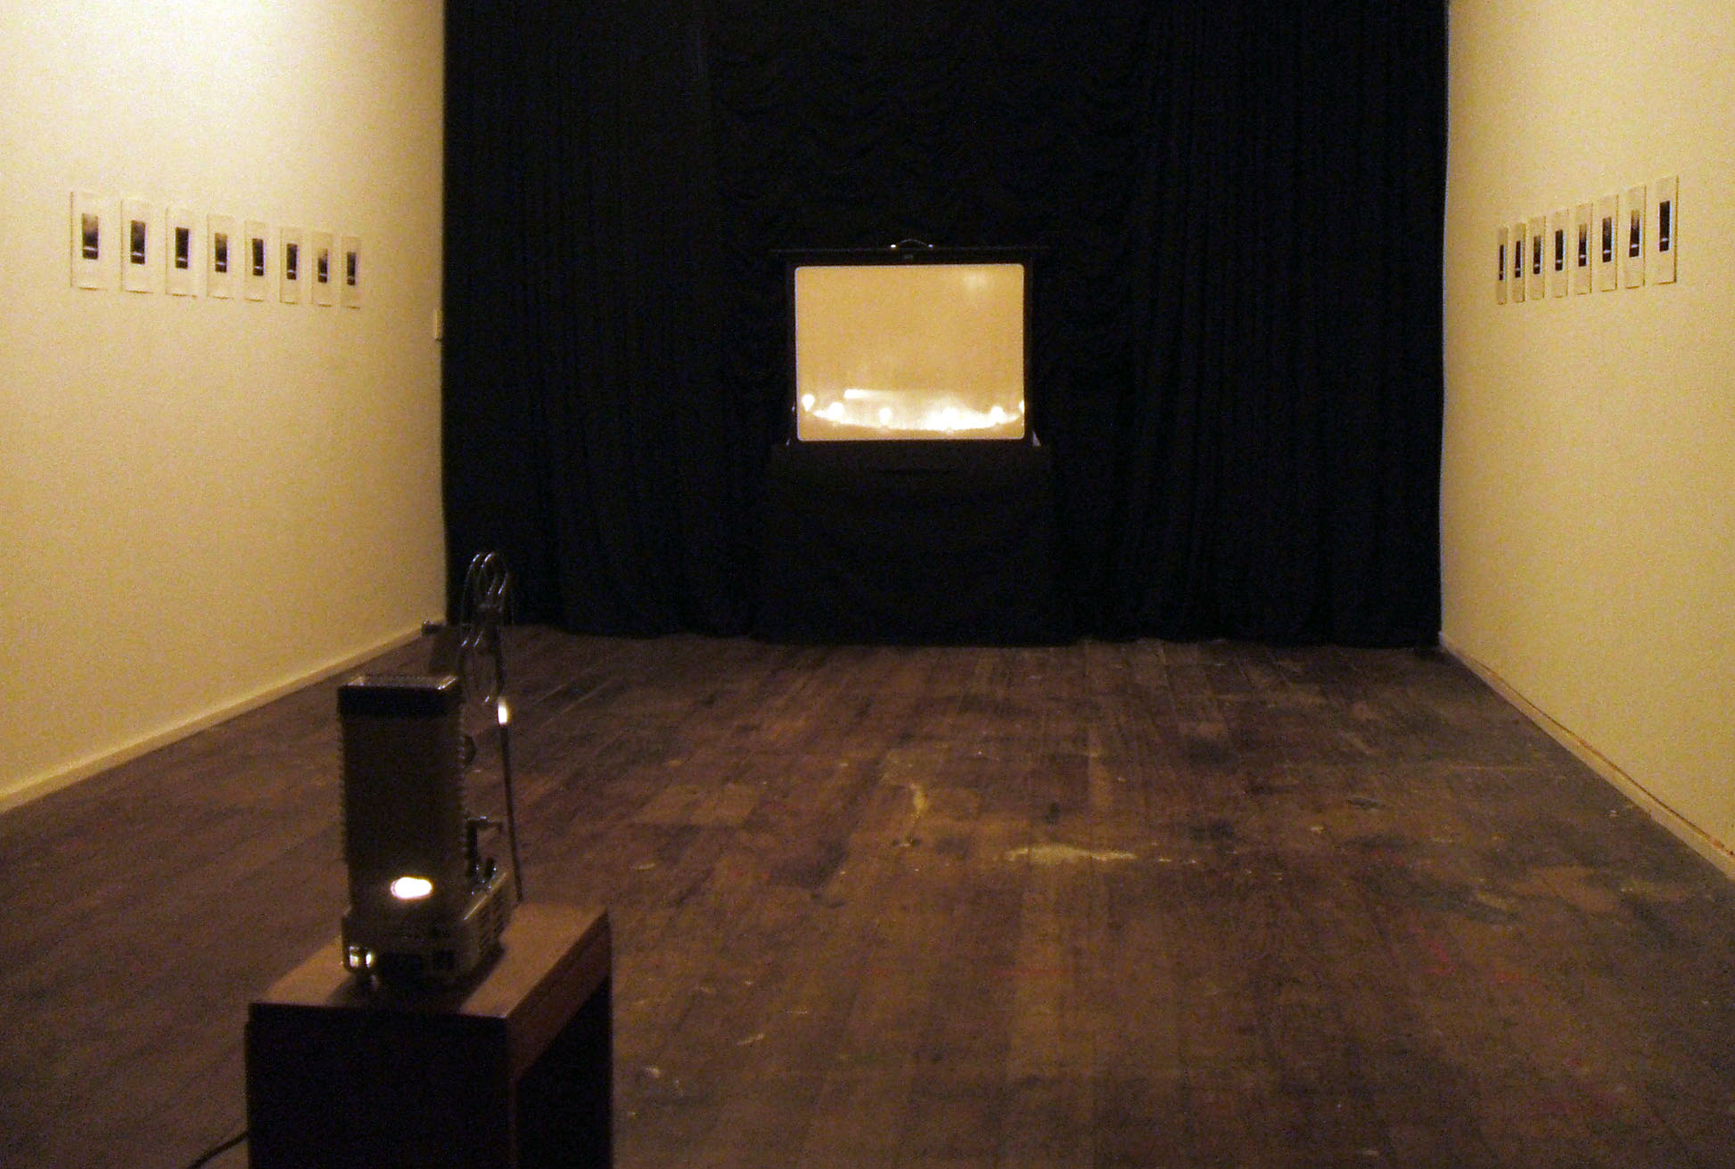
Notes:
Figure 22. Incandescent Silver (view slightly from the right of exhibition layout), 400 x 900 x 300 cm, September 2011, Digital documentation.

Slide 24
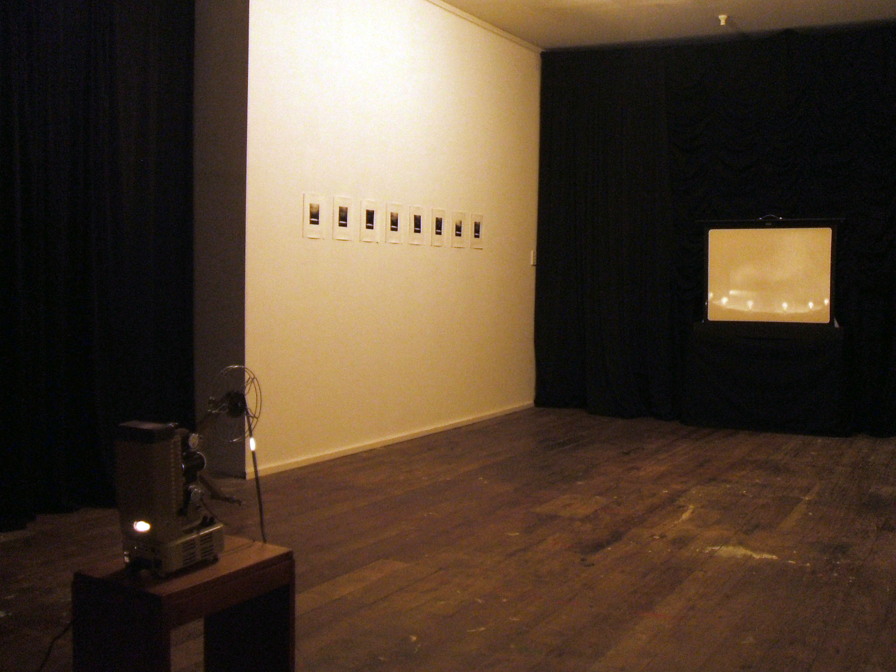
Notes:
Figure 23. Incandescent Silver (view from the right of exhibition layout), 400 x 900 x 300 cm, September 2011, Digital documentation.

