Slide 1
CAUTION: It is essential that kodecyte antibody screening and identification panels are labeled appropriately and
cannot be confused with, or accidentally used in a clinical or diagnostic setting. Kodecyte screening and identification panels must be clearly labelled and identified as not for clinical or diagnostic use.
SUPPLEMENTARY NOTES - Preparation of ASKG screening and antibody identification training panels
By arranging ASKG-kodecytes as an antibody identification (ID) panel along with unmodified cells (ASKG negative) specific antibody reactivity patterns can be created. The order of the ASKG-kodecytes and unmodified cells in ID panel format will represent antibody specificity, while the reaction strength for each sample will be sample (antibody) dependent it can also be controlled to some extent by using kodecytes with more or less antigen.
Preparation of ASKG ID training panels
Prepare bulk ASKG-kodecytes (kodecyte concentrations as desired) and unmodified cells – volumes and suspension concentrations will need to be determined on a case-by-case basis (note vi).
Into labeled tubes or vials dispense appropriate volumes of both ASKG-kodecytes and unmodified cells in a format suitable for an antibody identification panel (where kodecytes are positive reactions and unmodified cells negative reactions)
Printout (and modify sheet as required) an ASKG ANTIBODY IDENTIFICATION WORKSHEET to correlate with the ASKG kodecyte patterns (note vii). This worksheet can be substituted with alternative panel sheets.
Organize the ASKG-kodecytes and unmodified cell suspensions into desired reactivity patterns according to the antibody identification worksheet (note vii)
Prepare labelled patient samples for analysis which will include:
  an autocontrol cell suspension or sample (it can be unmodified cells in allo-antibody scenario) – (note viii)
  Sufficient plasma/serum to complete an antibody identification
Undertake antibody screening and antibody identification according to established procedures and record results
Notes:
vi. A public domain resource document in the form of an editable Excel sheet is available online (or by email request). Note the version number of this file is included in the filename in date format YYMMDD. In the yymmdd-ASKG.xls file the following information is available.
“Requirements” allows for the calculation of bulk reagent requirements after entering your parameters (e.g. number of panels required, number of ASKG-kodecytes/unmodified cells in each panel, cell volumes, % concentration of suspension and volumes of cells in tubes, etc)
“ID Master Worksheet” a version of the ASKG ANTIBODY IDENTIFICATION WORKSHEET for use or modification
“Example Master” has reduced versions of the ASKG ANTIBODY IDENTIFICATION WORKSHEET showing the examples of antibody identifications described below and examples under individual tabs
vii. The same patient serum/plasma samples can be given to different students, but if each is given a differently organized ASKG-kodecyte panel, they will get a different antibody specificity identification. Because the same kodecytes are used by all participants the serologic grade reactions can be compared between participants to determine methodological skill and accuracy in reaction grading.
viii. If reagent phenotyping confirmation of the patient’s red cells is also required then the autocontrol (AC) red cells will need to be selected to have an appropriate phenotype. The autocontrol cells will always be compatible if they are not modified into ASKG-kodecytes.
ASKG ANTIBODY IDENTIFICATION PANEL EXAMPLES
The examples on the following pages are theoretical examples using ASKG-kodecytes (indicated by a red font), unmodified cells (red dash) and the ASKG ANTIBODY IDENTIFICATION WORKSHEET. The following examples although theoretical are based on experimental observations using ASKG-kodecytes. The actual concentration of FSL to prepare kodecytes in different laboratories may vary and will need to be determined on an individual basis for the plasma sample(s) chosen and the inherent sensitivity differences between platforms and reagents.
Because reaction strength is in part dependent on the platform being used the following examples show the reactivity of the kodecytes as grades e.g. ASKG-(1+)-kodecytes, ASKG-(2+)-kodecytes, ASKG-(3+)-kodecytes and ASKG-(4+)-kodecytes rather than the correct terminology of the μmol/L concentrations of FSL-ASKG used to make them (e.g. ASKG-20-kodecytes).
Reactivity is dependent on both sample antibody level and ASKG-kodecyte antigen level
Specific antibody reaction patterns can be simply created by organizing kodecytes and unmodified cells in an order relating to an ASKG Antibody Identification panel. However, because different serum and plasma samples will naturally have different levels of ASKG antibody further serology complexities can be created. For example, the same sample when tested against two different kodecyte preparations will give two different reaction grades (see figures 2 & 3). This creates and opportunity to give students with different competencies different panels, but the same samples. Alternatively samples with lower levels of antibody will also give less reactivity against kodecytes of the same strength (compare figures 1 and 3). Again this can be utilized within a class to create controlled sample variations between students
ASKG Antibody Identification Panel Abbreviations
S = saline reactive cause by IgM activity
S-IAT = Saline anti-IgG (antiglobulin test). Not indicated is the addition of antibody positive cells to confirm reactivity (cc+)
ENZ = Enzyme treated panel
Reactions are graded on the 0-4 scale, with 0 = negative and grades 1 - 4 representing weak to maximal strong reactions

Slide 2
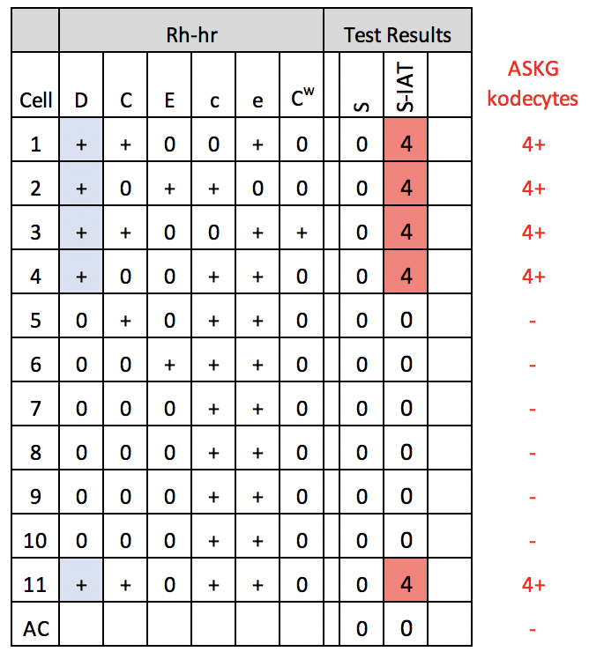
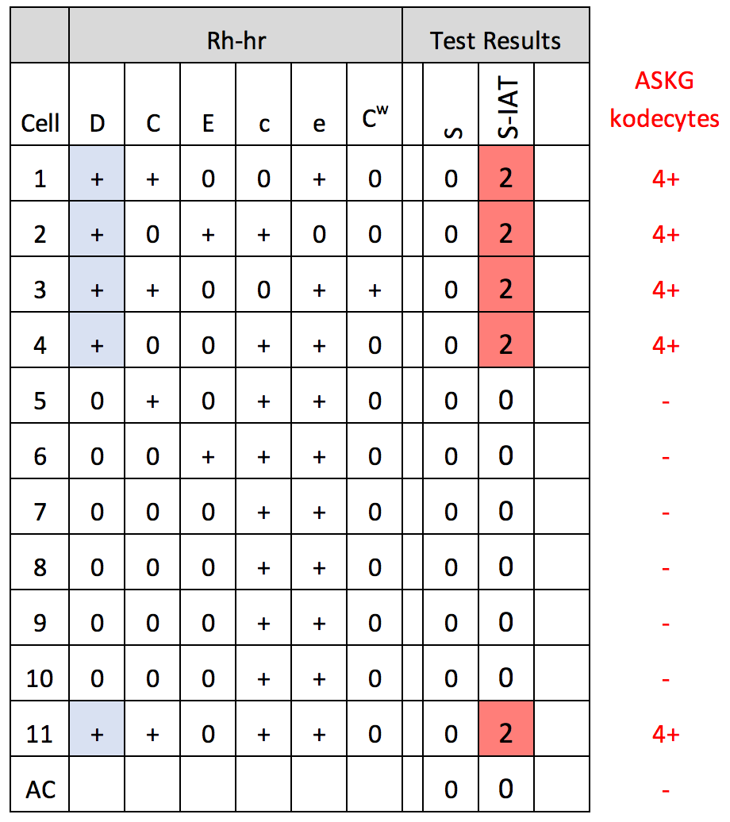

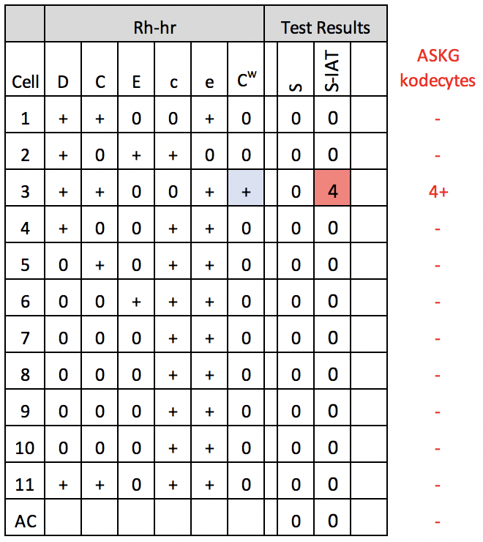
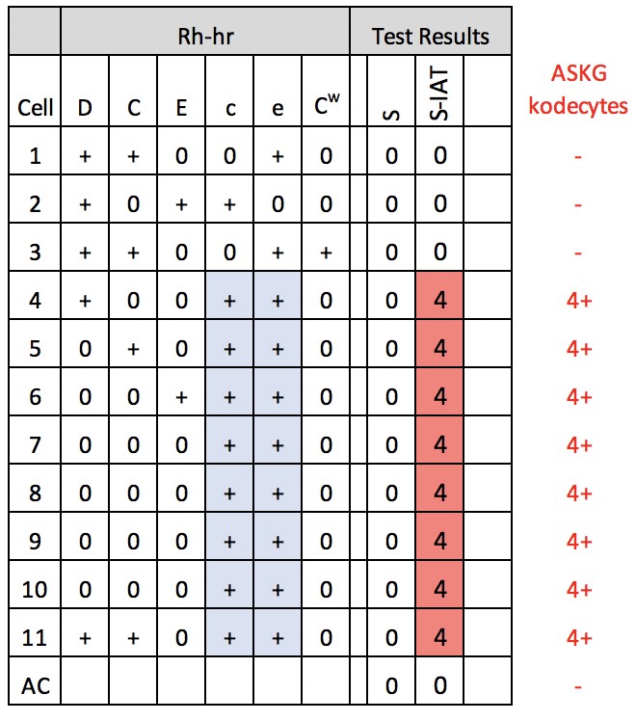
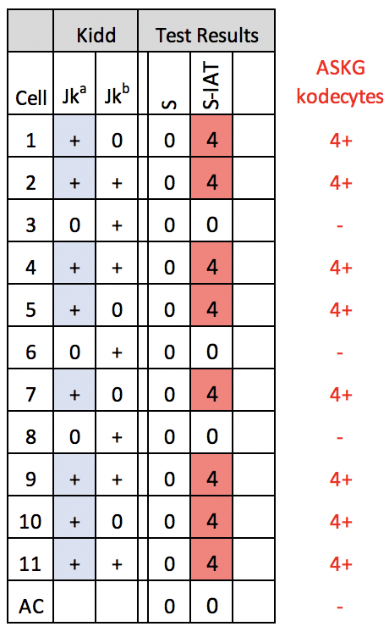
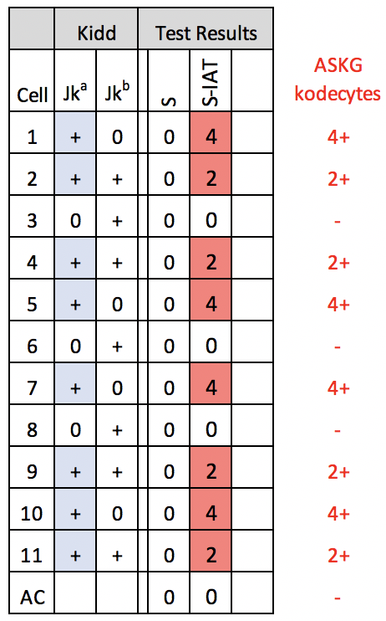
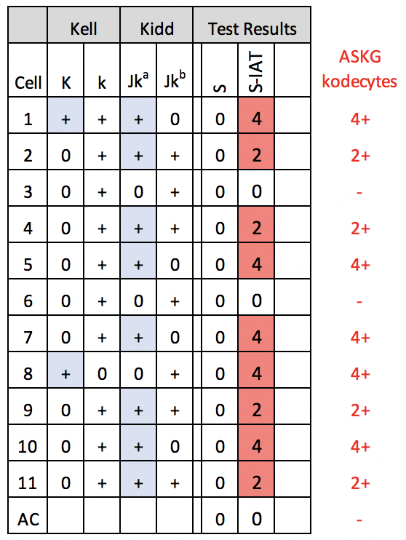
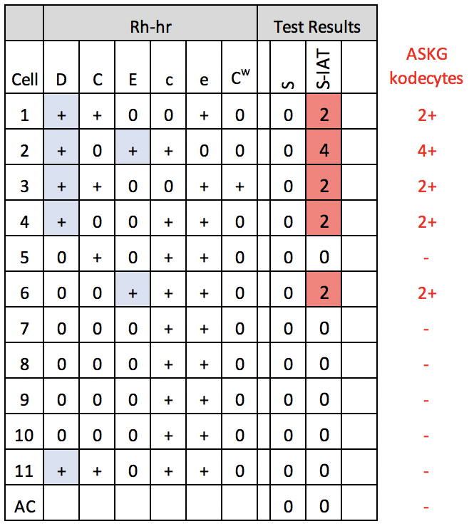
Example 2 – different antibody specificities created by reorganizing the panel
In this examples two different plasma samples, one with a high level of anti-ASKG (Figure 2) and the other with a lower level of antibody (Figure 3) are tested against ASKG-(4+)-kodecytes to give anti-D mimic reactions. Similarly if the plasma sample with the high level of anti-ASKG is tested against a panel made with ASKG-(2+)-kodecytes it will give weaker reactions (Figure 4).
Figure 2. Mimic of anti-D reactions in a sample with strong anti-ASKG activity
against ASKG-(4+)-kodecytes.
Figure 3. Mimic of anti-D reactions in a sample with strong anti-ASKG activity
against ASKG-(2+)-kodecytes.
Figure 4. Mimic of anti-D reactions in a sample with medium anti-ASKG activity against ASKG-(4+)-kodecytes.
Example 3 – more complex reactions can be created with different kodecytes
By changing the position of the kodecytes and unmodified cells in the ASKG Antibody Identification Panel it organized to give mimic reactions of rare and unusual antibodies. In the examples shown the rare anti-C^{w} antibody (Figure 5) and the unusual compound antibody anti-f(ce) are seen (Figure 6). Anti-Jkª is easily created (Figure 6) and by changing both the antigen levels of the ASKG-kodecytes in an ASKG Antibody Identification Panel anti-Jkª showing dosage (Figure 8) and complex mixtures (Figure 9 & 10) can also be mimicked. It is important to note the antibody mixtures are mimics and not two antibodies and cannot be separated (i.e. they only mimic a mixture reactivity patterns).
Figure 5. Mimic of anti-C^{w} reactions in a sample with strong anti-ASKG activity against ASKG-(4+)-kodecytes.
Figure 6. Mimic of anti-f(ce) reactions in a sample with strong anti-ASKG activity against ASKG-(4+)-kodecytes.
Figure 7. Mimic of anti-Jkª reactions in a sample with strong anti-ASKG activity against ASKG-10-kodecytes.
Figure 8. Mimic of an anti-Jkª showing dosage reactions created by using created by using ASKG-(4+)-kodecytes and ASKG-(2+)-kodecytes.
Figure 9. Mimic of reactions for an anti-Jkª + anti-K mixture created by using created by using ASKG-(4+)-kodecytes and ASKG-(2+)-kodecytes.
Figure 10. Mimic of reactions for an anti-D+E mixture created by using ASKG-(4+)-kodecytes and ASKG-(2+)-kodecytes.

Slide 3
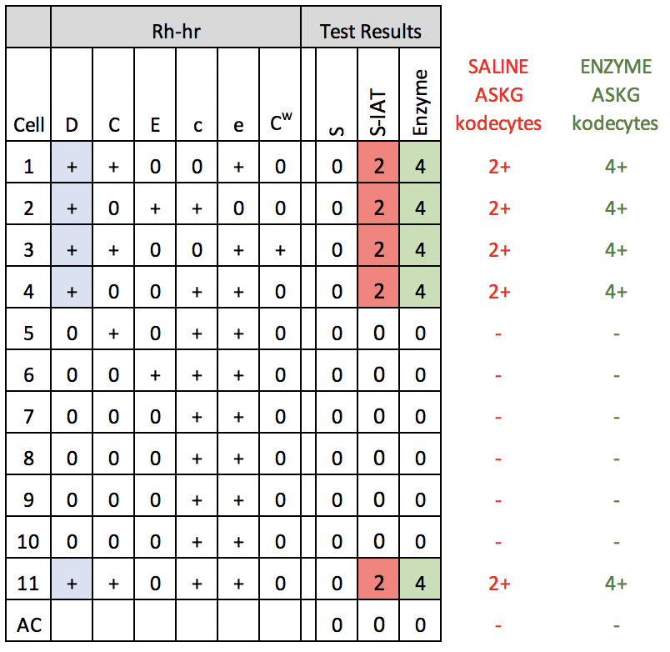
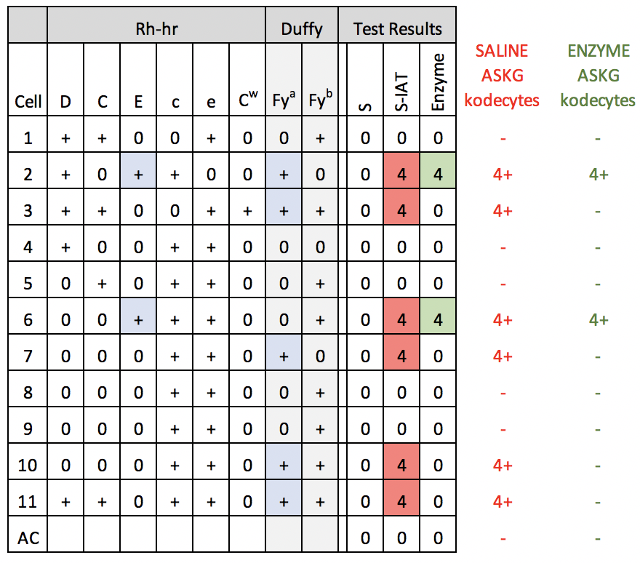
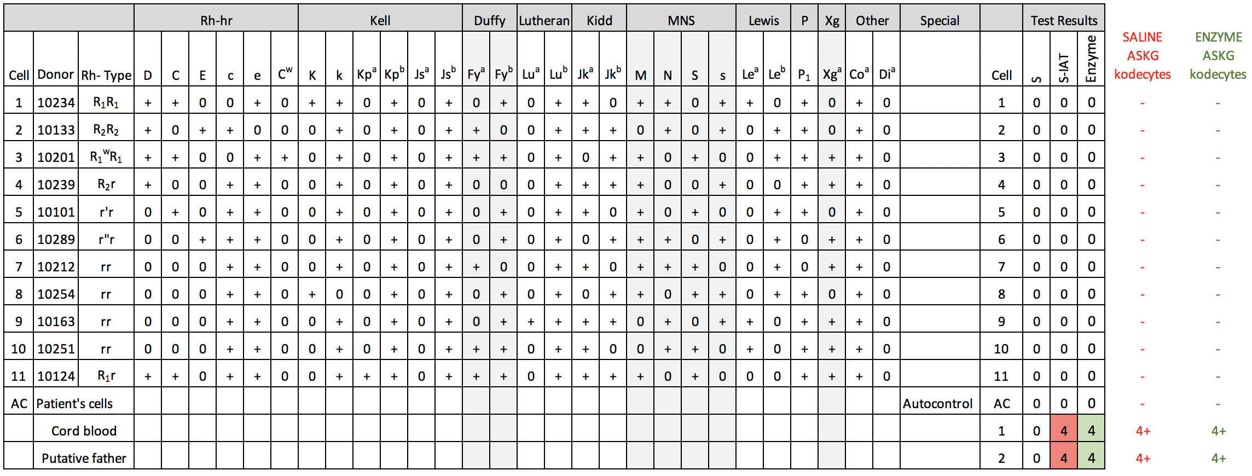
Example 4 – enzyme panels
The ASKG antigen maybe sensitive to some enzymes. However rather than enzyme treating ASKG-kodecytes either insert the ASKG antigen into the enzyme-treated cell after enzyme treatment (reduce insertion incubation time to 1 hour) to create enzyme resistant or enhanced antigens (Figure 11), or do not insert the ASKG antigen into enzyme treated cells to create enzyme sensitive antigens (Figure 12).
Figure 11. Mimic of reactions for an enzyme resistant (enhanced) antigen where anti-D reacts and is enhanced with enzyme modified cells. Note the saline treated cells are ASK-(2+)-kodecytes while the enzyme treated cells are ASKG-(4+)-kodecytes.
Figure 12. Mimic of reactions for an anti-Fyª + anti-E mixture where anti-Fyª does not react with enzyme modified cells while the anti-E does. Note that some enzyme treated cells are not kodecytes to give the correct reactions.
Example 5 – antibodies to low frequency antigens (private)
By making all the cells in the ASKG Antibody Identification Panel as unmodified cells (i.e. no kodecytes) it will appear that no antibody is present (Figure 13). Additional red cell samples should also be provided such as a cord blood sample (weak DAT+), sibling or putative father sample, or in a different scenario compatible and incompatible blood unit samples (for crossmatch or transfusion reaction investigations), which have been appropriately modified (or not) into an ASKG-kodecytes.
Figure 13. Mimics of antibodies to low frequency antigens are easily made

Slide 4
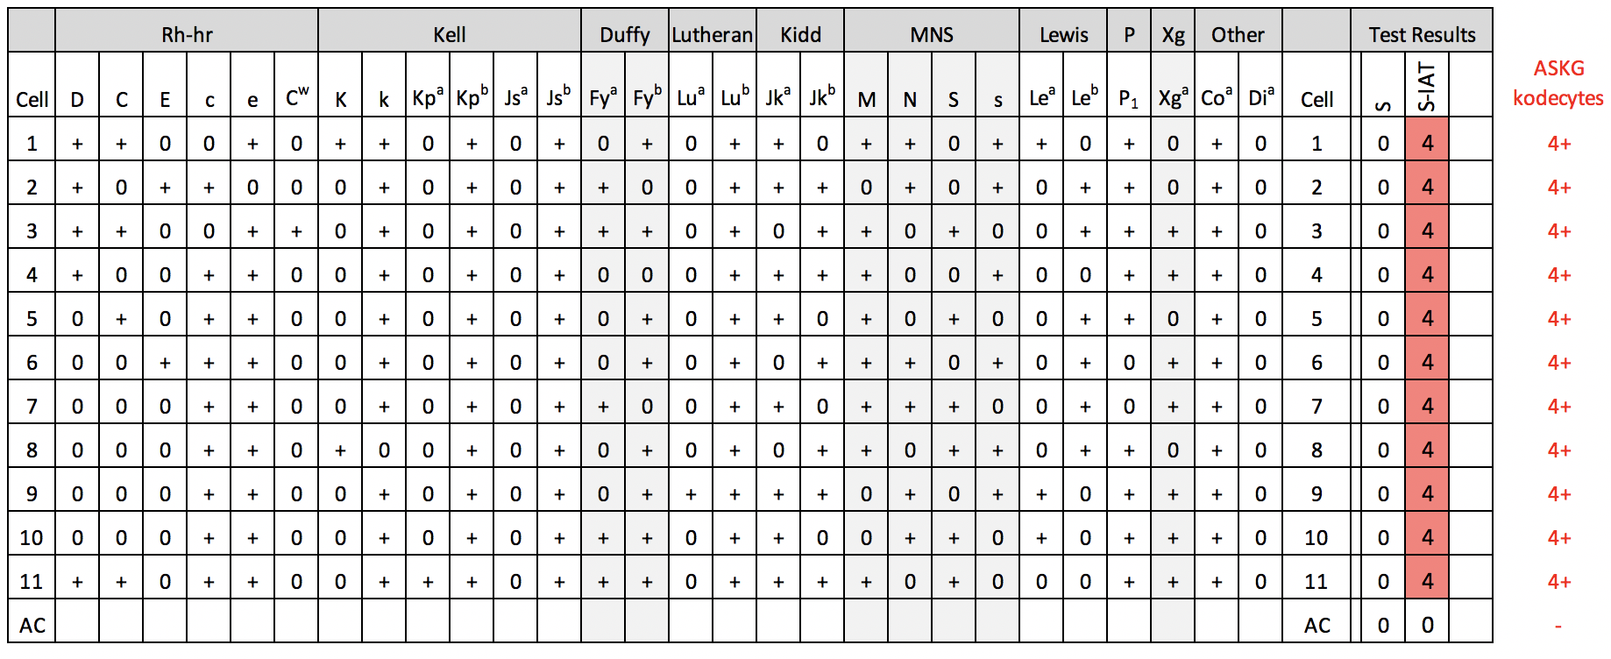
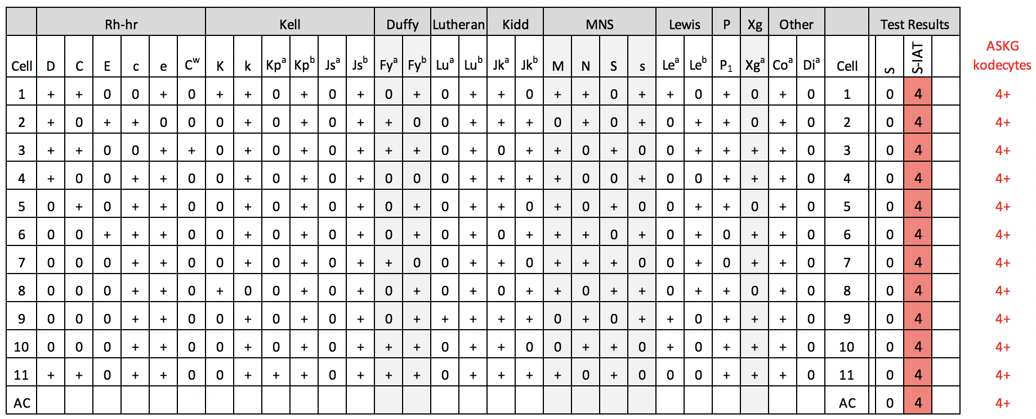


Example 6 – antibodies to high frequency antigens
By making all cells in the ASKG Antibody Identification Panel, except the auto control, as ASKG-kodecytes it will appear that the antibody is directed against a high frequency antigen (Figure 14). By spiking the serum sample with an allo-antibody such as anti-D and using both D+ and D- cells to create the ASKG-kodecytes then complex antibody scenario’s can be created.
Figure 14. Mimic of the reactions of a sample with antibody directed against a high frequency antigen
Example 7 - autoantibodies
By making all the cells in the ASKG Antibody Identification Panel including the auto control as ASKG-kodecytes it will appear that the antibody is an autoantibody directed against a high frequency antigen (Figure 15). Furthermore by introducing some variation in the ASKG-kodecyte antigen levels the auto-antibody can also be made to appear to have blood group related specificity. Note the autocontrol can also be made DAT positive by prior incubation with plasma (containing either IgG or IgG+IgM anti-ASKG).
Figure 15. Mimic of the reactions of sample containing an IgG autoantibody.
References
An extensive range of references and videos about Kode™ Technology are available at www.kodecyte.com or upon request
Support
For support or to provide suggestions (or training examples) on how to improve this product please email us.
Email: Steve Henry – shenry@kodebiotech.com
Original and editable copies of documents are available in the AUT Open Repository www.tiny.cc/ASKG
ASK Users Group
If you would like to join our ASK users group please contact us by email and we will put you on our mail-out list.

