Slide 1
Structuring an appropriate academic support strategy to assist Bachelor of Sport and Recreation (BSR) students to meet the BSR graduate profile.
Jennifer Nikolai (School of Sport and Recreation, SPRINZ)
Pedro Silva (Student Learning Centre)
Simon Walters (School of Sport and Recreation, SPRINZ)

Slide 2
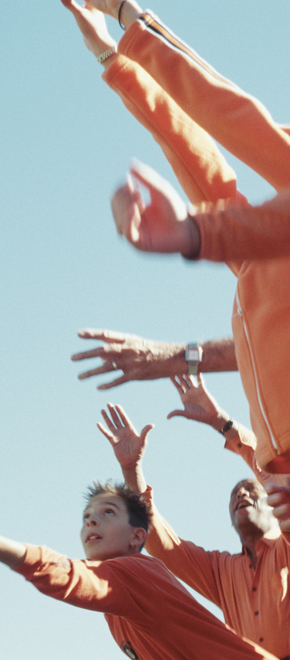
The BSR staff and student context
A recent internal review by academic staff in the School of Sport and Recreation revealed concerns about the academic skill development of BSR students.
Notes:
Who are our BSR students? Jennifer
Why do they enroll in the BSR at AUT? Jennifer
Who are the staff? Jennifer
Why are we still concerned about their academic skill development? Jennifer
Staff are currently going through a very reflective process in collaboratively designing a new BSR and in doing so we are beginning to challenge our methods of teaching and learning, and the lack of continuity through three years of staircasing key skills identified in our graduate profile: specifically CRITICAL THINKING and ACADEMIC WRITING.

Slide 3

Project’s Aim
The short-term aim of this study is to draw upon student and lecturer perspectives to inform the design and implementation of a pilot support strategy to be implemented commencing in 2015.
Focus groups with students and lecturers were conducted, asking the same questions of each participant group.
In adopting an action research approach, participants reflected upon their experiences as learners and teachers in the context of the BSR, towards reaching graduate capabilities.
Participants reflected on capabilities summarized by leadership, adaptability, critical thinking, research and digital literacy.
Notes:
Jennifer speak to the fact that open-ended focus group questions prompted discussions on these topics. BUT, interestingly and for this presentation, I propose that the variation on this process that occurred through a SURVEY MONKEY survey, gave us insights into preferred methods of learning identified by our students… and that this may be one of our greatest barriers in not supporting the identified deficits, based on our Programme Graduate Capabilities.
READ ATTACHED WORD DO ON TEACHING AND LEARNING PREFERENCES.

Slide 4
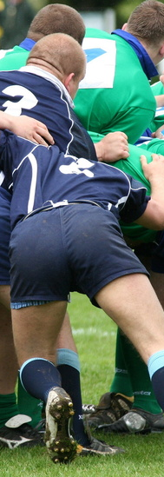
Action Research project
Framed within the Model of Pedagogical Reasoning (Shulman,1986)
Focussing on:
  pedagogical content knowledge,
  curricular knowledge,
  knowledge of learners
  knowledge on educational context.
The project reflects on learner and teacher perspectives within the BSR student experience and curriculum and content delivery
Aim: to inform the design of a support strategy aligned with the programme design.
Notes:
Pedro can you speak to the context of this as action research and the model of pedagogical reasoning and then talk through this slide from the SLC perspective?

Slide 5
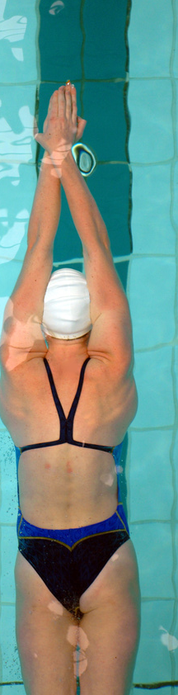
Providing the Context
Previous research indicates that contextualizing the learning environment brings significant benefits to the learning experience, as it provides a link between the learning and its application (Ambrose, Davis, & Zieger, 2013).
Notes:
Pedro, I am assuming that this is an area that you speak to every day and you knowing our audience best – can you please speak to this at the level that is appropriate?

Slide 6
Strategic approach
In collaboration with the Student Learning Centre, a number of strategies have been introduced in specific targeted papers, to address what is perceived to be a skill deficit.
Notes:
Pedro speak to your perspective and role as assisting a degree programme in embedded strategies to address what is perceived as a skill deficit.

Slide 7
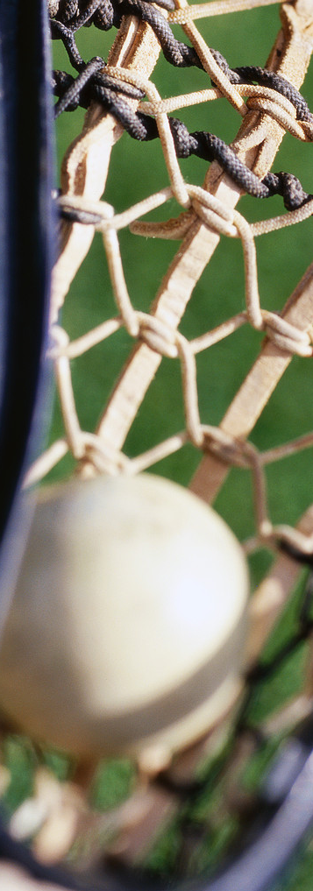
Pilot, implementation, reflection
The aims that were met became a platform for this pilot project (2014), to be implemented and reflected on further in 2015 and 2016.
Notes:
Jennifer briefly describe that initially we assumed that we could voluntarily recruit students to take part in SLC workshops working on these skill deficits, but our student population did not respond.
We have reflected on the student culture as therefore potentially responding through embedding support strategies within very specific core papers, stair-casing their skill development over three years.

Slide 8
Outcome 1
To map the skills currently identified in core papers towards meeting the BSR Graduate Profile.
This coincides with reflecting on student and lecturer perspectives towards improvements from staff and student focus groups 2014.
Notes:
Pedro – speak to Mapping the Skills based on Grad capabilities over level 5 – 6 – 7 papers

Slide 9
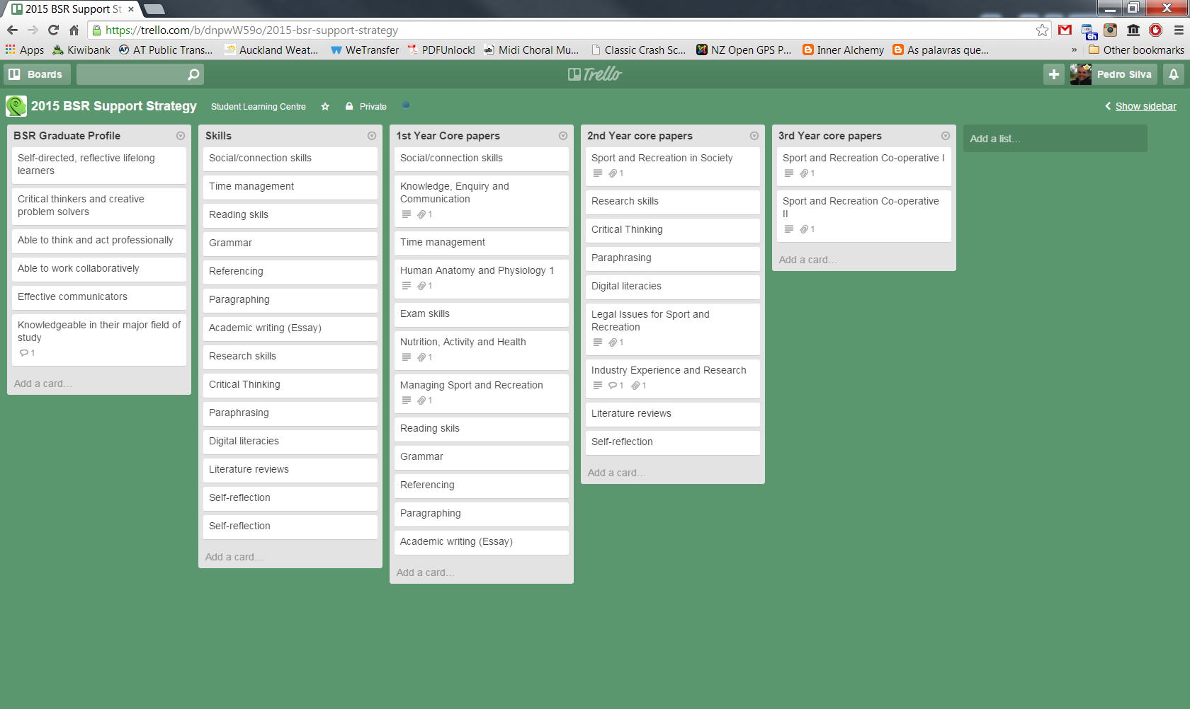
These strategies have had a positive impact at individual paper levels
Notes:
Pedro can you speak to this and maybe so the resolution is clear: could you simultaneously log on to TRELLO and go directly to this TRELLO page in the presentation.

Slide 10
Outcome 2
Design and implementation plan for a pilot support strategy for BSR students in 2015.
Notes:
Pedro – Discuss Support Strategy

Slide 11
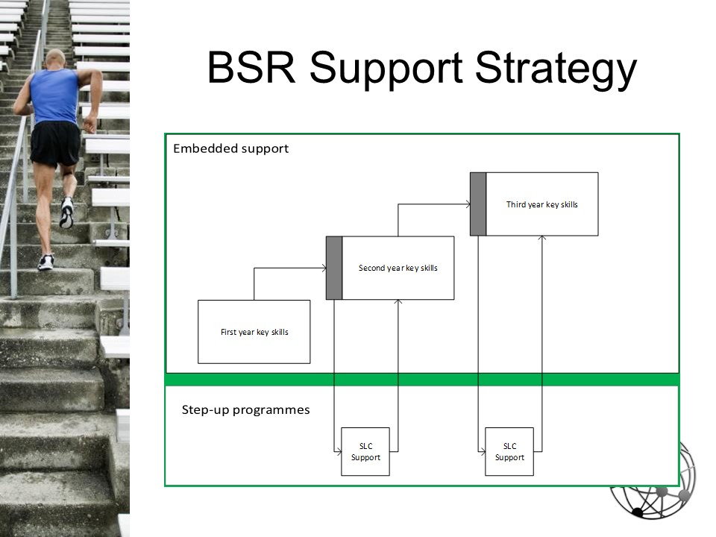

Slide 12
Outcome 3
Heightened awareness of diverse learning needs of students that challenge pedagogical approaches towards improvement and development of academic skills to positively impact student retention and success rates.
Notes:
Jennifer speak to general responses to teaching and learning: as referred to above: and to compliment this slide, read aloud the student quotes below: as providing reflection on how the students see that their attendance and engagement has a direct repercussion on their CHOICE as to wheter or not they might achieve an A, B or C.

Slide 13

Student focus group responses
“You keep everybody in the same classes throughout the entire programme so you really get to know each other. Without creating small groups you don’t really get to know anybody.”
“(We) want more hands on time doing the testing, especially for people who want to do the postgrad stuff.”
“I feel like I don’t learn in a big lecture hall so it’s better when the classes are smaller, more interactive.”
“I want more guidance learning, more inquiry learning… it feels like we are just getting taught, taught, taught what we are learning.”

Slide 14

Staff focus group responses
…that students feel afraid to be wrong and to participate
…that students are happy not to be challenged, and feel uncomfortable with problem solving
…that there is not a common understanding amongst lecturers about what critical thinking is, and how it can be developed
"We are still at a lecture format, where we throw knowledge at them."
"Do we change for them, or do they change for us?"

Slide 15

Outcomes and Directions
This project instigated reflections on academic skills expectations, considering diverse learning styles and approaches that engage learning and teaching relationships.
Future directions focus on scaffolding academic skills as graduate capabilities are met and student success leads to retention.
Ideally this fosters application and reflection within their future areas of employment or study, nationally or internationally, in studying at AUT.
Notes:
Jennifer reflection slide (20 seconds)

Slide 16

Potential Benefits
To provide context and greater relevance for undergraduate students in the School of Sport and Recreation;
To heighten awareness of lecturers of the diverse learning needs of students;
To improve and develop student academic skills to positively impact student retention and success rates.
Notes:
Jennifer

Slide 17
References
Ambrose, V. K., Davis, C. A., & Ziegler, M. F. (2013). From research to practice: A framework for contextualized teaching and learning. Journal of College Reading and Learning, 44(1), 35–50.
Bhoyrub, J., Hurley, J., Neilson, G. R., Ramsay, M., & Smith, M. (2010). Heutagogy: An alternative practice based learning approach. Nurse Education in Practice, 10, 322-326. doi: 10.1016/j.nepr.2010.05.001
Hase, S. (s.d.). Learner defined curriculum: Heutagogy and action learning in vocational training. Retrieved from: http://sitjar.sit.ac.nz/Publications/SITJAR%20AR%20edition%20A.pdf
Kenyon, C., & Hase, C. (2010). Andragogy and heutagogy in postgraduate work. In T. Kerry (Ed.), Meeting the challenges of change in postgraduate education (pp. 165-177). London, UK: Continuum International Publishing Group.
Shulman, L. S. (1986). Those who understand: Knowledge growth in teaching. Educational Researcher, 1(2), 4-14.
Notes:
Finish with this slide for a few seconds then go onto next slide

Slide 18
Your thoughts?
Have we missed any skills?
Do you have suggestions for variations on our approach?
What value is there in embedding strategies in this context?
Notes:
Pedro to guide the opening of prompts to lead us to peer discussions and suggestions and feedback…..

