Slide 1
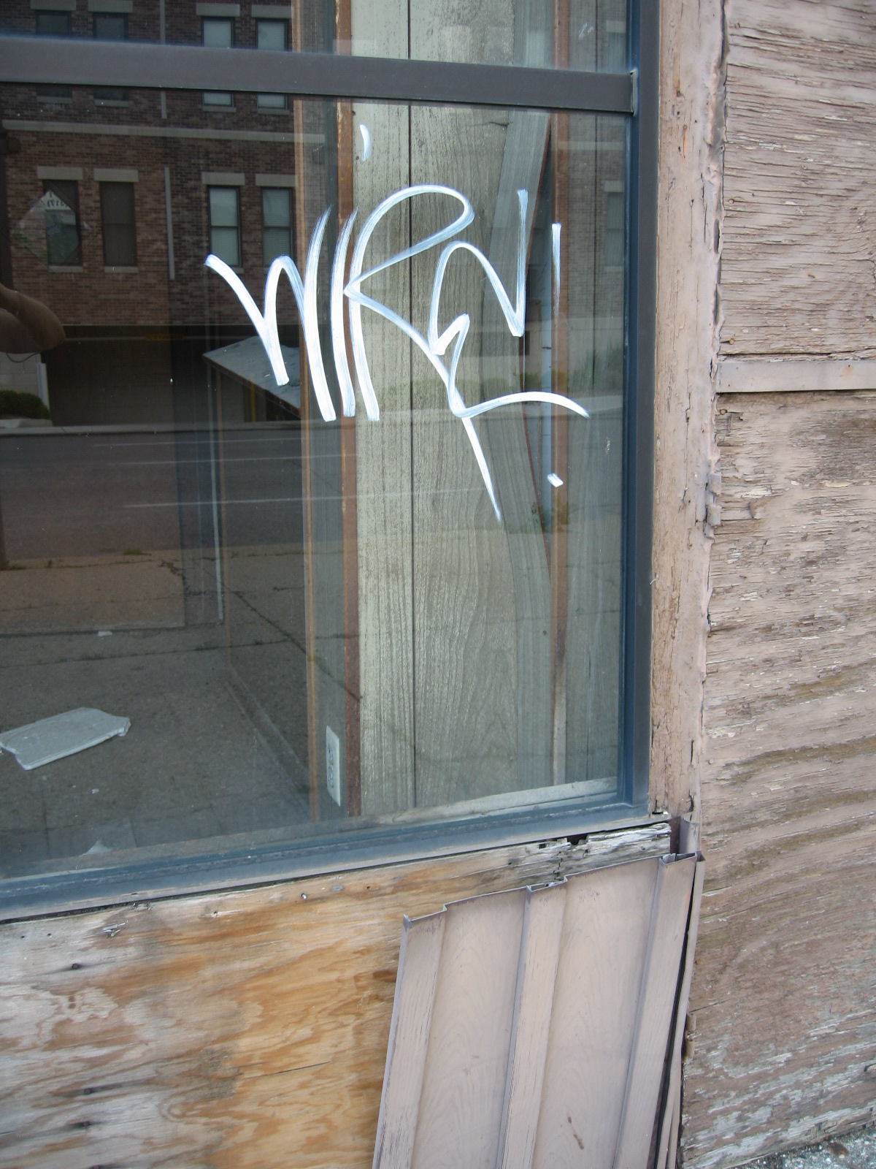
‘Unheimlich’
The existential mode of the
‘not-at-home’
Notes:
‘Unheimlich’
The existential mode of the ‘not-at-home’

Slide 2
Valerie Wright-St Clair
‘Listening Together’
AUT University
November 2008

Slide 3
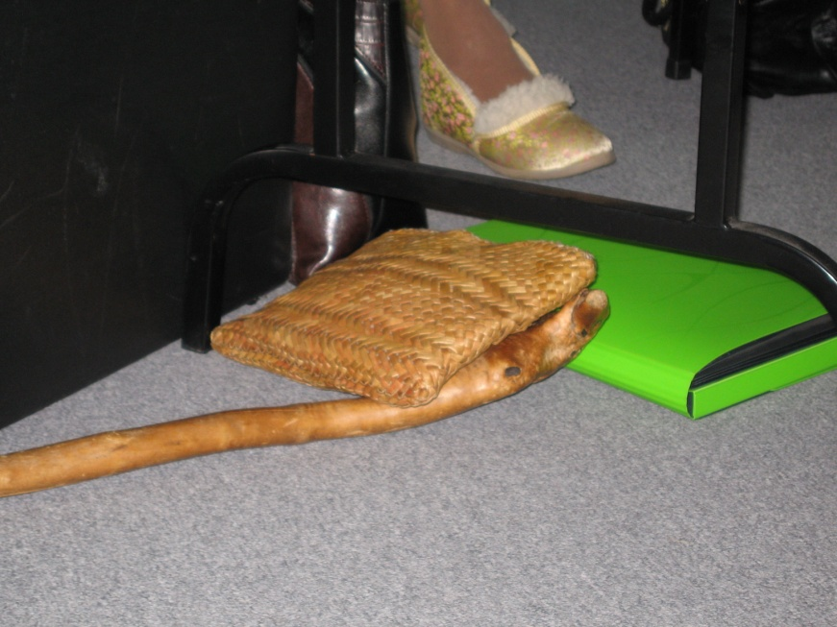
As illuminated amid
‘Being Aged’ in the everyday
The understandings rise up from the ordinary stories told by 15 New Zealand elders
Notes:
Here ‘not-at-homeness’ is as illuminated amid ‘Being Aged’ in the everyday
The understandings rise up from the ordinary stories told by 15 New Zealand elders

Slide 4
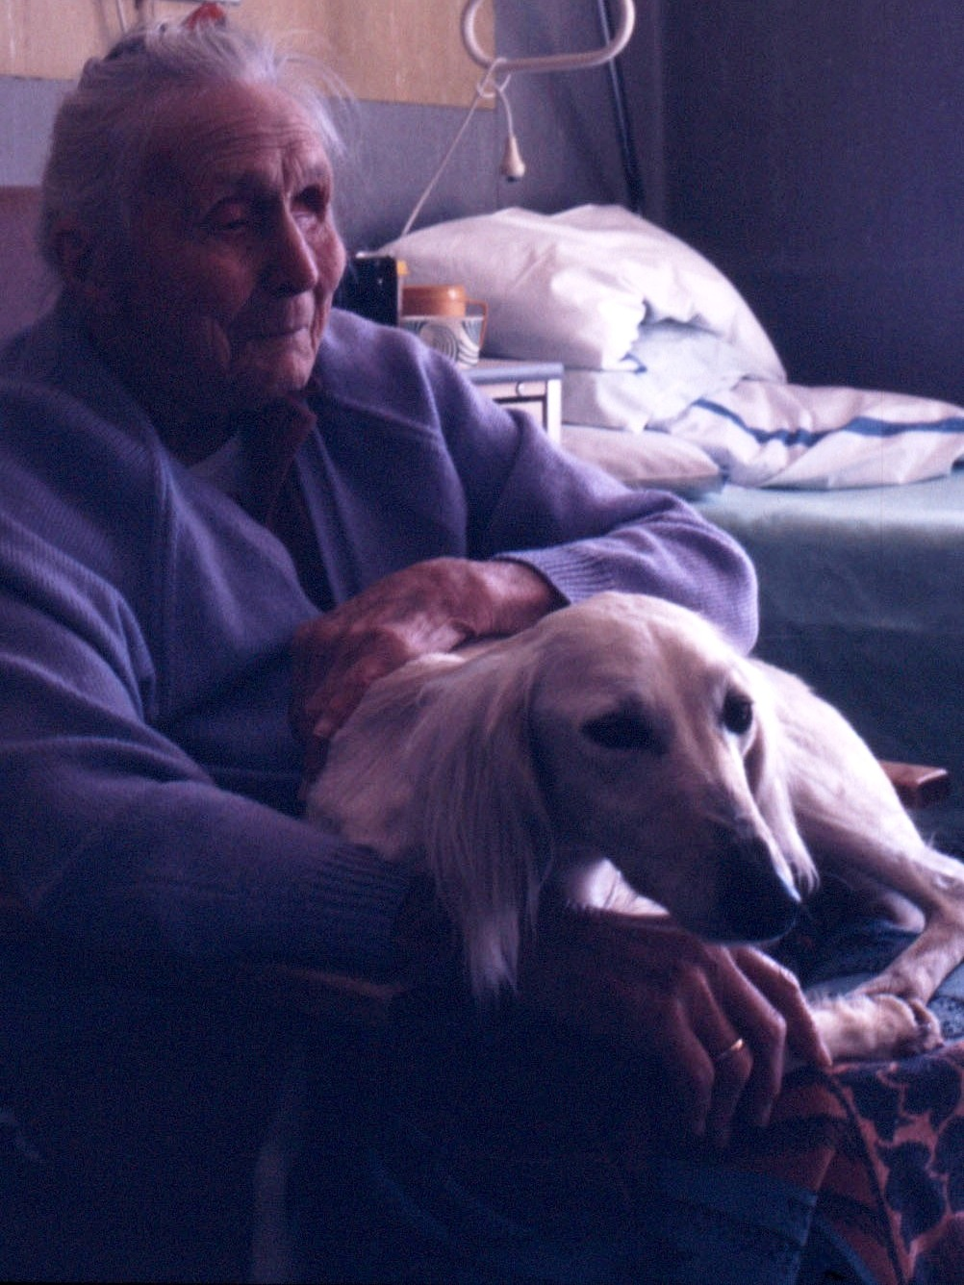
Being aged is always already there.
Concealed. Covered over
in its ordinariness.
Always present as Being-possible.
Being aged announces itself amid the everyday.
Notes:
Being aged is always already there.
Concealed. Covered over
in its ordinariness.
Always present as Being-possible.
Being aged announces itself amid the everyday.

Slide 5
There, between the what once was, the
what is, and the what might yet be.
Sometimes subtly,
sometimes alarmingly uncomfortable.
Notes:
There, between the what once was, the
what is, and the what might yet be.
Sometimes subtly,
sometimes alarmingly uncomfortable.

Slide 6
The eventful not-at-homeness is a showing,
thrusting being aged into being old.
Amid the familiar, experiencing the uncomfortableness of the unaccustomed.
Notes:
The eventful not-at-homeness is a showing,
thrusting being aged into being old.
Amid the familiar, experiencing the uncomfortableness of the unaccustomed.
Let’s listen together to Ferguson’s story. He speaks these words in his 98th year of being in the world.

Slide 7
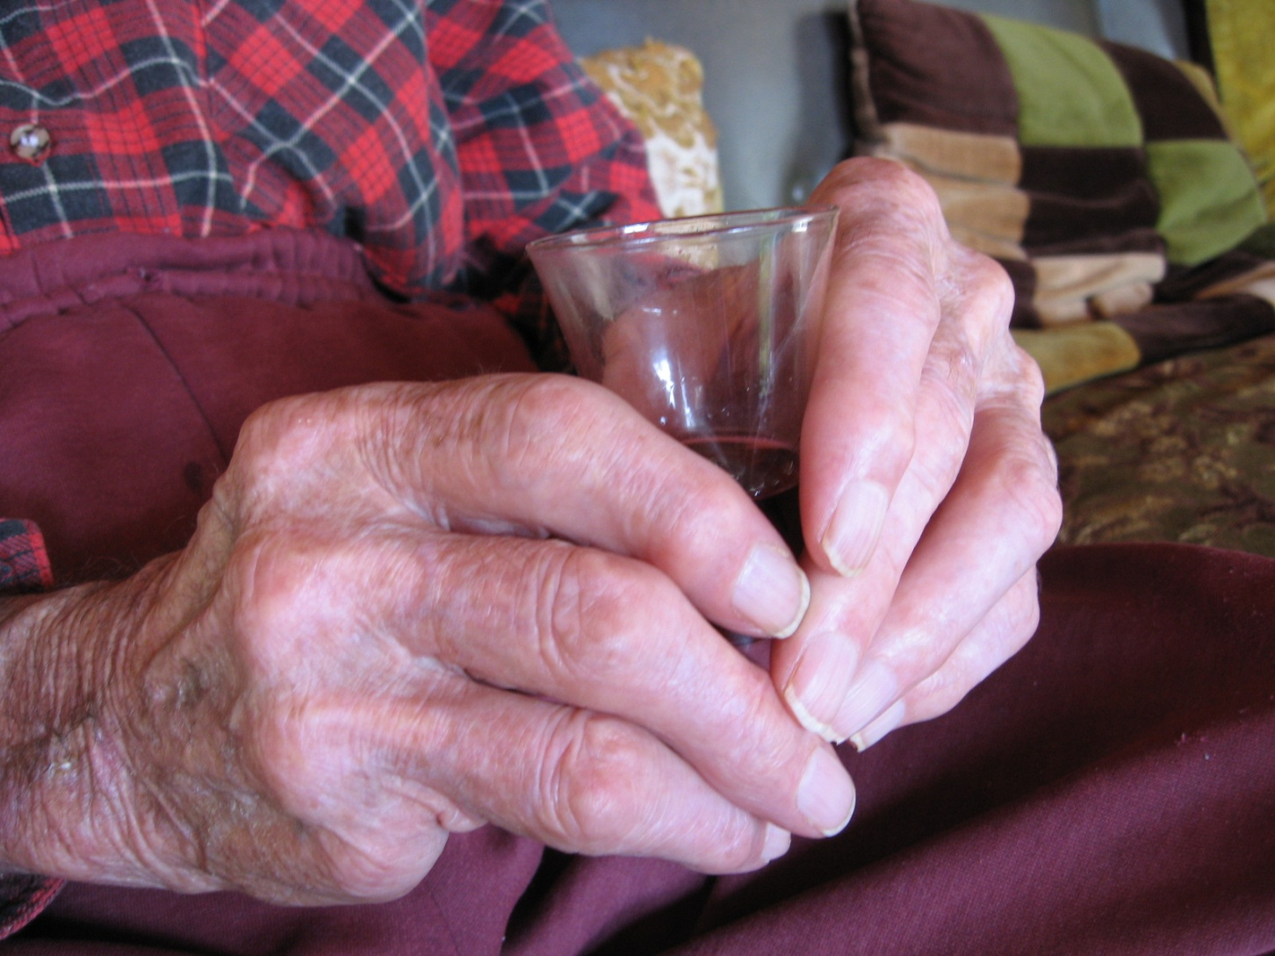
Notes:
What the hell went wrong the other day? I have a good dressing gown there, look. It is too bloody heavy now. I tried to put it on the other day. I had a hell of a time getting it on. And when I did get it on it was too bloody heavy and yet I have worn it all my life.
It used to be easy, just pull it on; easy. It is nice and warm, but when I tried to put it on the other day it was too heavy. After I went to all the trouble to get my arms in and getting it on, it was too bloody heavy. So I must be losing something else too, some strength. It must be something else.
I will wait and see how I go in winter. I will just have to put the heater on and get into bed. But I will wait and see; I can’t do much about it. I don’t know what it is. Just old age I suppose. I have got this way I can’t do it, I just can’t do it. There’s no way of doing it. The strength has gone from my hands. I am just fading away I think. I don’t know. It is hard to say isn’t it? There is a lot I can’t do [Ferguson, 97].

Slide 8
Heidegger (1927/1962) talks about the ‘canniness’ of being in the familiar everyday and the ‘uncanniness’ of experiencing the unfamiliar. He uses the German word “unheimlich” which literally translates as “unhomely” (King, 2001, p. 96).
Notes:
Heidegger (1927/1962) talks about the ‘canniness’ of being in the familiar everyday and the ‘uncanniness’ of experiencing the unfamiliar. He uses the German word “unheimlich” which literally translates as “unhomely” (King, 2001, p. 96).

Slide 9
In a mode of being characterised by uncanniness, or anxiety, the person is brought back from his or her absorption in the customary. “Everyday familiarity collapses….Being-in enters into the existential ‘mode’ of the ‘not-at-home’” (Heidegger, p. 233).
Notes:
In a mode of being characterised by uncanniness, or anxiety, the person is brought back from his or her absorption in the customary. “Everyday familiarity collapses….Being-in enters into the existential ‘mode’ of the ‘not-at-home’” (Heidegger, p. 233).
Interpretively, listening for experiences of ‘not-being-at-home’ in the ordinary everyday illuminates the phenomenon of being aged.

Slide 10
Notes:
Ferguson is used to just being in his dressing gown when he seeks its warmth. But this time, wanting to be in his dressing gown becomes a hell of a time for him. The words sound extreme; however, they are Ferguson’s way of bringing his experience into language. In the hellishness of the event, we hear how the customary mundaneness of getting into his dressing gown is this time characterised by anguish and suffering. The ordinary is instead an ordeal. Paradoxically, the word ‘hell’ has its Anglo-Saxon roots in the word ‘helan’ meaning to hide, conceal or cover over (Hayward & Sparkes, 1982). Yet in this event, Ferguson’s ‘hell’ of a time is an unconcealing rather than a concealing.
Then, once donned, instead of revealing its familiar character of warm comfortableness, Ferguson’s dressing gown discloses an unaccustomed burdensome-ness. As he recounts the event, he describes his dressing gown as being too bloody heavy. In the moment, Ferguson is not-at-home with experiencing the gown’s unfamiliar oppressive weightiness. He only comes to understand the unreadiness-to-hand of his embodied strength through this unaccustomed experience. His diminished strength unveils itself amid the usually mundane. Suddenly what was ordinary is distressingly obtrusive. Hence, Ferguson’s ‘being aged’ announces itself in being weaker. It announces itself in the face of his dressing gown’s burdensome heaviness.

Slide 11
Notes:
In saying he is just fading away the poignancy of this event is illuminated. Fading is a notion perhaps typically reserved for describing other phenomena or objects in the world; such as the fading light at the end of a day, or the fading colour of things exposed to the sunlight.

Slide 12
Thus, “if a person transfers an expression from one thing to the other, he has in mind something that is common to both” (Gadamer, 2004, p. 428).
Notes:
Thus, “if a person transfers an expression from one thing to the other, he has in mind something that is common to both” (Gadamer, 2004, p. 428).

Slide 13
Notes:
In this way, Ferguson finds words and uses metaphor to express how being weaker is for him. It is his way of having me come to understand something so nebulous. An embodied ‘fading away’ speaks of a gradually dimming vigour; of a withering, or of gradually disappearing until there is nothing left.

Slide 14
Strangely enough, it is the ordinariness which holds the potential to illuminate a ‘not-at-homeness’ in the everyday (Heidegger, 1927/1962).
Notes:
Strangely enough, it is the ordinariness which holds the potential to illuminate a ‘not-at-homeness’ in the everyday (Heidegger, 1927/1962).
As the days roll on, perhaps in the taking account of things which can no longer be counted on, like the dressing gown’s comfortableness, what was momentarily extraordinary evolves into a ‘new’ ordinariness; a new at-homeness.
In honour of Ferguson who did fade away just six weeks after we talked, and in respect of the Navaho and their ancestors in the land of our international guests, I close with the words carved in stone in Indianapolis.

Slide 15
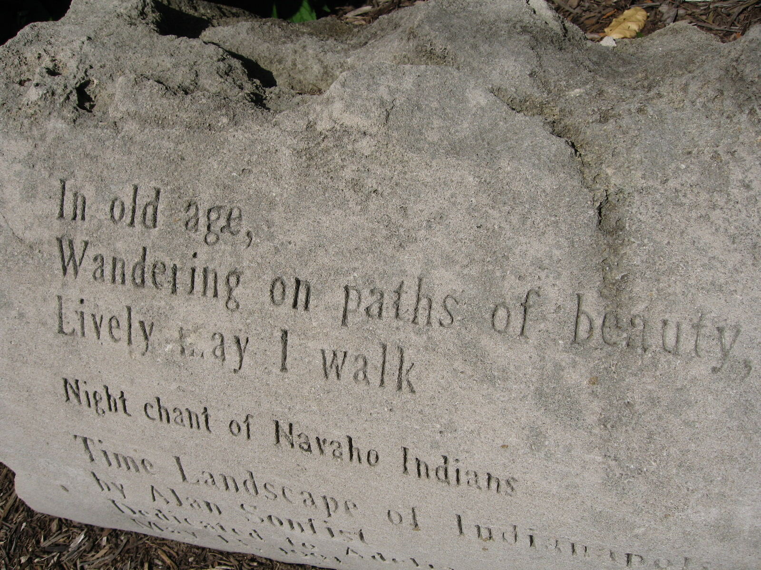
Notes:
[pause for reading]
Thank you.

Slide 16
‘Unheimlich’
Questions & Conversation
Notes:
‘Unheimlich’
The existential mode of the ‘not-at-home’

Slide 17
Gadamer, H.-G. (2004). Truth and method (J. Weinsheimer & D. G. Marshall, Trans. 2nd, Rev ed.). London: Continuum.
Heidegger, M. (1927/1962). Being and time (J. Macquarrie & E. Robinson, Trans. 7th ed.). Oxford, UK: Blackwell Publishers Ltd.
Wright-St Clair, V, A. (2008). 'Being aged' in the everyday: Uncovering the meaning through elders' stories. Doctoral thesis, University of Auckland, Auckland, New Zealand. http://hdl.handle.net/2292/3080
Notes:
References

