Slide 1
Global India and Cultural Space in Auckland’s Performance Scene
Alison Booth
AUT University
NZASIA Conference 2013

Slide 2
New Cultural Spaces
Ethnographic research
Auckland Based
Focus
  young, educated recent migrants from India
Observation
  The creation of new cultural spaces through producing live performance events.

Slide 3
Musical Preferences
Traditional Producer and Audience Support
  Filmi-Pre-liberalisation
  Filmi Post-liberalisation
  Classical
  Non-Filmi Pre-Liberalisation
“Global India” Producer and Audience Support
  Post-Liberalisation Bollywood
  Djmix/Hip-hop/Fusion
  Clubbing
  “World”
  MTV format
  Desi

Slide 4
Language and Indian Cultural Organisations in Auckland
Language | Number of Speakers | Percentage | Cultural organisation affiliations and founding dates
Hindi | 43,229 | 46.00% | Auckland Indian Association (1938) Bhartiya Samaj (1995) Waitakere Indian Association (2000) Manukau Indian Association (1981)
Gujarati | 15,588 | 16.50% | Auckland Indian Association (1938) Pukekohe Indian Association (1913)
Panjabi | 10,569 | 11.20% | New Zealand Punjabi Cultural Association (1960s) Sikh Centre (1964)
Tamil | 5535 | 5.80% | Muthtamil Sangam (2002) NZ Carnatic Music Society (1999)
Urdu | 3879 | 4.00% | Urdu Hindi Cultural Association of New Zealand Inc. (2011)
Sinhala | 3854 | 4.00% | United Sri Lanka Association, Auckland Branch (2000?)
Telegu | 2802 | 3.00% | New Zealand Telegu Association (1998)
Marathi | 2547 | 2.70% | Auckland Marathi Association (2005) Migrant Heritage Charitable Trust (2000?)
Bengali | 2159 | 2.30% | Probasee Bengali Association of New Zealand (2000?)
Malayalam | 2125 | 2.20% | Auckland Malayalee Samajham (2012)
Kannada | 876 | 0.90% | New Zealand Kannada Koota (2000?)
Konkani | 582 | 0.62% | NZ Mangalorean Inc. (2009)
Fiji Hindi | 444 | 0.47% | Fiji Association in Auckland (1970)
TOTAL | 94,199 Language Speakers

Slide 5
Notions of Indianness
1) Holi 2012 Festival of Colours- Bhartiya Samaj (Founded 1995)
    Cultural identity located in India
  2) Holi Festival: (Holi Mela)- Waitakere Indian Association (Founded 2000)
    Cultural identity located in Fiji
3) Holi Hungama- New Zealand Indian Student Association (Founded 2011)
Cultural Identity located in “Global India”
Manukau Indian Association (MIA)
Founded 1981
Cultural identity located in Indian diaspora
Notes:
Manukau Indian Association –MIA in brief, will welcome Indians from any origin, whether from any par of India – Gujarat, Maharashtra, Kashmir, Punjab, Bengal, Malayalam, Karnatak or any state, any country – Fiji, England, South Africa, USA, Africa,-say any country of the world. We are all Indians and our doors are open to all. There are no qualifications and conditions based on caste, creed, state or origin or financial commitment. Welcome to our MIA and become a member today. You will find a membership form on this Website. Please fill the applcation and pay for it online.
Manukau Indian Association has been particularly very active in raising the profile of Indian people and empowering them.
They have been associated/affiliated to New Zealand Indian Central Association and has been taking active part in deliberations on all issues concerning Indians.
Our logo says MIA empowering NZ Indians. This has been truly translated in action. IN 2005 and previous years, we were trying hard to get Mayor of Manukau to come to Manukau Indian Association’s invitation for their programs. The Mayor and the council did not acknowledge and did not have the courtesy to eve reply to the invitation. They were hard to contact and communicate. But now, it is other way. Mayor and the council supports Manukau Indian Association in all activities, Diwali program and even agreed to give the new premises to us. It has been a complete turn around and we feel it is a result of our visibility activities.
Manukau Indian Association has been holding regular annual programs/concerts for Diwali and other festivals such as Navratri. They have a very active

Slide 6
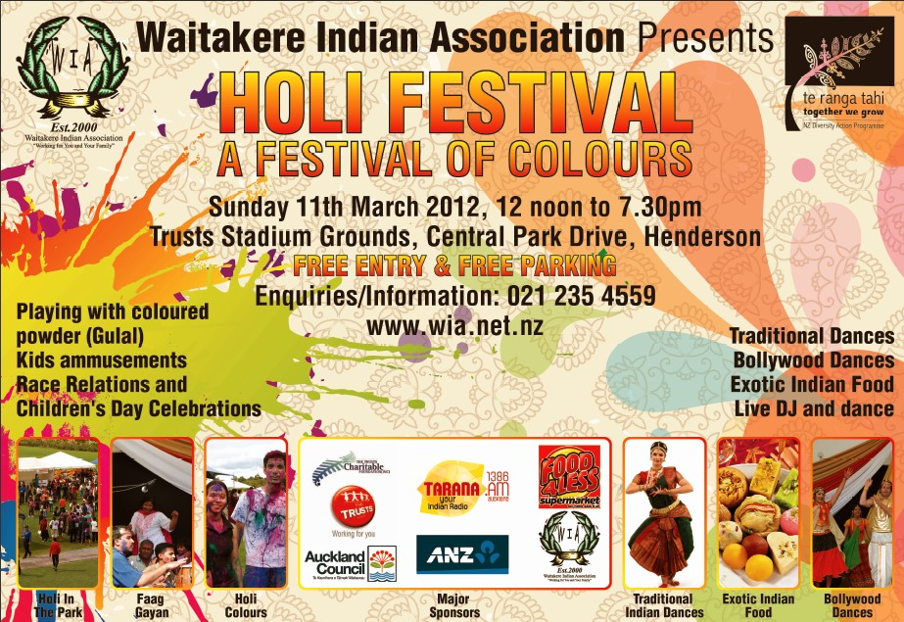
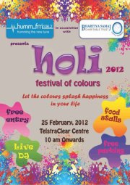
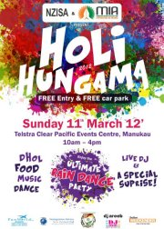
Cultural Identity:
Three
Holi
Celebrations

Slide 7
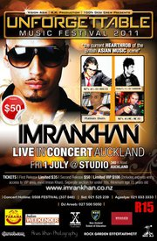
Case Study:
Unforgettable Music Festival 2011

Slide 8
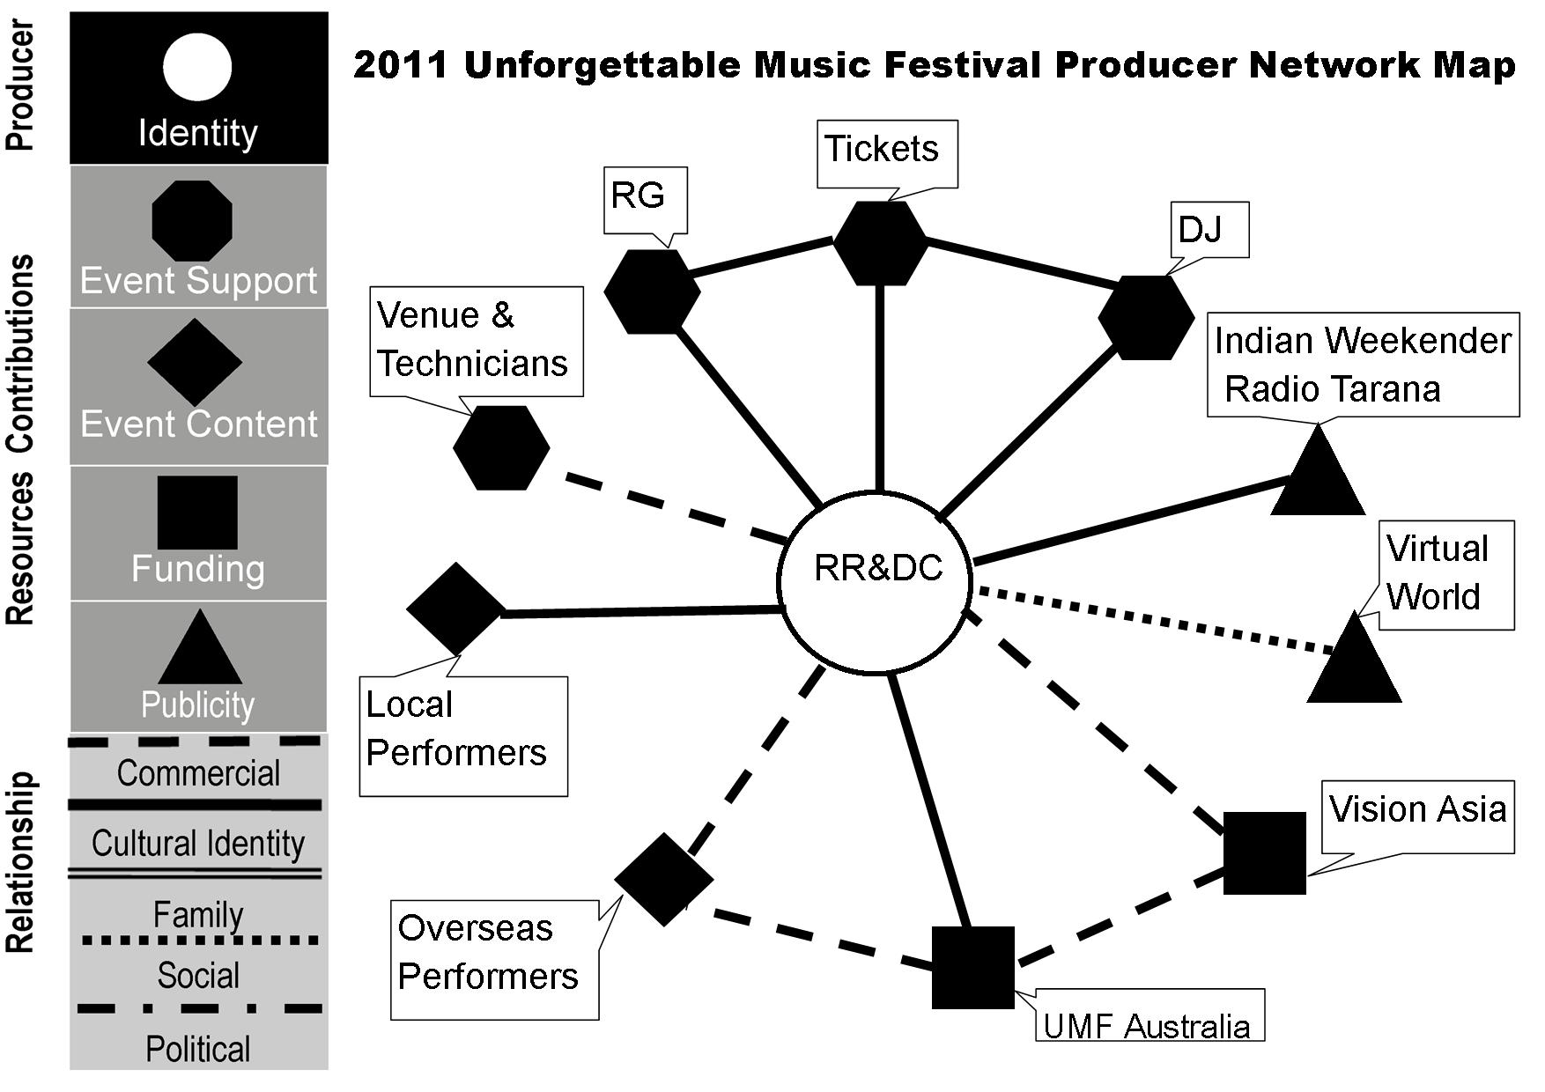

Slide 9
