Slide 1
Mobile Robot Navigation – some issues in controller design and implementation
L. Huang
School of Engineering and Advanced Technology Massey University

Slide 2
Outlines
Introduction
Target tracking control schemes based on
    Lyapunov method
    Potential field method
Speed control
Conclusion

Slide 3
Introduction
A wheeled mobile robot (WMR) can be driven by wheels in various formations:
Differential
Omni Directional
Steering

Slide 4
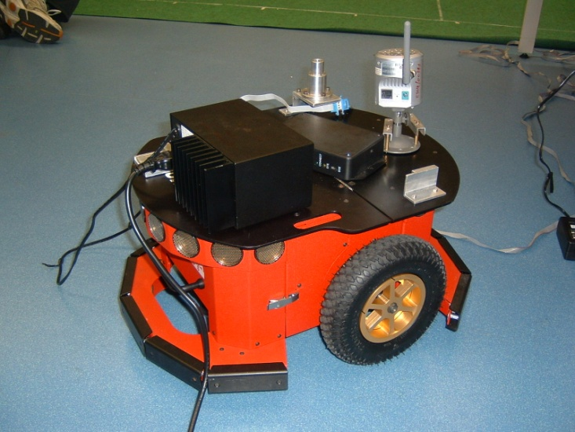
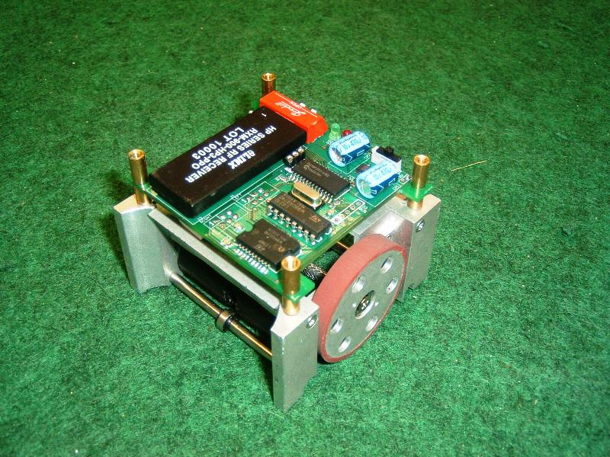
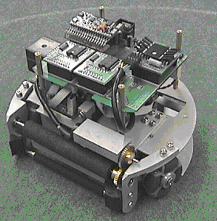
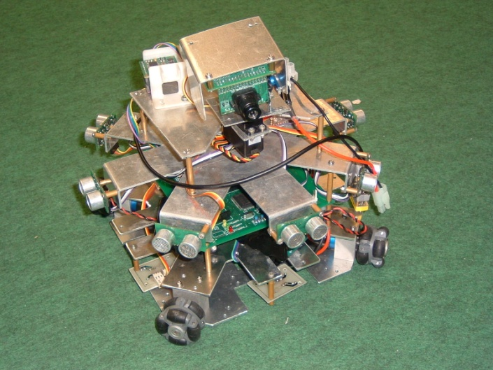
Differential Wheel Robot
Omni Wheel Robot

Slide 5
Two basic issues:
How to move a robot from posture A to posture B stand alone ?
How to determine postures A and B for a robot when a group of robots performing a task (such as soccer playing) ?

Slide 7
Differential wheel driven robot (no-holonomic):
Robot’s posture (Cartesian coordinates) cannot be stablized by time-invariant feedback control or smooth state feedback control (Brockett R. W. etc.).
Stabilization problem was solved by discontinuous or time varying control in Cartesian space (Campion G. B., Samson C. etc.)
Asymptotic stabilization through smooth state feedback was achieved by Lyapunov design in Polar coordinates – the system is singular in origin, thus avoids the Brockett’s condition (Aicardi M. etc ).
Trajectory tracking control is easier to achieve and is more significant in practice (desired velocity nonzero) (Caudaus De Wit, De Luca A etc.).

Slide 8
Omni-wheel driven robot
It is fully linearisable for the controller design (D’Andrea-Novel etc.)
Dynamic optimal control was implemented ( Kalmar-Nagy etc.)
Robot modeled as a point-mass
Potential field method was used for robot path planning (Y.Koren and J. Borenstein)
Issues to be addressed
Application of Lyapunov-based and potential field based methods in the development of target tracking control
scheme

Slide 9
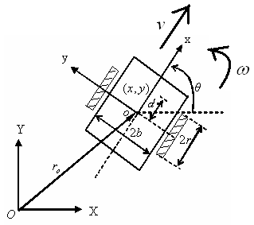
General control approaches
Kinematic Model
Nonholonomic Constraint
(rolling contact without slipping)
Differential Wheel Robot
Nonhonolonic (No-integrable) and under actuated (2-input~3-output)
cannot be stabilized by time-invariant or smooth feedback control

Slide 10
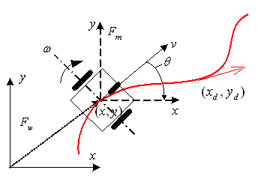
Trajectory tracking (Cartesian coordinates based)
Given
find
to make

Slide 11
It can be proved (due to Lyapunov and Barbalat), the
following control can meet the objective :
Desired linear velocity (along the trajectory)
From the planned trajectory
Desired angular velocity
Desired direction
Note:
The trajectory needed to be specified in prior; the controller fails when

Slide 12
with nonlinear modifications to adjust angular motion:
,
where

Slide 13
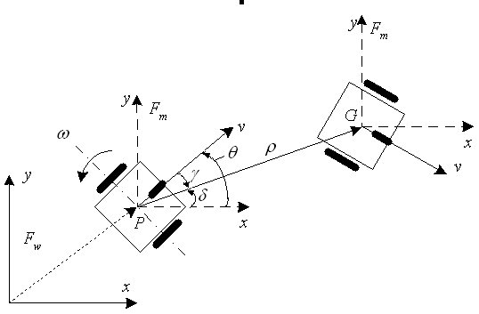
Goal / target tracking (Polar coordinates based)
Control task: move the robot from its original posture: to the target posture

Slide 14
The system model described in polar coordinates:
The model is singular at

Slide 15
Let
It can be proved that ( due to Lyapunov and Barbalat)
with the Lyapunov function candidate
large control effort or fluctuation when the angle tracking error is near zero or the linear tracking error is big
the target is assumed to be stationary

Slide 16
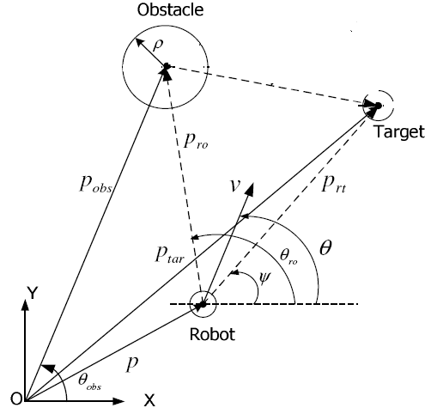
Potential field approach (point mass model)
Attractive and repulsive fields:
Robot move along the negative gradient
of the combined field:
The law only specifies the direction of the robot velocity
target is assumed to be stationary
local minima

Slide 17
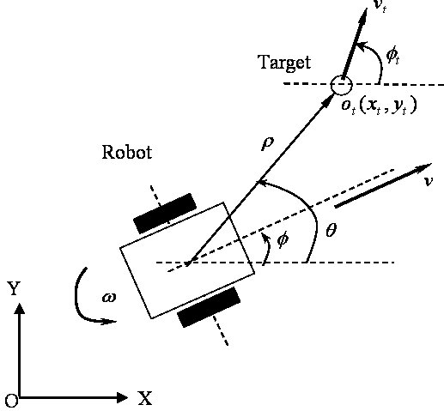
Lyapunov based target tracking controller with limited control efforts
System model (extended from the
conventional one by including the
velocity of the target):

Slide 18
Controller 1: Extension of the general control approach
It can be proved with Lyapunov method, that under the controller,
(Lyapunov function candidate: )
Note:
target motions directly affects the control efforts
sinusoidal functions of the systems states attenuate the magnitude
of control
tracking errors appear as the denominators in the terms of the controller
linear tracking and angular tracking errors are treated equally – too
demanding ?

Slide 19
Controller 2: Improvement from Controller 1
Prioritise and change the control objectives:
and reflect them in the definition of the Lyapunov function:
New controller:
which can also achieve the convergence of the tracking errors, but with
less control efforts

Slide 20
Comparison: control efforts of Controllers 1 and Controller 2
or

Slide 21
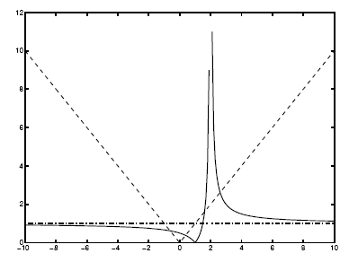
By observation, the magnitude of controller 2 is less than that
controller 1
Analysing the factors ( ) affecting the controller magnitude,
it is obvious that, except for the region near that affecting
Controller 1 is larger in magnitude than that affecting Controller 2.

Slide 22
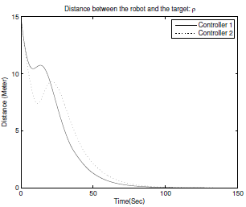
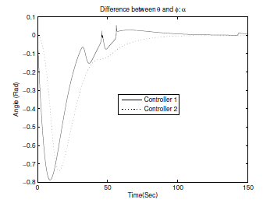
Simulation Results (tracking a target Moving along a circle)
Linear tracking
Angular tracking

Slide 23
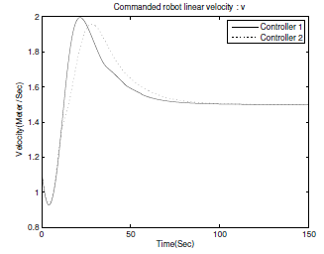
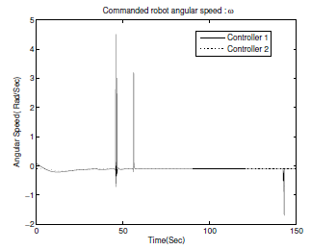
Linear velocity
Angular velocity

Slide 24
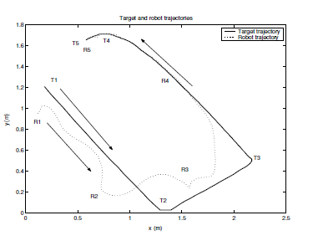
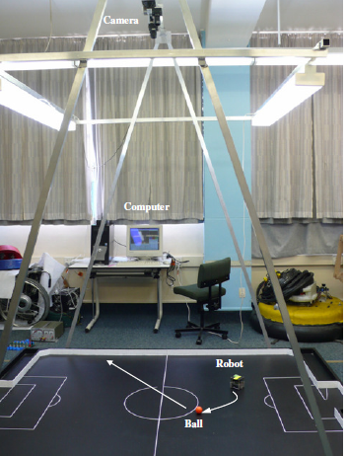
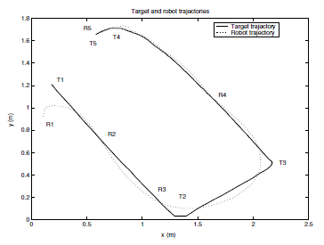
Experiments
Robot trajectory under Controller 1
Robot trajectory under Controller 2

Slide 25
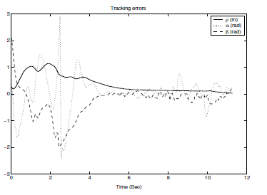
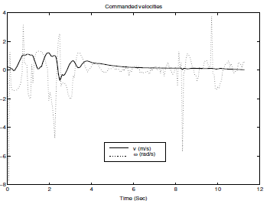
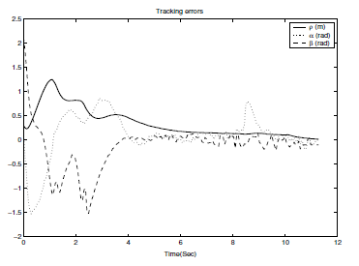
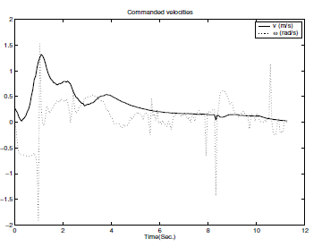
Under Controller 1:
Tracking errors
Velocities
Under Controller 2:
Tracking errors
Velocities

Slide 26

Demonstrations
Controller 1
Controller 2

Slide 27
Conclusions:
It is feasible to reduce the control efforts through
  prioritization of control objectives
  defining of Lyapunov function to reflect that priority
  attenuation of controller outputs with some special functions of the system states (like sinusoidal functions etc.)
  while achieving the same or better control results in comparison with the conventional controllers
The performance of the controller is affected by the noises of the sensors for state feedback (esp. velocity).

Slide 28
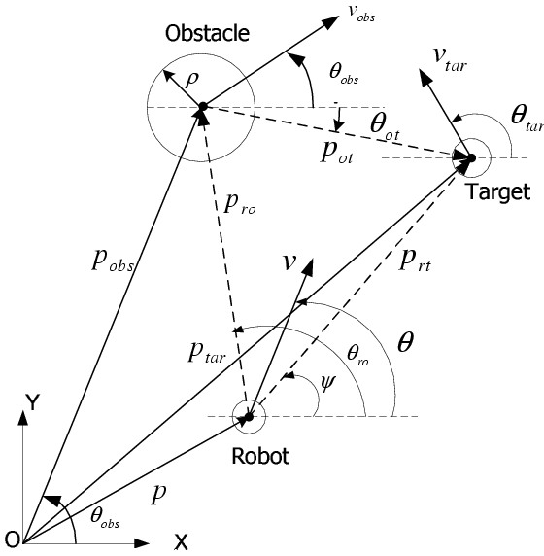
Potential field based control approach for
robot’s target tracking
System model:
Potential fields:

Slide 29
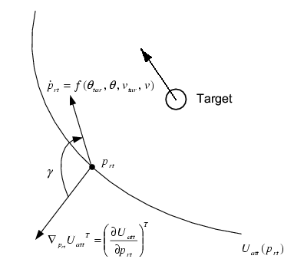
Case 1: Moving target free of obstacles
Minimization of the angle between the gradient of the field and the direction of robot motion relative to the target.

Slide 30
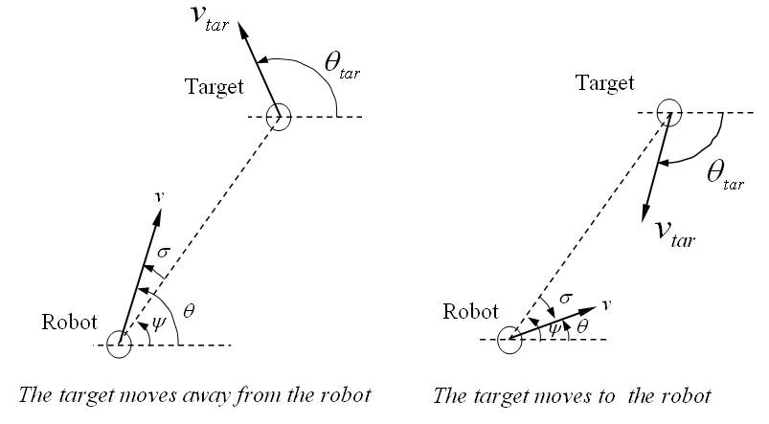
Direction
Robot direction is adjusted around the directional line pointing to the target

Slide 31
Speed
Intuitively
It is chosen to decrease , or
One of the choices is:
It leads to:
The speed determined by the relative linear distance, the target velocity
and there directional relationship.

Slide 32
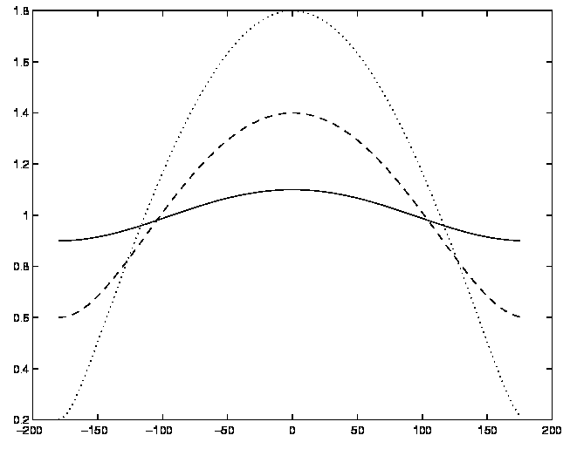
Comparison of the robot and target speeds:
The robot does not need to be always faster than the target
(e.g. . when )

Slide 33
Case 2: Moving target with moving obstacles
The approach can be extended to solve the path/speed planning of the robot surrounded by multiple obstacles.

Slide 34
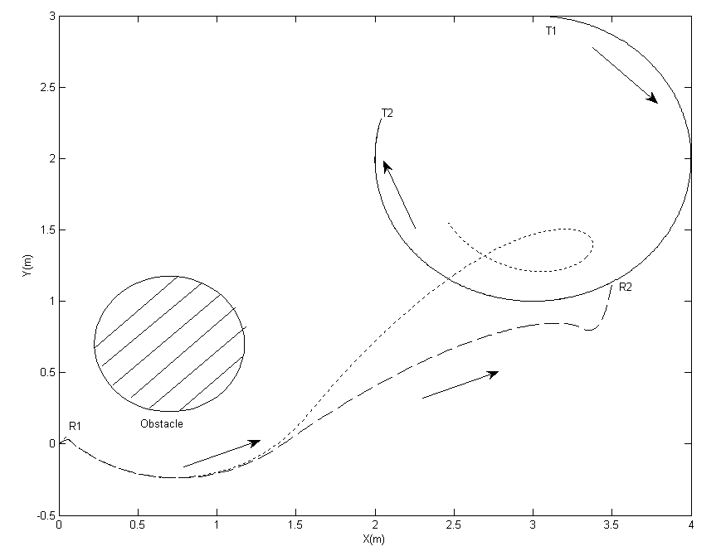
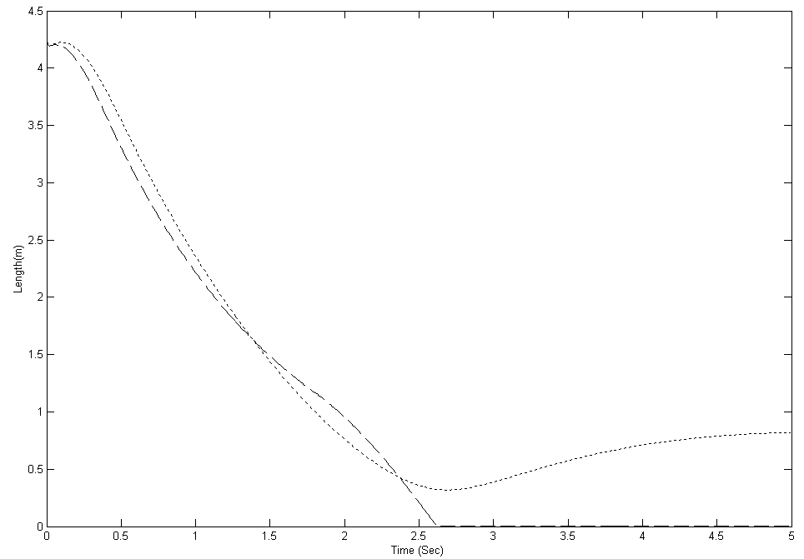
Simulation Results:
Trajectories
Relative Distance
Solid line: target
Dashed line : robot under the proposed controller
Dotted line :robot under the conventional potential field controller

Slide 35
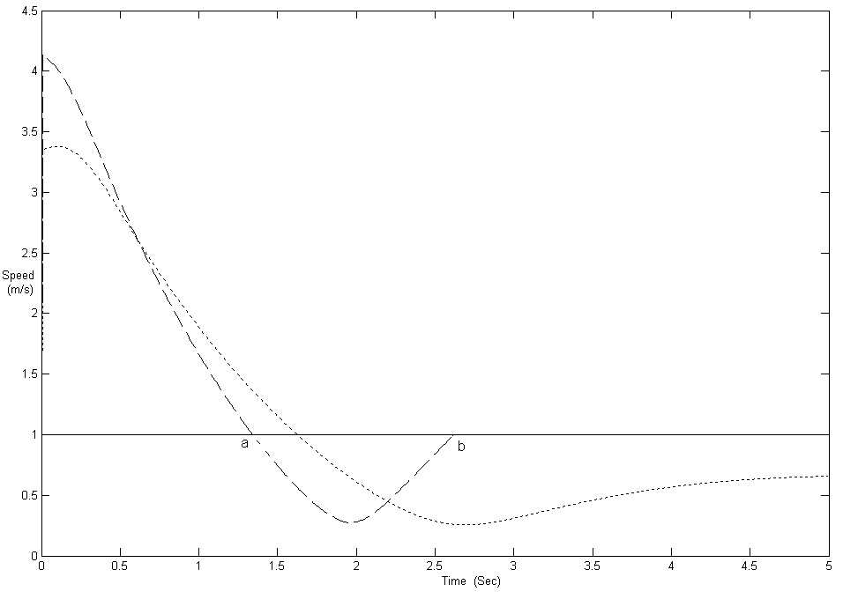
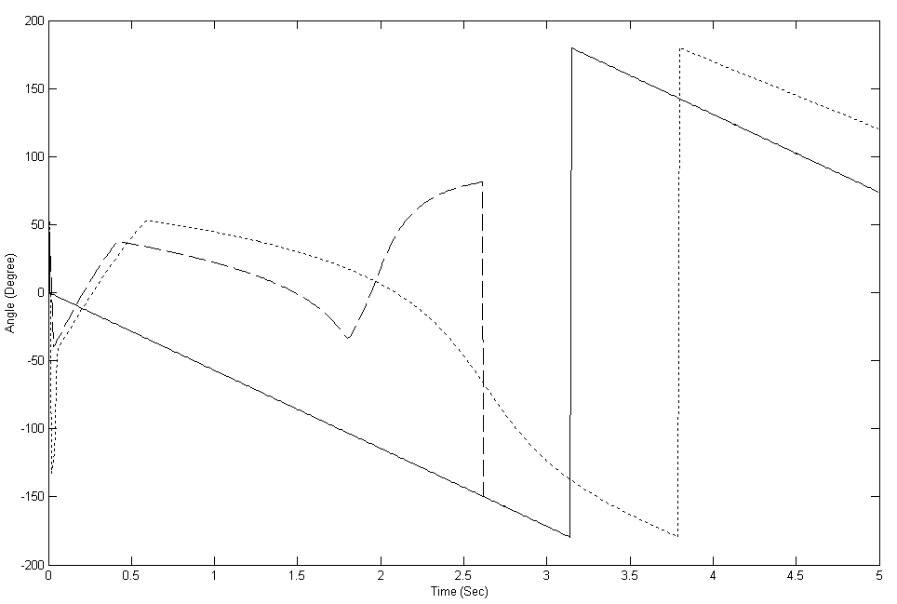
Speed
Angle
Solid line: target
Dashed line : robot under the proposed controller
Dotted line :robot under the conventional potential field controller

Slide 36
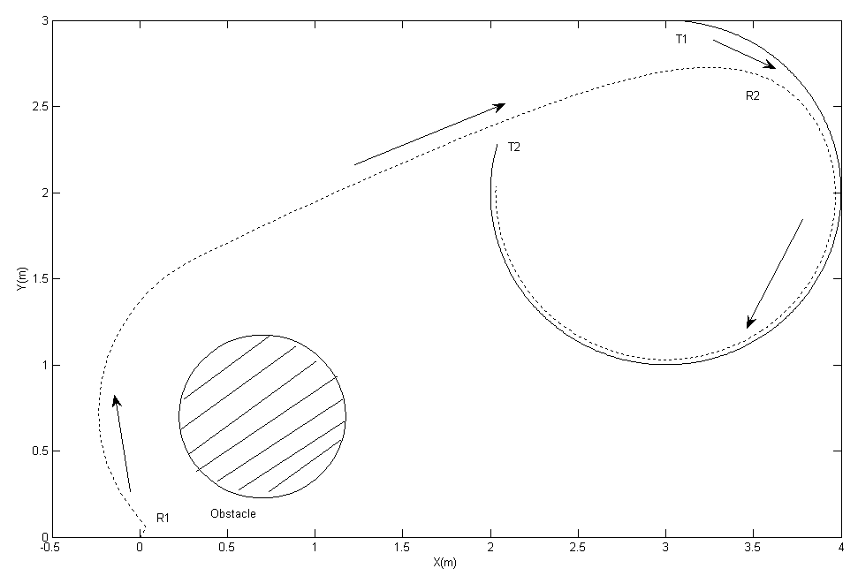
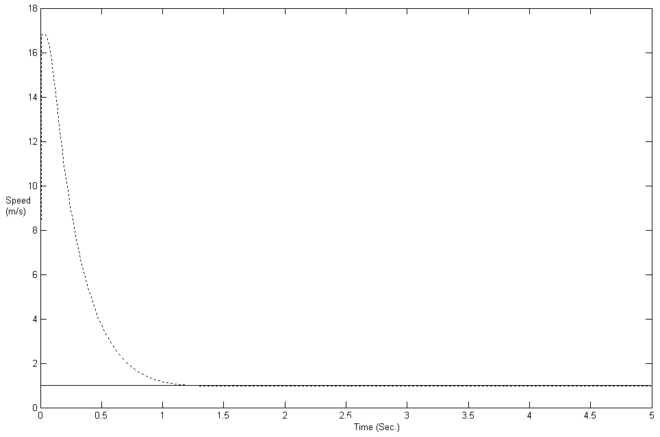
Performance of the conventional field method with a high gain
Trajectories
Speed

Slide 37
Conclusion:
the speed as well as the direction of the robot motion are
determined with potential field method
the velocity of the moving target is taken into consideration
the proposed approach maintains or improves tracking accuracy
and reduce control efforts, in comparison to the traditional
approaches
further study on the determination of the optimum speed of
the robot can be done by specifying additional performance
requirements.

Slide 38
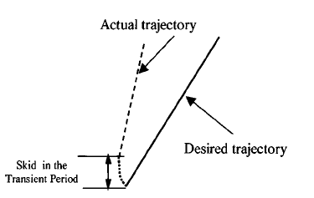
Speed control considering dynamic coupling
between the actuators
Synchronisation of the wheels’ motion affects the robot’s trajectory
Coupling between the actuators needs to be considered

Slide 39
Model based adaptive control
Dynamic model:

Slide 40
Introducing new variables
then
Dynamic model is transformed to a more compact form :

Slide 41
Based on the transformed dynamic model, the adaptive speed controllers are derived:
Modified to reduce the amplitudes of the control outputs:

Slide 42
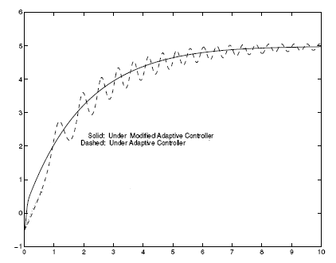
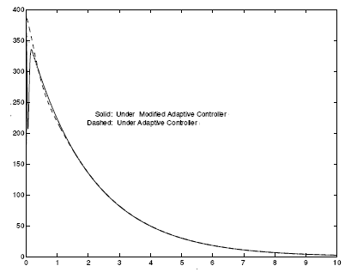
Simulation results

Slide 43
Model free PID control
A loop for the coupling of the wheels’ speeds is added.

Slide 44
When
Transfer functions :
First order motor model is adopted:
PID controller is used for the speed control
Implemented with one PIC18F252 microcontroller

Slide 45
Speed Control of an Omni-wheel robots
Modeling (Kinematics)
Omni Wheel Robot

Slide 46
Inverse kinematic model:

Slide 47
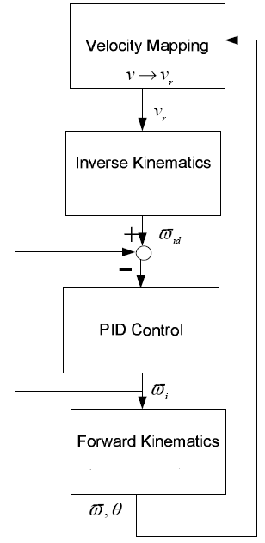
Chooped fed motors with drivers to drive the wheels
PID controller implemented with one one 80296 microcontrollers (three PWM outputs)
Encoder resolution 512 ppr
Sampling time 1 ms
Control loop completed within 0.5ms
This is achieved through:
codes written in an assembly language without using floating point libraries (too slow)
fixed point notation and a look up table of whole numbers to represent a floating point number with reasonable accuracy
only the simple operations like addition, substration, multiplication and bits-shifting are used.

Slide 48
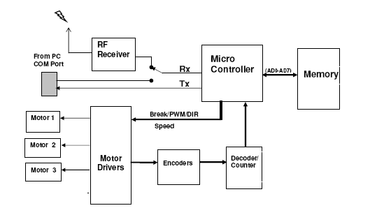
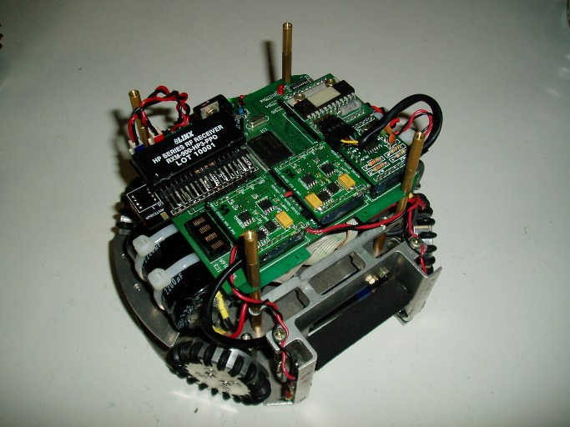
Implementation

Slide 49
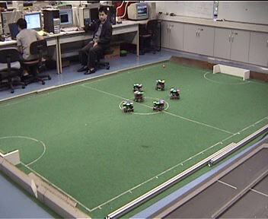
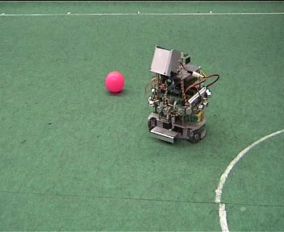
Demonstrations

Slide 50
Conclusion
Lyapunov and potential field based target tracking controllers, and speed controller for dynamically coupled wheels for mobile robots were presented
Both position and velocity of the target were considered in the target tracking
controller design
Functions of the system states, especially those of the target, are
are designed to moderate the magnitude or fluctuation of the control effort
The states of the system were assumed to be available; sensor noises affect
the performance of the controller.
To get a good system states estimation and prediction from the sensor data
is another big issue to be addressed together with the controller design (Kalman filtering, Bayesian method etc.)
Further study can be undertaken on integrating open-loop optimal
control, closed-loop control and system states estimation and prediction

