Slide 1

The benefits of labour migration and the need for International recognition of qualifications
David Craig NCLR, The University of Otago
Richard Bedford, AUT & Waikato University

Slide 2
The benefits of labour migration and the need for International recognition of qualifications
Three points:
Labour mobility and diaspora are increasingly important to sustainable development in the Pacific
The main mobility and remittance opportunities are for skilled migrants; but also for those who complete part or all of their training offshore
To enable skills and training to build Solomon islands mobility and economy, and to improve the match of skills and jobs in Solomon islands, internationally recognized qualifications are crucial

Slide 3
The benefits of labour migration and the need for International recognition of qualifications
Labour mobility and diaspora are increasingly important to sustainable development in the Pacific
The main mobility and remittance opportunities are for skilled migrants; but also for those who complete part or all of their training offshore
To enable skills and training to build Solomon islands mobility and economy, and to improve the match of skills and jobs in Solomon islands, internationally recognized qualifications are crucial

Slide 4
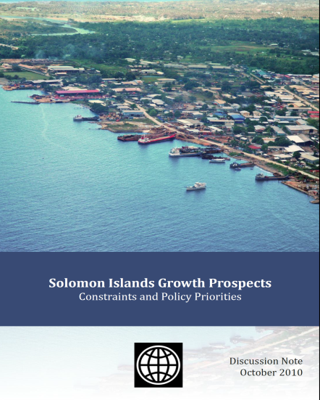
World Bank 2010: Solomon Islands Sources of Growth
‘Most countries have improved living standards by moving from agricultural production towards manufacturing and services, with accompanying urbanization.
‘Geographical disadvantages, combined with [governance and other factors] suggest that Solomon Islands’ progress along this trajectory will be highly constrained over the medium term.
‘Effective strategies to promote improved living standards need to recognize the constraints of the country’s geography, improve people’s ability to exploit resources available to them or to access centers of economic activity

Slide 5

World Bank 2010: Solomon Islands Sources of Growth
Future economic growth in Solomon Islands will come from four primary sources:
A vibrant smallholder agriculture sector
Natural resource industries that benefit Solomon Islands.
3. An internationally mobile workforce. Growth in the local private sector will not be sufficient to provide jobs for the rapidly growing labor force. For many Solomon Islanders the best prospects for well-paid, productive employment may lie overseas. Short-term regional labor schemes can lead to remittances and the acquisition of skills that benefit the local economy. In the longer-run, integration of the Solomon Islands labour market with regional partners would allow Solomon Island workers to make the best use of their skills and partner countries to address growing labor shortages. P i

Slide 6

Remittance corridors: New Rivers of Gold?
The value of remittances to poor countries is enormous.
Since 1996 they have been worth more than all overseas-development aid, and for most of the past decade more than private debt and portfolio equity inflows.
In 2011 remittances to poor countries totalled $372 billion.
Given that cash is ferried home stuffed into socks as well as by wire transfer, the real total could be 50% higher.
Economist: April 28 2012
http://www.economist.com/node/21553458

Slide 7

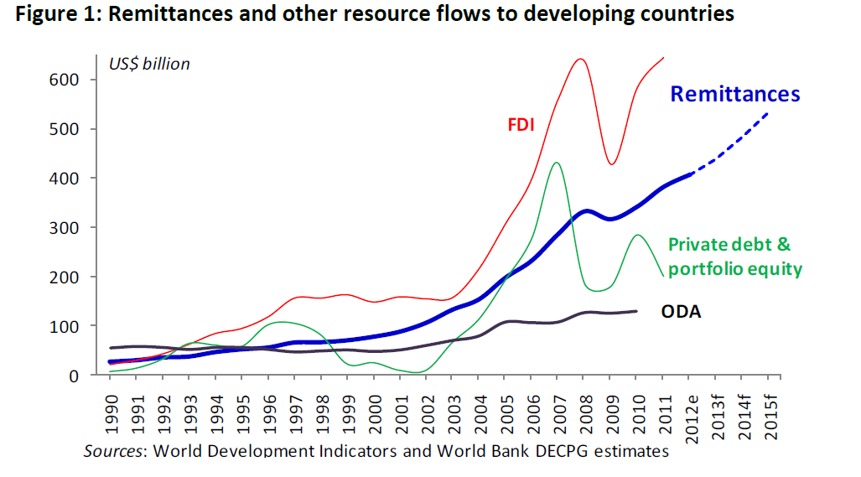
3 TiMES Official Development Assistance http://siteresources.worldbank.org/INTPROSPECTS/Resources/334934-1288990760745/MigrationDevelopmentBrief19.pdf

Slide 8
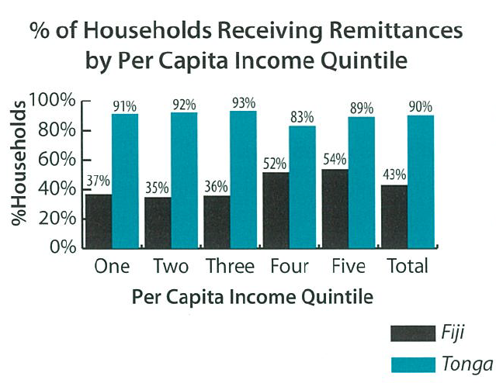

Remittance contributions to household income Luthria et al 2006 At Home and away: Expanding job opportunities for pacific islanders through labour mobility
‘Migration has become so substantial that in Fiji as many as one third of all households had at least one overseas migrant (compared to 60% in Tonga) and 43% received remittances (compared with 90% in Tonga). p51

Slide 9
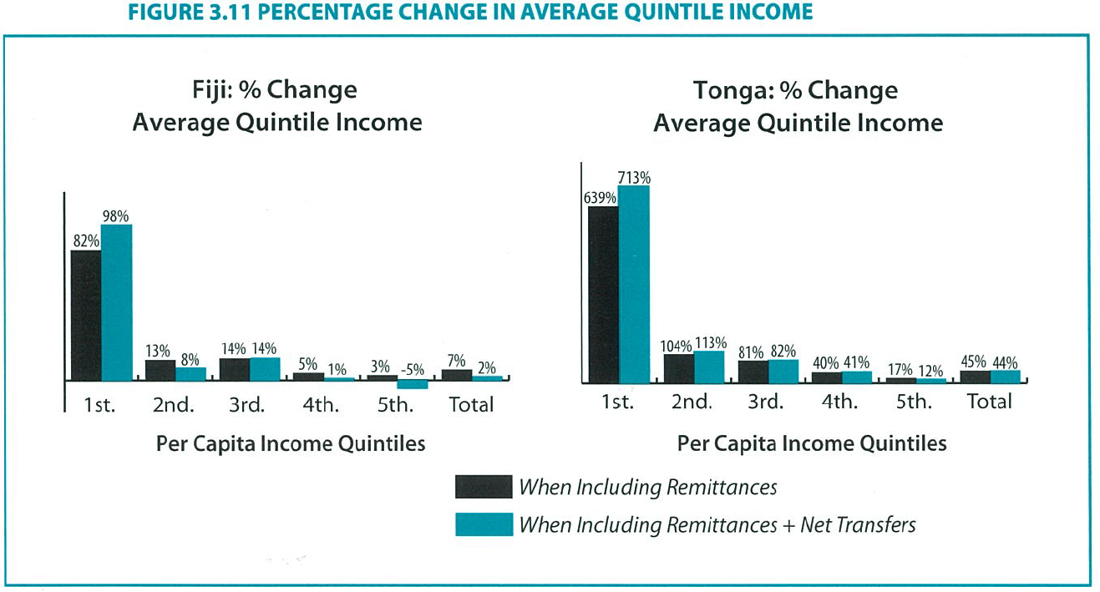
Remittances and Poverty Luthria et al 2006 At Home and away: Expanding job opportunities for pacific islanders through labour mobility

Slide 10

AT Home and Away Luthria et al 2006 At Home and away
‘Migration has reduced the level of open and disguised unemployment in the migrant sending countries p50
‘Migration can contribute to social stability as well as economic development . Remittances are associated with better secondary level educational attainment (by alleviating the budget constraint to education).
‘Having a migrant in the household increases the likelihood of other household members acquiring post-secondary education (by inducing greater investment in education). p viii
‘These findings indicate that larger investments in education, as the result of increased remittances, could augment supply of skilled workers in source countries by increasing both incentives and ability to finance education. P ix

Slide 11
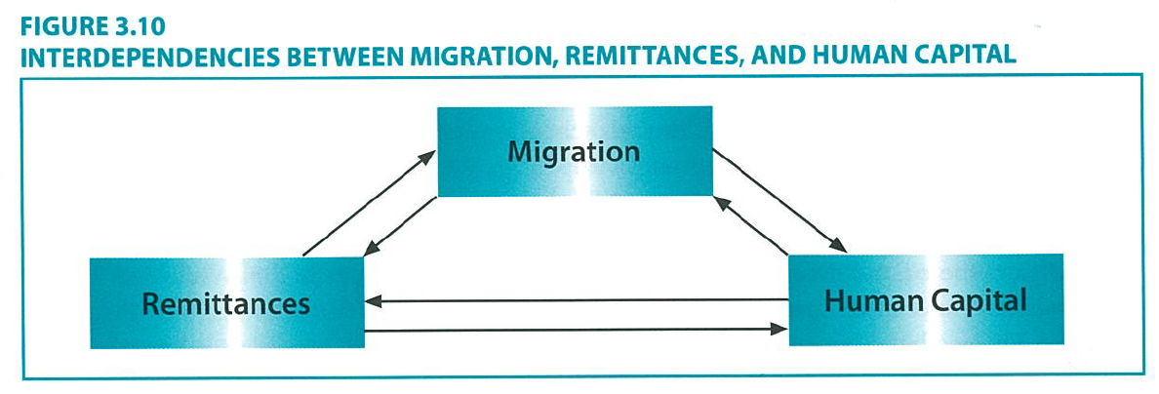
Three interacting/ reinforcing factors

Slide 12
The benefits of labour migration and the need for International recognition of qualifications
Three points:
Labour migration and diaspora (including mobility for training) are increasingly important parts of sustainable development in the Pacific
The main mobility and remittance opportunities are for skilled migrants; but also for trainees who complete part or all of their training offshore.
3. To enable skills and training to be a part of Solomon islands future mobility and economy, and to enable a match between skills and jobs here in Solomon islands, internationally recognized qualifications are crucial

Slide 13
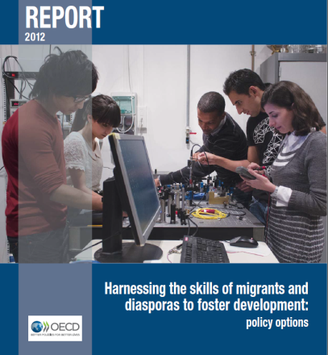
HARNESSING THE SKILLS OF MIGRANTS AND DIASPORAS TO FOSTER DEVELOPMENT: POLICY OPTIONS
International students account for over 6% of the total student population of OECD countries and constitute a major source of highly-skilled labour for those countries.
In recent years, most host countries have made it easier for students to change their immigration status after completing their studies, so as to allow this pool of skilled labour to settle there.
http://www.oecd.org/els/mig/Policy_Brief_Migrants_En_BD%20DEFINITIF.pdf p10

Slide 14
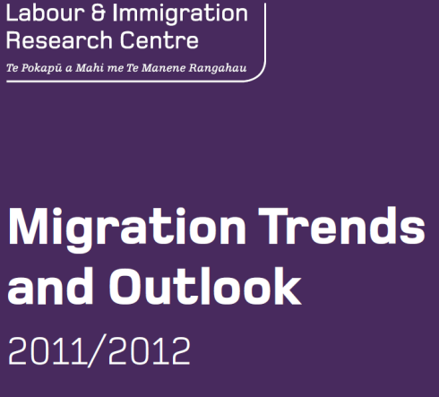
NZ Labour and Immigration research Centre 2013 Migration Trends and Outlook
International students have become an important source of skilled migrants for New Zealand and other countries.
Many countries attract international students by providing opportunities to work or stay in the country permanently after completing study.
Over the last decade, 1 in 5 international students gained permanent residence in New Zealand within five years of being issued their first student visa. In 2011/12, 38 % of skilled principal migrants were former international students.
P iv

Slide 15
MOBILITY Pathways: ‘Kanaka Man’s’ story
Studied nursing in SI and at USQ
Helped brother into business: saved $A5000 for tuition fees
Applied to study Certificate Aged Care at a Brisbane technical training school (3 days/ week)
Working part time on student visa (up to 20 hours/ week, sending money home)
Rest Home employer sponsor temporary work visa 457
Possible transition to residence after 2 years

Slide 16
The benefits of labour migration and the need for International recognition of qualifications
Three core points:
Labour migration and diaspora (including mobility for training) are increasingly important parts of sustainable development in the Pacific
The main migration and remittance opportunities are for skilled migrants; but also for trainees who complete part or all of their training offshore.
3. To enable skills and training to be a part of Solomon islands future mobility and economy, and to enable a match between skills and jobs here in Solomon islands, internationally recognized qualifications are crucial

Slide 17

HARNESSING THE SKILLS OF MIGRANTS AND DIASPORAS TO FOSTER DEVELOPMENT: POLICY OPTIONS
Massive underemployment in developing countries, and the persistence of labour shortages at various skill levels in main destination countries….. suggest that labour migration will persist in coming decades.
So that these changes can benefit all, i.e. countries of origin, host countries and migrants themselves, it is of paramount importance to improve the match between supply and demand with regard to skills, both at the time of departure and upon return to the home country.
This is the overriding aim of greater international mobility of skills.
http://www.oecd.org/els/mig/Policy_Brief_Migrants_En_BD%20DEFINITIF.pdf p11

Slide 18
HARNESSING THE SKILLS OF MIGRANTS AND DIASPORAS TO FOSTER DEVELOPMENT:
POLICY OPTIONS
‘The mismatch between skills and jobs for immigrants in destination countries can impact the extent of remittances they are able to transfer and the applicability of their qualifications in the labour market. While migrants who are well integrated into the labour market acquire new technical, linguistic and professional skills, those in jobs not corresponding to their qualifications run the risk of incurring a long-lasting loss of human capital.

Slide 19
The three way Mobility and skills win-win?
Mobility and diaspora, including mobility to train offshore
Quality and international recognition of training and qualifications
Skills/ jobs match in and beyond Solomon islands

Slide 20
Solomon Islands 2009 and 2070
2009
20% of 516,000 in urban places
Urban population: 102,000 million
2070
40% of 1.43 million in urban places
Urban population: 572,000

Slide 21
Looking back
The current urban population of around 110,000 (allowing for some correction for under-enumeration) is not far from the total population enumerated in the Solomon Islands census of 1959 – 125,000.
Over the 50 years 1959-2009 the urban population of the Solomon Islands grew to reach the equivalent of the total population in 1959.

Slide 22
Looking ahead
Over the next 50 years a similar situation could arise whereby the population of around 516,000 in 2009 might be living in towns in the Solomon Islands by 2060.
There could be a lot more urban residents than this if urbanisation proceeds at a faster rate and more than 40% of the population is living in towns.

Slide 23
Western Melanesia 2010 and 2070
2010
20% of 7.64 million in urban places
Urban population: 1.53 million
2070
40% of 18.29 million in urban places
Urban population: 7.32 million

Slide 24
Other Pacific 2010 and 2070
2010
50% of 2.32 million in urban places
Urban population: 1.16 million
2070
70% of 3.09 million in urban places
Urban population: 2.16 million

Slide 25
A global perspective 2010 and 2070
2010
50% of 6.9 billion in urban places
Urban population: 3.45 billion
2070
70% of 9.8 billion in urban places
Urban population: 6.9 billion

Slide 26
Emigration to OECD countries by country of birth, 2008
Country of birth | Emigration rate (%) | Rank
Niue | 77.1 | 1
Samoa | 40.5 | 7
New Zealand | 12.4 | 36
Australia | 1.9 | 113
Vanuatu | 1.5 | 118
Papua New Guinea | 0.8 | 136
Solomon Islands | 0.8 | 138

Slide 27
Solomons Diaspora, 2000-2002
Place of residence | Number | Percent
Other Melanesia | 1,400 | 33.3
Australia/NZ | 1,800 | 42.8
UK/Europe | 490 | 11.7
Asia/Middle East | 250 | 6.0
Americas | 220 | 5.2
Africa | 40 | 1.0
Total diaspora | 4,200 | 100.0

Slide 28
Solomons-born, ANZ, 1901-1947
Year | Pacific | Solomons | % Solomons
1901 | 10,766 | 4,000? | 35-40?
1911 | 3,614 | 210 | 5.8
1921 | 4,791 | 235 | 4.9
1933/36 | 5,247 | 98 | 1.9
1945/47 | 7,447 | 134 | 1.8

Slide 29
Solomons-born, ANZ, 1966-2006
Year | Pacific | Solomons | % Solomons
1966 | 34,370 | 600 | 1.7
1976 | 75,690 | 850 | 1.1
1986 | 123,350 | 1,150 | 0.9
1996 | 185,980 | 1,570 | 0.8
2006 | 245,340 | 2,050 | 0.8

Slide 30
Solomons-born in ANZ as percentage of Solomons population, 1901-2006
Year | Solomons | ANZ | % ANZ
1901 | 110,000? | 4,000? | 3.8
1946 | 110,100 | 130 | 0.1
1986 | 285,200 | 1,150 | 0.4
2006 | 492,700 | 2,050 | 0.4

Slide 31
Solomon Is-Born Populations in Australia and NZ, 2001 and 2006
Year | Australia | New Zealand | Solomon Is
2001 | 1,326 | 505 | 428,000
2006 | 1,498 | 549 | 493,000
Change | + 172 | +42 | +65,000
% change | 8.3 | 12.8 | 15.2

Slide 32
Solomon Is-Born Populations in Australia and NZ, 2006 and 2011
Year | Australia | New Zealand | Solomon Is
2006 | 1,498 | 549 | 493,000
2011 | 1,757 | (705?) | 553,300
Change | + 259 | (+155?) | +60,300
% change | 17.3 | (28.2?) | 12.2

Slide 33
Australia’s Solomons population, 2011
Solomon Islands population | Number
Born in the Solomon Islands | 1,758
Solomon Islands ancestry | 1,406
Solomons ancestry, Solomons-born | 698
Sole ancestry Solomons | 650
Sole ancestry Solomons-born (SASB) | 494
% Solomons ancestry who are SASB | 35.1
% Solomons born who are SASB | 28.1

Slide 34
Age structure of Solomons-born in Aust, 2011
Age group | Solomons | Vanuatu | PNG | Pacific
0-14 | 13.1 | 8.8 | 7.5 | 6.3
15-24 | 16.9 | 13.4 | 8.7 | 8.9
25-39 | 28.4 | 28.5 | 30.1 | 30.1
40-59 | 36.4 | 34.6 | 44.1 | 43.0
60+ | 5.1 | 14.7 | 9.5 | 11.7
Total | 1,757 | 1,107 | 26,652 | 122,357

Slide 35
Young Adults (15-24), OCEANIA 2010 and 2050 (000’s)
Area | 2010 | 2050 | Difference
Melanesia | 1,658 | 2,757 | 1,099
Micronesia | 96 | 100 | 4
Polynesia | 126 | 129 | 3
New Zealand | 628 | 679 | 41
Australia | 3,147 | 3,671 | 524

Slide 37
BRAIN DRAIN vs BRAIN GAIN
Brain Drain?
Nearly 1/3 of migrants to OECD countries are university graduates (as opposed to 6% at home)
Loss of top talent (but these people are mobile anyway)
Need to safeguard core capabilities
Or Brain Gain?
Circular migration and returnees’ knowledge
More incentives for all to learn and engage
Remittances improve secondary school attainment
Builds educational institutions’ capability and currency
Higher skills training for everyone: and better skills matching?

Slide 38

HARNESSING THE SKILLS OF MIGRANTS AND DIASPORAS TO FOSTER DEVELOPMENT: POLICY OPTIONS OECD September 2012
Today’s migration flows are characterised by a higher level of skill, a higher proportion of women and a broader range of destination countries than in the past.
http://www.oecd.org/els/mig/Policy_Brief_Migrants_En_BD%20DEFINITIF.pdf P4

Slide 39
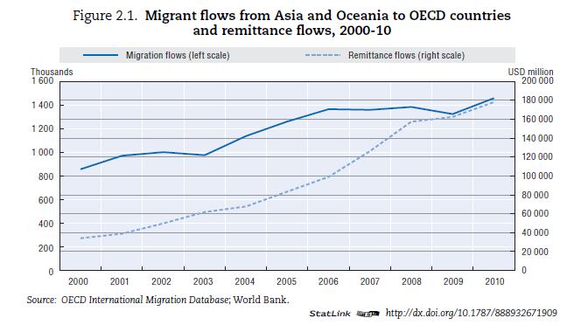
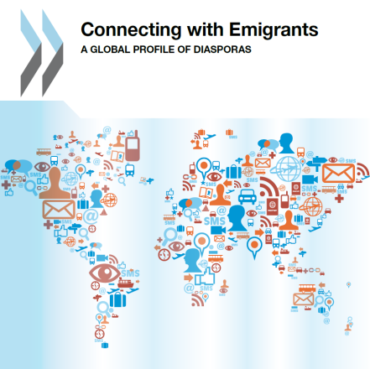

Slide 40
HARNESSING THE SKILLS OF MIGRANTS AND DIASPORAS TO FOSTER DEVELOPMENT: POLICY OPTIONS OECD September 2012
Many migrants have established roots in their destination countries while at the same time are better connected with their home countries because of easier transport and new tools of communication.
Migrants possess real and substantial resources, both in financial terms,… and in terms of human capital
In addition, migrants are key players in trade links between their home and destination countries, and some initiate projects that expand employment and infrastructure, at the local level in particular.
http://www.oecd.org/els/mig/Policy_Brief_Migrants_En_BD%20DEFINITIF.pdf P4

