Slide 1

On the Performance of KiwiSaver Funds
Bart Frijns & Alireza Tourani-Rad
Auckland University of Technology
and
Auckland Centre for Financial Research

Slide 2
Introduction
KiwiSaver was introduced on July 1, 2007, and is a subsidised, defined contribution investment scheme
As of mid 2013, AUM in KiwiSaver are approx. NZ$15, with 2.1 million investors
Many investors stay with the default option, which may not be appropriate for their specific investment needs
Financial literacy seems to be important here, as people need to make informed decisions about retirement. How much information/knowledge do they need?

Slide 3
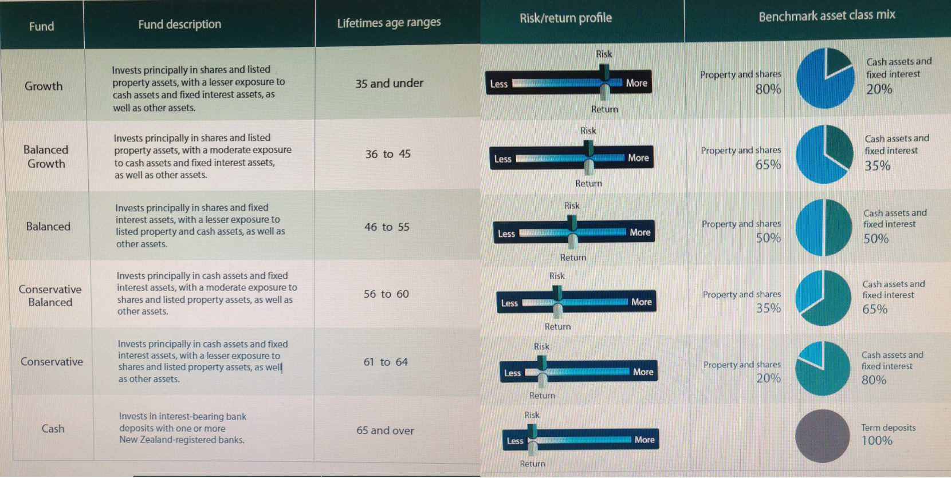
Fund Choice
Information on funds and choice is often limited/concise and often reflects, asset allocation, profile, some performance statistics, and/or some questionnaire to assess risk aversion, etc.
Source: ANZ investment statement

Slide 4
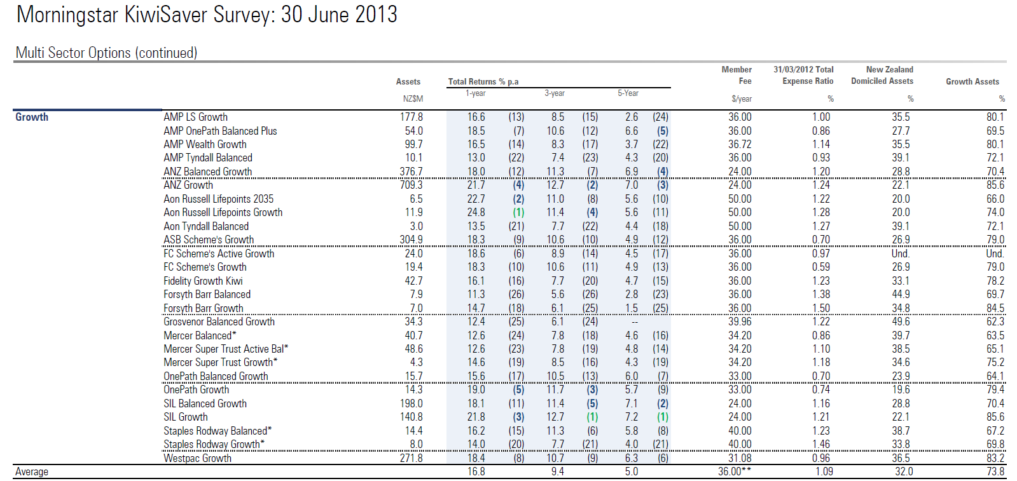
Performance Comparison
Source: Morningstar (www.morningstar.co.nz)

Slide 5
What we know about Mutual Funds
In aggregate, mutual funds underperform relative to the market. The degree of underperformance is strongly related to fees (Jensen, 1968; Fama and French, 2008)
Active management does not yield persistent outperformance. Active funds generally underperform relative to passive funds (due to higher fees)
At a fund level, there is very limited evidence of persistent outperformance. The outperformance that exists can typically be explained by known market phenomena (size effect, momentum effect) (Carhart, 1997)
When outperformance is observed this is typically among small funds
There is positive relation between performance and flow (Sirri and Tufano, 1998; Del Guerco and Tkac, 2002)

Slide 6
What we know about KiwiSaver
Investors are inert (status quo bias), investors chase past returns, advice leads to riskier investments, does not lead to higher returns (Zhang, 2013)
KS investors are not attracted their bank’s funds, there is a positive relation between returns and fund flows (Matthews, 2013)

Slide 7
Data
We obtain monthly Net Asset Values from Morningstar
Sample period: September 2007 – April 2013
Risk-free rate from RBNZ’s site : 90-day bank bill
Benchmarks from Ken French’s site
All data in NZ Dollar

Slide 8
Replicability of funds I
We aim to replicate balanced and moderate funds from conservative and growth
We use constrained OLS:
Examine the fit of the constructed series with the actual series, i.e.
We expect α = 0 and β = 1, and can test this using an F-test.

Slide 9
Replicability of Funds II
 | Constrained OLS |  |  | Fit of Reconstructed Funds |  |  |  | Fees
Fund | Conserv. | Growth | Aggressive/ Equity | Alpha | Beta | R² | F-test | Fund Fees | Reconstructed Fees | Diff.
AMP Moderate | 0.73 | 0.27 |  | 0.012 | 1.01 | 99.34% | 0.99 | 0.975% | 0.9177% | -0.05734%
AMP Moderate | 0.796 |  | 0.21 | 0.018 | 1.01 | 99.03% | 1.01 | 0.975% | 0.9328% | -0.04225%
AMP Moderate Balanced | 0.49 | 0.51 |  | 0.005 | 1.00 | 99.98% | 1.57 | 1.025% | 0.9556% | -0.06942%
AMP Moderate Balanced | 0.59 |  | 0.41 | 0.013 | 1.00 | 99.87% | 1.76 | 1.025% | 0.9775% | -0.0475%
AMP Balanced | 0.36 | 0.64 |  | -0.021 | 0.99 | 99.75% | 2.68* | 1.025% | 0.9761% | -0.04888%
AMP Balanced | 0.48 |  | 0.52 | -0.011 | 0.99 | 99.78% | 0.98 | 1.025% | 1.0050% | -0.02%
Aon Moderate | 0.64 | 0.36 |  | 0.038 | 0.98 | 98.82% | 1.64 | 0.94% | 0.9384% | -0.0016%
Aon Balanced | 0.25 | 0.75 |  | 0.214 | 1.00 | 99.88% | 1.30 | 1.01% | 1.0125% | 0.0025%
ASB Moderate | 0.64 | 0.36 |  | -0.028 | 0.97 | 98.34% | 2.99* | 0.60% | 0.5080% | -0.092%
ASB Balanced | 0.32 | 0.69 |  | -0.022 | 0.99 | 99.70% | 1.66 | 0.65% | 0.6110% | -0.039%
Fidelity Balanced | 0.50 | 0.50 |  | -0.023 | 0.99 | 98.31% | 0.72 | 1.19% | 1.1550% | -0.035%
Grosvenor Balanced | 0.66 | 0.34 |  | -0.017 | 1.01 | 99.52% | 0.76 | 1.07% | 1.0380% | -0.032%
Mercer Balanced | 0.41 | 0.59 |  | -0.00 | 0.99 | 99.77% | 2.10 | 0.72% | 0.6888% | -0.0312%
OnePath Cons Balanced | 0.76 | 0.25 |  | -0.008 | 0.99 | 99.52% | 1.03 | 0.60% | 0.6106% | 0.0106%
OnePath Balanced | 0.51 | 0.49 |  | -0.016 | 0.84 | 83.00% | 6.51*** | 0.65% | 0.6482% | -0.0018%
OnePath Balanced Growth | 0.25 | 0.75 |  | 0.001 | 1.00 | 99.98% | 0.14 | 0.70% | 0.6950% | -0.005%
SIL Cons Balanced | 0.75 | 0.26 |  | -0.013** | 1.00 | 99.85% | 3.65** | 1.06% | 1.1096% | 0.0496%
SIL Balanced | 0.51 | 0.49 |  | -0.016*** | 1.00 | 99.96% | 7.01*** | 1.11% | 1.1335% | 0.0235%
SIL Balanced Growth | 0.25 | 0.75 |  | -0.013*** | 1.00 | 99.98% | 5.47*** | 1.16% | 1.1725% | 0.0125%
Staples Balanced | 0.14 | 0.86 |  | 0.1647 | 0.71 | 69.81% | 13.20*** | 1.05% | 1.1440% | 0.094%
Tower Balanced | 0.56 | 0.44 |  | -0.014 | 0.97 | 98.78 | 1.43 | 0.98% | 0.9724% | -0.0076%
Tower Balanced | 0.74 |  | 0.26 | -0.031 | 0.96 | 96.67% | 2.76* | 0.98% | 0.9450% | -0.035%
Tower Growth | 0.43 |  | 0.57 | -0.024 | 0.95 | 97.06% | 2.98* | 1.09% | 0.9997% | -0.0903%

Slide 10
Replicability of Funds II

Slide 11
Performance of KiwiSaver funds
Performance analysis is only conducted for Growth/Aggressive funds
These funds contain largest equity proportions, and performance measurement literature on this is most developed

Slide 12
Summary Stats
Fund | Obs | Return (% p.a.) | St. Dev. (% p.a.) | Fund | Obs | Return (% p.a.) | St. Dev. (% p.a.)
AMP Aggressive | 67 | 1.27% | 13.08% | Grosvenor High Growth | 67 | 0.62% | 11.94%
AMP Growth | 67 | 1.90% | 10.91% | Mercer High Growth | 67 | 1.60% | 12.55%
AON Growth | 67 | 3.96% | 13.78% | OnePath growth | 67 | 3.03% | 9.64%
ASB Growth | 67 | 2.51% | 10.94% | ANZ Growth | 67 | 4.21% | 10.38%
Brook Growth | 67 | 5.91% | 8.72% | SIL Growth | 67 | 4.38% | 10.37%
Westpac Growth | 67 | 3.94% | 8.06% | Smart Growth | 67 | 0.01% | 15.58%
Fidelity growth | 67 | 4.12% | 9.12% | Staples Rodway Growth | 66 | 4.29% | 9.20%
Fidelity Aggressive | 67 | 3.80% | 11.61% | TOWER Growth | 67 | 2.93% | 10.88%
Fisher Growth | 67 | 5.34% | 12.80% | TOWER Equity | 67 | 0.44% | 15.68%
Forsyth Barr Growth | 58 | 2.36% | 8.76%

Slide 13
CAPM
Risk-adjusted performance in mutual funds is commonly measured using the CAPM
This model regresses excess return of a fund on the excess return on a market index:
Beta (β) measures the (market) risk of the fund
Alpha (α) measures the risk-adjusted out- or underperformance, and provides a measure for stock selections skills

Slide 14
Risk Adjusted performance based on CAPM
Fund Name | Obs. | α | RMRF | R² |  | Fund Name | Obs. | α | RMRF | R²
AMP Aggressive | 67 | -0.309 (-0.77) | 0.504*** (3.95) | 25.60% |  | Forsyth Barr Growth | 58 | -0.270 (-0.84) | 0.457*** (4.92) | 43.48%
AMP Growth | 67 | -0.243 (-0.72) | 0.431*** (4.10) | 26.69% |  | Grosvenor High Growth | 67 | -0.406* (-1.82) | 0.792*** (11.32) | 75.96%
AON Growth | 67 | -0.083 (-0.17) | 0.502*** (4.38) | 22.81% |  | Mercer High Growth | 67 | -0.298 (-0.72) | 0.623*** (5.90) | 42.00%
ASB Growth | 67 | -0.232 (-0.85) | 0.680*** (9.91) | 65.72% |  | OnePath Growth | 67 | -0.171 (-0.63) | 0.566*** (7.61) | 58.01%
Brook Growth | 67 | 0.078 (0.35) | 0.512*** (5.82) | 60.15% |  | ANZ Growth | 67 | -0.082 (-0.29) | 0.623*** (9.40) | 60.92%
Westpac Growth | 67 | -0.088 (-0.45) | 0.521*** (12.21) | 70.07% |  | SIL Growth | 67 | -0.067 (-0.24) | 0.621*** (9.39) | 60.70%
Fidelity growth | 67 | -0.085 (-0.53) | 0.594*** (8.45) | 73.32% |  | Smart Growth | 67 | -0.446 (-0.94) | 0.717*** (5.67) | 36.51%
Fidelity Aggressive | 67 | -0.132 (-0.51) | 0.734*** (11.48) | 69.14% |  | Staples Rodway Growth | 66 | -0.034 (-0.13) | 0.449*** (5.68) | 41.29%
Fisher Growth | 67 | -0.002 (-0.01) | 0.728*** (6.35) | 55.52% |  | TOWER Growth | 67 | -0.186 (-0.61) | 0.613*** (7.76) | 54.00%
 |  |  |  |  |  | TOWER Equity | 67 | -0.437 (-1.18) | 0.891*** (7.86) | 55.91%

Slide 15
Consequences of different risk levels
Assumptions:
Inflation: 2% Bond yield: 5%
Contribution: 6% Market Return: 10.5%
Salary : $50,000 Market risk (stdev.): 20%
Age of 30 Simple linear glide path
Fund 1 (beta = 0.5)
  Expected: $487,978
  Lower Bound: $156,459
  Upper Bound: $3,683,345
  Total Contributions: $155,983
Fund 2 (beta = 0.9)
  Expected: $587,090
  Lower Bound: $107,165
  Upper Bound: $31,415,281
  Total Contributions: $155,983

Slide 16
4-factor model
Several stylized facts have been observed in financial markets:
  We observe that small caps typically perform better than large caps (Banz, 1980)
  Value stocks generally outperform “glamour” stocks (Statman, 1980)
  Winners tend to stay winners, losers tend to stay losers (in the short-run) (Jeegadeesh and Titman, 1993)

Slide 17
Risk adjusted performance based on 4-factor model
Fund | α | RMRF | SMB | HML | WML | R² | Fund | α | RMRF | SMB | HML | WML | R²
AMP Aggressive | -0.381* (-1.78) | 0.635*** (9.47) | -0.119 (-1.10) | -0.408*** (-3.73) | 0.001 (0.01) | 67.23% | Grosvenor High Growth | -0.412*** (-3.92) | 0.812*** (16.50) | -0.187* (-1.93) | -0.013 (-0.17) | -0.061*** (-2.15) | 91.43%
AMP Growth | -0.302* (-1.65) | 0.538*** (9.65) | -0.099 (-1.08) | -0.333*** (-3.58) | 0.000 (0.01) | 66.82% | Mercer High Growth | -0.330* (-1.78) | 0.683*** (12.54) | -0.167** (-2.18) | -0.196** (-2.36) | -0.113*** (-2.04) | 85.38%
AON Growth | -0.136 (-0.59) | 0.596*** (8.41) | -0.107 (-0.90) | -0.343*** (-2.87) | -0.100 (-1.16) | 68.99% | OnePath Growth | -0.194 (-1.26) | 0.616*** (13.28) | -0.211*** (-3.70) | -0.080 (-1.32) | -0.014 (-0.32) | 84.30%
ASB Growth | -0.249* (-1.96) | 0.719*** (22.03) | -0.205*** (-3.87) | -0.067 (-1.27) | -0.050 (-1.58) | 90.76% | ANZ Growth | -0.106 (-0.63) | 0.672*** (17.18) | -0.192*** (-3.32) | -0.098* (-1.88) | -0.029 (-0.58) | 86.27%
Brook Growth | 0.083 (0.39) | 0.512*** (4.85) | -0.171 (-1.43) | 0.079 (0.64) | -0.009 (-0.17) | 65.69% | SIL Growth | -0.090 (-0.55) | 0.670*** (17.19) | -0.195*** (-3.38) | -0.094* (-1.81) | -0.029 (-0.58) | 86.19%
Westpac Growth | -0.106 (-0.78) | 0.557*** (17.59) | -0.115** (-2.59) | -0.074* (-1.70) | -0.007 (-0.24) | 85.16% | Smart Growth | -0.478* (-1.72) | 0.791*** (14.12) | -0.406*** (-3.36) | -0.096 (-0.92) | -0.054 (-0.77) | 72.56%
Fidelity Growth | -0.074 (-0.63) | 0.579*** (8.90) | -0.115** (-2.05) | 0.061 (1.04) | -0.087*** (-3.30) | 85.51% | Staples Rodway Growth | -0.047 (-0.27) | 0.490*** (5.65) | -0.028 (-0.22) | -0.161 (-1.07) | -0.056 (-0.90) | 62.68%
Fidelity Aggressive | -0.144 (-0.90) | 0.759*** (15.30) | -0.102 (-1.45) | -0.075 (-1.44) | -0.063** (-2.22) | 82.74% | TOWER Growth | -0.222 (-1.35) | 0.678*** (15.03) | -0.068 (-1.11) | -0.234*** (-3.39) | -0.061 (-1.37) | 85.54%
Fisher Growth | -0.023 (-0.10) | 0.746*** (9.28) | 0.275*** (3.45) | -0.326*** (-3.02) | -0.219*** (-6.98) | 81.33% | TOWER Equity | -0.500** (-2.68) | 1.005*** (20.92) | -0.103 (-1.24) | -0.386*** (-4.44) | -0.051 (-1.00) | 88.32%
Forsyth Barr Growth | -0.327* (-1.71) | 0.537*** (7.16) | -0.021 (-0.24) | -0.227* (-1.83) | -0.030 (-0.72) | 74.47%

Slide 18
Market Timing Skills
The models presented before measure stock selection skills
We can also assess market timing skills
The squared term measures market timing skills (i.e. δ > 0 positive stock picking skills)

Slide 19
Market Timing Skills
Fund | α | RMRF | RMRF² | R² | Fund | α | RMRF | RMRF² | R²
AMP Aggressive | 0.066 (0.15) | 0.510*** (4.73) | -0.026*** (-2.64) | 28.18% | Grosvenor High Growth | -0.251 (-1.45) | 0.794*** (11.62) | -0.011 (-1.06) | 76.49%
AMP Growth | 0.062 (0.18) | 0.435*** (4.90) | -0.021** (-2.57) | 29.14% | Mercer High Growth | -0.097 (-0.26) | 0.626*** (6.05) | -0.014 (-1.17) | 42.80%
AON Growth | 0.129 (0.27) | 0.505*** (4.64) | -0.015 (-1.45) | 23.56% | OnePath Growth | 0.132 (0.48) | 0.626*** (10.10) | -0.015** (-2.19) | 62.24%
ASB Growth | -0.125 (-0.51) | 0.681*** (9.91) | -0.007 (-0.84) | 66.02% | ANZ Growth | 0.145 (0.53) | 0.624*** (10.13) | -0.015** (-2.20) | 62.00%
Brook Growth | -0.079 (-0.36) | 0.509*** (5.71) | 0.011 (0.66) | 61.19% | SIL Growth | -0.284 (-0.54) | 0.719*** (5.82) | -0.011 (-0.90) | 36.85%
Westpac Growth | 0.019 (0.09) | 0.523*** (12.57) | -0.007 (-1.50) | 70.62% | Smart Growth | -0.041 (-0.15) | 0.449 (5.55) | 0.000 (0.04) | 41.29%
Fidelity Growth | -0.245 (-1.52) | 0.591*** (9.87) | 0.011 (1.08) | 74.29% | Staples Rodway Growth | 0.045 (0.16) | 0.617 (8.00) | -0.016* (-1.81) | 55.40%
Fidelity Aggressive | -0.221 (-0.88) | 0.733*** (11.38) | 0.006 (0.93) | 69.33% | TOWER Growth | -0.115 (-0.35) | 0.896 (8.27) | -0.022* (-1.84) | 57.25%
Fisher Growth | -0.135 (-0.40) | 0.726*** (6.18) | 0.009 (0.50) | 55.85%
Forsyth Barr Growth | -0.131 (-0.49) | 0.470*** (4.69) | -0.010 (-0.91) | 44.34%

Slide 20
Conclusion
Our study reveals several important results regarding KiwiSaver funds
  Many funds are replicable, suggesting that most fund providers only have a conservative and a growth fund, replicating funds sometimes is cheaper
  There is no evidence of systematic outperformance. In some cases, we observe systematic underperformance Growth funds are not equal, they are very different in terms of risk taking behaviour
  Funds predominantly invest in Large cap stocks, and tend to focus on glamour stocks. Small cap, value is not considered in the investment universe
  None of the funds display positive market timing skills, several of them show significant negative skills
How much knowledge can be expected from a mum and dad investor?

Slide 21
Replicability of funds
 | Constrained OLS |  |  |  | Fit of Reconstructed Funds |  |  |  |  | Fees
Fund | Conservative | Growth | Aggressive/ Equity |  | Alpha | Beta | R² | F-test |  | Fund Fees | Reconstructed Fees | Diff.
AMP Moderate | 0.73 (143.88) | 0.27 (52.47) |  |  | 0.012 (0.93) | 1.01 (98.57) | 99.34% | 0.99 |  | 0.975% | 0.9177% | -0.05734%
AMP Moderate | 0.796 (158.23) |  | 0.21 (43.15) |  | 0.018 (1.08) | 1.01 (81.50) | 99.03% | 1.01 |  | 0.975% | 0.9328% | -0.04225%
AMP Moderate Balanced | 0.49 (377.46) | 0.51 (391.61) |  |  | 0.005 (1.61) | 1.00 (564.20) | 99.98% | 1.57 |  | 1.025% | 0.9556% | -0.06942%
AMP Moderate Balanced | 0.59 (223.62) |  | 0.41 (155.49) |  | 0.0137 (1.61) | 1.00 (225.37) | 99.87% | 1.76 |  | 1.025% | 0.9775% | -0.0475%
AMP Balanced | 0.36 (66.49) | 0.64 (118.06) |  |  | -0.021 (-1.51) | 0.99 (161.02) | 99.75% | 2.68* |  | 1.025% | 0.9761% | -0.04888%
AMP Balanced | 0.48 (119.40) |  | 0.52 (127.32) |  | -0.011 (-0.85) | 0.99 (169.95) | 99.78% | 0.98 |  | 1.025% | 1.0050% | -0.02%
AMP Growth | 0.19 (55.10) |  | 0.81 (228.76) |  | 0.017 (1.51) | 1.00 (277.37) | 99.92% | 1.32 |  | 1.033% | 1.0775% | 0.0445%
Aon Moderate | 0.64(55.02) | 0.36 (31.12) |  |  | 0.038 (1.20) | 0.98 (74.25) | 98.82% | 1.64 |  | 0.94% | 0.9384% | -0.0016%
Aon Balanced | 0.25 (47.39) | 0.75 (140.16) |  |  | 0.214 (1.50) | 1.00 (230.75) | 99.88% | 1.30 |  | 1.01% | 1.0125% | 0.0025%
ASB Moderate | 0.64 (63.22) | 0.36 (35.81) |  |  | -0.028 (-1.08) | 0.97 (61.98) | 98.34% | 2.99* |  | 0.60% | 0.5080% | -0.092%
ASB Balanced | 0.32 (49.19) | 0.69 (107.16) |  |  | -0.022 (-1.34) | 0.99 (146.57) | 99.70% | 1.66 |  | 0.65% | 0.6110% | -0.039%
ANZ Cons. Balanced | 0.75 (307.60) | 0.25 (103.25) |  |  | -0.011* (-1.75) | 1.00 (210.73) | 99.85% | 3.08* |  | 1.02% | 1.0575% | 0.0375%
ANZ Balanced | 0.51 (227.02) | 0.50 (222.27) |  |  | -0.014*** (-2.70) | 1.00 (347.40) | 99.95% | 4.88** |  | 1.07% | 1.1052% | 0.0352%
ANZ Balanced Growth | 0.25 (147.43) | 0.75 (436.52) |  |  | -0.009** (-2.19) | 1.00 (591.58) | 99.98% | 3.23** |  | 1.12% | 1.1325% | 0.0125%
BT Westpac Balanced | 0.29 (13.09) | 0.71 (32.20) |  |  | -0.0167 (-0.49) | 0.97 (54.72) | 97.84% | 2.14 |  | 0.65% | 0.6565% | 0.0065%
Fidelity Balanced | 0.50 (28.81) | 0.50 (29.20) |  |  | -0.0228 (-0.75) | 0.99 (61.48) | 98.31% | 0.72 |  | 1.19% | 1.1550% | -0.035%
Grosvenor Balanced | 0.66 (97.63) | 0.34 (51.25) |  |  | -0.017 (-0.99) | 1.01 (115.64) | 99.52% | 0.76 |  | 1.07% | 1.0380% | -0.032%
Mercer Balanced | 0.41 (70.70) | 0.59 (103.64) |  |  | -0.00 (-0.06) | 0.99 (167.04) | 99.77% | 2.10 |  | 0.72% | 0.6888% | -0.0312%
OnePath Cons Balanced | 0.76 (175.99) | 0.25 (57.05) |  |  | -0.008 (-0.78) | 0.99 (117.17) | 99.52% | 1.03 |  | 0.60% | 0.6106% | 0.0106%
OnePath Balanced | 0.51 (12.62) | 0.49 (12.23) |  |  | -0.016 (-0.48) | 0.84 (17.95) | 83.00% | 6.51*** |  | 0.65% | 0.6482% | -0.0018%
OnePath Balanced Growth | 0.25 (132.66) | 0.75 (393.00) |  |  | 0.001 (0.14) | 1.00 (510.10) | 99.98% | 0.14 |  | 0.70% | 0.6950% | -0.005%
SIL Cons Balanced | 0.75 (297.63) | 0.26 (101.83) |  |  | -0.013** (-2.06) | 1.00 (206.98) | 99.85% | 3.65** |  | 1.06% | 1.1096% | 0.0496%
SIL Balanced | 0.51 (247.65) | 0.49 (241.17) |  |  | -0.016*** (-3.34) | 1.00 (386.35) | 99.96% | 7.01*** |  | 1.11% | 1.1335% | 0.0235%
SIL Balanced Growth | 0.25 (134.39) | 0.75 (400.93) |  |  | -0.013*** (-2.99) | 1.00 (557.98) | 99.98% | 5.47*** |  | 1.16% | 1.1725% | 0.0125%
Staples Balanced | 0.14 (2.15) | 0.86 (12.78) |  |  | 0.1647 (1.07) | 0.71 (12.26) | 69.81% | 13.20*** |  | 1.05% | 1.1440% | 0.094%
Tower Balanced | 0.56 (25.14) | 0.44 (19.40) |  |  | -0.014 (-0.30) | 0.97 (42.79) | 98.78 | 1.43 |  | 0.98% | 0.9724% | -0.0076%
Tower Balanced | 0.74 (57.03) |  | 0.26 (19.70) |  | -0.031 (-0.68) | 0.96 (43.75) | 96.67% | 2.76* |  | 0.98% | 0.9450% | -0.035%
Tower Growth | 0.43 (23.04) |  | 0.57 (30.26) |  | -0.024 (-0.38) | 0.95 (46.68) | 97.06% | 2.98* |  | 1.09% | 0.9997% | -0.0903%

