Slide 1

Employee Social Liability – Measuring a New Construct
Rachel L Morrison & Keith Macky (AUT University, Auckland, NZ)
The Context in Brief – social networks in the workplace
Employee social capital
Employee Social Liability (ESL)
The structure of employee social liabilities
Measurement approach and findings to date
What next?

Slide 2
1. Our Context – Workplace Social Networks
All employees are embedded within a social network
This network comprises patterns of ties or relationships with other individuals (Newman, Hanges, Duan & Ramesh, 2008) .
These relationships may be internal and external to the firm, proximal or distal, strong or weak, emergent or stable, desired or undesired, valued or not, but are nonetheless ubiquitous to being employed...
And have the potential to provide resources and benefits to an individual (Bourdieu & Wacquant, 1992; Nahapiet & Ghoshal, 1998)

Slide 3
2. Employee social capital
Social capital is a multilevel construct applied as an attribute of nations, economic regions, communities, organisations, groups and, more recently, individuals (Coleman, 1990; Kouvonen et al., 2006; Labianca & Brass, 2006; Portes, 1998)
Individual’s social capital accrues from belonging to social networks that assist you in functioning in society and the value you get from those social ties. Some people will have more social capital than others (Bordieu 1986; Sobel 2002; Glaeser, Laibson, & Sacerdote, 2002)
Employee social capital is an employee’s network of social ties that assist them in functioning at work and is the sum of the resources that accrue to an individual by virtue of those networks (Bourdieu & Wacquant, 1992).
In particular, workplace social networks characterised by trust and reciprocity will generate more social capital - on a continuum from low to high (Kouvonen et al., 2006; Suzuki et al., 2010)

Slide 4
3. Employee Social Liability (ESL)
Theoretical Point of Departure 1 – depending on the nature of the relationships contained within them, workplace social networks can also hinder an individual’s functioning and achievements at work, as well as impact negatively on health and well-being.
Rather than a source of resources, social networks can generate social liabilities for individuals by virtue of possessing social ties that work against the interests of an individual.
Theoretical Point of Departure 2 – Social liabilities are more than simply the absence of, or having low, social capital. This is not a zero-sum relationship. It is possible for someone to accrue both capital and liabilities from their workplace social network(s).

Slide 5
The Social Network Capital and Liability Matrix
Social Liability
Low Social Capital High Social Liability
High Social Capital High Social Liability
Low Social Capital Low Social Liability
High Social Capital Low Social Liability
Social Capital

Slide 6
4. The structure of Employee Social Liabilities
We propose that ESL is a higher level construct made up of four components:
Relationships characterised by distrust and suspicion
Lack of reciprocity and cooperation from colleagues
Exposure to negative relationships and behaviours at work, including interpersonal sabotage, undermining and ambivalent relationships (frenemies) (Labianca and Brass 2006; Duffy, Ganster, & Pagon, 2002; Uchino, Holt-Lunstad, Smith, & Bloor, 2004)
High social demands and interpersonal distractions at work; e.g. from time wasters, chatters and attention seekers
1 and 2 represent the antithesis of social capital from a network,
while 3 and 4 provide unique sources of liabilities independent of any capital accruals that a network might also be providing.

Slide 8
5. Measurement approach and findings to date
We have:
Analysed the extant literature and used three focus groups of employees to generate an initial pool of 85 items aimed at measuring the four ESL components
Used an online Q-sort method involving 32 subject matter experts who were asked to sort the items provided into categories of items with what they thought were similar in meaning.
Identified clusters were:
trust/distrust,
cooperation (and lack thereof)
emotional support,
social distractions,
friendships, and
negative behaviours / relationships.
SMEs were also asked to rate each item on a 7-point likers agree-disagree scale in terms of whether it described their network (to eliminate items with too little variance). From this, 31 items were eliminated as being redundant and 11 were discarded either because less that 20% used them to describe their network or they were not consistently categorised in the Q-sort.
This left 42 items (including those clustered as support and friendship) for the next phase.

Slide 9
Phase 3: Instrument refinement
An online Qualtrix panel survey of 1000 Australian employees
(55% female; mean age = 46.8 SD = 12.7; median tenure 6.3 years; median years in career = 12.4)
“With reference to your current place of work and the relationships you have with others who work there, please indicate the extent to which you agree or disagree with the statements below” (1 strongly disagree, 7 strongly agree)
Principal Axis Factor Analysis with oblique direct oblimin rotation
Distrust of Others: 4 items, coefficient alpha .855, mean = 3.14 SD=1.37
People I work with cannot be trusted to do as they say;
People I work with are mostly looking out for themselves;
I can’t be too careful in dealing with the people I work with;
I suspect that people I work with are actively working against me

Slide 10
Phase 3: Instrument refinement
Lack or reciprocity/low cooperation: 7 items, coefficient alpha .909, mean = 5.36 SD=1.02
Most people I work with cooperate with each other; most of the time people I work with try to be helpful; My coworkers and I assist each other in accomplishing assigned tasks; etc
Negative relationships: 11 items, coefficient alpha .950, mean = 3.39 SD=1.51
Some people I work with have insulted me; People at work have spread gossip and rumours about me; Some people I work with have undermined my efforts to be successful on the job; etc.
Social demands / distraction: 7 items, coefficient alpha .838, mean = 3.26 SD=1.14
My friends at work often keep me from my job requirements; I am often distracted by others at work; Some of the people I work with are very needy, demanding a great deal of my attention; etc.

Slide 11
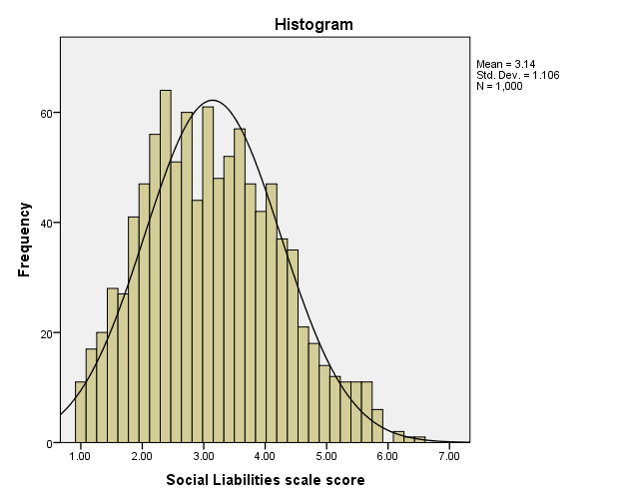
Phase 3: Instrument refinement
Overall Employee Social Liability scale:
25 items
Coefficient alpha = .94
Reciprocity-cooperating items reverse scored
High scores = high social liability
Mean = 3.14; SD = 1.11; SE = .03
Median = 3.07
Mode = 2.79

Slide 12
CFA Fit indices – In support of the second order, latent variable model
CFA Model | χ² | df | χ² / df | RMSEA | Confidence Interval | AGFI | CFI | TLI
Model 1 25 items on 1 factor | 6286.31 | 275 | 22.86 | .148 | .145 to .151 | .502 | .653 | .622
Model 2 25 items on 4 factors | 1800.12 | 269 | 6.69 | .075 | .072 to .079 | .828 | .915 | .906
Model 3 22 items on 4 factors | 509.44 | 187 | 2.72 | .042 | .037 to .046 | .939 | .979 | .974
Model 4 22 items on 4 factors on 1 second-order | 525.94 | 184 | 2.86 | .043 | .039 to .047 | .935 | .978 | .972

Slide 13
Second order, latent variable model

Slide 14
6. Nomological network
Variables | M | SD | 1 | 2 | 3 | 4 | 5 | 6 | 7 | 8 | 9 | 10 | 11 | 12 | 13
1 ESL – 25 item | 3.09 | 1.09 | .94
2 Negative Relationships | 3.31 | 1.62 | .91 | .94
3 Distrust | 3.44 | 1.45 | .81 | .63 | .82
4 Social Distractions | 3.18 | 1.19 | .78 | .59 | .55 | .84
5 Cooperation (lack of) | 2.53 | 1.01 | .79 | .59 | .67 | .43 | .90
6 Neuroticism | 2.62 | 1.02 | .31 | .29 | .22 | .25 | .22 | -
7 Extraversion | 3.08 | 1.03 | -.15 | -.13 | -.12 | -.15 | -.11 | -.33 | -
8 Conscientiousness | 4.38 | 0.70 | -.12 | -.10 | -.07 | -.14 | -.08 | -.20 | .11 | -
9 Emotional Intelligence | 3.68 | 0.48 | -.40 | -.34 | -.32 | -.30 | -.37 | -.53 | .33 | .40 | .92
10 Organisational Deviance | 2.10 | 0.97 | .29 | .26 | .21 | .28 | .17 | .14 | -.04 | -.39 | -.29 | .83
11 Interpersonal Deviance | 1.68 | 0.82 | .27 | .28 | .19 | .22 | .17 | .05 | .04 | -.24 | -.24 | .52 | .83
12 Friends at work | 4.59 | 1.26 | -.53 | -.44 | -.50 | -.26 | -.64 | -.18 | .25 | .04 | .31 | -.11 | -.06 | .89
13 Manager Support | 4.97 | 1.47 | -.66 | -.57 | -.57 | -.37 | -.70 | -.17 | .10 | .05 | .30 | -.19 | -.17 | .56 | .95
 |  |  |  |  |  |  |  |  |  |  |  |  |  |  | alphas

Slide 15
6. Where to next?
Test for outcomes: Four seem obvious to us. The impact on employee engagement, well-being, career success, and work group cohesiveness. We would also anticipate that these in turn impact on both individual and organisational performance.
The proposed theoretical model …

Slide 17
Thank you.
Questions?

