Slide 1

Alison McIntosh, Claire Flemmer, Simon Darcy & Brielle Gillovic
Enabling accessible and inclusive tourism:
Lessons from New Zealand and Australia

Slide 2
Accessible and inclusive tourism
The access tourism market represents 25% of global tourism.
‘Accessible and inclusive tourism’ emphasises tourism for all.
Enables people with access requirements to engage independently and with equity and dignity in tourism.
Access and inclusion need to be enabled across the whole visitor journey (ISO 21902:2021 – Accessible Tourism For All).
Barriers to access remain and efforts toward UD are slow (Flemmer & McIntosh, 2024).

Slide 3
Accessibility information in New Zealand
Accurate, reliable, detailed information – and the appropriateness of its format and delivery – is critical to people with disability making informed, individualised decisions during the planning process (Domínguez Vila et al., 2019; Eichhorn et al., 2008).
The digital provision of accessibility information is an enabler or barrier to tourism participation (Darcy & Buhalis, 2011).

Slide 4
Tourism agencies invest in digital provision of accessibility information
Digital provision of accessibility information gives a competitive advantage to businesses, stimulates latent tourism demand, and reaches a previously untapped market (Darcy & Pegg, 2011).
National tourism agencies are investing in back- and front-end provision of accessibility information and resources for businesses and regions on their websites (e.g., Australia, England, Portugal, Scotland, Spain).

Slide 5
Ministry funding and project deliverable
We were recipients of funding for Ministry’s ‘Innovation Programme for Tourism Recovery’.
We conducted a feasibility study of our innovation, which was a digital platform for an accessible and inclusive New Zealand visitor journey.
The project focused on:
  Concept validation or testing of the innovation.
  Sourcing relevant partners, expertise, or skillsets.

Slide 6
Digital platform for an accessible and inclusive New Zealand visitor journey
Provision of accessibility information for visitors via a digital platform, housed and promoted nationally and regionally (i.e., database and app).
Access to useful toolkits and resources for businesses and regions.
Facilitation to embed accessibility and inclusion in region’s Destination Management Plans.
Transformation that is not premised on accessibility auditing.

Slide 7

Providing tourism businesses and organisations with the ability to better service the accessibility sector. www.goacccess.travel
November 2024

Slide 8

Current Environment
There has been no simple industry-wide method of easily collecting and displaying accessibility information and presenting it for consumers;
There are some websites that provide accessibility information for consumers but there are limitations:
  a focus on mobility, particularly on wheelchair dependence, when for many people wheelchair access is not relevant;
  a tendency towards compliance standards and ‘scoring’ the level of accessibility; and
  the number and type of establishments (mainly accommodation) listing their access information.
No industry-wide collection
Focus on mobility or specific types of businesses

Slide 9
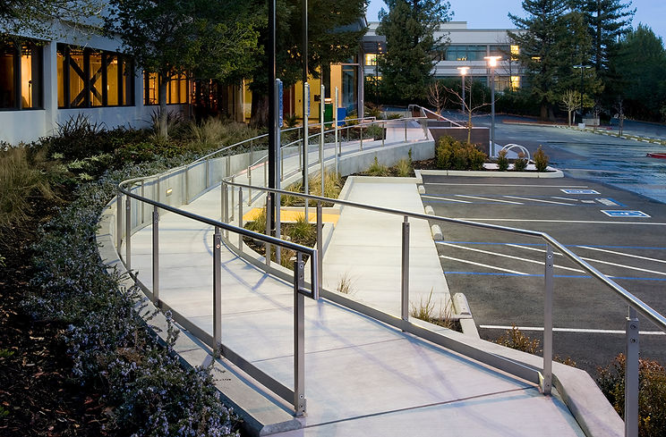
Features & Benefits
Go Access Travel
is an easy-to-use digital platform for tourism businesses to deliver accessibility information to consumers;
provides clear information for informed decision making via channels consumers already know;
is a scalable commercial-grade industry-wide solution; and
can simultaneously feed data to the business’s own website, hotel chain websites, other aggregators and booking systems, thus improving efficiency.
Easy to use
Commercial Grade Platform
Feed data to all websites

Slide 10
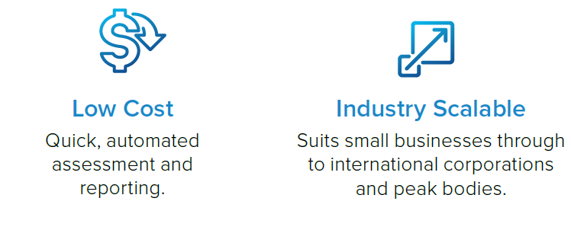
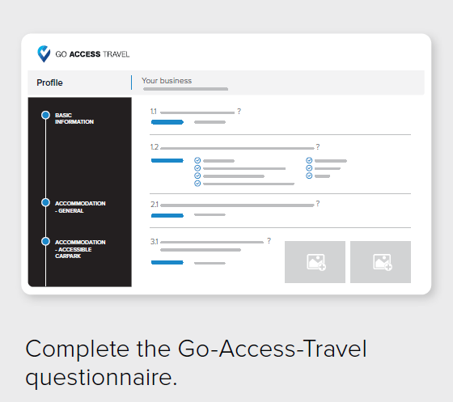
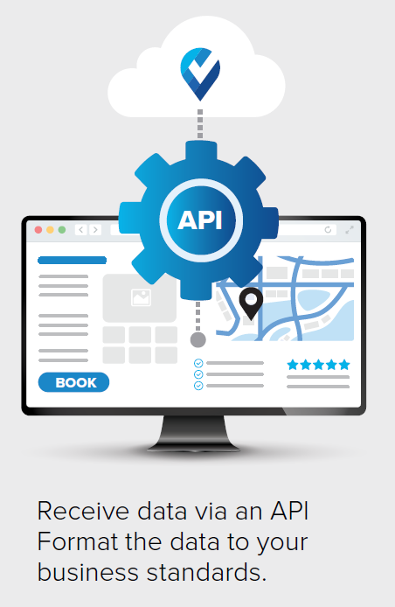
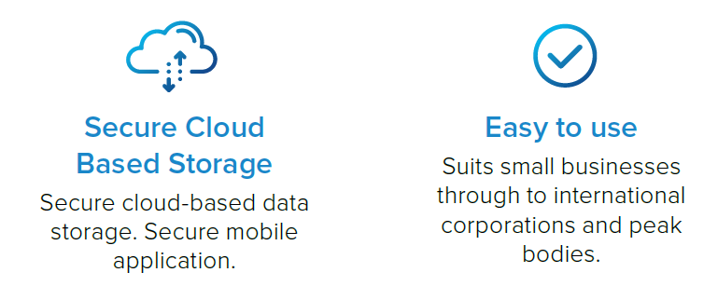
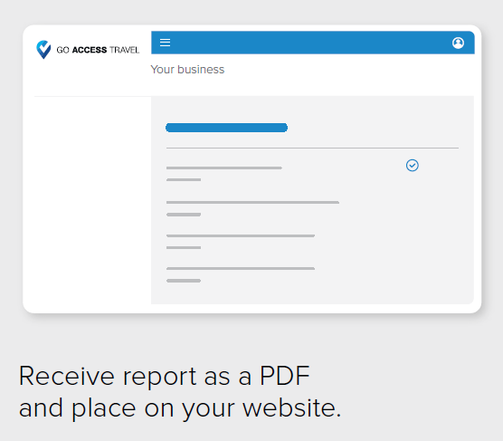
How it works
Complete Questionnaire
PDF Report
API transfer of data to websites

Slide 11



Partners
Prof Simon Darcy is an internationally renowned academic and researcher providing strategic advice to organisations on improving organisational inclusion of people with disability in the venue, transport, travel, sport, employment and accessible tourism sectors.
Equal Access is one of Australia’s leading Universal Design and Disability Access and Egress Consultancies. Led by founder Bruce Bromley, its personnel are accredited with ACAA Inc and provide a specialist consulting service to enhance the built environment for members of the community with disability. www.disabilityaccessconsultants.com.au
NEM Australasia is a leading boutique consulting firm to private businesses and industry associations with expertise in the hotels, tourism and leisure sectors. www.nem.net.au
Compliance Experts assist local and international organisations in reducing the complexity and cost of compliance, through systematic and controlled digital processes. Go Access Travel is built on Compliance Expert’s industry leading platform Compliance Checkpoint. www.complianceexperts.com
David Sinclair, a senior executive with a robust understanding of the disability sector (recently retired as CEO of ATSA), and the building of new business ventures. David understands critical business drivers and excellence in client experience philosophy.

Slide 12
Conclusion
The tourism sectors in New Zealand and Australia have generally failed to address the lived experiences of tourists with disabilities.
Without commitment, changes to infrastructure, industry attitudes and information provision, individuals with disabilities will remain unable to assume the role as tourist (Gillovic et al., 2024).

Slide 13
References
Darcy, S., & Buhalis, D. (2011). Conceptualising disability. In D. Buhalis & S. Darcy (Eds.), Accessible tourism: Concepts and issues (pp. 21-42). Channel View Publications.
Darcy, S., & Pegg, S. (2011). Towards strategic intent: Perceptions of disability service provision amongst hotel accommodation managers. International Journal of Hospitality Management, 30(2), 468-476. https://doi.org/10.1016/j.ijhm.2010.09.009
Domínguez Vila, T., Alén González, E., & Darcy, S. (2019). Accessible tourism online resources: A Northern European perspective. Scandinavian Journal of Hospitality and Tourism, 19(2), 140-156. https://doi.org/10.1080/15022250.2018.1478325
Eichhorn, V., Miller, G., Michopoulou, E., & Buhalis, D. (2008). Enabling access to tourism through information schemes? Annals of Tourism Research, 35(1), 189-210. https://doi.org/10.1016/j.annals.2007.07.005
Flemmer, C., & McIntosh, A. (2024). Equitable access to the built environment for people with disability. 14th Annual International Conference on Architecture (ATINER 2024), 8-11 July 2024, Athens, Greece.
Gillovic, B., McIntosh, A., & Darcy, S. (2024). The disabled tourist: Navigating an ableist tourism world. Emerald Publishing.

Slide 14
Thank you for listening!

