Slide 1
STLHE 2014
Transforming Our Learning Experiences Conference
Queen’s University, Kingston Ont., Canada
June 18-20, 2014
Transformative learning and teaching
through inclusiveness, power-sharing and critical enquiry
Alice U-Mackey and Maria Hayward
alice.u@aut.ac.nz; maria.hayward@aut.ac.nz
School of Language and Culture
Auckland University of Technology

Slide 2
Presentation Overview
Introduction
Theoretical underpinnings
Research project
Intercultural Education Program model
Significant findings
Conclusion
Notes:
Programme designed as a critical multicultural settlement programme – but this paper sought to emphasise the intercultural skill development which it was argued is enhanced via this post-critical approach.

Slide 3
Introduction
Brief background
Settlement requires knowledge and skills
Lacuna of programs with focus on rights, inclusiveness,
power-sharing, critical enquiry, intercultural exchange
Model developed and piloted
Participants newly-settled refugees from Burma/Myanmar
Notes:
AUT, MSD, Jacqueline Mortimer-Hughes - contribution to the programme and the research project
Developed and piloted a prog to support settlement of recently arrived Burmese, based on crit, enq, rights, intrecult exch, inclusiveness

Slide 4
Theoretical underpinnings – Interculturalism
Liddicoat (2002): culture as highly variable and constantly changing phenomenon; dynamic approach.
Alred, Byram and Fleming (2006): analysing the intercultural experience and acting upon this; taking on other’s perspective; ethical issues (own assumptions etc.).
Bennett (2009, p.52): ‘… increased awareness of subjective cultural context (worldview), including one’s own, and developing greater ability to interact sensitively and completely across cultural contexts as both an immediate and long-term effect of exchange’
May and Sleeter (2010): The concept that culture is concrete is extremely outdated.
Perry and Southwell (2011, p. 454): ‘…move to intercultural competence, which builds on intercultural understanding by including behaviour and communication’
Notes:
Skills are intercultural competence skills which are:
Understanding one’s own culture
Understanding new culture
Interacting effectively through modified behaviour and taking on other’s perspective
Both teachers and learners are involved in this learning and changing (transformative) process

Slide 5
Theoretical underpinnings - Critical Pedagogy
Ager and Strang (2008): Integration is two-way and non-conformity-oriented; Intercultural skills required
May and Sleeter (2010): CP: Voice, dialogue, power, social class.
McPherson (2010, p.550): Integration can ‘reflect a view that social cohesion is best achieved through greater levels of conformance by newcomers’.
Byram, Holmes and Savvides (2013, p.251): ‘Teachers and learners now need to be ‘aware’ of other people’s ‘cultures’ as well as their own’.
Notes:
Inclusiveness was seen to be an important aspect of definition of integration.
Using the broader definitions (of integration) of these people which include: Socially connected, participating, 2-way, non-conformity
CP is….
Used a critical pedagogy approach to develop intercultural skills that support integration

Slide 6
The Research Project
Aim: To document implementation and effectiveness of program
Methods: Audio-taped observations, focus group discussions,
facilitator reflections
Participant profile:
Number | Gender | Age | Time in NZ | Reason for sampling this group
20 (regular) 6 (less reg.) | 16 (males) 4 (females, regular) 6 (females, less regular) | 25-45 | 2 months – 2 years | -newly settled -identified by refugee social service agency as a group that would benefit from this type of program
Notes:
We conducted research to document the effectiveness of the programme which was developed with integration and interculturalism in mind

Slide 7
The Intercultural Programme Model
Aims:
Enhance settlement and integration
Impart knowledge alongside intercultural skills
Incorporate sharing of culture, opinions, ideas
Encourage and develop critical enquiry skills
Program: 20 sessions (6 months)
Topics: family and gender roles, making friends, discrimination, bullying, nutrition, gardening, alcohol & drug abuse …

Slide 8
The Intercultural Programme Model
Based on a model by Hayward (2007)
Designed to support re-instatement of power (agency) and equality (Bennett, 2009; Byram & Feng, 2004)
‘Rights-based’ approach (right to safety, freedom of speech and belief, gender equality, respect; right to healthcare and education entitlement (United Nations General Assembly, 1948)
Inclusiveness, critical reflection, empowered decision-making
Facilitator – specific skills, attributes
Notes:
a ‘rights-based’ approach, i.e:, each programme topic would be framed within a context of enhancement of rights, such as the right to safety, freedom of speech and belief, gender equality, respect, and the right to healthcare and education entitlement (United Nations General Assembly 1948).
Not a language-based programme, not information transmission, but a two-way exchange of ideas, experiences, and problem-solving

Slide 9
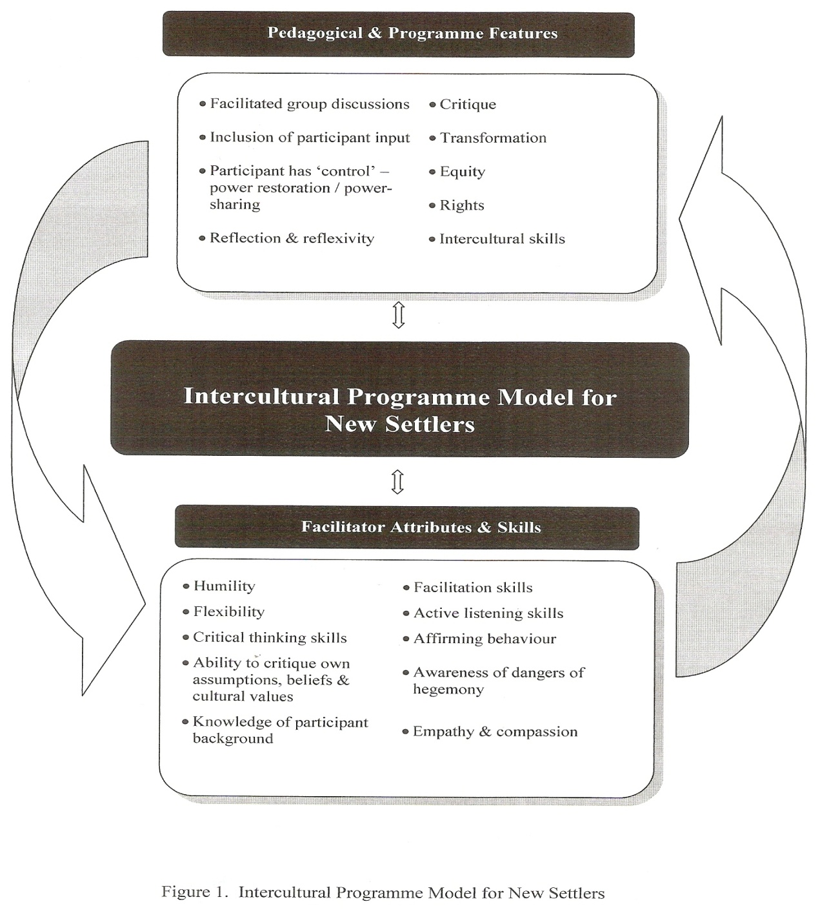
The Intercultural Programme Model for New Settlers
(Hayward & U-Mackey, 2013, p. 432)
Notes:
Nb: knowledge of the refugee experience was essential for the pilot program with former refugees – for other contexts, it might be useful to know generally about the reasons for migration of the various groups of learners

Slide 10
Sample Lesson Plan
Introduce topic
Elicit existing knowledge and identify gaps
Present new information to fill gaps
Compare and contrast
Elicit possible reasons for differences
Ask how individuals think they will manage the changes or differences – which ones will they have no choice about (e.g. legal)
What about social, behavioural differences? Will they adapt or not? How? What are the consequences for both pathways/choices?

Slide 11
Old Age Care
(Sample delivery)
Eliciting existing knowledge and identifying gaps:
What is old age care?
How do people care for the elderly population in your countries?
In NZ? (create a table reflecting different models)
What are the advantages and disadvantages of each item on the list?
Enquire about any changes in thinking during this process

Slide 12
Significant Findings
Inclusiveness:
Selection, prioritization and duration of topics by participants
Equality of input across genders and ages
Power-sharing:
Choices, decisions shared
Opinions, ideas, criticisms invited
Critical Enquiry:
Disparities between social practices/laws highlighted
Interrogation about possible rationale, positives and negatives
Critical reflection required by all

Slide 13
Significant Findings
Intercultural knowledge and skills:
Cultural knowledge exchanged and gained
Cultural identity acknowledged
Awareness of intercultural differences and similarities
Understanding of others’ perspectives, values and beliefs
Questioning/Criticality of own values and beliefs
Transformation of behavior, attitudes, interactions
Notes:
Findings grouped in these four categories

Slide 14
Sample Participant Quotes
Inclusiveness
‘They include us in the class discussions; NZ teachers are different because they ask us for opinions’
Power-sharing
‘We have not had power or rights before’
Critical enquiry
New Zealanders ‘don’t love their elderly population because they put them in retirement homes without their families’
‘The teachers encourage us to tell them about our culture which they don’t know’
‘I can tell my family about many things. I feel important. I also have knowledge like my children’
‘The teachers listen to us and ask us about ourselves’
‘Our husbands are now more understanding and so, of course, we love them more’
‘I’m not scared to talk here. We can talk and ask questions just like friends’
‘Before this course, I thought women have too many rights in New Zealand and don’t listen to the men, but now I understand more and I help my wife in the house’
Notes:
NB: Participant QUOTES for inclusiveness, power-sharing, critical enquiry are also examples of intercultural awareness; comparison between own and new culture , intercultural knowledge and skills, behaviour, attitudes, change

Slide 15
Conclusion
Programme design validated
Responsive to/inclusive of participants
Interculturalism enhanced through participation and exchange
Critical pedagogy supported process and skills development
Transformative learning experiences/effect on participants
Flexible programme model can be applied to other courses according to learners’ needs and ability levels

Slide 16
Thank you for your interest
and participation.
Any questions?

Slide 17
References
Ager, A. & Strang, A. (2008). Understanding Integration: A Conceptual Framework. Journal of Refugee Studies 2, no. 2: 166-191.
Alred, G., Byram, M. & Fleming, M.P. (2006). Education for Intercultural Citizenship: Concepts and Comparisons. Clevedon, UK: Multilingual Matters.
Bennett, M. J. (2009). Defining, measuring and facilitating intercultural learning: a conceptual introduction to the intercultural education double supplement. Intercultural Education 20, sup1: S1-S13.
Byram, M. & Feng, A. (2004). Culture and language learning: Teaching, research and
scholarship. Language Teaching 37 (3), pp. 149-168.
Byram, M., Holmes, P. & Savvides, N. (2013). Intercultural communicative competence in foreign language education: questions of theory, practice and research. The Language Learning Journal, Vol. 41 (3), pp. 251-253. DOI:10.1080/09571736.2013.836343
Hayward, M. (2007). Applying post-critical approaches to refugee-centred
education, Unpublished MA thesis. Auckland, NZ: AUT University.
Hayward, M. & U-Mackey, A. (2013). Inclusiveness, power sharing and critical
enquiry: intercultural programme model for new settlers. Intercultural Education, Vol. 24 (5), pp. 430-441. DOI:10.1080/14675986.2013.844471
Liddicoat , A. (2002). Static and dynamic views of culture and intercultural
language acquisition. Babel, Vol. 36, No. 3, pp. 4-11.
May, S. & Sleeter, C.E. (2010). Critical Multiculturalism: Theory and Praxis. New York: Routledge.
McPherson, M. (2010). ‘I integrate, therefore I am’: Contesting the normalizing discourse of integrationism through conversations with refugee women. Journal of Refugee Studies Special Issue: Critical Reflections on Refugee Integration: Lessons from International Perspectives 23, no. 4: 546-570.
Perry, L.B. & Southwell, L. (2011). Developing intercultural understanding and skills: models and approaches. Intercultural Education 22, no. 6: 453-466.
United Nations General Assembly. (1948). The Universal Declaration of Human Rights. Retrieved from http://www.un.org/en/documents/udhr/

