Slide 1
Links between gambling availability, participation and harm – a 28 year New Zealand case study and relevant findings from Sweden and Victoria
‘More than just a game: where gambling begins and ends’
25-27 November 2015
Stamford Plaza Hotel, Adelaide, Australia
Max Abbott
Gambling and Addictions Research Centre
Auckland University of Technology, Auckland, New Zealand
Email max.abbott@aut.ac.nz

Slide 2
Introduction
“Gambling, like rust, never sleeps. Neither does the host, nor society.”
Gambling participation & gambling-related harms change over time – driven by:
Gambling mix & availability
Economic, demographic & social factors
Adaptation – individual, societal

Slide 3
Unprecedented expansion of legal, commercial gambling in recent decades
Some gambling forms strongly associated with problem gambling
Gambling participation & gambling-related harms including social costs not randomly distributed
Problem gambling – males, young adults/teens, low income, single marital status at high risk
Some studies – also low occupational status/education, minority ethnic status, large city residence

Slide 4
Availability, exposure & adaptation
Abbott et al (1999; 2004) & Shaffer et al (2004)
Maintain relationships between availability & problems/harms complex
Consideration needs to be given to
  availability, exposure, exposure duration
  individual & environmental factors that moderate exposure effects

Slide 5
Hypotheses
Abbott (2006)
During exposure to new gambling forms, particularly EGMs and other continuous activities, previously unexposed individuals, population sectors & societies are at high risk for the development of gambling problems
Over time – years rather than decades – adaptation (‘host’ immunity & protective environmental changes) typically occurs and problem levels decrease, even in the face of increasing exposure
Adaptation can be accelerated by regulatory & public health measures
While strongly associated with problem development, EGMs give rise to more transient problems

Slide 6
Traditional public health model
Vector
(transmission)
Agent
Host
Illness or death
1
2
3
4
Strategies
Eliminate or reduce prevalence and / or distribution of agent (1)
Prevent or reduce transmission (2)
Strengthen host resistance (3)
Secondary and tertiary prevention (4)
More complex in the case of NCDS
Multicausal – target multiple risk and protective factors
Prevalence reduced by reducing incidence and duration of harms

Slide 7

Availability hypothesis
Participation
(‘Exposure’ / ‘Consumption’
- type, dose, duration)
Availability
+
-
-
Harms
Total consumption model

Slide 8
Adaptation hypothesis
Environment
Environment
-
-
Availability
Participation
Harms
Host
Host

Slide 9
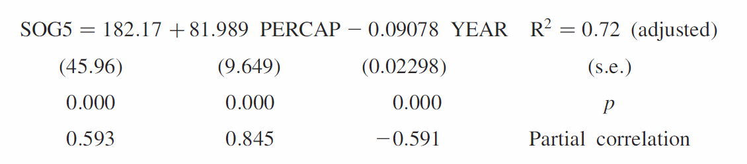
Studies suggest both exposure and adaptation occurring
Storer, Abbott & Stubbs (2009)
Study examined 34 Australian and New Zealand prevalence studies in relation to EGM density and time
Multivariate linear regression
Prevalence increases with increasing EGM density – predicts increase of 1 EGM in an area results in an increase of
0.6-1.0 problem gamblers
Prevalence decreases with time – annual decrease of
0.09% (1.14-0.04%)

Slide 10
Study examined 190 prevalence studies in relation to time
R.J. Williams., R.A. Volberg., R.M.G. Stevens. 2012 The Population Prevalence of Problem Gambling: Methodological Influences, Standardized Rates, Jurisdictional Differences, and Worldwide Trends. Report Prepared for the Ontario Problem Gambling Research Centre & the Ontario Ministry of Health and Long Term Care

Slide 11
Some risk factors changing
In part related to changed gambling mix
New Zealand 1991-1999 - problem gamblers “feminised, aged & moved a little upmarket”
Followed introduction of EGMS, casinos & diversification of lottery products
‘Feminisation’ also in Australia, some parts of North America
Significant reduction in regular participation in continuous forms & problem prevalence – but some groups continue to be at elevated risk

Slide 12
New Zealand: Changes 1985-2012
• Prior to the 2012-2016 survey, DIA national participation and attitude surveys in 1985, 1990, 1995, 2000, 2005 – past year participation increased from 85% to 90% (1985-1990), stayed around 90% during the 1990s, and reduced to 80% (2005-2012)
• Large national gambling/problem gambling studies in 1991 and 1999 – replicated DIA findings
• New forms of gambling introduced from 1987 - expenditure rose sharply from 1987-1990 then more gradually until 2003
• Since 2004, gambling expenditure stayed constant but dropped 20% when inflation-adjusted (primarily due to reduced EGM expenditure)
• EGM venues and numbers reduced since 2004 (2004 - 25,221; 2015 – 16,440)

Slide 13
• Past year and past week participation in almost all forms peaked during the few years after introduction and declined steadily thereafter
• Weekly Lotto participation fell from 42% to 17%, Instant Kiwi 13% to 3%, raffles 7% to 3%, non-casino EGMs 5% to 1%, track betting 4% to 1%
• From 2005 - 2012 past year and weekly participation continued to decrease for most more popular activities including non-casino EGMs
• From 1999 to 2012 reductions across almost all demographic groups, especially weekly participation (particularly large for 34 years and younger; exceptions – aged 65+, lacking formal qualifications, unemployed, Pacific Islanders, Asians)
Participation in four or more activities 22% (2012) has decreased since 2005 (28%) and a high point of 40% during the 1990s

Slide 14
Reasons for gambling/not gambling
Reasons given for gambling vary by gambling type and have stayed much the same since 1985
Exception – considerable increase in numbers gambling to win prizes or money (especially Lotto, Keno, housie, EGMs, sports betting, casinos)
For a few years after new forms introduced moderate to large percentages say they participate out of curiosity
Reasons for not gambling: moral or religious (43%), lack of interest (31%), waste of money/other priorities (29%), chances of winning not good (14%), can’t afford it (9%), addictive/leads to problems (8%)

Slide 15
DIA Surveys and NGS

Slide 19
Participation in gambling activities at a frequency of at least once a week
(1985-2012)
Gambling activity | Frequency of participation %
 | At least once a week
 | 1985 | 1990 | 1995 | 2000 | 2005 | 2012
Lotto |  | 35 | 35 | 30 | 21 | 17
Keno | - | - | 2 | 1 | 1 | <1
Instant Kiwi or other scratch ticket | - | 14 | 10 | 9 | 6 | 3
Housie | 2 | 2 | 2 | 1 | 1 | <1
Horse/dog race betting | 5 | 4 | 3 | 2 | 3 | 1
Sports betting |  |  |  | 1 | 1 | 1
Casino gambling | - | - | <1 | 1 | <1 | <1#
Non-casino EGMs | - | 5 | 3 | 3 | 3 | 1

Slide 20
Methods to moderate gambling
A third used one or more methods (setting money limits most common, also separating gambling and other money, setting time limits, avoiding venues, leaving ATM and credit cards at home)
More frequent for weekly continuous gamblers (46%) than weekly non-continuous (33%) and infrequent (26%)
More frequent among higher spenders
Large majority said effective

Slide 21
Table 3: Views on the reason for having gambling: 1985-2012
Gambling activities should be for: | Views on having gambling %
 | In favour |  |  |  |  |  | Not in favour
 | 1985 | 1990 | 1995 | 2000 | 2005 | 2012 | 1985 | 1990 | 1995 | 2000 | 2005 | 2012
Fundraising for worthy causes | 94 | 93 | 94 | 92 | 84 | 85 | 4 | 6 | 6 | 7 | 15 | 14
Profit sharing promoter/ cause | - | - | 71 | 69 | 55 | 58 | - | - | 26 | 27 | 40 | 41
Sales promotion | 47 | 56 | 50 | 55 | 45 | 53 | 45 | 39 | 46 | 41 | 50 | 46
Business enterprise | 22 | 26 | 32 | 31 | 22 | 25 | 72 | 67 | 63 | 65 | 73 | 74
A means of raising government revenue | 38 | 26 | 25 | 25 | 18 | 26 | 54 | 68 | 72 | 71 | 78 | 73

Slide 22
Table 4 Views on socially undesirable activities: 1985-2012
Gambling activity | Views of social undesirability %
 | 1985 | 1990 | 1995 | 2000 | 2005 | 2012
Online gambling | - | - | n/a | 53 | 68 | 55
Non-casino EGMs | 38 | 30 | 36 | 45 | 64 | 57
Casino table games or EGMs | - | - | 38 | 54 | 59 | 47
Text games or competitions | - | - | 67 | 56 | 53 | 39
Horse/dog race betting | 10 | 21 | 26 | 35 | 39 | 20
Sports betting | - | - | 35 | 26 | 30 | 18
Housie or bingo | 9 | 14 | 17 | 15 | 19 | 7
Keno | - | - | 16 | 12 | 17 | 7
Lotto | 19 | 13 | 12 | 12 | 16 | 4
Instant Kiwi or other scratch tickets | - | 16 | 12 | 10 | 14 | 4
Raffles | 3 | 8 | 9 | 9 | 9 | 2
All/any depending on the person | - | - | - | 1 | 1 | 11
None of these | 35 | 29 | 13 | 17 | 11 | 16

Slide 24
Change over time – problem gambling
Prevalence decreased significantly during the 1990s and since plateaued
When adjusted for methodological differences no significant changes from 1999 to 2012 in lifetime probable pathological and problem gambling
When adjusted for methodological differences no significant changes in PG and MRG from 2006 to 2012 (2006/07 and 2011/12 NHS and 2012 NGS)

Slide 25
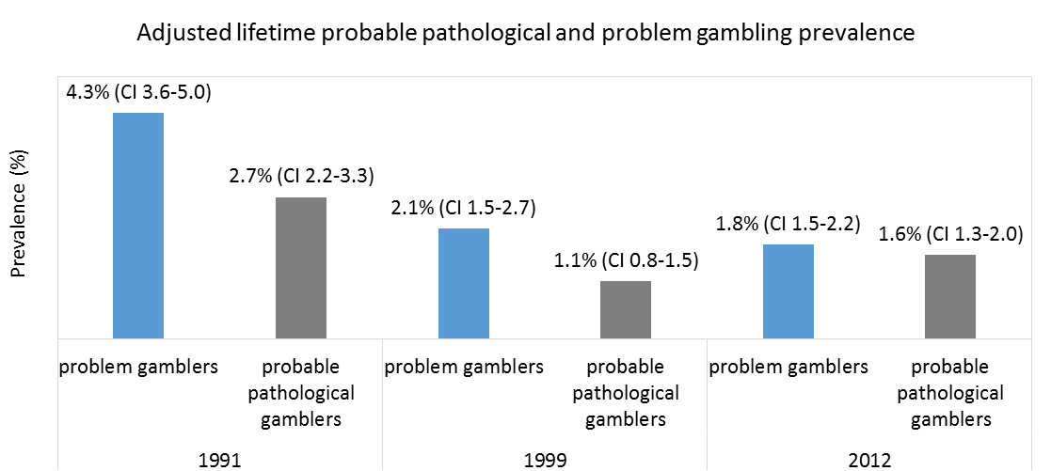

Slide 26
Risk factors - demographic
2012 - 6.2% of Maori PG or MR compared with 8% Pacific Islanders, 3% Asians and 1.8% European/Other
(Maori and Pacific Islanders also higher prevalence in all previous studies)
Males: 1 in 8 Pacific, 1 in 16 Maori, 1 in 22 Asian and 1 in 48 European/Other PG or MR
Females: 1 in 20 pacific, 1 in 15 Maori, 1 in 67 Asian and 1 in 72 European/Other PG or MR
Multivariate analyses identified Maori and Pacific Island ethnicity as the main risk factors for current problem gambling, followed by male gender
Additional risk factors for combined PG and MR: younger age, lack of formal qualifications, unemployment, living in most deprived deprivation quintile
Anglicans low risk and Other Christians and Other Religions high risk
Some of these groups – Pacific Islanders, Asians, younger age, Other Christians, Other Religions have low levels of gambling participation

Slide 27
Gambling risk factors and comorbidities
Regular continuous gamblers (23% PG or MR), preferences for and
monthly or more frequent participation in EGMs and a number of other continuous forms, participation in multiple activities and high expenditure
A third of problem gamblers believe their spouse or partner has a problem relative to 2% non-problem, 4% LR and 12% MR
As in previous studies PG (and MR and LR to varying degrees) had high rates of hazardous drinking, tobacco use, other drug use, self-rated poor health, psychological distress and low quality of life
Problem gamblers much more often experienced major life events and experienced deprivations (e.g. forced to buy cheaper food, unemployment, income from benefits, put up with cold to save heating costs)

Slide 28
Sweden
First national survey 1997/98 – Swedish Gambling Study (Swegs) N=7,139; response rate 72%; second survey 2009 (Swelogs) N=8,165; response rate 55%
SOGS-R probable pathological gambling prevalence 0.6% (NZ 1999 0.5%)
Males, young adults, disadvantaged social groups high risk (as in NZ in 1991 but less so in 1999)
Abbott et al (2004) predicted risk factor changes if EGMs became widely distributed and casinos introduced
EGMs reintroduced 1996, 4 casinos 2000s, Internet – regulated & unregulated
1998-2008 gambling expenditure +13% but remained 3% of household disposable income

Slide 29
Gambling participation
1997/ 98 – 1998/09
Past year participation reduced significantly
Only poker higher
All others lower – sports (-50%), EGMs (-31%), table games (-31%), lottery (-25%), bingo (-25%)
Past month participation also reduced significantly
Lower - lotteries, sports, casino table games, bingo
No change – track
Higher – EGMs, poker

Slide 30
Gambling – socio demographics
Overall participation declined across all major demographic groups
Greatest decline in ages 16-17 & 18-24
Both surveys – participation higher for males, age 25+, Swedish born, live outside large cities, high school qualification, married
Increased poker participation confined to males (past year from 11.9% to 18.1%; past month 3.6% to 8.0%)
  Males 18-24 (past month from 8.0% to 19.3%)
  Males 25-44 (past month 3.4% to 11.3%)
  No significant change for males 16-17 or 45-74

Slide 31
Probable pathological and problem gambling
1997/98 SOGS-R (Past 12 months) probable pathological 0.6% (0.4-0.8); problem 1.4% (1.1-1.7)
2008/09 SOGS-R (Past 12 months) probable pathological 0.9% (0.7-1.1); problem 1.3% (1.0-1.6)
No significant changes in current probable pathological or problem gambling

Slide 32
Past year combined current probable pathological and problem gambling 1997/98 – 2008/09
Both surveys – males, younger adults/youth & single people higher prevalence
2008/09 – non-Swedish born, resident in big cities and non-University education higher prevalence
Significant increases for ages 18-24 (3.4% to 5.8%) & primary education only (2.0% to 3.4%)
Also significant age x gender differences
  Decrease for females age 25-44 (0.9% to 0.4%, p = 0.003)
  Increase for males age 18-24 (4.7% to 9.3%, p = 0.007)
  Increase in the proportion of probable pathological gamblers (29% to 40%, p = 0.05)

Slide 33
Multivariate analyses
Both studies – odds ratios higher for men, age under 25 and non-Swedish born
Ratios higher in 2008/09
In 2008/09 – odds ratios higher for big city residence & non-university education
In 1997/98 – odds ratios higher for single with children & lower for married without children
Note- younger people, non-Swedish born, big city residents, single with children have lower participation rates

Slide 34
Victoria
Since 1992, prior to the 2008-2012 survey, 9 state-wide participation surveys – yearly participation increased from around 75% in the early 90s, peaked at 86% and 87%, and decreased since 1997 to 77%-81%
Gambling expenditure rose sharply during the 1990s (increased four-fold from 1991-2001)
From 2001 to 2008 per capita expenditure reduced from $1,500 to $1,200 (from 3.5% to 2.5% of household disposable income)
EGM numbers capped but migrated

Slide 35
Comparisons: 2003 Victorian Longitudinal Attitudes Survey (N = 8,479 – core survey 1,758; response rate 35%) and 2008-2012 Victorian Gambling Study (N = 15,000; response rate 52%)
Gambling
Past year participation reduced from 77% to 73% (despite more forms being included in 2008 survey)
Past month and past week participation reduced more (48% to 41%; 31% to 23%)
Reductions in all popular activities and most others, including high risk continuous forms
Reductions across almost all demographic groups, especially monthly and weekly
Most substantial reductions for young adults, university graduates and people whose main language not English

Slide 36
Comparisons 2003 -2008
Problem gambling
When adjusted for methodological differences there are no significant changes in PGSI problem, moderate-risk and low-risk gambling
Males and people with lower education high prevalence in both studies (PG+MR)
In 2008 young adults and metropolitan residence emerged as additional groups with high rates (PG+MR) (note – both had low participation rates and large participation reductions)
In multivariate analyses migrants and being single without children emerged in 2003; speaking a language other than English at home in 2008 (latter group had low participation in 2008 and a large reduction since 2003)

Slide 37
In both 2003 and 2008 weekly and monthly table games, EGMs, sports and track betting and Keno were most strongly associated with PG+MR
The 2008 study made adjustments to take account of methodological differences between the 2003 and 2008 surveys, namely standardising the 2003 estimates for omitting non-weekly gamblers and regular Lotto and instant lottery participants
Many Australian surveys used similar methodologies to the 2003 survey
As proposed by Abbott (2000), this generated substantially lower estimates, especially for MR and LR gambling

Slide 38
Conclusions / questions
Availability and adaptation processes occur simultaneously and differentially across population sectors
Why have problems plateaued in some jurisdictions when participation has declined markedly?
How do we reduce harm further if reduced availability and/or participation do not lead to reduced harm?
Is adaptation to particular forms of gambling protective when novel forms of gambling and/or delivery are introduced?

