Slide 1
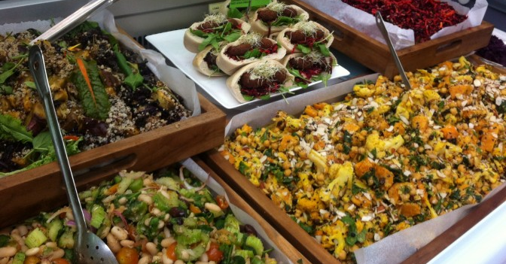
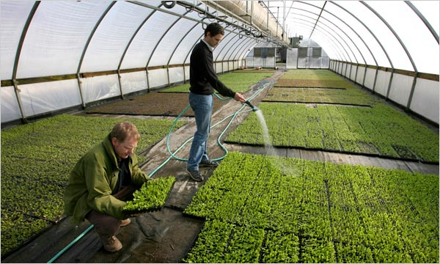
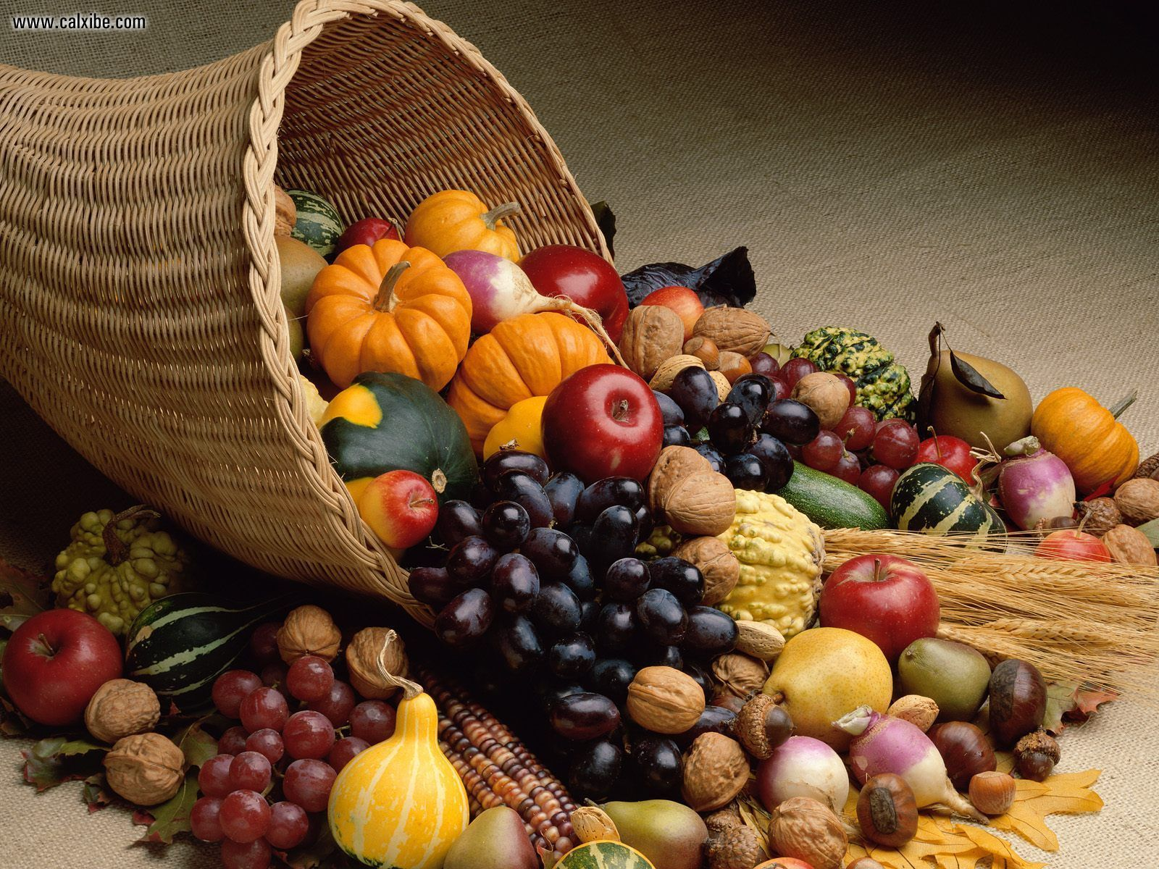

Eating on the fringe:
Influences on organic food consumption
Dr Jill Poulston, Faculty of Culture and Society

Slide 2
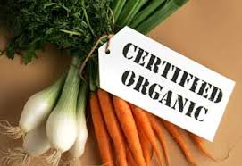
New Zealand Food Safety Authority regulations focus on production rather than the end product. Common themes are:
  Growing and processing without chemicals, fertilisers or genetically modified organisms;
  Using sustainable farming methods such as crop rotation and organic fertilising.

Slide 3
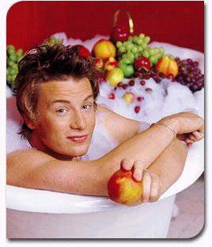
Consumers:
Educated, seeking quality food and healthy lifestyles
Influenced by health and environmental considerations
LOHAS and Cultural Creatives
In privileged locations where organic supermarkets predominate (e.g. Encinitas, California)
  Organic food is seen as the preserve of the middle classes, foodies, and the so-called hippy do-gooders (Jamie Oliver)
Notes:
Lifestyles of health and sustainability

Slide 4
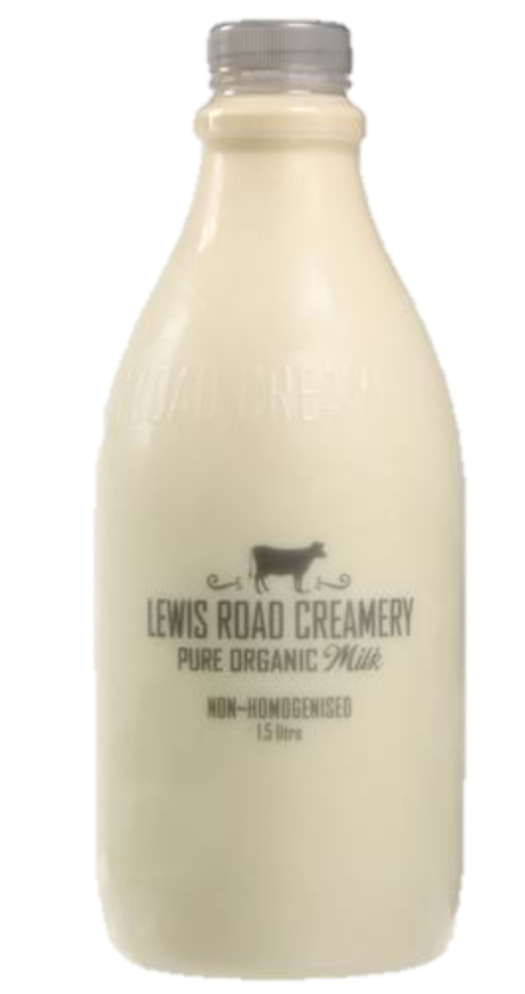
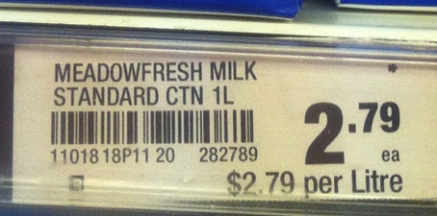
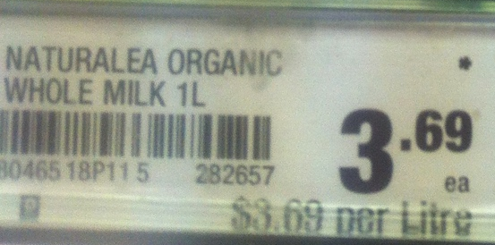
Exclusory factors…
Cost can be 50% - 75% more than conventional food
NZ organic milk is around $1 a litre more than standard milk, organic apples $2.00 or more a kg, and organic eggs, $6.00 more a dozen (July 2016).
Supply tends to be limited to specific urban areas.
Notes:
The World Cancer Report by the International Agency for Research on Cancer (IARC) has shown that New Zealand and Australia have the highest incidence rates of prostate and colorectal cancer in the world. What is it about New Zealand and Australia that increases the risk of developing these types of cancers?

Slide 5

Health effects
Research tends to focus on specific additives, producing confusing results
A meta-analysis of 162 papers found no nutritional advantage in eating organic food (Dangour et al., 2009)
A subsequent meta-analysis of 323 papers found higher anti-oxidants and less pesticide residue (Baranaski et. al., 2014)
  (Organic food by definition, is neither grown with, nor contains harmful additives such as preservatives)

Slide 6
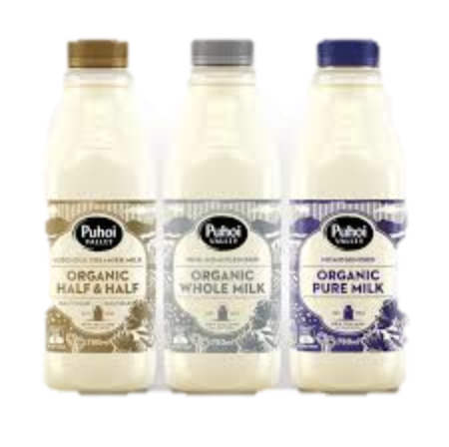
Organic milk
More protein and omega acids (Palupi et al., 2012)
Lower nitrates, more ascorbic acid (Koh et al., 2012)
More antioxidants (Hallmann, 2012)

Slide 7
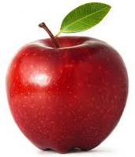
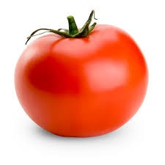
Taste differences
Several studies have found organic food tastes better (Radman, 2005).
Organic apples are firmer and sweeter than conventionally grown apples (Reganold et al., 2001)
Organic orange juice tastes better, but not
organic milk (Fillion & Arazi, 2002).
Conventional tomatoes are sweeter and better tasting (Gilsenan ey al, 2012)
More sweetness, acidity and flavour in organic tomatoes due to less nitrogen content (Heeb et al., 2005)

Slide 8
Research approach
Research question: what influences organic provision and consumption? (NZ is lagging behind the organic food trend)
Two datasets
  Restaurateurs serving organic food in NZ
  Organic consumers in Encinitas (USA) and Findhorn (UK)
Grounded Theory used for both studies. Data coded and categorised around themes relating to research questions.
Critical theory used to question beliefs about organic food and the reasons that led to them (see Lor, 2014)

Slide 9
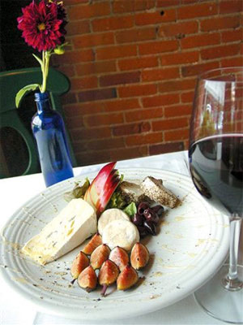
NZ restaurant owners
Interviews: one up-market restaurant and 4 cafés
Probed motives for offering organic menus
  (See Poulston & Liu, 2011)
Notes:
15 + 5 Q&A

Slide 10
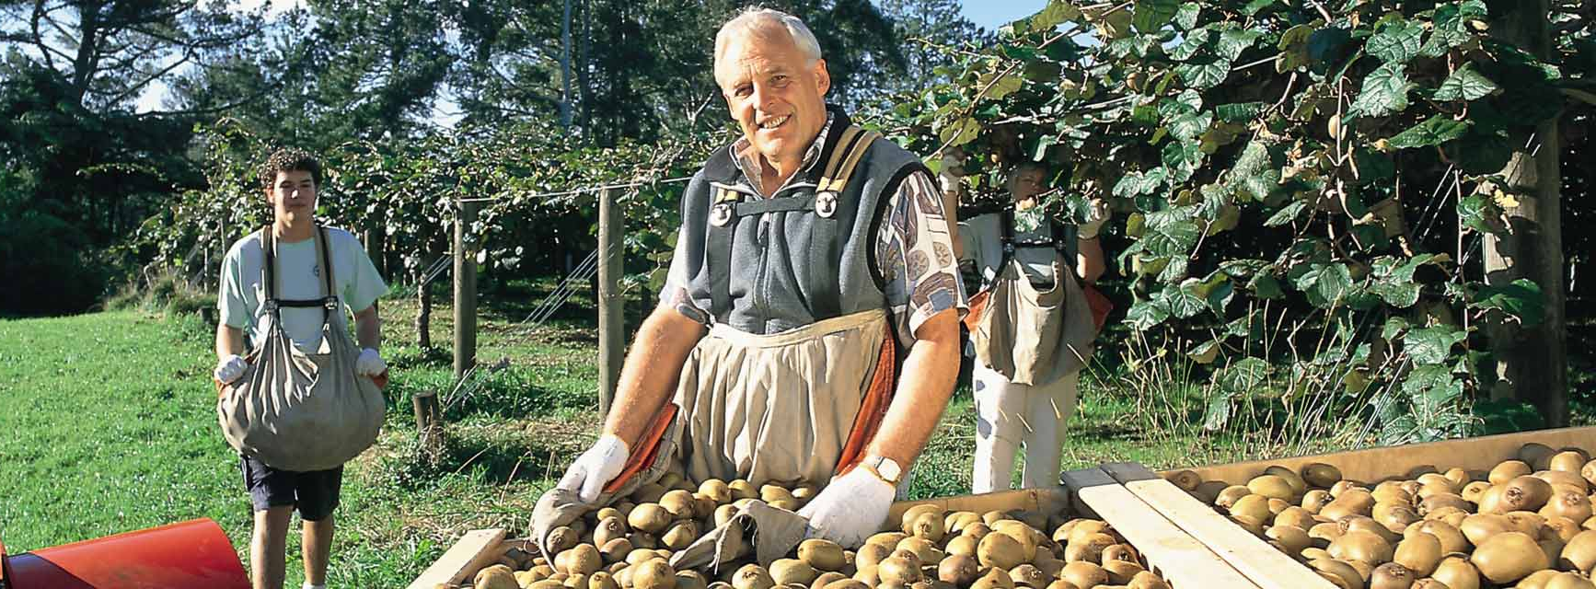
  Difficulties with price and supply
  You have to deal with so many different suppliers.
  It is very difficult to manage them… drive costs down.
  They are not used to service delivery, they have no idea, you know, they deliver when it suits them.
Notes:
Manet: Bar at the Folies Bergeres 1881

Slide 11
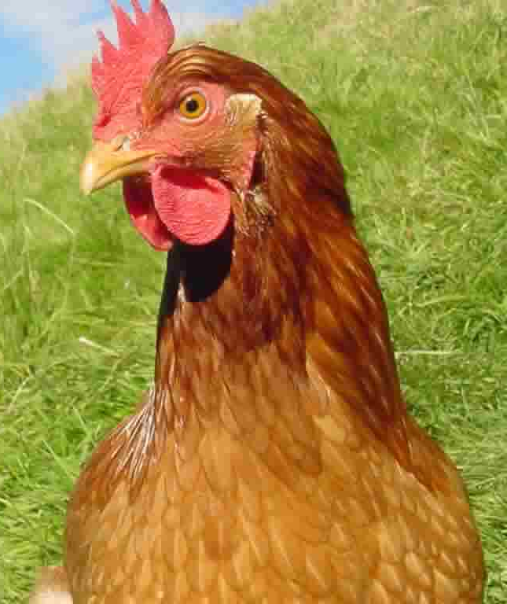
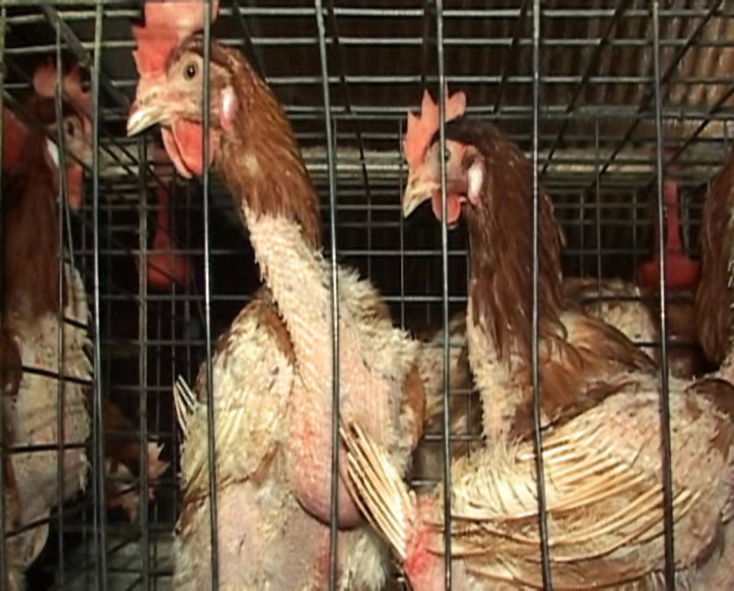
  Balancing green and profit values
  We strive for profit through a philosophy of sustainability.
  I source some organic produce that gives us a difference.
  I am not purchasing organic to save the world… I never thought about the environment until you said it.

Slide 12
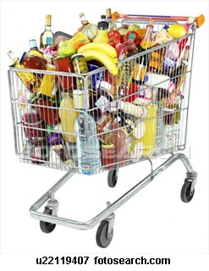
UK & USA data
Personal motives
Organic food tastes better and has more vitality
Natural food perceived as healthier
  Feels better in my mouth and stomach
  Protects my immune and digestive system
  I'm worth it, my family is worth it
  Supermarket food, it’s dead…
  Jimbo’s vegetables are happy vegetables
  Macbeth the butcher takes care of his animals and kills them humanely (Scotland)

Slide 13

  Avoiding pesticides and toxins
  There is already so much pollution in the environment and with the (conventional) food that we eat, we increase that
  Toxins, pesticides, and harmful micro-organisms create acidity in the body… and degenerative diseases thrive
  Chemicals harm my body and mind
  My neighbour died of leukemia associated with pesticides
  Regular food lacks micro-nutrients – minerals

Slide 14
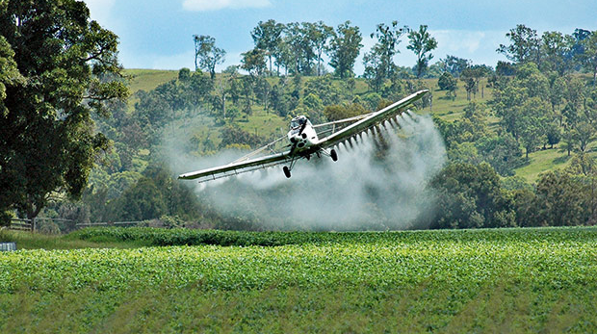
Communal concerns
Conventionally produced foods avoid costs of ethical food production, such as fair trade policies, supporting small communities, and sustainable farming practices
  Crap food … has a lot of hidden costs in it that aren’t represented in the price
  I want to live harmoniously with the environment
  Other food is too cheap - future generations will pick up the cost

Slide 15


Major themes
  Eating healthily, avoiding pesticides, toxins, chemicals hormones, and preservatives
  Preserving the environment for future generations
  Dollar voting: using purchasing power to influence
  Cost not mentioned as an influence

Slide 16
The three-bodied approach
Physical
Tasting, touching, smelling
Avoids toxins
Emotional
Emotional response
Mental
Call to action
Green values and beliefs
Provides micro-nutrients
Personal physical wellness
Planetary wellness
Sense of returning to clean safe food
Dollar voting
Happy vegetables happy meat
Nurturing family wellness

Slide 17
How is this relevant to CTS?
Conventional food consumption favours large corporations
Organic food is the privilege of the educated and wealthy
Purchasing organic food improves access for others and reduces prices by stimulating demand and supply
Buying organic food can be viewed as a charitable donation to the environment and community.
Notes:
Reviewers questioned the relevance of organic food consumption to wellness tourism
Health retreats in Canada and NZ generally mention organic food on their websites

Slide 18
Essentially, every time we choose to buy an organic product we’re voting for a better food system (Jamie Oliver)

Slide 19
