Slide 1

Doing robust hermeneutic phenomenology:
Reflexive engagement within circles of understanding
Deb Spence RN, RM, PhD
Senior lecturer
Nursing
Notes:
I would like extend a very warm welcome to fellow hermeneuts and others intrigued by this research paradigm. You will all be well aware of the importance of context to human understanding.
This is Auckland Harbour, and the view across to Rangitoto, one of our most recent volcanos.

Slide 2

Notes:
Like Sydney, we too have a harbour bridge and beautiful beaches.

Slide 3
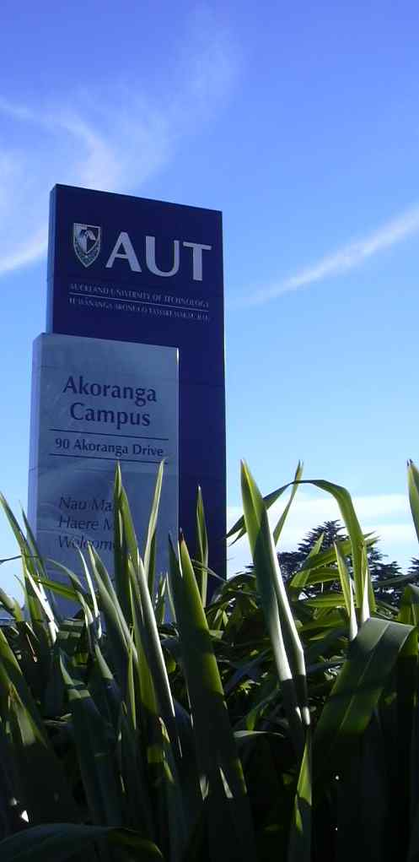
Notes:
Valerie, Susan and I work on the North Shore Campus of AUT University and represent nursing, occupational therapy and midwifery in a Faculty of Health and Environmental Sciences that caters for a wide range of health disciplines also including physiotherapy, Maori health, paramedicine, oral health, psychology, public health, podiatry and sports science.
We share methodologies, come from different disciplines and work interprofessionally researching with and supervising people both from within and beyond our own disciplines.
Our presentations build on each others.

Slide 4
Overview
  Context: supervision of research students
  Guiding tenets
  Surfacing and engaging with pre-understandings
  Attentiveness to language and meanings
  Supervisory practices
Notes:
Mine begins by …

Slide 5
Context
Bringing self to the situation
Insights gained through experience –- Quote
Rilke’s words of wisdom
Notes:
Read from Introduction
Read from bringing self to situation
Read Rilke’s quotation

Slide 6
“Be patient towards all that is unsolved in your heart and
try to love the questions themselves like locked rooms or
books that are written in a foreign tongue. The point is to live
everything. Live the questions now. Perhaps you will then,
gradually without noticing, live your way into the
answers”.
(Rilke, in Wellwood, 1990, p.1).

Slide 7
Guiding tenets
Gadamer (1975)
  Prejudice
  Historically effected consciousness
  Fusion of horizons
  Play
Taylor (1985)
  Strong evaluations
Lampert (1997)
  Contact/conflict
Notes:
Guided therefore by the key Gadamerian tenets: ‘prejudice’, ‘historically effected consciousness’, ‘fusion of horizons’ and ‘play’ and recognising Taylor’s (1985) notion of ‘strong evaluations’ and Lampert’s (1997) work on cross-cultural interpretation, I encourage students to illuminate the ways in which values and contact with difference engender the conflict essential for ongoing critique and understanding.

Slide 8
Surfacing and engaging with pre-understandings
Presuppositions interviewing - Quote 3 - Pre-understandings
Keeping a reflective journal - Quote 4 - Quote 5
‘Warm’ and ‘cool’ spots - Quote 6
The importance of questioning and engaging in dialectical processes - Questions
Notes:
Read from surfacing and engaging with pre-understandings

Slide 9
Attentiveness to language
Etymology
Gerunds
Avoid absolutes and dichotomies - Prompts
Writing to reveal tensions and paradox
Show and tell
Notes:
Read from attentiveness to language

Slide 10
Supervisory practices
Encourage commitment to a cyclical journey of thinking, questioning and writing
Recognise the historically and culturally situated nature of all understanding
Embody attitudes and behaviours that keep open the play and support the continued playing out of possibilities
Explicate one’s moral position vis-à-vis the phenomenon and incorporate reflective accounts
Encourage not only the asking of questions but the ‘listening’ critically to questions arising from interpreting the texts
Explore possibilities and contradictions
Pay careful attention to meanings and selection of words

Slide 11
Conclusion
As is reiterated by Gadamer (1996)
There is an art in seeing what is questionable
To this, I add:
And in knowing when to question and questioning in a manner that makes new understandings possible.

Slide 12
References
Gadamer, H. G. (1996) Truth and Method, J. Weinsheimer and D. Marshall, Trans. New York: Continuum.
Lampert, J. (1997). Gadamer and cross-cultural hermeneutics, Philosophical Forum, xxix (1) 351-368.
Rilke, R. M. In Wellwood, 1990 Journey of the heart. New York: Harper Collins.
Taylor, C. (1985). Human agency and language. Philosophical Papers 1. Cambridge: CUP.

Slide 13
Kia ora
Thank you deb.spence@aut.ac.nz

Slide 14
All human beings (including one’s supervisors and examiners) have prejudices. These should be explored for how they enable and limit understanding rather than being denied or bracketed.
Language, like conversation and play, is something we enter into and are encompassed by. It is a shared and unpredictable social activity.
Students need to be encouraged to question existing understandings and traditions for it is through questioning and laying open surface experiences that horizons are enlarged and enriched.
Back - Context

Slide 15
“We arrive with exhilarated feelings; to work with good
intentions. Sometimes it’s feelings of achievement,
completion of the work we have done, for the goals set. But
it’s also the look on their faces, hanging on the promises we
made, not by our saying but by our doing. We hoped we had
changed some lives but we know others who have to wait.
We hope, we hope and they wait until we arrive again with
the same promise. We don’t always leave with the same
elated feelings, thinking, promising; we must come again for
there is so much more to be done”.
(Lal, 2011, p. 5).
Back - Surfacing

Slide 16
Empathy for and a strong desire to care for people with limited access to health care and resources
Willingness to contribute specialist knowledge and expertise
A wish to make a positive difference to people in the country of her birth
Strong affiliation with the humanitarian health care team
Knowing that needs always outstrip the team’s capacity to deliver
Back - Surfacing

Slide 17
“I like the positive feel of Gadamer’s writing. I like his ideas
about the enabling possibilities of prejudice. This helps me to
see what makes nursing people from another culture
possible ….It is also intriguing that he uses the terms
“striving” and “in between” and that he draws on Aristotle’s
notion of phronesis in relation to moral understanding when
discussing issues of ‘application’”.
(Spence, 1999).
Back - Surfacing

Slide 18
“Is being open the way forward? Jane [2.2] states:
Is it more important to be open as a person than to go into a situation with your only mantle being, “I’m from your ethnic group”.
This seems congruent with Gadamer and Lampert. I need to re-read Leininger with this in mind”.
(Spence, 1999).
Back - Surfacing

Slide 19
“Nurse X mentions client vulnerability but does not see this
as a reason to take more responsibility or make more effort in
terms of compromise and flexibility.
It’s hard trying to be non judgmental about nurses’ attitudes
and their inability to be culturally sensitive”.
    (Spence, 1999).
Back - Surfacing

Slide 20
What pre-understandings do I bring to the research process?
How are my understandings fusing with those of the participants’ texts and other literature?
Where are my emotional responses signalling what matters?
What am I not seeing or responding to?
Are certain interpretations being privileged over others?
Back - Surfacing

Slide 21
How do the words used enable and limit understanding?
How does the interpretation facilitate ongoing dialogue
and the possibility of different understanding?
3. Is this the best word / phrase?
Back - Attentiveness

