Slide 1
Digitising New Zealand wine regions: an initial investigation
Subana Shanmuganathan
Geoinformatics Research Centre (GRC) Auckland University of Technology (AUT)
Notes:
Climate and “terroir” of New Zealand wine regions: a GIS perspective

Slide 2
overview
Background
  “terroir” x “cultiva”
  Viticulture
  wine making
Methods
  Vector
  Raster
Initial results
conclusions
specific personality

Slide 3
“terroir” and “cultiva”
A " terroir " is a group of vineyards (or even vines) from the same region, belonging to a specific appellation, and sharing the same type of soil, weather conditions, grapes and wine making savoir-faire, which contribute to give its specific personality to the wine.
http://www.terroir-france.com/theclub/meaning.htm

Slide 4
“Terroir” X “Cultiva”
Variety
Clone
Rootstock
Soil
Canopy management
Terrain
Pest Pressure
Disease Pressure
Climate
  Rainfall
  Humidity
  Sunshine
Wind speed
Cluster microclimate
Seasonal Variation
Vineyard Practices
Cultivation practices
Source:http://lfbisson.ucdavis.edu/
lfbisson.ucdavis.edu/PPT/VEN124_Sec_I_Lec_01.ppt

Slide 5
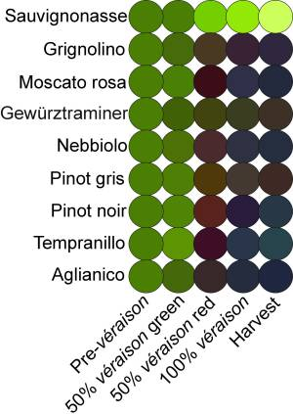
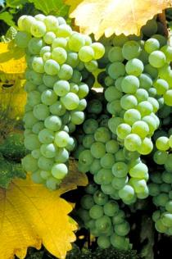
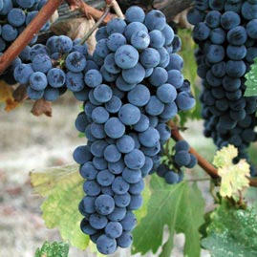
Grape varieties (“cultiva”)

Slide 6
+ Wine making => specific personality
Each choice in the successive steps of the elaboration of wine has repercussions on the taste and the quality of the wine
the terroir
The climate (and the date of harvest)
the grape-variety
the type of container used for fermentation
the temperature - the juice of grape is maintained during fermentation
the fermentation period
the type of container used for maturation
http://www.terroir-france.com/wine/making.htm

Slide 7
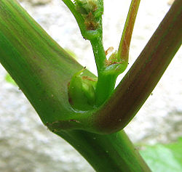
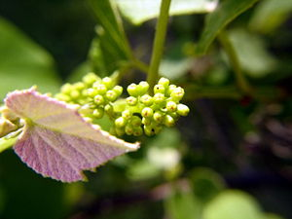
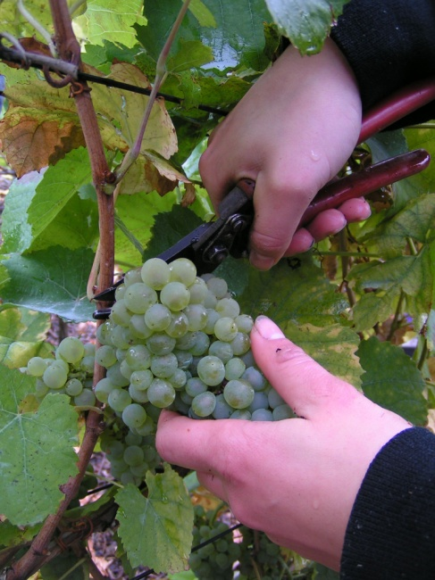
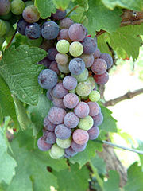
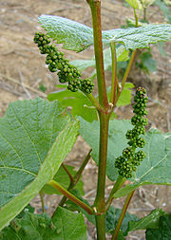
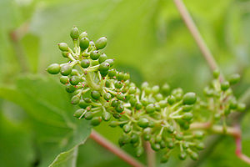
Grapevine phenology
precise data

Slide 8
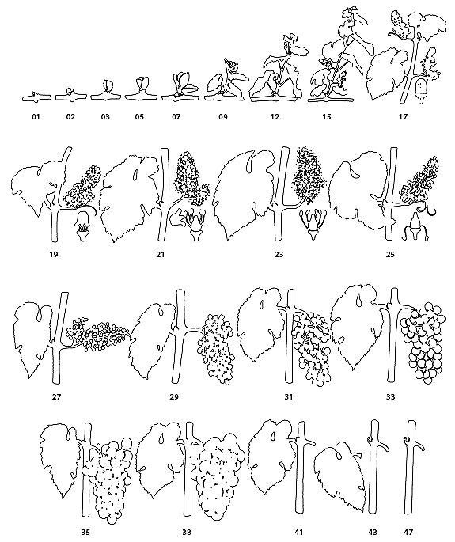
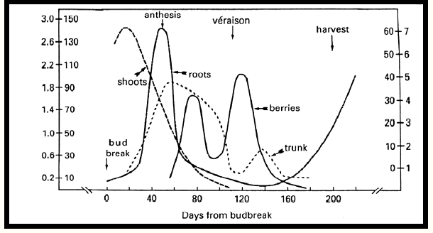
Grapevine phenology

Slide 9
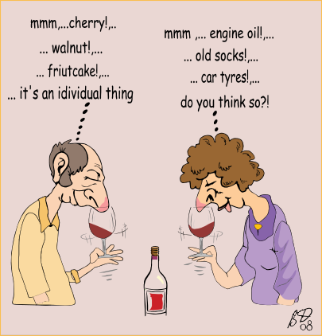
Wine tasting
Source: www.bryandownes.com/page9.html

Slide 10
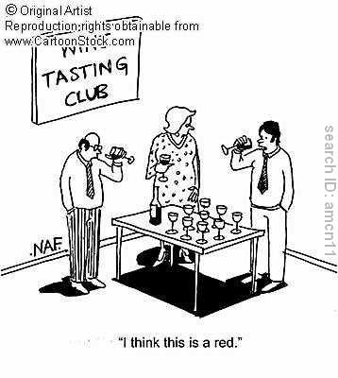
Sommelier comments
come in many forms:
video
text
ratings
Audio
web
and a note about sommelier comments…
What flavors are on the nose?
Soruce: http://winedinedaily.com/wine/wine-quotes/item/wine-cartoon

Slide 11
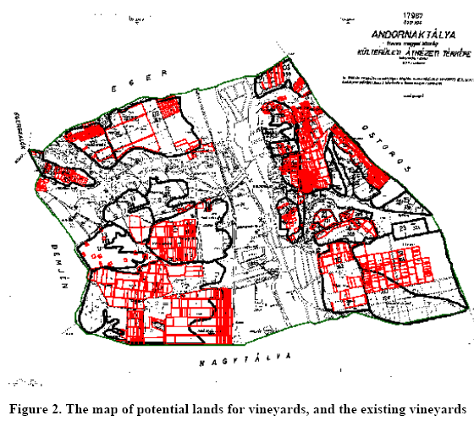
Literature review
Martinovich, L., Katona, Z., Szenteleki, K., & Boto, E. P. (2010). Updating the Evaluation of Hungarian Wine Producing Fields Using the National GIS Register (VINGIS) 6pp. Retrieved June 15, 2010, from VINGIS: Managing Hungary's vineyards with Open Source: http://www.oiv2007.hu/documents/viticulture/Hungarian_wine_GIS_register_VINGIS_OIV_jav_POSTER.pdf:3

Slide 12
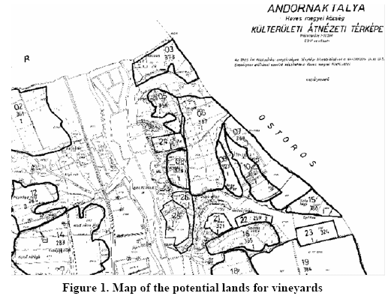
Agrometeorology (frequency of winter frost damage, spring, fall frost damage),
Soil (Soil type, Soil forming rock, PH and lime state, physical soil kind, water management features, Humus level, thickness of the production layer of soil. The area homogenity concerning the soil type),
Water management (water management of the area based on site observation), degree of erosion, The lie of the land, Elevation (slope degree and aspect, elevation above sea level on hill and mountainside, emergence from the environment on the plain and flat areas, relief, area surface on hill and ountainside, relief, area surface on plain and flat areas, environment proximity of woods, degree of built up areas), area utilization, road conditions.
Martinovich, L., Katona, Z., Szenteleki, K., & Boto, E. P. (2010). Updating the Evaluation of Hungarian Wine Producing Fields Using the National GIS Register (VINGIS) 6pp. Retrieved June 15, 2010, from VINGIS: Managing Hungary's vineyards with Open Source: http://www.oiv2007.hu/documents/viticulture/Hungarian_wine_GIS_register_VINGIS_OIV_jav_POSTER.pdf:2

Slide 13
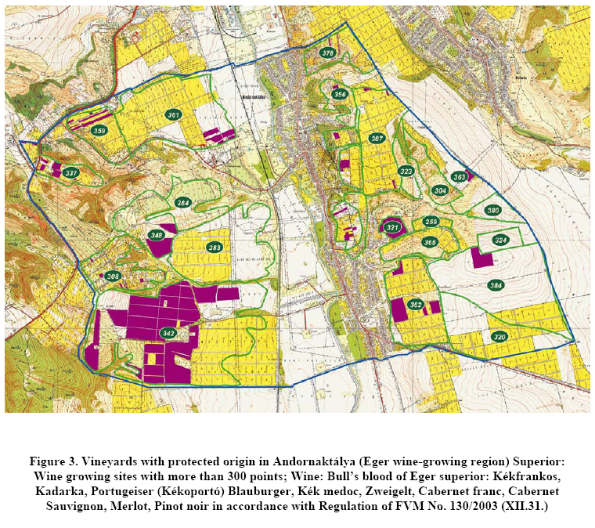
Martinovich, L., Katona, Z., Szenteleki, K., & Boto, E. P. (2010). Updating the Evaluation of Hungarian Wine Producing Fields Using the National GIS Register (VINGIS) 6pp. Retrieved June 15, 2010, from VINGIS: Managing Hungary's vineyards with Open Source: http://www.oiv2007.hu/documents/viticulture/Hungarian_wine_GIS_register_VINGIS_OIV_jav_POSTER.pdf:5

Slide 14
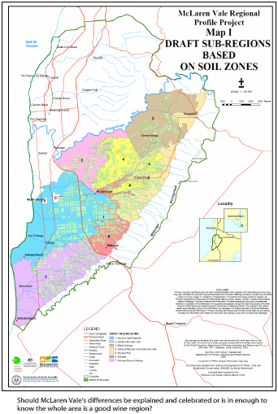
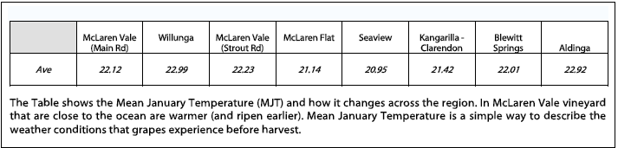
“The winery Clarendon Hills is famous for making Blewitt Springs wines and selling them for super prices in the US market”
Topography and ripening patterns
wine fight club. (2010:3) Retrieved from
www.lazyballerina.com/Winefightclub/winefightclubJul07.pdf

Slide 15
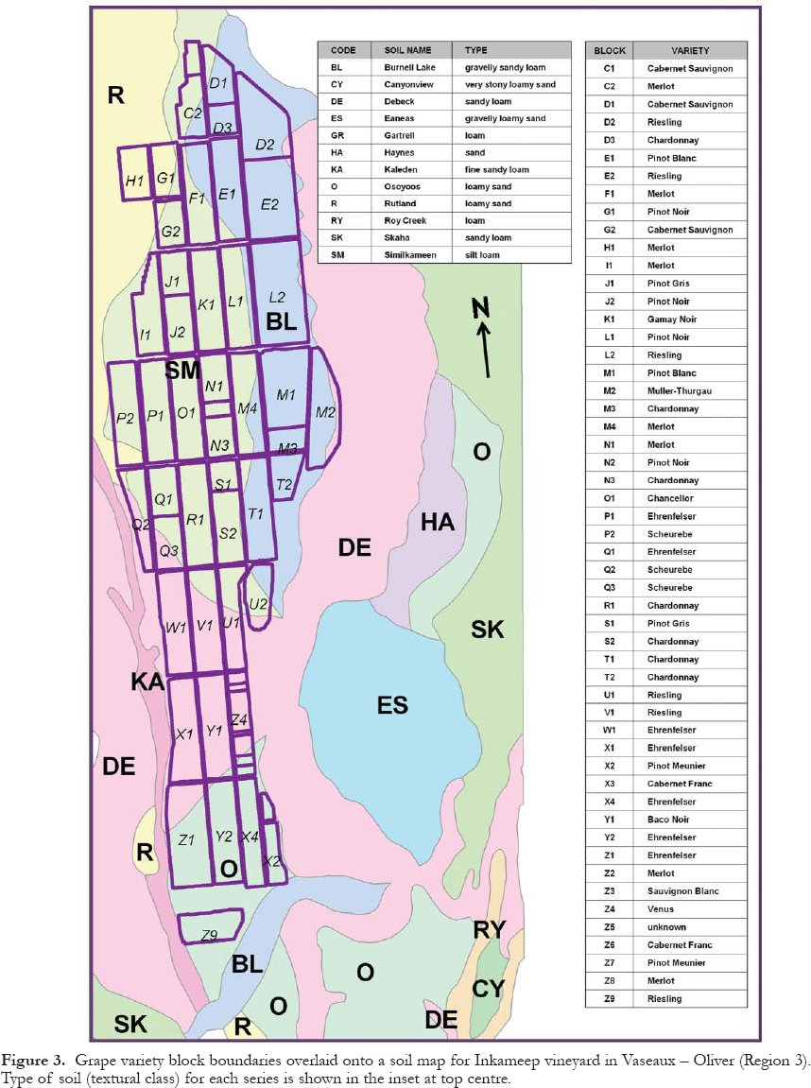
Grape variety block boundaries overlaid onto a soil map for Inkameep vineyard in Vaseaux – Oliver
Type of soil (textural class) :
depth to bedrock; surface stoniness; texture (resulting from the size distribution of mineral particles); perviousness class; drainage class; depth to root restriction; shear strength; permeability; pH; salinity class and cation exchange capacity
Geology and Wine 10: Use of Geographic Information System Technology to Assess Viticulture Performance in the Okanagan and Similkameen Valleys, British Columbia Volume 32, Number 4 (2005)
http://journals.hil.unb.ca/index.php/gc/article/view/2718/3167

Slide 16
independent Vs dependent factors
Methods used
Vector (Point, Polygon … )
Raster

Slide 17
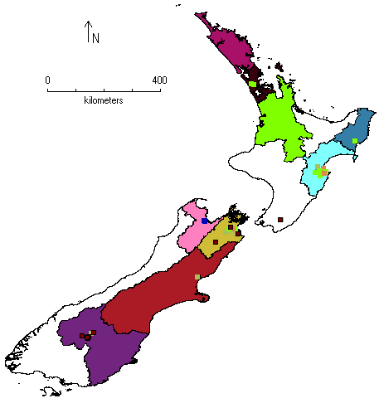
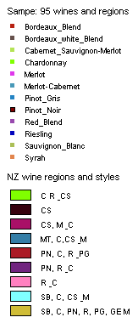
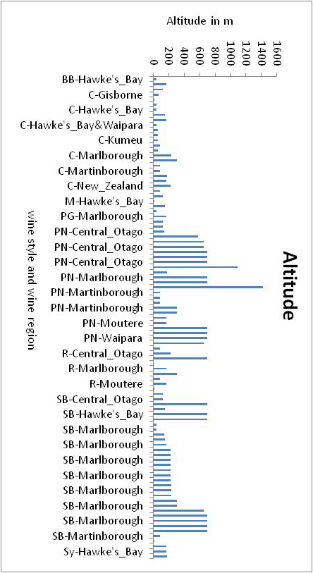
Point based
S Shanmuganathan (2012) Viticultural zoning for the identification and characterisation of New Zealand Terriors using cartographic data -in proceedings of GeoCart2012

Slide 18
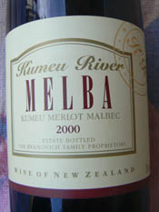
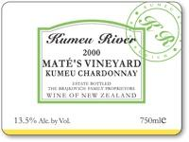
Wine labels

Slide 19
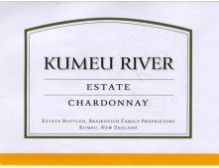
Vintages and sommelier comments
750ml Kumeu River Estate Chardonnay Auckland
The 2007 vintage was terrific and produced wonderful Chardonnay throughout the entire Kumeu River stable. The Estate Chardonnay from this vintage is ripe, rich and beautifully concentrated. The beautiful peach and hazelnut aromas along with the rich silky texture are distinct characteristics that we expect to see from this wine.
Cellar to 2011/2012.
http://www.nzwineonline.com.au/content_common/pr-new-zealand-chardonnay_new-zealand-white-wine-kumeu-river-estate-auckland-chardonnay.seo

Slide 20
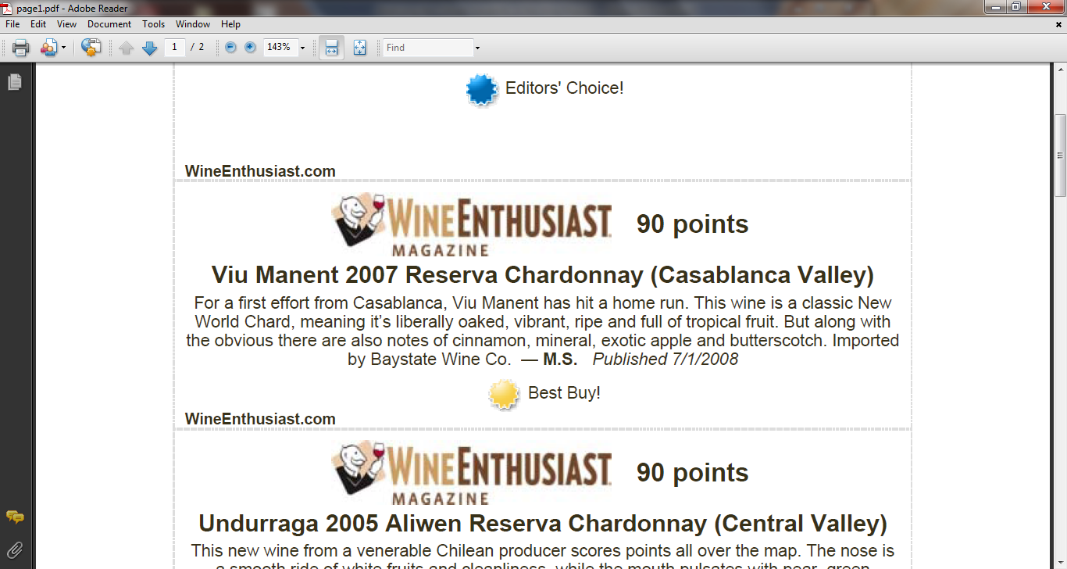
Text mining ; Sommelier comments

Slide 21
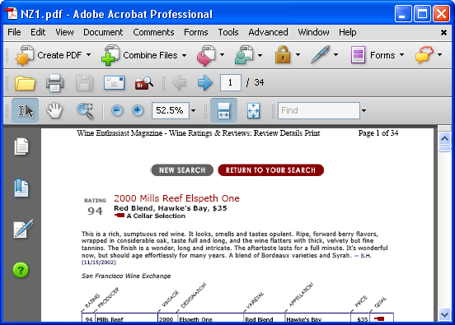
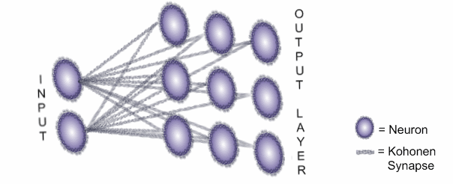
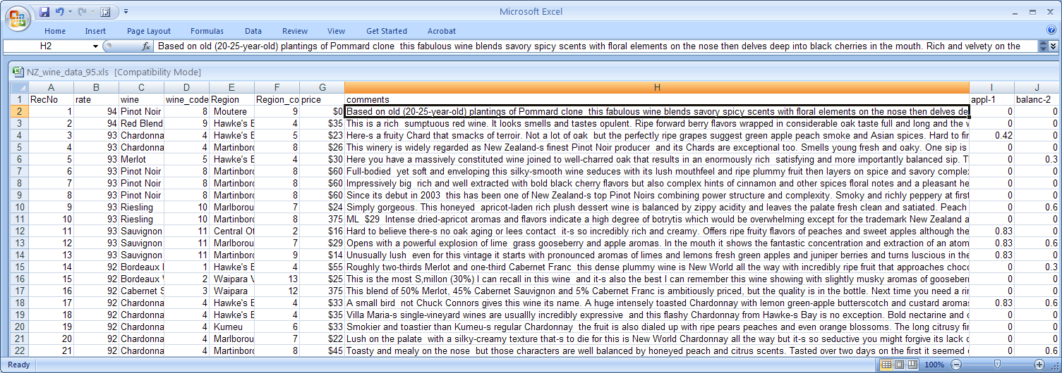
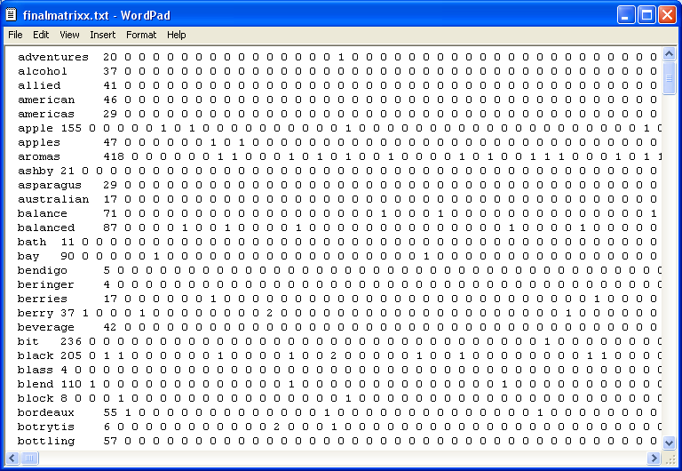
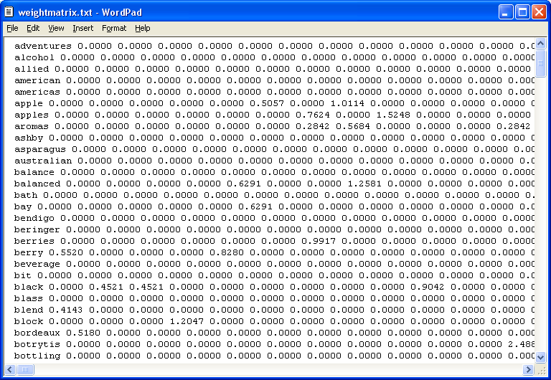
Web text mining wine comments
Structured data
Unstructured data
Notes:
Web text mining using structured and unstructured (text) data.

Slide 22
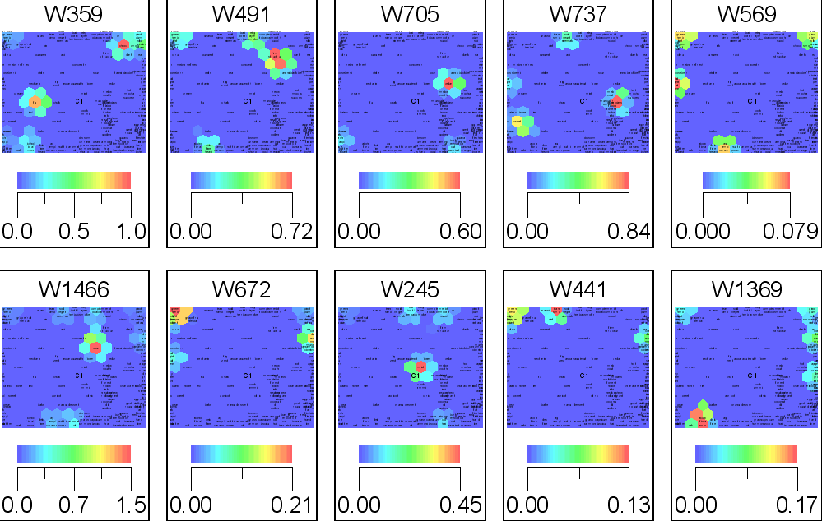
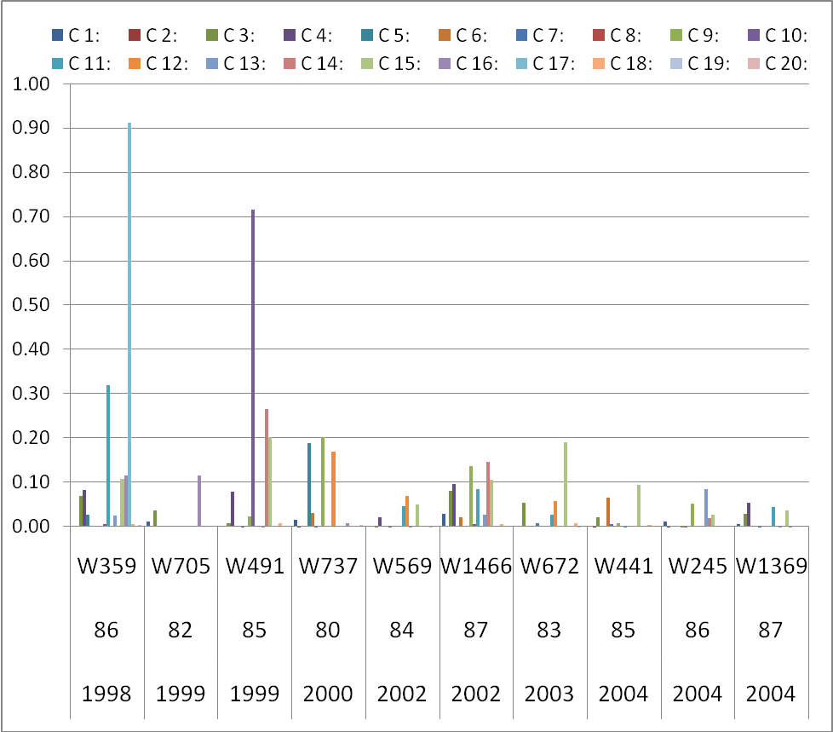
Pinot Noir – Canterbury 1998-2004
C 1: sour, length, flower, mint, mellow youth, hot mocha success, chalki, muscular purpl, molass, anis approach char cranberri deep group integr raspberri roast strawberri wood, open, cook jammi, disjoint flabbi forest hollow inki neutral robust, characterist, woodi, apricot, citric, cashew fragrant ginger, auster bacon develop lactic licoric oliv rhubarb rubi, orang, dessert, coconut dill golden, gentl rough, astring leafi, guava menthol, leesi, leaf tomato, aromat oili round, blossom currant grass harmoni sharp thick ting warm, bean capsicum lusciou opul sweati viscou, almond cloi hai medicin quinc syrupi, bark butterscotch cut hazelnut slight thin tree, banana mango pure, aggress bitter distinct fat fleshi flinti hard live lyche perfum petal rose steeli tight variet young C 2: raci, concentr, pea, fig zesti, asparagu C 3: chocol, dark, tea, coffe dusti earthi meati mushroom, tannic, blackberri, cinnamon clove, cedar, brown leather persist readi syrah velveti C 4: bake, oaki, alcohol floral lemon linger spici, delic fine heavi modest, ag ampl caramel gri subtl, nutti power strong C 5: balanc, honei, riesl, appl, sweet C 6: grassi, lean simpl, pink, pungent C 7: citru, lime, melon, refresh C 8: white, nectarin C 9: soft solid veget winemak, bai bottl herbac C10: firm structur C11: black cola noir pinot plum silki tannin vintag, smoki, berri red C 12: gooseberri, acid bright fruiti intens C 13: cabernet merlot smooth suppl, dri C 14: eleg layer smoke, complex tobacco C 15: clean crisp fresh green herb light pepper tart, bodi medium tropic C 16: pear, chardonnai oak peach pineappl spice vanilla, butter toast C 17: full C 18: grapefruit herbal C 19: dry miner rich C 20: creami

Slide 23
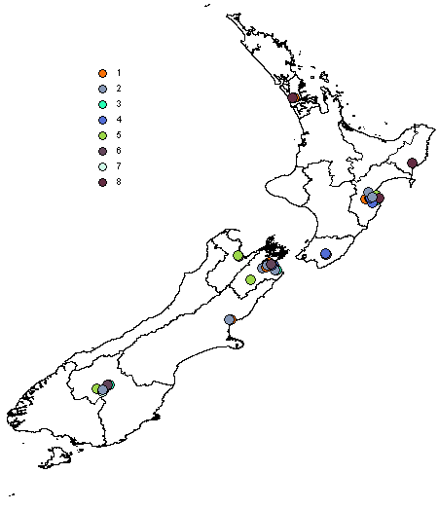
 | C 1 | C 2:
sauvignon-36 | 0.000 | 0.395
passion-30 | 0.000 | 0.367
grapefruit-19 | 0.000 | 0.335
miner-24 | 0.095 | 0.237
fruit-17 | 0.078 | 0.205
fig-15 | 0.045 | 0.168
hint-22 | 0.000 | 0.152
import-23 | 0.034 | 0.152
wine-42 | 0.177 | 0.143
pink-31 | 0.000 | 0.133
note-26 | 0.152 | 0.114
herbal-21 | 0.019 | 0.113

Slide 24
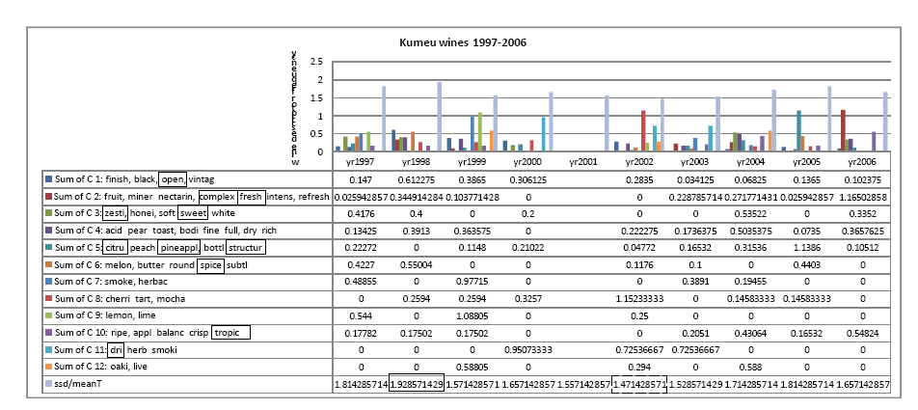
Wine quality & climate data analysis
Figure 2. SOM of 51 wine descriptors extracted from comments made by sommeliers on 30 Kumeu (New Zealand) wines produced 1997-2006 (source: www.winemag.com/buyingguide/
Observation on the graph is that year 1998 ^, the shows the highest ssd/meanT within the period analysed herein consists of high descriptor frequencies for clusters C 2, C 3, C 6 and C 10 descriptors. Meanwhile, year 2002 with the lowest ssd/meanT consists of higher frequencies for C 5, C 8 and C 11 descriptors. Discriminant analysis run on the data set produced 11 words (boxed in the left) as contributing factors in determining the variable vintage (or year considered as a dependent variable on the 11 descriptors).
Notes:
Histogram of Kumeu (New Zealand) wine descriptor frequencies in the 12 SOM clusters (figure 1) added for each year (1997-2006). In the graph, each year appearing on x axis consists of a set of wine descriptor frequencies for that year (1 through 12) and lastly, standard deviation/ mean temperature (ssd/meanT), as vertical bars and this enables the visualisation of wine descriptors and temperature variation over this period.

Slide 25
Statistical methods - discriminant
  Variables Entered/Removed ^{a,b,c,d}Step Entered Residual Variance
  1 spice-42 29.138
  2 sweet-45 22.022
  3 pineappl-34 17.459
  4 dri-12 13.715
  5 complex-10 11.796
  6 zesti-51 9.902
  7 citru-9 7.384
  8 fresh-16 5.851
  9 open-31 5.038
  10 tropic-48 3.675
  11 structur-43 3.124
11 descriptors (from 30 Kumeu wine comments) found to be major contributing factors and their contribution in vintage-to-vintage variations within the period of 1997-2006.
Standardized Canonical Discriminant Function Coefficients Function
1 2 3 4 5 6 7
citru-9 -2.473 .591 .211 .553 -.764 .604 -.950
complex-10 12.264 -1.558 1.124 1.146 -.768 .863 -.452
dri-12 -10.025 1.610 .192 .012 .424 -.011 .608
fresh-16 -7.063 .772 -.648 -.850 1.166 -.046 -.132
open-31 4.818 1.016 -.878 -.044 -.420 .389 -.321
pineappl-34 5.751 1.290 1.193 -1.262 -.019 .184 .192
spice-42 5.799 1.292 .821 .241 .202 .036 -.252
structur-43 -3.040 -1.417 -1.103 .493 .175 -.116 .535
sweet-45 -3.033 2.587 -.343 -.286 .750 -.457 .367
tropic-48 -1.467 -.170 1.220 .504 .094 .487 .319
zesti-51 7.981 -.342 -1.257 .084 -.171 .348 .116
Coefficients of 7 functions used in the prediction of 9 classes of wines vintage 1997-2006 (without 2001) show relative impact (positive, negative) of descriptors.

Slide 26
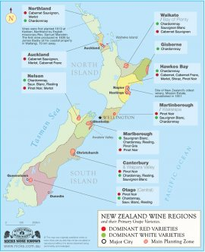
regional ratings against climate: NZ wine regions
http://winefeeds.wordpress.com/2009/03/15/new-zealand-wine-region-map/

Slide 27
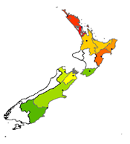
Marlborough SB vintage (1996-2006) descriptors & ratings
(veget-111 >= 0.37) and (fruit-37 <= 0) and (fresh-36 <= 0.26)
=> rate scale=low (11.0/3.0)
(asparagu-8 >= 0.6) and (fruit-37 <= 0) => rate scale=low (7.0/2.0)
(sour-99 >= 0.94) => rate scale=low (3.0/0.0)
(heavi-50 >= 0.9) => rate scale=low (6.0/2.0)
(group-45 >= 0.84) => rate scale=low (5.0/2.0)
(complex-22 >= 0.4) => rate scale=high (24.0/10.0)
=> rate scale=med (325.0/71.0)
JRip rules show the correlations between Marlborough SB vintages and descriptors
381 Marlborough vintages was converted into matrix of 118 wine descriptors and their rates transformed into
low <80 medium (med) >79 and <90 high >89 (100 point)

Slide 28
Marlborough SB vintages (1997-2007) & ratings
J48 creami (creamy), bean, honei (honey), lime, melon, grassi (grassy), sweet, tropic, nectarine, eleg (elegant), apple, fruit, herbal, and linger.
| | | | | grassi-43 <= 0
| | | | | | sweet-104 <= 0.52
| | | | | | | lime-63 <= 0
| | | | | | | | tropic-109 <= 0: med (10.0)
| | | | | | | | tropic-109 > 0: high (3.0/1.0)
| | | | | | | lime-63 > 0: high (3.0/1.0)
| | | | | | sweet-104 > 0.52: high (2.0)
| | | | | grassi-43 > 0: high (2.0)
| | | | melon-68 > 0: high (3.0)
| | | veget-111 > 0: low (2.0)
| asparagu-8 > 0.4
| | fruit-37 <= 0.05: low (9.0/2.0)
| | fruit-37 > 0.05: med (11.0/2.0)
complex-22 > 0
| linger-64 <= 0
| | herbal-53 <= 0.36
| | | fruit-37 <= 0.17
| | | | appl-5 <= 0
| | | | | eleg-30 <= 0
| | | | | | nectarin-72 <= 0: med (8.0)
| | | | | | nectarin-72 > 0: high (2.0)
| | | | | eleg-30 > 0: high (2.0)
| | | | appl-5 > 0: high (2.0)
| | | fruit-37 > 0.17: high (5.0)
| | herbal-53 > 0.36: high (3.0)
| linger-64 > 0: med (2.0)
complex-22 <= 0
| asparagu-8 <= 0.4
| | rich-88 <= 0.36
| | | creami-25 <= 0
| | | | group-45 <= 0
| | | | | bean-12 <= 0
| | | | | | honei-54 <= 0.49: med (278.0/57.0)
| | | | | | honei-54 > 0.49
| | | | | | | finish-34 <= 0.1: med (4.0)
| | | | | | | finish-34 > 0.1: high (6.0/1.0)
| | | | | bean-12 > 0
| | | | | | bean-12 <= 0.75
| | | | | | | fresh-36 <= 0: med (3.0)
| | | | | | | fresh-36 > 0: low (2.0)
| | | | | | bean-12 > 0.75: low (2.0)
| | | | group-45 > 0
| | | | | lime-63 <= 0: low (5.0)
| | | | | lime-63 > 0: med (2.0)
| | | creami-25 > 0
| | | | melon-68 <= 0: med (8.0/1.0)
| | | | melon-68 > 0: high (2.0)
| | rich-88 > 0.36
| | | veget-111 <= 0
| | | | melon-68 <= 0

Slide 29
Descriptors-Marlborough SB -j48
bean-12 > 0.75: low (2.0) veget-111 > 0: low (2.0)
fruit-37 <= 0.05: low (9.0/2.0) fresh-36 > 0: low (2.0)
honei-54 <= 0.49: med (278.0/57.0) finish-34 <= 0.1: med (4.0) bean-12 <= 0.75 lime-63 > 0: med (2.0) fruit-37 > 0.05: med (11.0/2.0) linger-64 > 0: med (2.0)
finish-34 > 0.1: high (6.0/1.0) group-45 > 0 creami-25 > 0 melon-68 > 0: high (2.0) tropic-109 > 0: high (3.0/1.0) lime-63 > 0: high (3.0/1.0) sweet-104 > 0.52: high (2.0)grassi-43 > 0: high (2.0) melon-68 > 0: high (3.0) nectarin-72 > 0: high (2.0) eleg-30 > 0: high (2.0)appl-5 > 0: high (2.0)fruit-37 > 0.17: high (5.0) herbal-53 > 0.36: high (3.0)

Slide 30
NZ Chardonnay descriptors
Gisborne
sweet-19 <= 0
| spice-18 <= 0
| | appl-1 <= 0.27: med (28.0/7.0)
| | appl-1 > 0.27: high (2.0)
| spice-18 > 0: high (3.0/2.0)
sweet-19 > 0
| vanilla-23 <= 0: med (3.0)
| vanilla-23 > 0: low (3.0)
Waipara
toast-8 <= 0.26
| citru-3 <= 0: med (8.0/2.0)
| citru-3 > 0: high (2.0/1.0)
toast-8 > 0.26: high (3.0)
Hawke’s Bay
| | | | honei-17 > 0: high (2.0)
| | | creami-9 > 0: high (2.0)
| | orang-23 > 0: high (3.0)
| ripe-28 > 0.23: med (8.0/1.0)
lime-19 > 0: med (6.0/1.0)

Slide 31

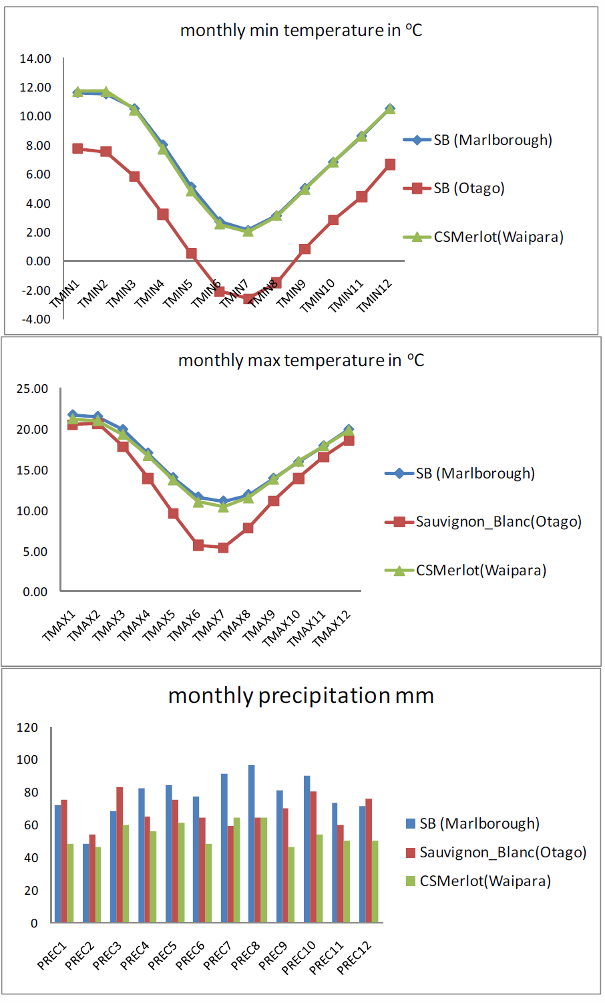
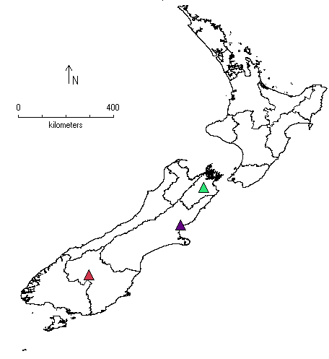
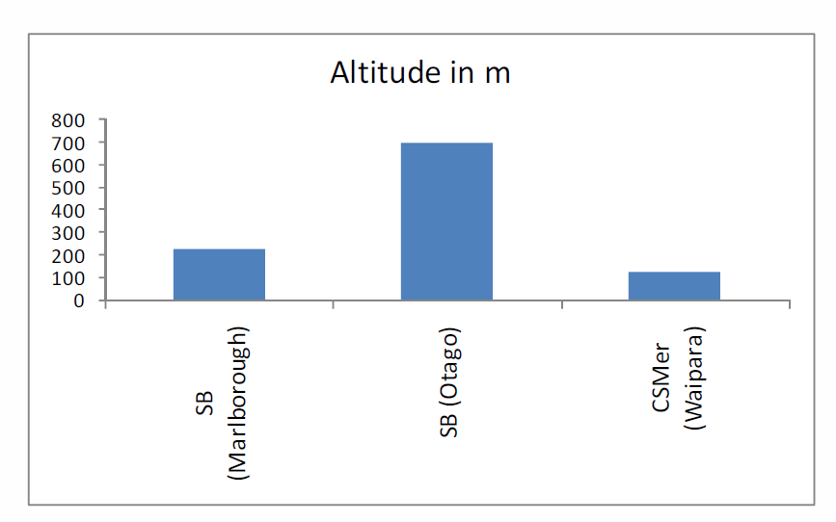
Point based

Slide 32
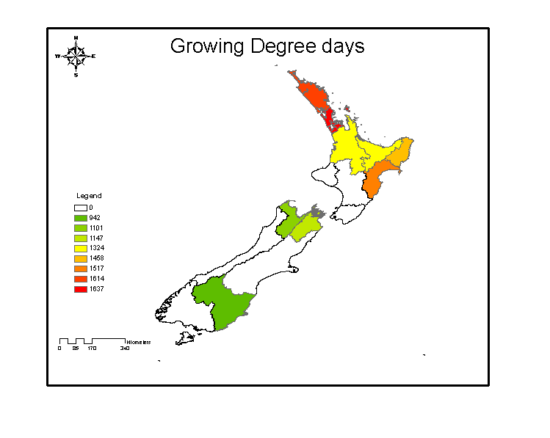
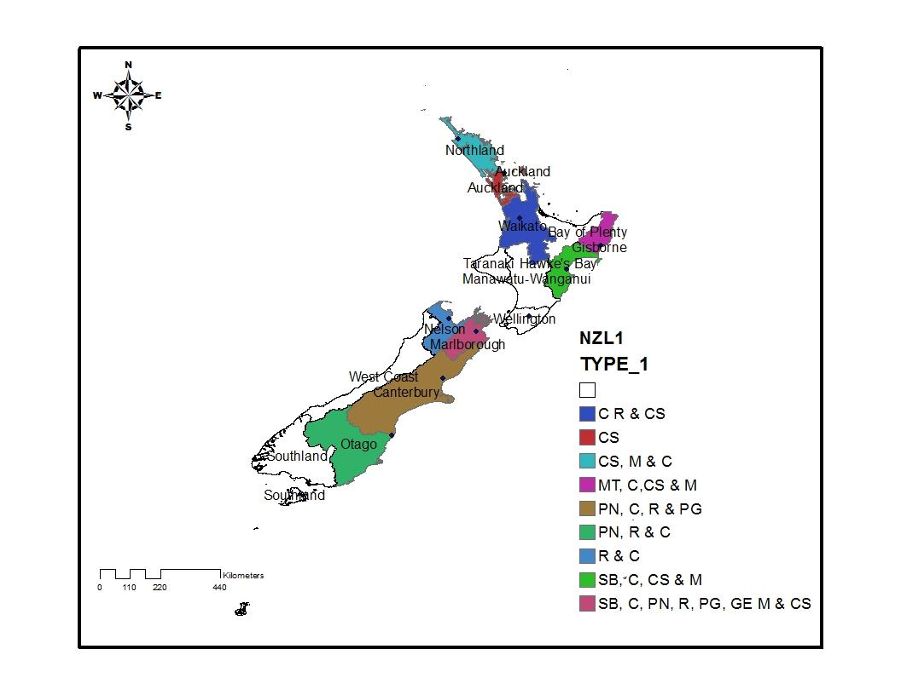
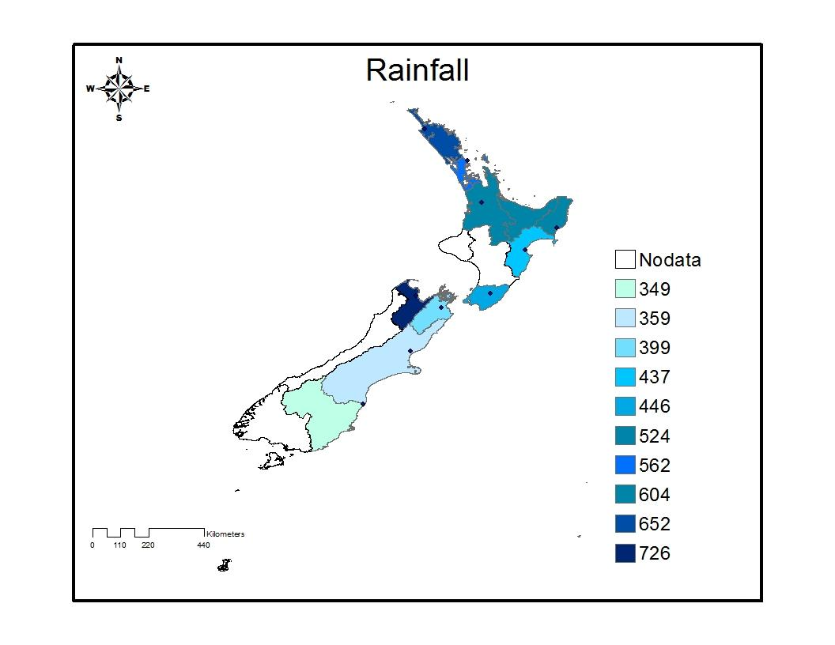
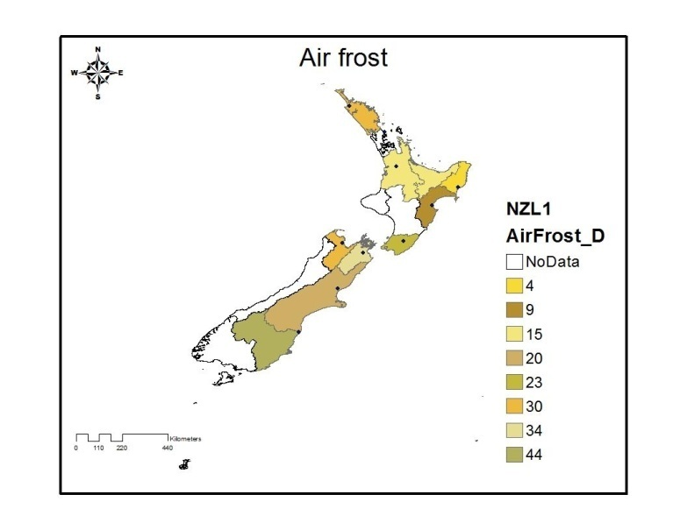
Polygon based
@ the regional scale

Slide 33
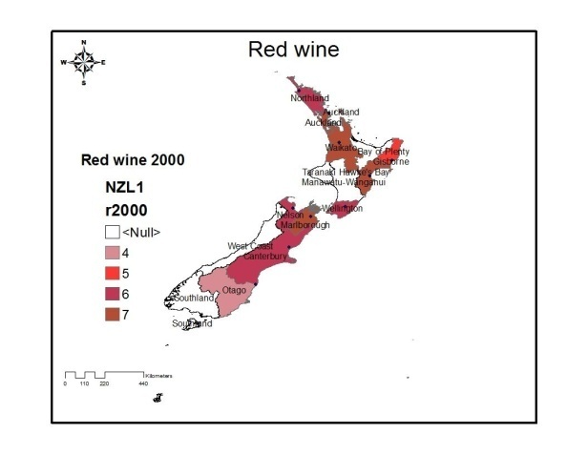
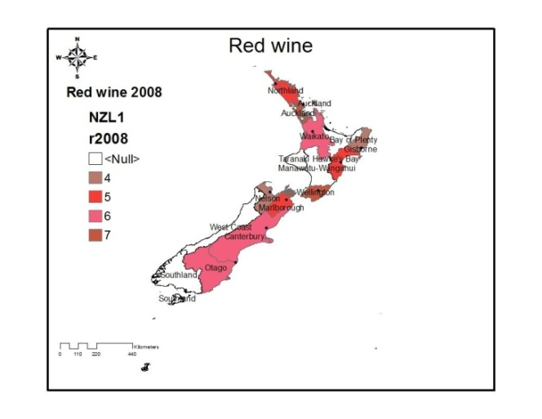
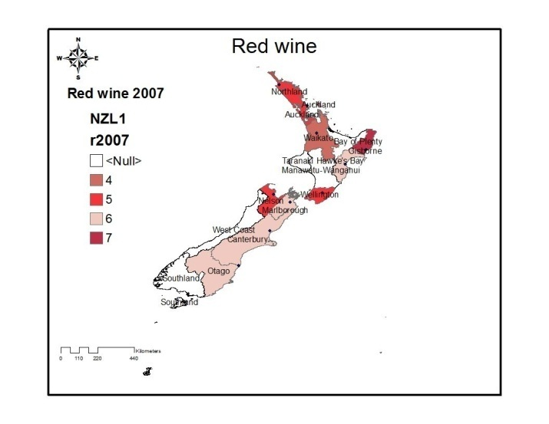
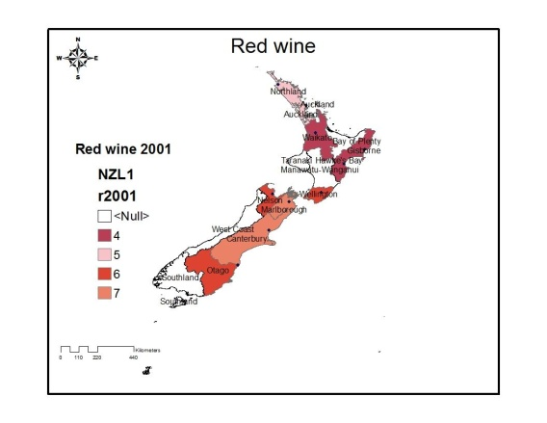
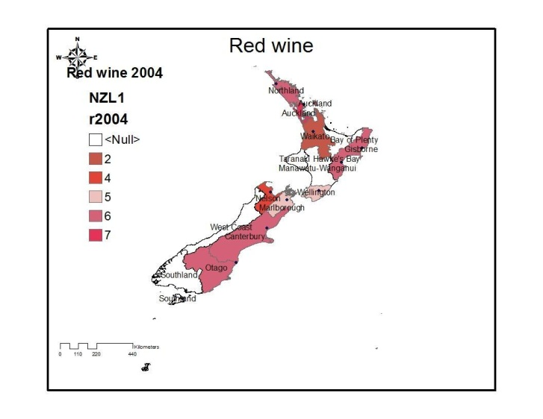
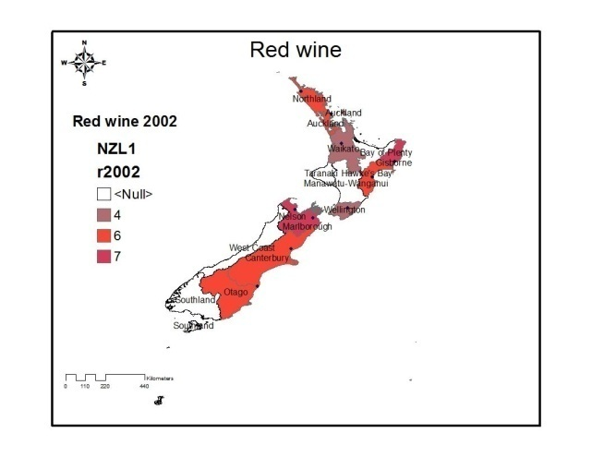



Slide 34










Slide 35


Polygon based
Rainfall
Mean Air Temperature
Extreme Maximum Air Temperature
Mean 20cc Earth Temperature
Mean 20cc Earth Temperature
Mean Vapour pressure
Growing degree days (GDD)
Days of Snow
Low Maximum Air Temperature
Standard (std) Day mean Temperature
Low Daily Mean Temperature
High (hi) Daily Mean Temperature
Mean 9 am Relative Humidity (RH)
Mean 9 am Temperature

Slide 36
wine rating and independent variables
@ the regional scale
Auckland: August low maximum (max) air temperate. Other regions December, February and March monthly total rainfall as deterministic factors
red wine regional rating is March mean 9 am relative humidity (RH)

Slide 37
Raster based

Slide 38
The methodology
Raster images
Rasterise (sample)
Cluster (unsupervised)
Re project cluster results / profile
Analyse results

Slide 39

New Zealand Vineyards

Slide 40
by Region (tonnes crushed)

Slide 41

Digital Elevation Map DEM hill shade

Slide 42

Digital Elevation Map DEM
Hill shade

Slide 43

Digital Elevation Map DEM
Elevation

Slide 44



Slide 45

Dependent variables for NZ vineyard polygons
Water balance
Soil particle size
Slope
Water deficiency
Elevation
Temp Min
Annual Solar
Drainage
For 27343 pixels

Slide 46


Pixel (data) clustering with SOM

Slide 47







Water deficiency
1
3
2
3
1
2

Slide 48








Annual temperature Temperature minimum Drainage

Slide 49








1
2
3
2
5
4
1
3

Slide 50








Water deficiency
Temp minimum
drainage
elevation
Temp annual

Slide 51






Slide 52


Temperature annual
Temperature minimum

Slide 53




Temperature annual

Slide 54




Drainage

Slide 55


Slide 56


Slide 57


Slide 58



Slide 59


Slide 60
conclusions
Climate and “terroir “ of NZ wine regions are very unique and can be defined.
Of the variable studied:
@ the regional scale and within regions
water deficiency
elevation
soil particle size
water balance
Temperature min
The methodology show potential
Further analysis required to exactly define NZ “terroirs”

