Slide 1
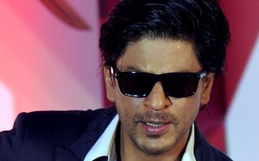
Changing Cultural Economy in the Production of Indian Performance
Alison Booth
AUT University

Slide 2
Four Step Value Chain (Sakeeney 2013)
Step One | Origination | The natural resources: In cultural terms the creative or those that interpret the arts. “Louisiana has an abundance of cultural ‘oil’, but much of it remains untapped and dormant”.
Step Two | Production | Turning the natural resources into marketable products. “Required- a skilled workforce, a population of entrepreneurs and businesses, research and development capacity, and finance needed to transform creative capital into marketable goods and services”.
Step Three | Distribution | Taking the marketable products into the consumer market. “In the case of culture, an effective distribution system requires branding, marketing, and the development of cultural import and export markets”.
Step Four | Support System | Government policies, organisations and networks that are involved for advocating for the industry. “In the case of culture social attitudes, trust and confidence, and networks are critical components of this support system”.

Slide 3
Value, Resources and Production Networks
Value Chain | Resources | Production Networks
Origination | Event Content | The access to performers, whether local or overseas, with a reputation affects the community perception and the financial viability of the event.
Production | Event Support | Includes all of the logistics required to make the event happen on the day and involves a series of networks that ideally includes skilled individuals that the producer knows and trusts.
Distribution | Publicity | Attracting a target market willing to view the event as having value and worth purchasing a ticket and spending the time to attend.
Support System | Funding | Arts funding grants, commercial sponsorship, ticket sales, endorsements and advocates for events are generated through relationships and networks. Reputation is a powerful asset in delivering feasible events.

Slide 4
Producer Types, Resources and Value Chains
Producer Types | Community Organisations | Government Agencies | Entrepreneurs
Origination (Event Content) | Cultural Identity Relationships | Political Relationships | Commercial and Political Relationships
Production (Event Support) | Cultural Identity and Social Relationships | Political and Cultural Identity Relationships | Commercial, Political and Cultural Identity Relationships
Distribution (Publicity) | Cultural Identity and Social Relationships | Political and Cultural Identity Relationships | Commercial and Cultural Identity Relationships
Support (Funding) | Cultural Identity and Social Relationships | Commercial and Cultural Identity Relationships | Political and Cultural Identity Relationships

Slide 5
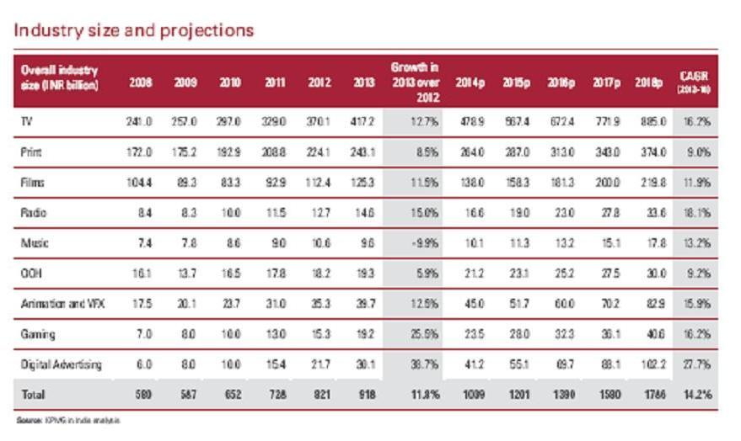
KPMG India Creative Industry Projections

Slide 6
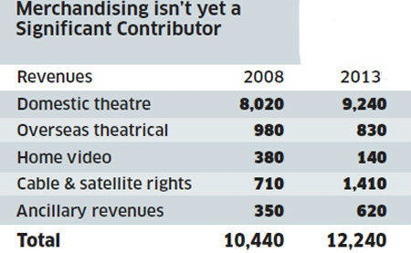
http://www.bollywoodpresents.com/merchandising-new-revenue-stream-for-bollywood.html

Slide 7
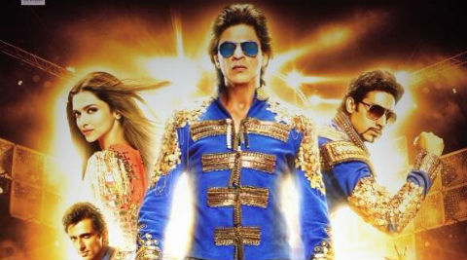
Shahrukh Khan Happy New Year Tour

Slide 8
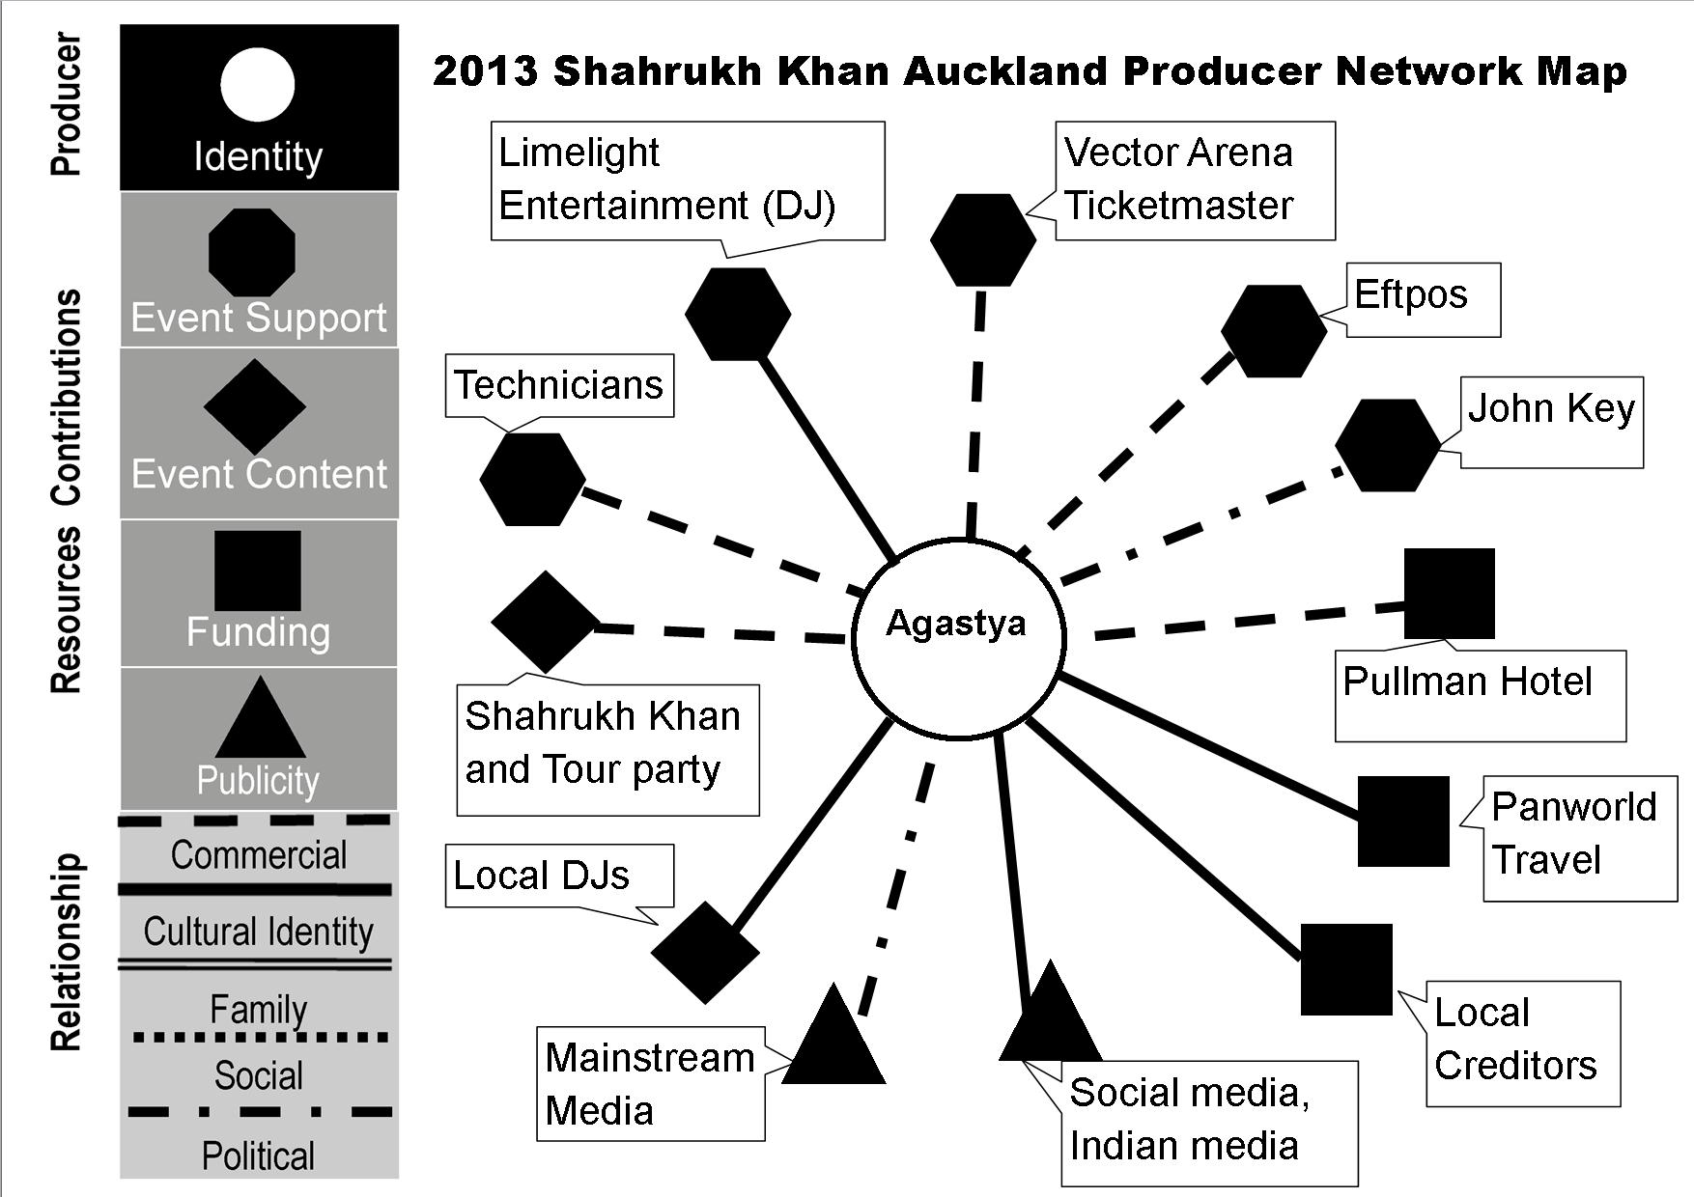
Temptation Reloaded Networks

Slide 9
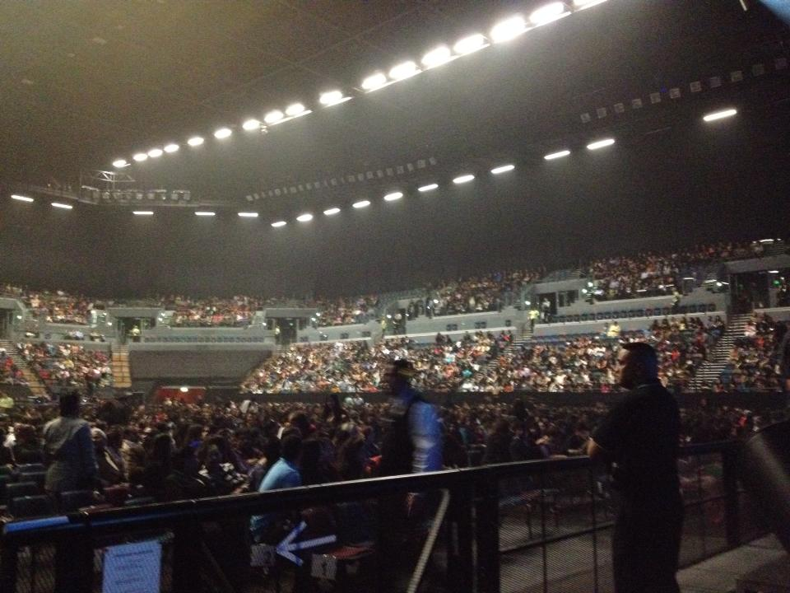
Vector Arena Full House

Slide 10
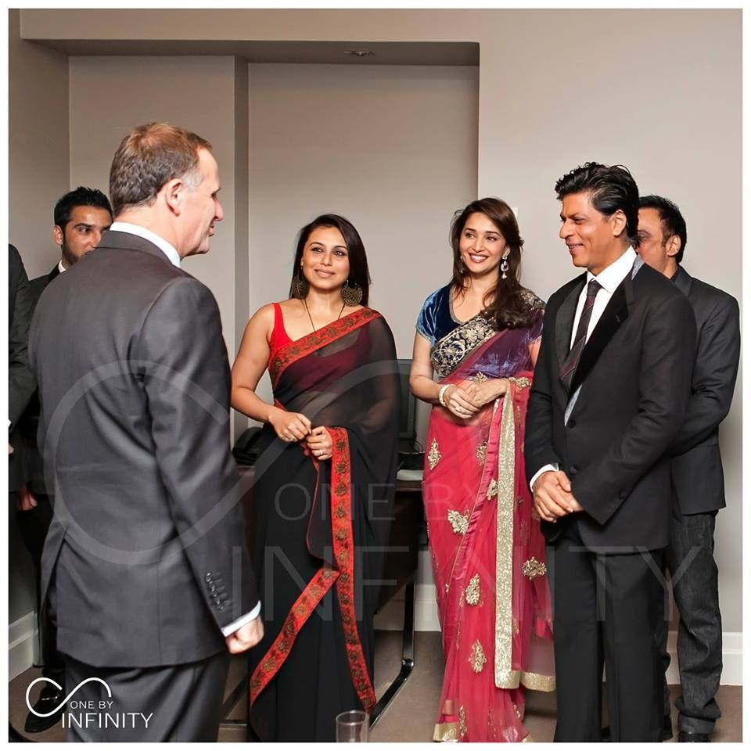
John key with the Stars

Slide 11
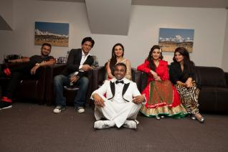
Agastya the Producer and the Stars
Agastya Pesara, seated on the ground with (from left) Yo Yo Honey Singh, Shahrukh Khan, Rani Mukherjee, Madhuri Dixit and Jacqueline Fernandez (Photo from Agastya Pesara’s Facebook) s
Agastya Pesara, seated on the ground with (from left) Yo Yo Honey Singh, Shahrukh Khan, Rani Mukherjee, Madhuri Dixit and Jacqueline Fernandez (Photo from Agastya Pesara’s now unavailable Facebook site)

Slide 12
SRK to make 200 cr profit before Happy New Year releases Staff Reporter, 3 July 2014 Trans Asia News MUMBAI:
Diwali may be a long way off but the big idea bulb is blazing bright inside Bollywood icon Shahrukh Khan’s business head already and it may well be time for some serious fireworks as he plans to set the cash registers ringing well ahead of the actual release of his next big venture- Farah Khan’s ‘Happy New Year’ by using the promotional drive for the film as his cash-cow.
The plan involves a huge global tour ostensibly to promote the film, with a stellar cast the includes Deepika Padukone, Abhishek Bachchan, Sonu Sood and Boman Irani, not to mention the director- Farah Khan, who joins the troupe.
SRK is focussing on UK, US and Canada- considered his strongholds, with a few pitstops in other countries. In anticipation of the SRK blitzkrieg, organisers in the US and Canada are cancelling local shows slated around the same time. After the foreign tour, the team is also expected to perform in India.
In the past, the promotional drive of a Bollywood production has been considered a big component of its budget. Producers usually push their stars to give time for interviews, photo shoots and TV shows. But according to Mumbai Mirror, SRK is set to rewrite the rules with his new game-plan.
The preparation for the travelling mega show has reportedly begun. The actors have been asked to allot dates in August for rehearsals, which will be conducted in SRK's office. They have already allotted dates for the shows, which will be held in September and October.
"The cast agreed to the arrangement as SRK will pay them over and above their acting fee. Around 140 professional dancers will also be hired. It's an ambitious venture which aims to be even bigger than the Temptations Reloaded concert tour," says a source close to the production house. Incidentally, the shows will be organised by the same company which put together Temptations Reloaded in October 2013. Rani Mukerji, Madhuri Dixit and Jacqueline Fernandez had performed but SRK stole the show with his lungi dance from Chennai Express.
About 25-30 shows are being planned and each is expected to fetch SRK Rs 7 crore. Going by this calculation, they could add almost Rs 200 crore to the kitty even before the film opens in the theatres. If SRK, who has always been a trailblazer, manages to pull this one off, it could well become the next success mantra for Bollywood's dream merchants.

