Slide 1
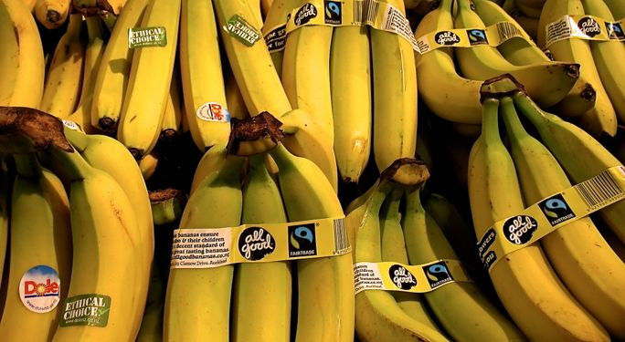
Certification Ethics:
Towards Better Bananas?
www.peoplescoffee.co.nz
Helen Tregidga & Kate Kearins, AUT University
Eva Collins, University of Waikato
Massy University Sustainability Conference
13-15 November 2013

Slide 2
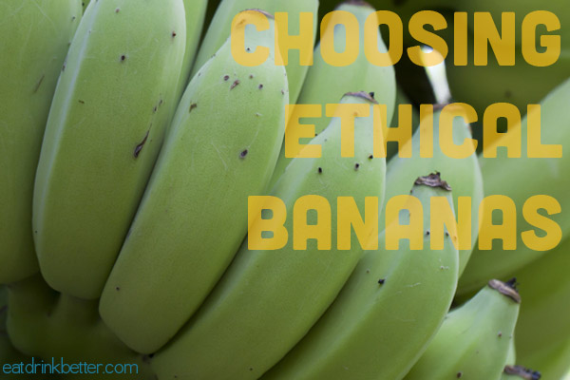
Overview
Does ethics certification lead to “better” products and product information?
Dean’s (1999) analytics of government framework used to problematise and analyse the ethical certification practices of companies with varying certifications and claims in the New Zealand banana market.

Slide 3

Banana Facts
We eat a lot of bananas (rice, wheat, corn, bananas) - $143 million market in NZ, $25 billion globally
Low-cost, commodity product
History of large, negative environmental and social impacts
Internationally huge growth
in FairTrade bananas
www.stoppress.co.nz

Slide 4
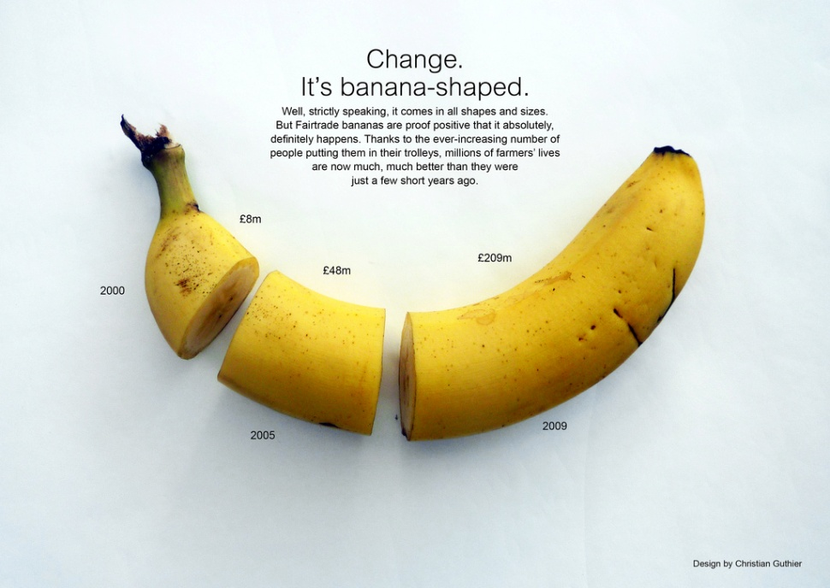
Ethical Certification
Certification and labels can act as a “short-cut” for consumers’ purchase decisions
  communicate environmental and/or social information about products
Types
  Self-certification
  Second party
  certification
  Third party certification
Increasingly profitable
www.flickr.com

Slide 5

Criticisms of Certification
Proliferation of labels
Costly to develop/implement
Legitimacy/creditability/greenwashing
Single-attribute certifications that pick off only one particular criterion
Transparency of the standards behind the labels
www.treehugger.com

Slide 6
Governmentality
“any more or less calculated and rational activity, undertaken by a multiplicity of authorities and agencies, employing a variety of techniques and forms of knowledge, that seeks to shape conduct through working through our desires, aspirations, interests and beliefs, for definite but shifting ends with a diverse set of relatively unpredictable consequences, effects and outcomes” (Dean, 1999, p. 11).

Slide 7
Governmentality Applied to the NZ Banana Market
Problematisation of current practice of governing
Four analytics of fields of visibility, techne (techniques and practices), episteme (knowledge created) and identity formation are applied
Utopian element – what is desired ends
Four banana marketing companies
Products from different tropical locales, and that look and taste similar

Slide 8

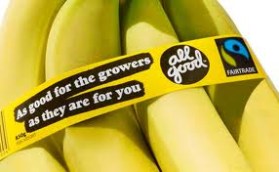
The visual analytic
Take Your Pick
www.tvnz.co.nz
www.celsias.co.nz
Regular bananas $1.89-$2.49 / kg
Dole’s Ethical Choice bananas $2.99 /kg
All Good Bananas $3.99 / bunch ≥ 850g
May 2013

Slide 9
The teche analytic
  The eco-label and certification connotes that the product which carries the label has undergone routines and practices – and has been endorsed.
The episteme analytic
  Knowledge created about the products that carry the label – as ‘better’ than products that don’t display a label
  Price points could also work to construct knowledge
Identity formation
  Fairtrade, All Good, Dole, and the ‘ethical consumer’ all constructed as governed or governors (or both) within the practice of ethical certification
Utopian element
  Appears to be a taken-for-granted belief that ethical certification will lead to better information in the market place and provide consumers with the ability to distinguish product offerings on social and environmental criteria

Slide 10
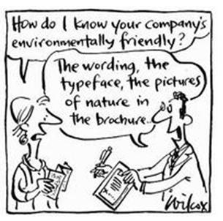
Findings
Current practices can serve to
confuse and, more concerningly, legitimise some firms by making them appear more ethical than they are.
NGO action ultimately prompted the more dubious eco-label to be withdrawn.
Earlier action by the Government’s Commerce Commission may have raised some doubts but did not, on its own, result in any change to the practice, which raises concerns that more market-based governance regimes cannot necessarily be relied upon.
www.oliveventures.com

Slide 11
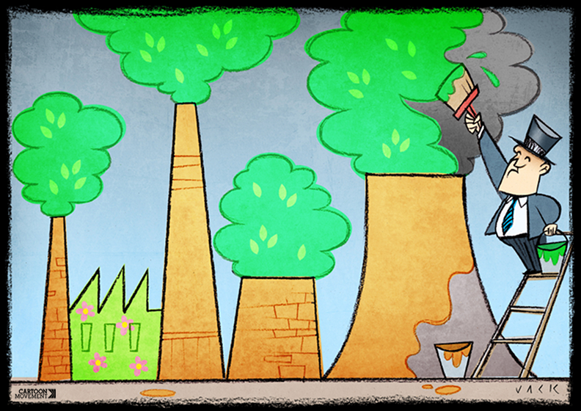
Conclusion
www.cartoonmovement.com
A role for regulation in ensuring clearer rules and routines is indicated from our research
There is a need to address the power imbalance through state regulation (defining and enforcing minimum compliance with environmental standards for example) as currently corporations have a lot of power to mislead in relation to ethical certification.

