Slide 1


Psychosocial factors Impacting Job Dissatisfaction and Burnout in New Zealand’s Hospitality Industry
Lindsay Neill, AUT University, Auckland New Zealand.
Dr. Larry Powell Research Mentor AUT University, Auckland, New Zealand.
David Williamson, Head of Department, AUT University, Auckland New Zealand.
Warren Goodsir, Head of Department, AUT University, Auckland New Zealand
Notes:
Hello, my name is Lindsay Neill …I’m pleased to present this research …….. On behalf of my colleagues LP, DW WG.
In this presentation we explore the …TITLE
This research is part of a wider research project examining the constructs of cynicism and altruism toward a wider goal of identifying constructs of a ‘hospitality personality’.
However, within this presentation we will examine

Slide 2
Psychosocial factors Impacting Job Dissatisfaction and Burnout in New Zealand’s Hospitality Industry
Constructs of job satisfaction/dissatisfaction
Burnout and its implications
Methodology brief
Results using the McRae Costa Personality ‘Big Five’ Indicator
Gender themes evident in the research
Prosocial aspects related to job satisfaction
Job satisfaction related to ‘mastery self concept’ and ‘prosocial self concept’
Suggestions for the inclusion of our findings within these domains for employer use.

Slide 3
Psychosocial factors Impacting Job Dissatisfaction and Burnout in New Zealand’s Hospitality Industry
What is job satisfaction:
Job satisfaction was defined by Locke (1976) as
“a pleasurable or positive emotional state resulting from one’s job or job experiences” (p. 1300). Later, Armstrong (2003) defined job satisfaction as the feelings and attitudes of people toward their job.
Notes:
To understand job dis-satisfaction, let’s examine job satisfaction….ask them to read the quote…
Consequently job dissatisfaction reflects the negative emotional states resulting from job experiences… that… negatively impact the feelings and attitudes people hold toward their jobs.
On going job dissatisfaction can lead to burnout

Slide 4
Psychosocial factors Impacting Job Dissatisfaction and Burnout in New Zealand’s Hospitality Industry
Burnout, as noted by Maslach, Schaufeli and Leiter, (2001, p. 397):
“Is a prolonged response to chronic emotional and interpersonal stressors on the job, and is defined by the three dimensions of exhaustion, cynicism, and inefficacy.”.
Notes:
Invite to read

Slide 5
Psychosocial factors Impacting Job Dissatisfaction and Burnout in New Zealand’s Hospitality Industry
Burnout becomes manifest within feelings of
-Exhaustion leading to
-Depersonalisation and
-Inefficacy
Notes:
Exhaustion; as well as its physical manifestations, exhaustion prompts action by the exhausted…including
…Depersonalisation: in the creation of distance from others, and…
…Inefficacy…within their reduction of workplace accomplishments.
The three symptoms of burnout are significant to the hospitality industry because, when hospitality is viewed through the lens of Pine and Gilmores experience economy, hospitality workers are more than providers of food, beverage, accommodation and service…they are educators, entertainers, agents of escapism and conveyers and trendsetters of dining and consumptive aesthetics and culinary capital.
Viewing hospitality within an experience framework for its consumers moves the industry from the ‘ordinary’ toward the ‘extra-ordinary’.
So how did we achieve our results?

Slide 6
Psychosocial factors Impacting Job Dissatisfaction and Burnout in New Zealand’s Hospitality Industry
Method:
Data was gathered using two multi-construct exploratory written questionnaires
Administered to Restaurant Association of New Zealand members, where n= 122

Slide 7
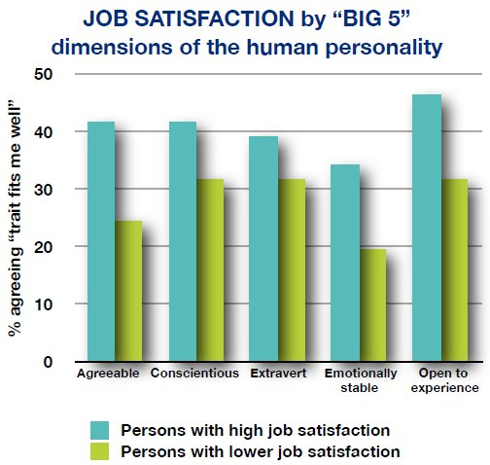
Notes:
First we examined satisfaction levels using the ‘Big Five’ McRae-Costa personality factors.
Measuring satisfaction also identified dissatisfaction.
What did we find
Respondents holding high levels of job satisfaction tended to be, more agreeable, more conscientious, extraverted, emotionally stable as well as being open to new experiences.
Contrasting this respondents with low levels of job satisfaction tended to rate lower on all five indicators. Specifically, the biggest differences between satisfied and dissatisfied workers were within agreeableness, emotional stability and openness.
Satisfaction/dissatisfaction was measured over the following variables….

Slide 8
Job (dis)-satisfaction was measured across these domains
Interesting, meaningful
How skills used
Employee relations
Customer relations
Growth opportunities
Work difficulty
Care of employees
Job security
Salary level
Pay rise, promotion
Performance standards
Evaluation fair
Employee inclusion
Recognition, praise
Teamwork
Notes:
By gender we noted some general patterns…

Slide 9
Notes:
Men are generally more satisfied in overall job satisfaction, as well as within 11 of the 15 domains we explored, than women were.
Men tended to be more satisfied with how their skills and experience were being used, with the quality of employee relations, with performance and evaluation standards, and how interesting and meaningful their work was.
However, there were some interesting exceptions to that, specifically,
Women were much more satisfied than men with their opportunities for growth, pay increases and promotion.
Women were also slightly more happy with the degree of recognition and praise they received for their contributions.
Next we examined psycho-social wellbeing, within five ‘needs ladders’ reflecting ‘existence’, relatedness’ and ‘growth’ within the domains of physical health, financial security, good relationships, respect, self esteem and creative growth.
These domains reflect the ‘actualisation-of –human-potential, noted by psychologists including Alderfer and Maslow.

Slide 10
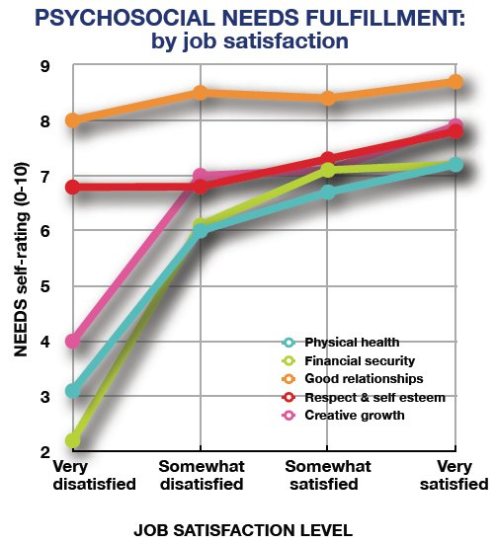
Notes:
Our respondents revealed that
The relationship between satisfaction, hospitality work and personal need fulfilment is strong.
For physical health, financial security and creative growth needs, it is quite clear that higher need fulfilment and higher job satisfaction go together.
However the other two needs ‘good relationships’ and a sense of ‘respect and esteem’ it appears to make little difference. Their fulfilment is apparently more independent of ones work experience.
Next we asked respondents to self-rate using a series of adjectives determined by social psychologists to measure self-concept or self esteem.
The two main dimensions of self concept that we looked at were
‘mastery self concept’…I see myself as a strong aggressive powerful, competent ambitious, and
‘pro-social self concept’ …I see myself as a good kind compassionate co-operative generous.

Slide 11
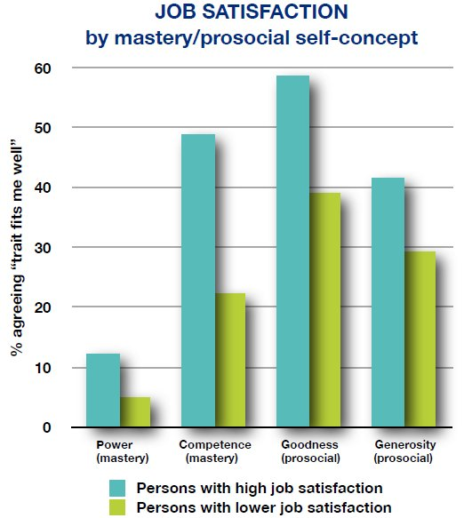
Notes:
Our results show that those who are highly satisfied with their work, tend to hold higher scores in mastery and pro social domains than respondents with low job satisfaction, with stronger emphasis within competence.
Next slide…

Slide 12
So how can these findings help in ‘employing the right people’

Slide 13
Find strategies/questions within interviews that:
Engage agreeability, conscientiousness, extraversion, emotional stability and openness to new experience.
Consider preferences inherent to gender.
Find out what people think of themselves and the world around them: do they think in zero-sum terms or positive sum terms.
Consider constructs of physical health, financial security and creative growth needs related to potential employees.
Listen!
Your Questions Welcomed….thank you.
Notes:
Zero sum =
Positive sum =

Slide 14
Psychosocial factors Impacting Job Dissatisfaction and Burnout in New Zealand’s Hospitality Industry
Armstrong, M. (2003). A Handbook of Human Resource Management Practice. (9th,Ed.). London: Kogan Page.
Locke, E.A. (1976). The nature and cause of job satisfaction. In M. D. Dunnette (Ed.).
Handbook of Industrial and Organizational Psychology. Chicago: Rand McNally.

