Slide 1


IGF gene-network
identifies specific interactions underlying extreme SBP
in developing children
NZSA Conference
University of Canterbury
November 2015
P.G. Parmar,
C.E. Pennell, L.J. Palmer, L. Briollais
Notes:
Today I am going to talk about an analyses assessing gene-network models to identify predictors of elevated systolic blood pressure in developing children.

Slide 2
OUTLINE
Aim
Background
Study design
Analyses
Results
Conclusions
Future research
Notes:
I will first outline the aim of the project, give a little bit of background on the problem that elevated SBP causes, the genes and subsequent network we are interested in (and underlying paradigm we are investigating). I will then discuss very briefly the study design before detailing the two-stage model we implemented and the results we found. I will finish up by drawing conclusions on this work and where we might be headed in future using gene-network models.

Slide 3
AIM
Investigate if modelling the insulin-like growth factor (IGF)-Axis as a gene-network can identify gene-interactions predictive of the early onset of elevated systolic blood pressure (SBP) in developing children.
Notes:
The aim of this project is to investigate if modelling the insulin-like growth factor (IGF)-Axis as a gene-network can provide insight underlying the early onset of elevated systolic blood pressure (SBP) in growing children

Slide 4
RATIONALE
Elevated BP is a symptom and a disease
Consistent, persistent elevated BP (140mmHg SBP/90mmHg DBP) = Clinical Hypertension
  Established cardiovascular (CVD) risk-factor
  Is the leading cause of adult death and disability in the world through its predisposition to CVD events e.g. MI, stroke, obesity, type-II diabetes, metabolic syndrome
Notes:
So the problem were are investigating is elevated systolic blood pressure. Why? Anyone who works in anything slightly medically related will know the elevated blood pressure is both a symptom and a disease in itself. Consistent and persistent elevated blood pressure is termed clinical hypertension which is an established cardiovascular risk factor.
Hypertension is the leading cause of adult death and disability in the world due to predisposing individuals to CVD-related events.

Slide 5
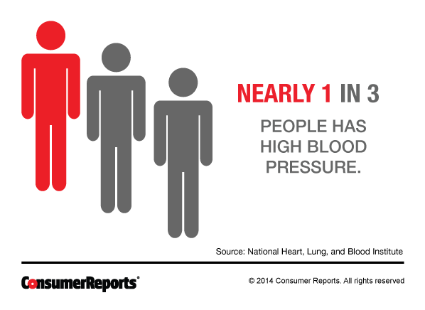
Notes:
Hypertension is a very common disease, affecting nearly 1 in every 3 adults worldwide.

Slide 6
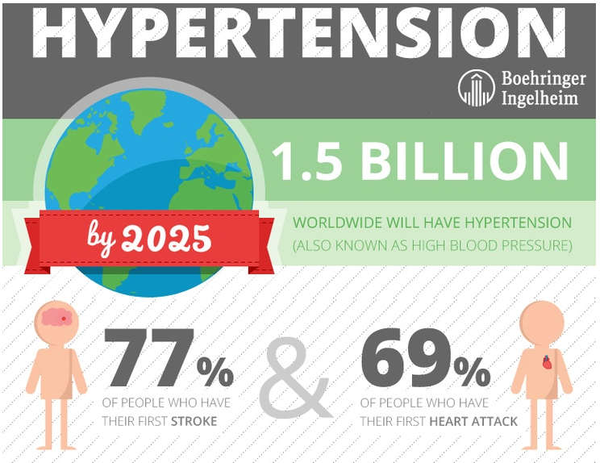
Notes:
It is proposed that in 10 years time 1.5 billion people will have hypertension. Furthermore, the majority of people who suffer a stroke or heart attack will have had hypertension.

Slide 7
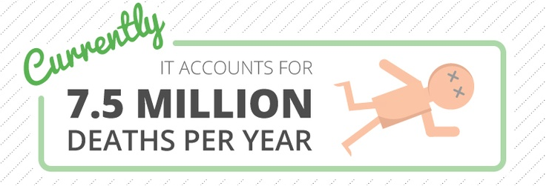
Notes:
It accounts for about 7.5 million deaths per year from CVD-related events

Slide 8
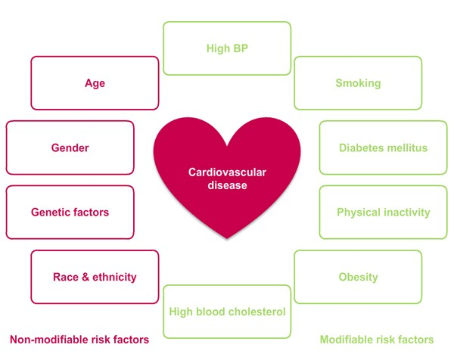
https://www.metalyse.com/myocardial_infarction/risk_factors.html
Notes:
An individuals risk for cardiovascular disease is predisposed by many factors. These are grouped as ‘non-modifiable’ risk factors which include age, sex, ethnicity and genetic factors.
‘Modifiable’ risk factors are those including smoking, physical inactivity, obesity, cholesterol and high blood pressure.

Slide 9
High BP
Genetic Factors
https://www.metalyse.com/myocardial_infarction/risk_factors.html
Notes:
We are focussing on furthering our understanding of the relationship between genetic factors and high blood pressure in order to be able to reduce blood pressure and CVD risk

Slide 10

Why are we looking here?
Rather than here?
Notes:
So our focus here is to investigate the development of early onset elevated BP. So you might be wondering why were are focussing our efforts on the stages of developmental growth rather than in adults when the problem presents itself.

Slide 11
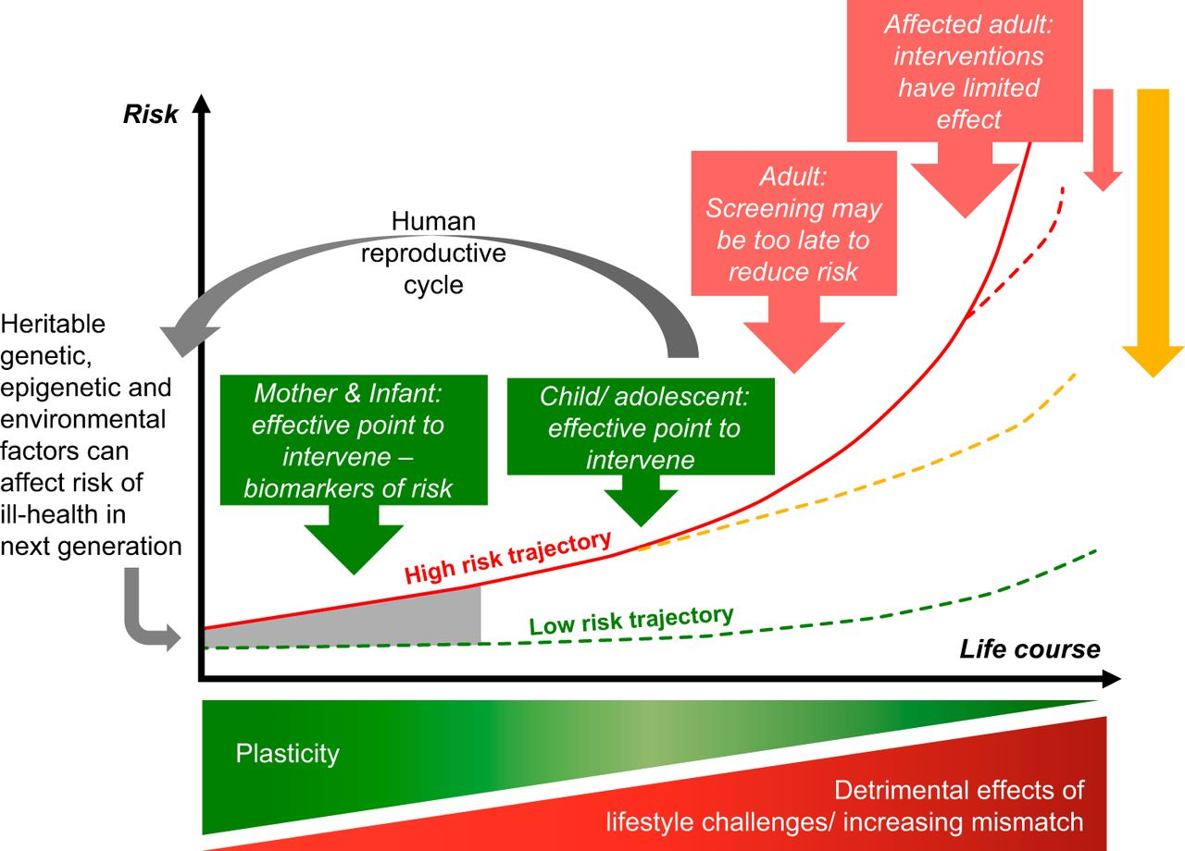
Hanson MA, Gluckman PD. Early developmental conditioning of later health and disease: physiology or pathophysiology? Physiol Rev. 2014 Oct;94(4):1027-76.
Notes:
Well, our hypothesis is underpinned by the Developmental Origins of Health and Disease paradigm, which states that genetic, epigenetic and environmental factors acting early in life can increase our risk to certain diseases. However, because during our lifetime (particularly during the younger developmental stages) were are undergoing a phase of “plasticity” which basically means we can easily adapt to change. Therefore it is thought that if we can identify early predictors of adult onset diseases and implement interventions during childhood and adolescence then we should be able to reduce that individuals risk of diseases during adulthood (at which time we are not so plastic/adaptive or receptive to intervention).

Slide 12

BP DATA
Raine (Western Australian Longitudinal Pregnancy and Birth Cohort)
Data from 2,279 individuals who had at least one SBP measure recorded at 5, 8, 10, 12, 14 and 17 years of age
The most being recorded at age five (1,947 individuals) and the least at the 17 year follow-up (1,249 individuals)
Notes:
The outcome data we are utilising here is SBP that was collected throughout childhood and adolescence from the Western Australian Longitudinal Pregnancy and Birth Cohort.
There was data from 2, 279 unique individuals who contributed at least one SBP measure at 5, 8, 10, 12, 14 and 17 years of age.

Slide 13
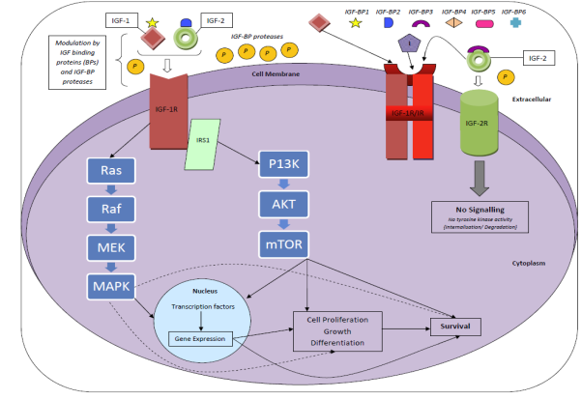
GENETIC DATA: IGF-Axis
Notes:
The IGF-network
The SNPs tagging the IGF-axis genes were coded in an additive way
Counting the number of minor alleles (0, 1 or 2) using SimHap and grouped by gene in the network analyses
IGF-axis comprises two cell-surface receptors (IGF-1R, IGF-2R), two ligands (IGF-1, IGF-2), a family of 10 IGF-binding proteins (IGFBP 1-10), 6 of which bind with higher-affinity (IGFBP 1-6) and associated IGFBP degrading enzymes known collectively as proteases.
The two ligands are known to bind (with different affinities) to binding proteins which will promote their interaction (or lack thereof) to one of the receptors. IGF-1R is the largest and most prolific receptor in the cell and typically modulates IGF1 and IGF2 ligands, whilst IGF-2R usually only binds to IGF2.
We are interested to see how the different components act to influence SBP in developing children and adolescents.

Slide 14
IGF-Axis
Gene | Number of SNPs | Percentage of SNPs
IGF-1 | 15 | 9
IGF-1R | 82 | 50
IGF-2 | 8 | 5
IGF-2R | 38 | 23
IGFBP1 | 5 | 3
IGFBP2 | 4 | 2
IGFBP3 | 5 | 3
IGFBP4 | 3 | 2
IGFBP5 | 5 | 3
Total | 165 | 100
Notes:
This illustrates the magnitude of the different genes in the IGF-Axis. The receptors, particularly IGF-1R is the largest whilst the binding proteins are the smallest.

Slide 15
THE MODEL
Following Tsonaka et al, we used a two-stage mixed effects model to estimate a gene interaction network involving the nine genes of the IGF axis and model their association with the longitudinal SBP outcome
Stage 1 generates gene-based random effects summarising the SNP effects within each gene
Stage 2 uses the gene-specific random effects from stage 1 to model the gene-gene interactions against SBP
Notes:
The model used here is a two stage model based on the work of Tsonka et al.
Following Tsonaka et al, we used a two-stage mixed effects model to estimate a gene interaction network involving the nine genes of the IGF axis and model their association with the longitudinal SBP outcome
Overall, stage 1 generates gene-based random effects summarising the SNP effects within each gene and stage 2 uses the gene-specific random effects from stage 1 to model the gene-gene interactions against SBP

Slide 16
STAGE 1: Genetic Model
Here we model the probability of carrying a particular SNP allele (the rare allele) as a function of fixed and random effects that represent genetic variations of the SNP genotypes at S loci studied
  A logistic model is used to specify the probability to carry at least one rare allele (dominant model) or two rare alleles (recessive model) as a Bernouilli trial
This model will return the empirical Bays (EB) estimates of the random effects
Notes:
The goal of the first stage analysis is to model the probability of carrying a particular SNP allele (the rare allele) as a function of fixed and random effects that represent genetic variations of the SNP genotypes at S loci studied
A logistic model is used to specify the probability to carry at least one rare allele (dominant model) or two rare alleles (recessive model) as a Bernouilli trial
The inclusion of random effects into a mixed-effects logistic model allows specifying gene-specific effects as well as their correlation structure
This model will return the empirical Bays (EB) estimates of the random effects.

Slide 17

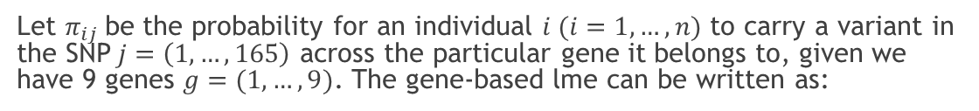
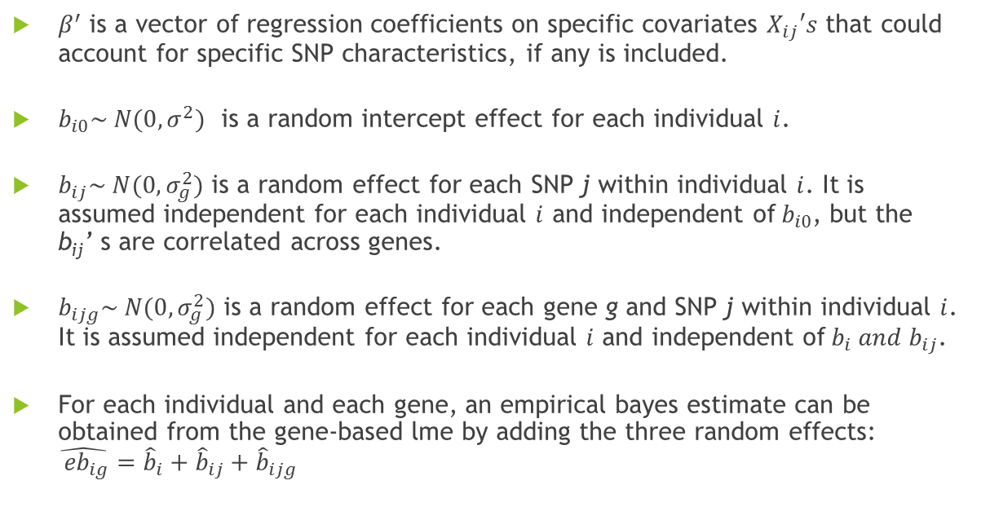
STAGE 1: Genetic Model
Let $π_{ij}$be the probability for an individual $i (i=1,…, n)$ to carry a variant in the SNP$j=\left(1, …, 165\right)$ across the particular gene it belongs to, given we have 9 genes $g=(1, …, 9)$. The gene-based lme can be written as:
$\log{\frac{π_{ij}}{1−π_{ij}}}= {X′}_{ ij}β+ b_{i}+ b_{ij}+b_{ijg}$
$β^{′}$ is a vector of regression coefficients on specific covariates $X_{ij}′s$ that could account for specific SNP characteristics, if any is included.
$b_{i0}\sim N(0, σ^{2})$ is a random intercept effect for each individual $i$.
$b_{ij}\sim N(0, σ_{g}^{2})$ is a random effect for each SNP j within individual $i$. It is assumed independent for each individual $i$ and independent of${ b}_{i0}$, but the b_{ij}’ s are correlated across genes.
$b_{ijg}\sim N(0, σ_{g}^{2})$ is a random effect for each gene g and SNP j within individual $i$. It is assumed independent for each individual $i$ and independent of${ b}_{i} and b_{ij}$.
For each individual and each gene, an empirical bayes estimate can be obtained from the gene-based lme by adding the three random effects: $\hat{{ eb}_{ig}}={\hat{b}}_{i}+{\hat{b}}_{ij}+{\hat{b}}_{ijg}$
Notes:
Here is the logistic model for stage 1.
Where beta naught is the constant we can fix to control the MAF of a SNP. Beta 1 is where you define the vector of regression coefficients for any gene-specific covariates you choose to fit (e.g. may want to differentiate ligands from receptors and binding proteins) – we don’t do that here but it is possible to be done.
We also have two random effects being defined here. Bi naught which is the random intercept effect for each individual (of which we have 2, 279) and beta ig is the random intercept for each gene (we have nine of these) within each individual (which are independent of bi naught but correlated across the nine genes).

Slide 18
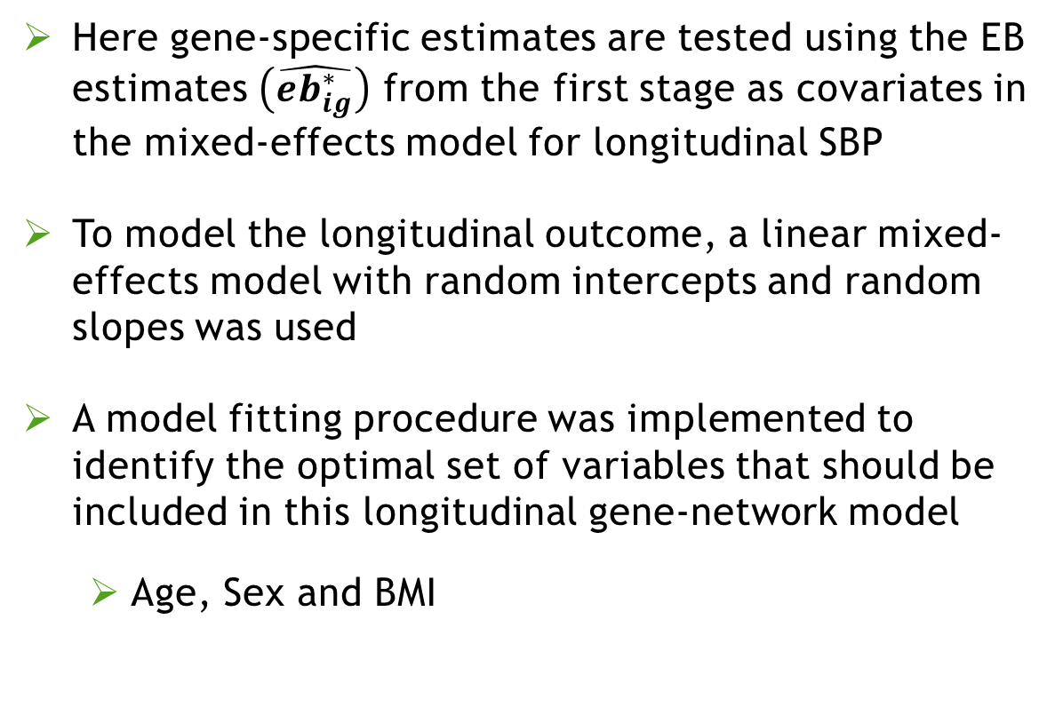
STAGE 2: Longitudinal Model
Here gene-specific estimates are tested using the EB estimates $\left(\hat{{eb}_{ig}^{∗}}\right)$ from the first stage as covariates in the mixed-effects model for longitudinal SBP
To model the longitudinal outcome, a linear mixed-effects model with random intercepts and random slopes was used
A model fitting procedure was implemented to identify the optimal set of variables that should be included in this longitudinal gene-network model
  Age, Sex and BMI
Notes:
Here gene-specific estimates are tested using the EB estimates $\left({\hat{b}}_{i}^{∗}\right)$ from the first stage as covariates in the mixed-effects model for longitudinal SBP
To model the longitudinal outcome, a linear mixed-effects model with random intercepts and random slopes was used
A model fitting procedure was implemented to identify the optimal set of variables that should be included in this longitudinal gene-network model
Age was modelled as a categorical variable’ which reflect the three main stages of developmental growth; pre-puberty (<10 years), puberty (11-14 years) and post-puberty (15+ years) representing three distinct time-frames or ‘epochs

Slide 19
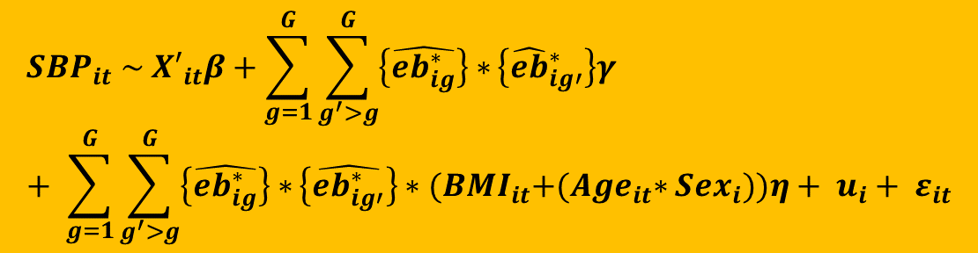

STAGE 2: Longitudinal Model
$${SBP}_{it} \sim {X′}_{it}β+\sum_{g=1}^{G}{\sum_{g^{′}>g}^{G}{\left\{\hat{{eb}_{ig}^{∗}}\right\}∗}\left\{{\hat{eb}}_{ig′}^{∗}\right\}γ }+ \sum_{g=1}^{G}{\sum_{g^{′}>g}^{G}{\left\{\hat{{eb}_{ig}^{∗}}\right\}∗}\left\{\hat{{eb}_{ig′}^{∗}}\right\}∗{(BMI}_{it}+{(Age}_{it}∗{Sex}_{i}))η+ u_{i}+ ε_{it}}$$
$t$ (= $1, …, 5)$ represents the number of follow-up visits at approximately (1) 5 years, (2), 8 years, (3) 10 years, (4) 14 years and (5) 17 years
$X_{it}=$ Design matrix for the fixed effect covariates which include; BMI, sex and age
${Age}_{it}$ = 5-14 years vs. 15+ years. In brief, these timeframes were chosen to reflect dramatic changes in developmental growth. Further justification surrounding these ‘epochs’ can be found in chapters six and seven.
${Sex}_{i}$= Males or Females
${BMI}_{i}$ = per unit (kg/m²) increase in year of age
$β\text{= }\text{Vector} \text{of} \text{regression} \text{coefficients} \text{on} \text{the} \text{fixed} \text{effects} \text{variables} \text{BMI}\text{, }\text{sex} \text{and} \text{age}$
${\hat{eb}}_{ig}^{∗}$ = gene-specific empirical Bayes random effects estimated from stage 1
$γ$= vector of regression coefficients on the gene-gene specific effects. It quantifies the effect of the pathway components on the longitudinal SBP outcome.
$η$= regression coefficients that capture the variation of gene by gene interactions with age (as a discrete variable) and sex on $SBP.$ It quantifies the age-specific effect of the pathway on the longitudinal SBP outcome.
$u\text{i} \sim N(0, σ^{2})$ = random intercept for each individual $i$
$ε_{it} \sim N (0, σ_{ε}^{2})$ = Within individual error term with variance $σ_{ε}^{2}$
The $u_{i}^{′} s$are assumed correlated and independent from the $ε_{i}′s$.
Notes:
So here we model SBP by ${\hat{b}}_{ig}^{∗}$ = gene-specific empirical Bayes random effects estimated from stage 1
$X_{it}=$ Design matrix for the fixed effect covariates which include; $β$ Vector of regression coefficients on the fixed effects variables; ${BMI}_{i}$, Sex_{i} and ${Age}_{it} u\text{0}\text{i}$ = individual-wise random intercept and $γ_{g}$ = vector of regression coefficients on the gene-specific effects, which is used to quantify the effect of the pathway on the longitudinal SBP outcome
$η_{g}$ = regression coefficients for the gene $g$ by age (as a discrete variable of <15 and 15+ years which were chosen to reflect dramatic changes in developmental growth) interaction effect on $SBP.$It quantifies the age-specific effect of the pathway on the longitudinal SBP outcome.
${Sex}_{i}$= Males or Females${BMI}_{i}$ = per unit (kg/m²) increase in year of age$σ_{ε}^{2}=$ Error variance The $u_{i}^{′}s$are assumed correlated and independent from the $ε_{i}′s$

Slide 20
Results
Comparing extreme gene-network profiles
Notes:
Plotting the Bonferroni-adjusted statistically significant effects here for the bottom 5% of measured SBP and the top 5% of SBP measures from the Raine cohort.

Slide 21
Figure legends
Only presenting Bonferroni-corrected p-values < 0.0001
Effects are presented separately by sex
Females
Males
Increases to SBP are denoted by dashed lines
Reductions to SBP are denoted by solid lines
Thickness of the line indicates the level of significance (i.e. thicker line = more statistically significant than thinner lines )
Colour of the line indicates the effect size (i.e. the darker the line, the larger the effect compared to lighter coloured lines = smaller the effect size )
Notes:
Because the output is quite large from these models I won’t present the results in tabulated form but rather summarise these as figures.

Slide 22
Extreme top 5% (< 15 years)
Notes:
The top 5% of SBP measures appears to be only associated with increasing BP in males
For children aged less than 15 years only Males were statistically significantly associated with elevated SBP. Namely IGF1-IGFBP4 and IGF1R-IGFBP1-IGFBP3

Slide 23
Extreme top 5% (15+ years)
Notes:
Looking at the gene-network profile for the most extreme 5% of SBP measures we see that IGF2R-IGFBP1 is significantly associated with reducing extreme SBP in males whilst IGF1R-IGFBP4 for reducing extreme SBP in females.
Strong associations between IGF2 and binding proteins (IGFBP2 and IGFBP4) were associated with increasing extreme SBP in females, as was IGFBP2-IGFBP5 (and IGF1R-IGFBP5). Strong associations were also identified between IGF2 and IGFBP2 and IGFBP5 (as well as IGF1R-IGFBP4) in elevating extreme SBP in males.

Slide 24
CONCLUSIONS
Children aged over 15 years had a much more active gene-network influencing SBP compared to children aged < 15 years
For children aged less than 15 years only males were statistically significantly associated with elevated SBP
  IGF1-IGFBP4
  IGF1R-IGFBP1-IGFBP3
For females aged 15 years and over, increases to extreme SBP was observed between
  IGF2 and IGFBP2 and IGFBP4
  IGFBP2-IGFBP5 (and IGF1R-IGFBP5)
For males aged 15 years and over, increases to extreme SBP was observed between
  IGF2 and IGFBP2 and IGFBP5
  IGF1R-IGFBP4
Notes:
I will first outline the aim of the project, give a little bit of background on the problem that elevated SBP causes, the genes and subsequent network we are interested in (and underlying paradigm we are investigating). I will then discuss very briefly the study design before detailing the two-stage model we implemented and the results we found. I will finish up by drawing conclusions on this work and were we might be headed in future using gene-network models.

Slide 25
Females
Males
Overlapping effects between males and females
for increasing elevated SBP was observed for the gene-gene interactions of IGF2-IGFBP2-IGFBP5

Slide 26
MEANING AND RELEVANCE
The results attained are reasonable and align logically with current literature
Polymorphisms within IGF2 have already been shown to influence regulation of blood pressure in obese children
We found that this gene-network is modified with age; this in itself may be due to a number of reasons including diet, hormones and developmental growth over time, particularly post-puberty
Notes:
The results attained are reasonable and align logically with current literature, particularly as IGFBP1 has been linked with both positive and negative associations to SBP and to well-known risk factors of cardiovascular diseases. Polymorphisms within IGF2 have already been shown to influence regulation of blood pressure in obese children. We found that this gene-network is modified with age; this in itself may be due to a number of reasons including diet, hormones and developmental growth over time, particularly post-puberty. Further investigation using this method and other modern high dimensional statistical methods to analyse gene-networks in cohort and large consortium data with external biological knowledge (such as exonic, regulatory gene information and the influence of hormones) would be ideal to validate our findings and improve accuracy surrounding the estimates produced from these models and further improve the power to detect complex interactions. Through characterizing the association between multiple genes and disease outcomes we will offer new insight into disease aetiology whilst providing tools for making individualized treatment decisions.

Slide 27
FUTURE
Further investigation using this method and larger datasets would be ideal to validate our findings and improve accuracy surrounding the estimates produced from these models and further improve the power to detect complex interactions
Through characterizing the association between multiple genes and disease outcomes we will offer new insight into disease aetiology whilst providing tools for making individualized treatment decisions
Notes:
Further investigation using this method and other modern high dimensional statistical methods to analyse gene-networks in cohort and large consortium data with external biological knowledge (such as exonic, regulatory gene information and the influence of hormones) would be ideal to validate our findings and improve accuracy surrounding the estimates produced from these models and further improve the power to detect complex interactions. Through characterizing the association between multiple genes and disease outcomes we will offer new insight into disease aetiology whilst providing tools for making individualized treatment decisions.

Slide 28




ACKNOWLEDGEMENTS
http://images.nationalgeographic.com
Notes:
Finally, I would like to thank you all for listening. If you were interested in reading about the original two-stage gene-network model as defined by Tsonaka, the details are here.
I am happy to take any questions that you may have.

