Slide 1
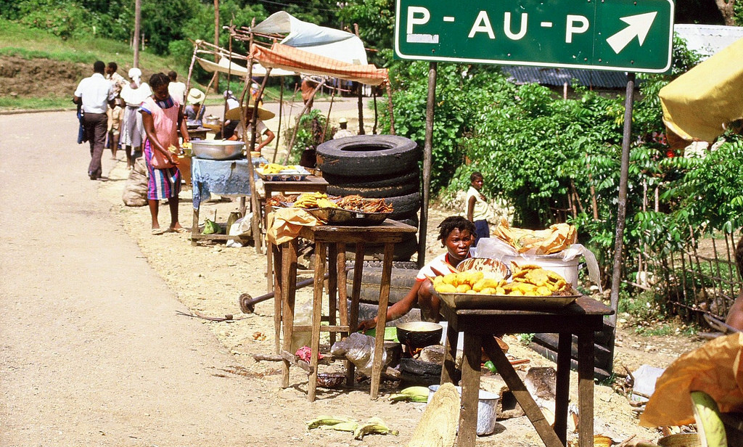
Exploring the potential of street food as a sustainable livelihood tourism strategy for developing destinations
6th ABEN Conference
5-6 Dec 2016
Griffith University
Dr Manuela Pilato - University of Winchester, United Kingdom
Dr Hugues Séraphin - University of Winchester, United Kingdom
Dr Anca C. Yallop - Auckland University of Technology, New Zealand

Slide 2
CONTEXT
The fastest growing trend for international travel has been for travel to LDCs (Holden, 2013)
Tourism – central in the strategy for the economic development of LDCs
Growing recognition that tourism requires more equality among all participants: alternative forms of tourism where less foreign capital and more local people, food and architecture are engaged (Crick, 1989)
Exogenous factors like political instability, economic crisis, natural disasters and the outbreak of diseases (Séraphin, 2014; Hai & Chick, 2011; Ritchie, Dorrell, Miller & Miller, 2004).
Alternative form of tourism (Crick,1989) (activities involving local people and local food); authentic form of tourism (Thompson, 2014; Wagner, 2015): people, the culture and natural assets are central (e.g. Haiti).
Notes:
Tourism is central in the strategy for the economic development of LDCs despite the fact these destinations struggle to establish themselves as tourist destinations. (example Haiti).
Many third world countries have chosen the tourism industry as a central development strategy, strongly encouraged in the 1960s by groups including the Organisation for Economic Cooperation and Development, World Bank and the United Nations.
Since the 1980s there has been a growing recognition that tourism requires more equality among all participants which has led to alternative forms of tourism where less foreign capital and more local people, food and architecture are engaged (Crick, 1989).
The tourism sector is especially vulnerable to exogenous factors like political instability, economic crisis, natural disasters and the outbreak of diseases (Séraphin, 2014d; Hai & Chick, 2011; Ritchie, Dorrell, Miller & Miller, 2004).

Slide 3
CONTEXT (CONTD)
Authenticity - the most important criterion for the development of heritage tourism (Xie & Wall, 2003 in Park, 2014: 62)
BUT: “authenticity often becomes meaningless due to strategically contrived and constructed nature of tourism settings and experiences” (Park: 2014: 60).
Finding a fine line between selling some aspects of a culture and keeping the culture authentic.
A call for the tourism industry to be more ethical in the way it does business (Lovelock & Lovelock, 2013)
Notes:
This authenticity is what made Haiti the most popular destination in the Caribbean between the 1940s-1960s (Theodat, 2004).
'The search for authenticity often becomes meaningless due to strategically contrived and constructed nature of tourism settings and experiences' (Park: 2014: 60). In such a context, Cros & McKercher (2015) explain that it is important to find a fine line between selling some aspect of a culture and keeping this culture authentic. There is a call for the tourism industry to be more ethical in the way it does business (Lovelock & Lovelock, 2013)

Slide 4
STREET FOOD: SOME FACTS
Street-food (i.e. ready-to-eat-food sold in a street or a public place; Kowalczyk, 2014) can be considered as an authentic way of living and an authentic activity visitors could be involved in.
Consumed each day by an estimated 2.5 billion people world-wide.
In Latin America, street food purchases account for up to 30% of urban household spending.
In Bangkok, 20,000 street food vendors provide city residents with an estimated 40% of their overall food intake.
In Thailand, a huge percentage of the population depend of this entrepreneurial activity for survival.
In Ghana, it is estimated that the sector employs over 60,000 people and has an annual turnover of US$100 million, with annual profits in the order of US$24 million.
(Fellow & Hilmi, 2011)
Notes:
Food (taste, ingredient, accompaniment, preparation, form of serving the dish and the way of consuming the dish), is an important motivator that push people to travel the world
In destinations like Africa, Asia and Latin America, where it is a common way of eating for a substantial part of the population, street-food can be considered as an authentic way of living and an authentic activity visitors could be involved in.

Slide 5
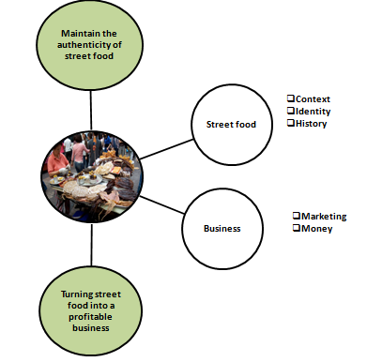
RESEARCH OBJECTIVE
-evaluating the potential of street food as a factor of appeal and sustainable livelihood strategy for developing destinations.
How can street food retain its authenticity in developing countries and be at the same time a profitable activity for the locals?
Notes:
The research objective of this paper could be summarised as shown this Figure. Our key objective is to find out how street food can retain its authenticity in developing countries and be at the same time a profitable activity for the locals
Examining the literature to identify how to find a fine balance between keeping street food an authentic product for tourists while being profitable for locals.

Slide 6
CONCEPTUAL FRAMEWORK
Sustainable tourism
Sustainable food
Street food
Entrepreneurship tourism
Notes:
The main argument of this paper is that related tourism activities that are components of the locals’ daily lives represent one of the most sustainable tourism activities.
Drawing from literature on marketing research in tourism, sustainability, business ethics and entrepreneurship the study examines factors that influence the level and support of sustainable tourism development, specifically the potential of ethical and sustainable food (e.g. such as street food) to have a positive impact on destinations and their sustainable development.

Slide 7
SUSTAINABLE TOURISM
A destination is considered to be sustainable if the tourism industry does not impact negatively on the environment, on human-environment interactions and local communities; but equally, the industry needs to contribute to cultural exchange between locals and visitors and meeting the economic needs of the populations (Mbaiwa, 2005 in Iniesta-Bonnillo et al, 2016).
Long-term capacity of the industry to remain ‘clean’
Main concern of tourism development for developing nations and indigenous people
Initiatives like Sustainable Tourism-Eliminating Poverty Program (ST-EP) initiated by the United Nations World Tourism Organisation (UNWTO) were taken to use tourism to reduce poverty and increase net benefits for poor people as part of their 'Pro-Poor Tourism' policy (Holden, 2013).

Slide 8
SUSTAINABLE FOOD
1 - Provides a viable livelihood for farmers, processors and retailers
2- Supports rural economies and the diversity of rural culture, in particular though an emphasis on local products that keep food miles to a minimum
3 – Use local, seasonally available ingredients as standard
4 – Reduce processed food
5 – Reduce packaging
6 - Support local biodiversity and local resources
7 – Serve insects as food
8 – Ethical by not using endangered species, or species grown in cruel conditions.
Sloan et al. (2013: 170-178)
Notes:
As 'there is no international legal definition of 'sustainable food' (Sloan, Legrand & Chen, 2013: 170), using Sloan et al (2013: 170-178) research, we are defining sustainable food in a developing tourist destination context as food that:

Slide 9
STREET FOOD
Noted to be low in cost and presents an attractive alternative to home-cooked food. Street food vending is usually practiced as a family business and in the majority of cases; it is a source of employment for the household members (FAO, 2014).
A way of living, a component of locals’ life; enables locals and visitors to participate in the same type of activities, engaging in local intangible cultural experience (Cros & McKercher, 2015)
Facilitating the direct sales of goods and services supplied by the poor to the tourist is an effective mechanism to reduce poverty (Holder, 2013).
Food safety: greater awareness and preventive measures need to be implemented for coping with risk factors (FAO, 2014).
Notes:
FAO – Food and Agriculture Organization of
protection of supply from microbial, chemical, and physical hazards that may occur during all stages of food production
For example, the Government of Bangladesh has recognized the role of street foods in urban food security and it has been outlined as a strategic area of intervention in the National Food Policy of Action (2008-2015) under strategy 3.5, entitled as ‘Safe, quality food supply: Institutionalization of safe and hygienic street food vending as medium and long term actions’ (FAO, 2014).the United Nations

Slide 10
ENTREPRENEURSHIP TOURISM
Michel (2000) claims tourism can fully benefit a destination, only if the locals are fully involved in the planning and development of the industry.
Entrepreneurship in tourism appears to be a serious contender to the involvement of the locals in the tourism sector and in some cases to help them to improve their standard of living.
Micro and small scale enterprises can increase the participation of the poor in the tourism industry (Manyara and Jones, 2005).

Slide 11
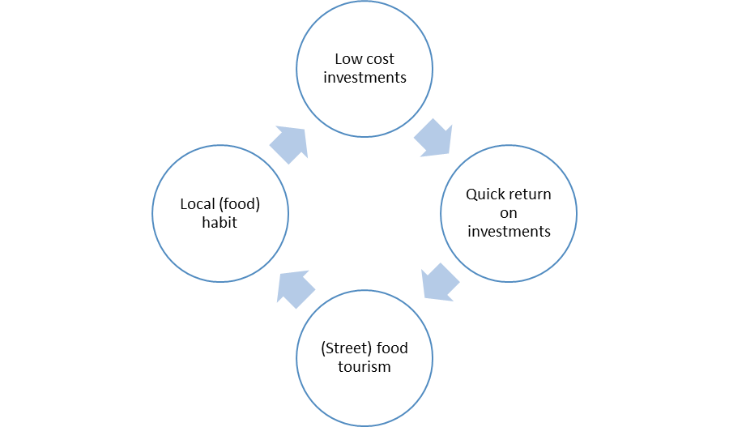
Sustainable tourism development in developing destinations not only should remain low cost in terms of investments but should also be part of the daily life of the locals. Street food meets all these criteria:
Source: Bellia et al. (2016)

Slide 12
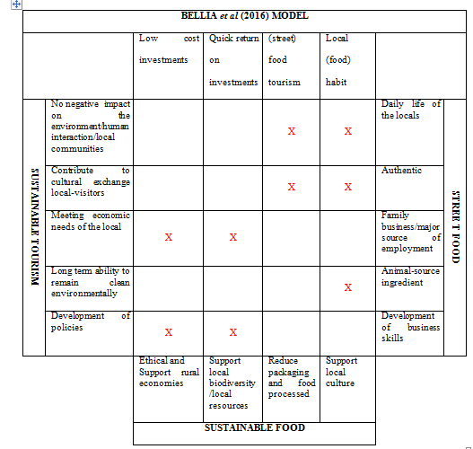

Slide 13
CONCLUSION
Street food corresponds to a tourist demand of authenticity;
It does not impact negatively on locals’ culture but instead it is shared with visitors;
(3) The vendors, who, generally are poor people, benefit directly from this form of tourism related activity;
(4) it represents an add-on activity that is promoted by Destination Marketing Organisations (DMOs), and it is not the main reason why people visit the destination, therefore, it will not impact on the carrying capacity of the destination; and
(5) street food is part of the way of life of local communities; within this context, street food is seen as a ‘related tourism activity’ and not as a form of tourism.

